Slide 1
CBS test scanning function @HBS app Presentation for SSI 5th informational meeting 21 February 2025 Deirdre Giesen, Daphne Debije, Janelle van den Heuvel, Jasmina Saitovic & Marina Veldhuizen Smart Survey Implementation Grant Agreement Number: 101119594 (2023-NL-SSI)
Disclaimer: Views and opinions expressed are however those of the author(s) only and do not necessarily reflect those of the European Union or Eurostat.
Neither the European Union nor the granting authority can be held responsible for them.

Slide 2
Outline
Goal of the test
Demo of app as tested
Focus on findings entering expenses

Slide 3
Goals of this test
Test usability of the @HBS app with a focus on the scan function
Understand if and how scan function affects trust in the app and trust in the quality of the data collected.

Slide 4
Tested materials
Letter & Leaflet
Prototype of @HBS app on lab phone
✔ login screen
X general and fixed costs questionnaires (shown but not implemented)
✔ start questions about vacation period
✔ calendar and data collection period
✔ manual entry of expenses
✔ (simulation of) scanning function receipts
X lookup tables for stores and expenditures
X classification of expenditures
X upload of digital receipts (not shown and not implemented)
✔ overview of all entered expenses

Slide 5
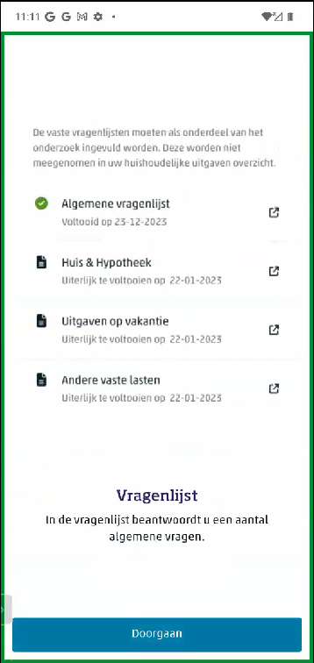
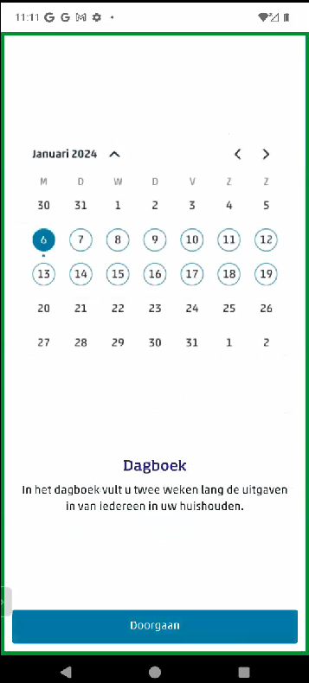
Demo

Slide 6
Test design
Qualitative, small scale, 20 test respondents (Rs), diverse backgrounds.
Test protocol coordinated with other similar tests in SSI project.
In lab at CBS .
Test duration about 1 hour.
Testing period 14-29 January 2025
Team of 4 methodologists and 1 UX expert

Slide 7
Test protocol
Introduction, informed consent
Test task (looking up a route) to practice think aloud & get used to test phone
Envelop with letter and brochure -> what would you do with this?
How would you download app (scan code or search in store)?
Login
Entry of first (short) test receipt:
what would you do
ask to enter manually
Scan of second (short) test receipt (simulation, 5 second, no errors)
Scan of third (medium) test receipt (simulation, 20 seconds, some errors) + correct errors
Manual entry of personal receipt
Scan of fourth (long) test receipt (simulation, 50 seconds, some errors) + correct errors
General impression of app
Evaluation of tasks and preferences for scanning or manual entry
Trust in app and does this depend on mode of data entry
Trust in data collected with the app and does this depend on mode of data entry
Final ideas and comments
Notes:
In the introduction respondents were told that the app was not yet completely ready (without going into details).
Also respondents were encouraged to think aloud and to share any feedback they would have on the app.
For the first ten interviews we only asked how they would download the app theoretically, for the second ten interviews we asked them to actually do this on their own phone.

Slide 9
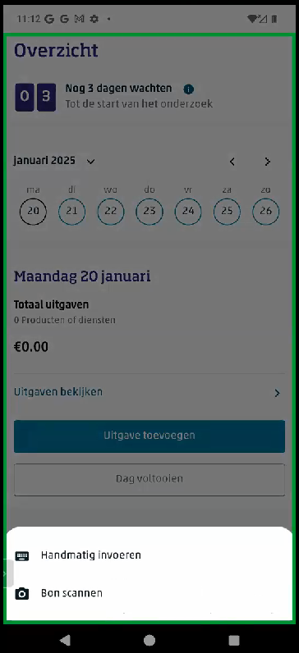
Entering expenses
Notes:
LATER

Slide 10
Preferences for manual entry or scanning after experiencing both options
Most prefer scanning (13 Rs)
Some prefer a mix: manual for short receipts and scanning for long receipts (4 Rs)
2 prefer manual entry
For 1 R preference not discussed in interview

Slide 11
Considerations for scanning or manual entry
Pro scanning
Quicker and less effort
Provides CBS with additional data
Pro manual
Long processing time for scan with errors and lots of editing not worth the time, quicker to enter manually
Easier than correcting scanning errors

Slide 12
How did entering expenses go?
Rs with moderate to high digital skills can enter and edit expenses without help (manually and scanning)
Those with low digital skills need help
Steep learning curve
Many small and some major issues

Slide 13
Main issues found with entering expenses in general
Check boxes for “foreign expense” and “online expense” confusing for many
Not clear what we want to know, e.g. if and how to report discounts, deposits and refunds
Not all receipts contain recognizable / individual product names. Even with own recent receipt R could not reproduce which price belonged to which product. These types of receipts are typical for smaller local shops and market stalls.

Slide 14
Main issues for entering manually
Product details not entered correctly (e.g. “groceries” in stead of item descriptions) or uncertainty about required level of detail.
Not immediately clear and some really struggle with selecting the Storename or Product to add it, may be due to lack of search function in prototype.

Slide 15
Main issues scanning
Making incorrect pictures
Only scanning the barcode
Without all corners visible
Uncertainty if the picture is readable, app does not allow to check this by zooming in on the picture
Many Rs became impatient with the long processing time
Several Rs do not notice there are errors in scanned data and are not guided to notice and correct these
The two editing screens after scanning with different functionalities are very confusing and not functional

Slide 16
Does mode of data entry matter for trust and privacy?
Scanning or manual data entry not relevant for trust and privacy
But permission for audio access when scanning strange
One R mentions there may be sensitive data on a receipt but trusts on protection of these data because of regulations

Slide 17
Does mode of data entry matter for data quality?
Several Rs think scanning is better:
Better quality
Less effort -> higher likelihood people will do this
More control of data for CBS
One R thinks manual entry is better as scanning has errors and people may not make the effort to correct errors
One R appreciates both modes of entry are possible, as not everybody will be able to scan receipts.
One R mentions that upload of digital receipts should be added as people will forget to collect paper receipts.

Slide 18
Entering expenses conclusions
Entering expenses is easy for Rs with some digital skills and learnable for most Rs with low digital skills (if helped).
Rs appreciate the scanning function very much.
But many improvements needed to ensure response and data quality.
Speed of scanning and the output quality of scanned data seem very important for user experience (and thus response and data quality).
Explanation of the response tasks should be thoroughly improved both in communication materials and within the app.

