Slide 1
Smart Surveys Implementation Future perspectives
Jean-Marc Museux¹, Eniel Ninka²
Eurostat
¹ Unit A5 Methodology; innovation in official statistics
² Unit F4 Income and living conditions; quality of life

Slide 2
Outline
Introduction
Phase 1 – Initiation of Trusted Smart Surveys
Phase 2 – Smart Surveys Implementation
Overall Assessment
Success Factors
Challenges
Way Forward

Slide 3
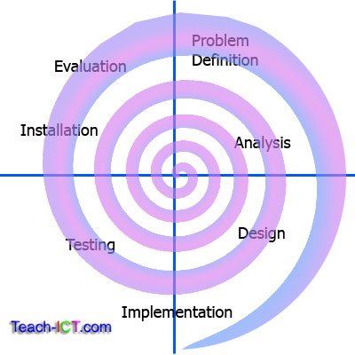
Phase 1 – Trusted Smart Surveys
Initial agenda…
Development of unifying concepts of smart surveys
Familiarisation with privacy-preserving technologies (trustworthiness)
Insights from behavioural sciences, citizen science, gamification
Run pilots based on existing tools for diary-based surveys (e.g. TUS, HBS)
Shared infrastructure, common services, functions and tools available to NSI
Requirements analysis (e.g. what to use, configure, customize, …)

Slide 4
Trusted Smart Statistics generic model
Use Cases HETUS/HBS
Use Case 2
(health, …)
Enhanced TUS
statistics
Enhanced HBS statistics
Enhanced/new …
Statistics layer
TUS
HBS
…
Application layer
Trusted Smart Surveys
Services layer
Data from sensors and smart technologies + questionnaires
Data layer

Slide 5
Parallel innovation tracks
ESSnet Trusted Smart Survey | F4 Innovation grants
Architecture focus (modular, reusable, evolvable and agnostic services) - European perspective | Business focus - ESS shareable tools
Central hub / European platform | National and European developments
Fully parametrised – support various surveys | Survey specific (HBS, TUS)
Privacy, confidentiality, auditability
User engagement
Smart

Slide 6
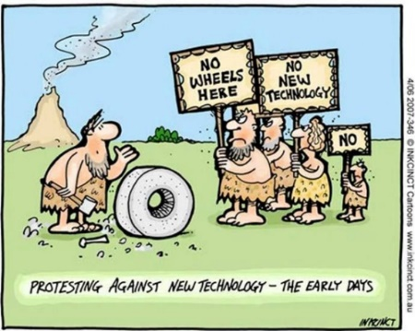
Phase 2 - Smart Surveys Implementation
Scope: Applied research to advance, develop and demonstrate the concept of smart surveys i.e., use of smart devices combining active and interactive data collection.
Identify the sharable components of the solutions that could be further developed and used among the NSIs, identify and promote good practices for privacy and communication methods for engaging respondents.
Mixed composition: 7 NSIs, 3 universities, one private company

Slide 7
Smart Surveys Implementation: focus areas
PoC with an end-to-end solution for complex smart surveys with focus on HETUS, HBS.
Respondents and smart devices: user centricity, communication strategy, impact on survey operation (role of interviewers).
Privacy is extremely important and goes hand in hand with the citizens participation to surveys. Preparation of DPIA for smart surveys.

Slide 8
Overall assessment
Adaptable and highly reactive project management, strong cooperation
Concepts and baseline capabilities are in place
Feasibility demonstrated (e.g. HBS and TUS in Germany)
Micro service architecture is scalable and supporting different modes of deployment (MOTUS, on premises)
Technological maturity (cloud native, containers, security …) and modular and components
Sharable developments and private data protection alignement

Slide 9
Success factors
Multi facets approach: good combination of methodological/IT developments + involvement of legal and HBS-TUS domain experts
Win-Win combination: NSIs, academia, private companies
Mature technology
User centricity: security, ethics, consent …
Hybrid funding model – big multi beneficiary projects combined with smaller individual grants

Slide 10
Challenges
Gradual transformation required (long term perspective)
Smart surveys are not the sole solution. Part of data collection revolution and citizens’ engagement for Official Statistics
Balancing investment and benefits
NSI management buy-in
Significant organisational/operational impact in NSIs
Co-development model (cooperation, open source, …) not yet mature
Varying levels of maturity across NSIs
Varying levels of respondent readiness
Notes:
Number of NSIs not-using smart surveys in HBS
Number of NSIs not-running a TUS at all: 12

Slide 11
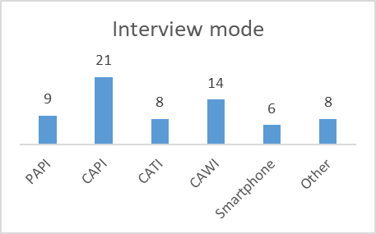
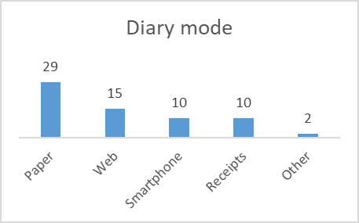
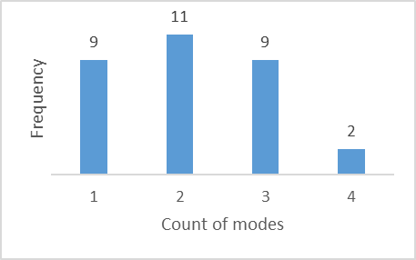
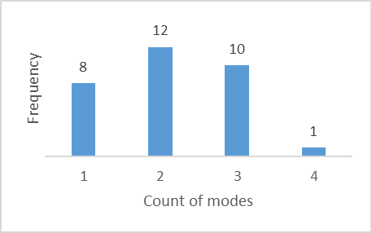
Planned modes for HBS 2026
Survey with 31 EU, EFTA and CC in June 2023
Notes:
The mixed-mode approach has gained consensus among the countries.
According to the results:
- nine out of 31 NSIs plan to adopt a single mode for the interview and eight for the diary;
- the large majority opting for two or three data collection modes;
- while two countries (for the interview part) and one (for the diary part) will offer four different possibilities to the respondents.
A mixed mode approach implies departing from the traditional in-person interviews and paper-based diaries, envisaging new and innovative data collection modes.

Slide 12
Way forward
Capitalise on results and community
Promote success stories at ESS level
Communication at various levels (working groups, innovation agenda)
Business-led implementation (focus on key use cases)
Create cooperation structures for key social surveys
Notes:
Open questions
How to move to actual implementation?
How to share knowledge / experience across NSIs?
How to narrow the maturity gap across NSIs?
Need and possibility for guidelines?

Slide 13
Thank you
© European Union 2025
Unless otherwise noted the reuse of this presentation is authorised under the CC BY 4.0 license. For any use or reproduction of elements that are not owned by the EU, permission may need to be sought directly from the respective right holders.
Slide 5: cartoon, source: INKCINCT; Slide 2: diagram, source: Teach-ICT.com

