Slide 1
Smart data collection: From research to production
Digital transformation and smart data collections in the domain of diary-based surveys in Germany
Smart Survey Implementation (SSI) conference on April 2nd and 3rd, 2025
Initially presented at the Meeting of the ESS Innovation Network (EIN) on December 10th, 2024

Slide 2
Agenda
Smart data collection: From research to production
HBS and TUS
Project – from research to production
Lessons learned going into production

Slide 3
Agenda
Smart data collection: From research to production
HBS and TUS
Project – from research to production
Lessons learned going into production

Slide 4
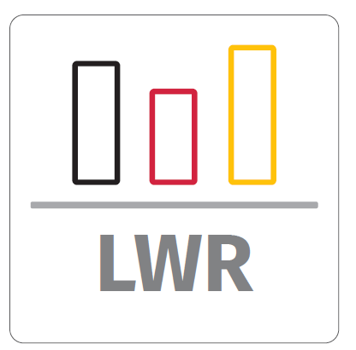
TUS & HBS
Smart data collection: From research to production
Methodological features
Economic accounts of private households (HBS)
Diary-based household surveys
Many free-text data entries
Resource-intensive data processing
Previous surveys were conducted entirely on paper mode (PAPI)
Time use (TUS)

Slide 5
Decision process towards digitalization
Smart data collection: From research to production
Declining trend in voluntary participation rates → Wiesbaden Memorandum in 2011
→ Eurostat and NSIs decided to develop and implement new data collection modes to call a hold on declining participation rates and increase data quality
Push-factors
Diary-based researches
Demanding and burdensome
Participants expect a digital option
Pull-factors
App-based researches offer:
… ways to minimize effort for respondents
… insights during field phase

Slide 6
Agenda
Smart data collection: From research to production
HBS and TUS
Project – from research to production
Lessons learned going into production

Slide 7
From research to production

Slide 8
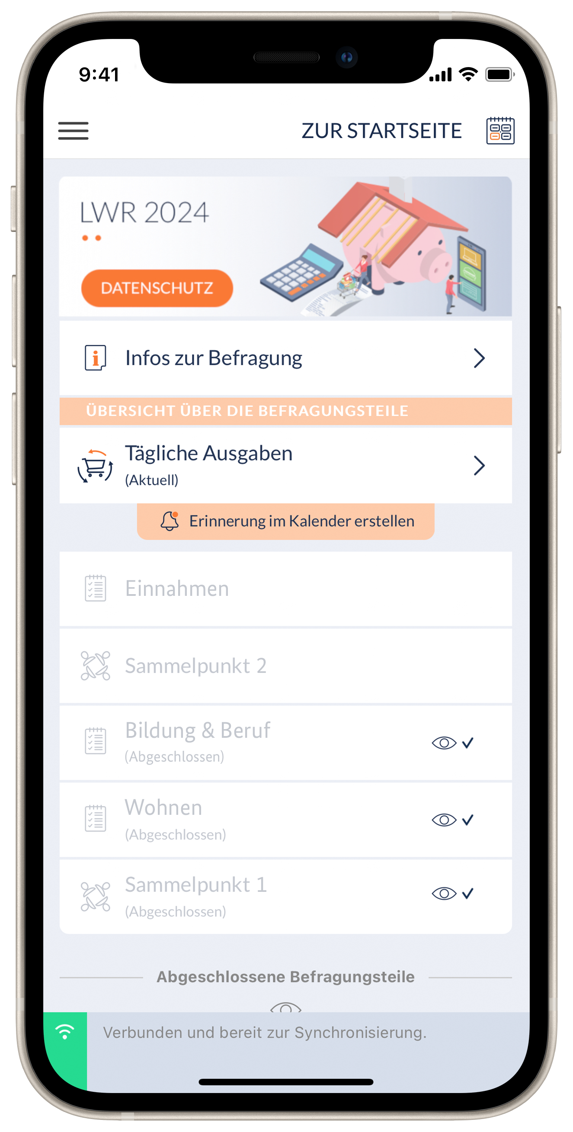
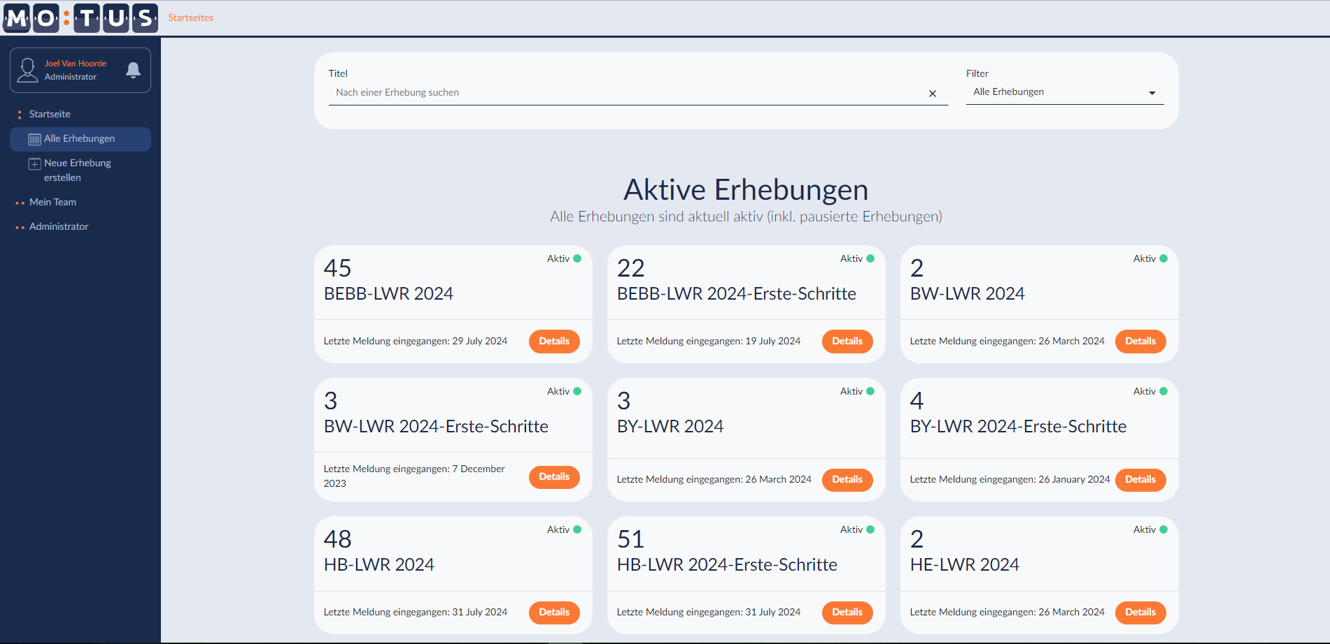
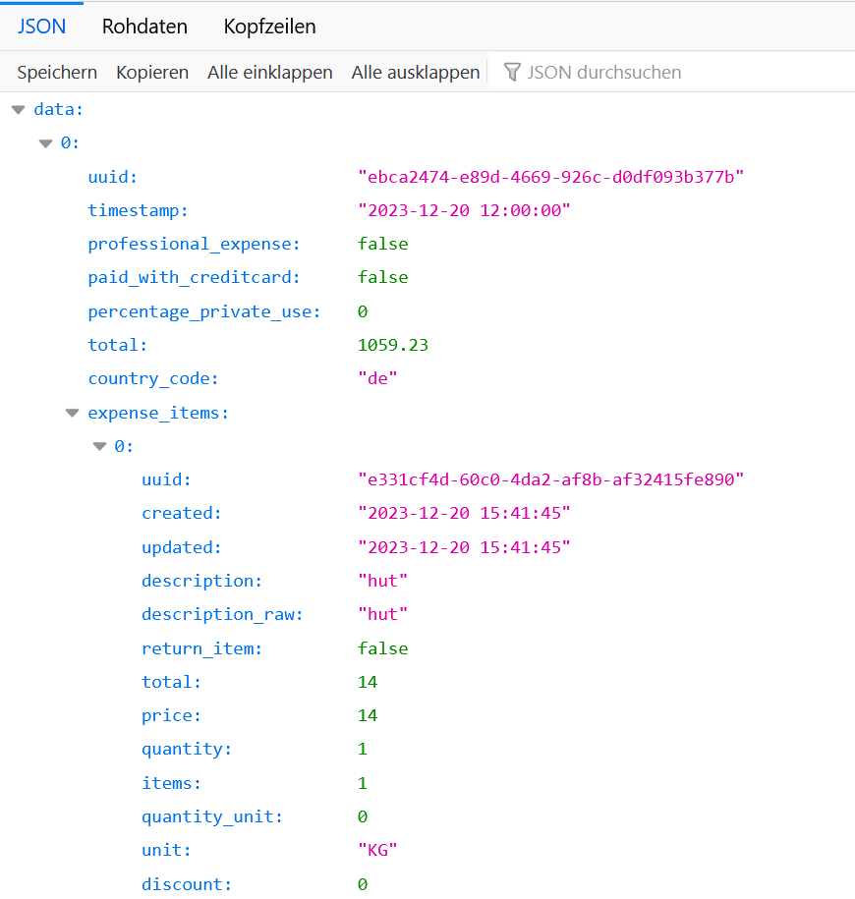
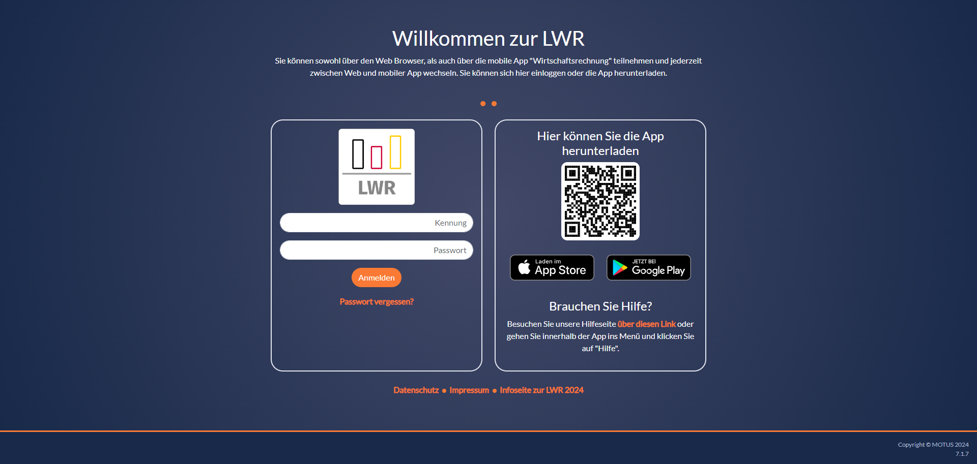
Software MOTUS

Slide 9
Timeline
Smart data collection: From research to production
2018
2019
2020
2021
2022
2023
2024
2025
Q1
Q2
Q3
Q4
Q1
Q2
Q3
Q4
Q1
Q2
Q3
Q4
Q1
Q2
Q3
Q4
Q1
Q2
Q3
Q4
Q1
Q2
Q3
Q4
Q1
Q2
Q3
Q4
Q1
Q2
Q3
Q4
Milestones
Germany
Preparing for “an App”
German require-ments
Development for DE-TUS
Develop-ment for DE-HBS
EU Grants
CRŒSS
Smart Survey Implementation
Source TM
Trusted Smart Surveys
HBS 2026 – Implementation
3 years
„Can it work?“
< 1 year
„Will it work?“
stages of
„working“
Sources:
https://www.flaticon.com/

Slide 10
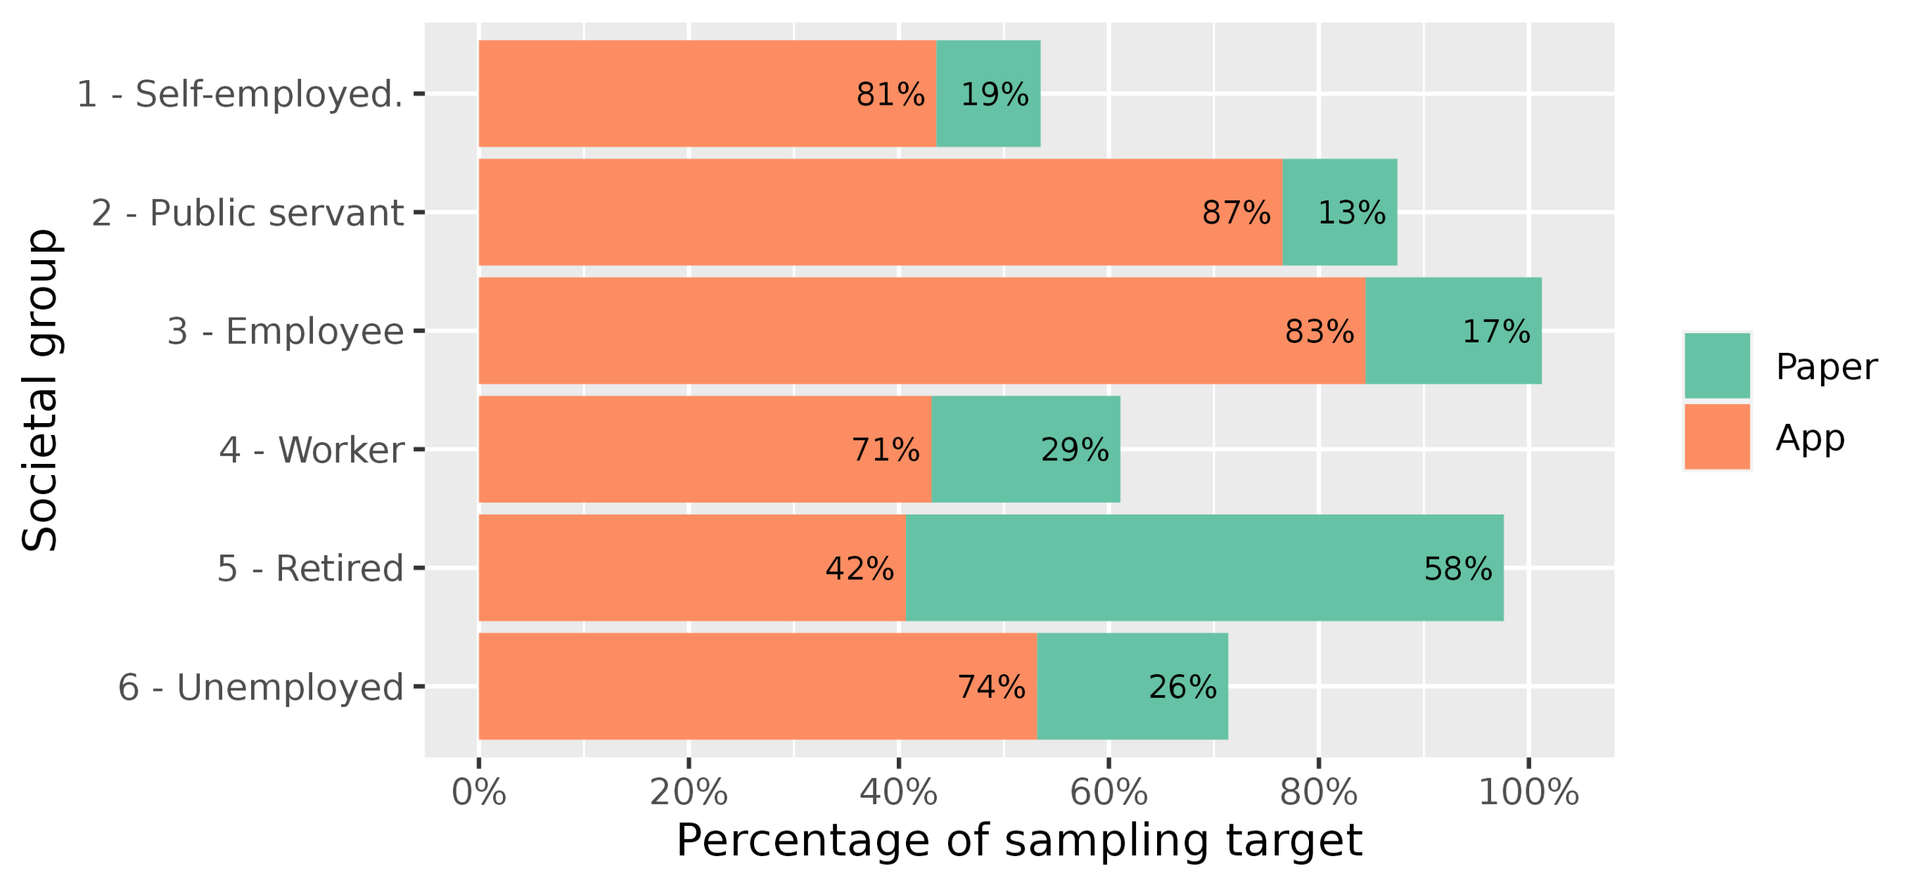
From research to production
Smart data collection: From research to production
Foundational work
The (not so basic) basics
Legal, data privacy, and data security
IT-infrastructure and server performance
Functional adaptations
Transforming a third-party app to meet specific national demands
Mode strategy
Online only? Online first? Free choice?
Measurement equivalence

Slide 11
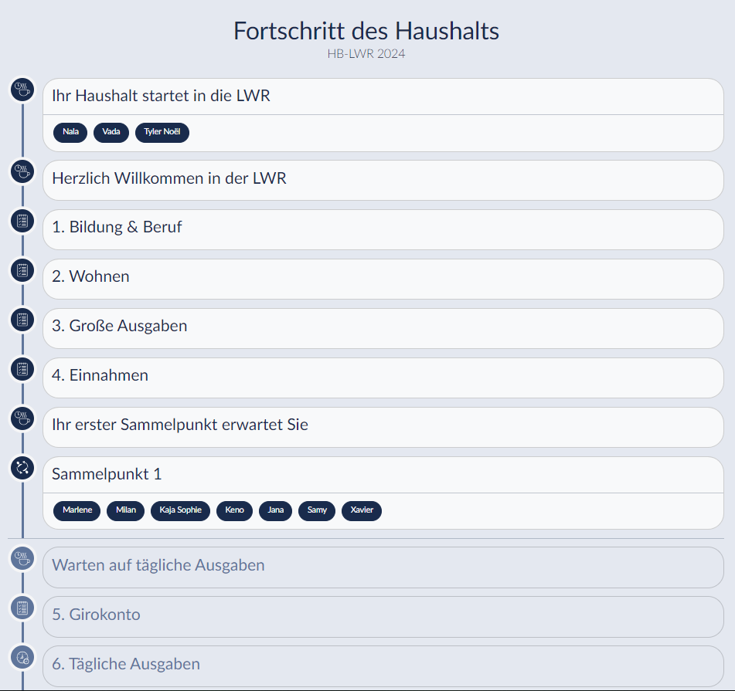
From research to production
Smart data collection: From research to production
Fieldwork efficiency
Survey managers – Learning a new role:
Service-oriented subject-matter
Technical experts
→ ~1 FTE per 700 households surveyed
Designing efficient service platforms
Opening the black box of the field phase

Slide 12
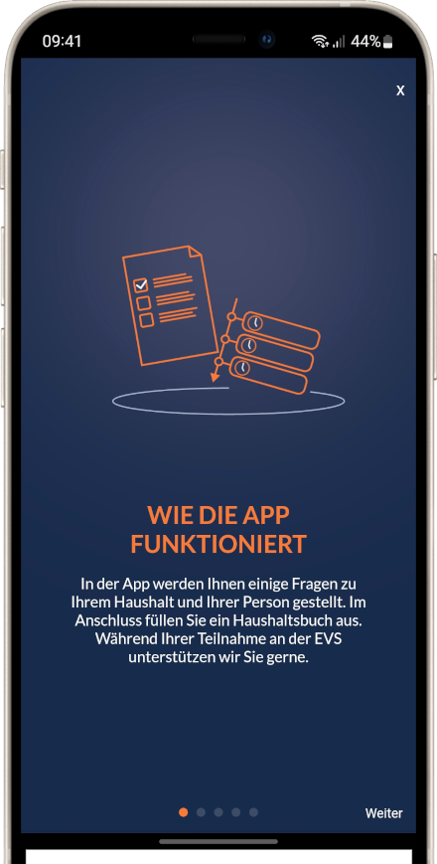
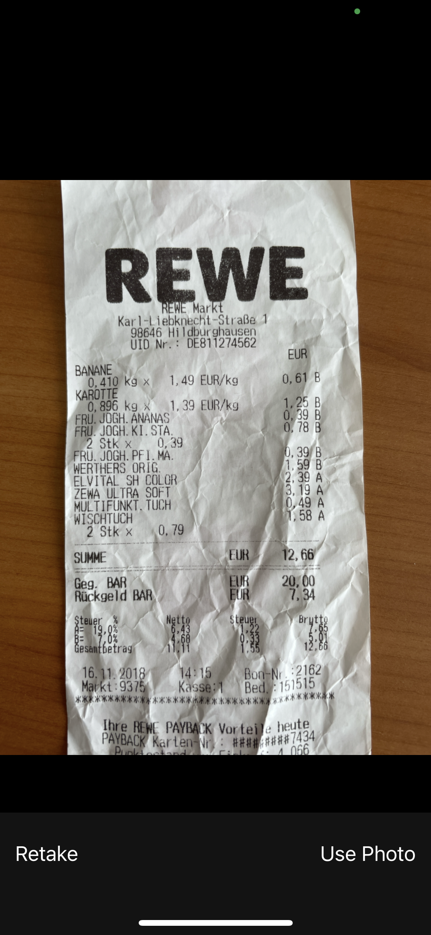
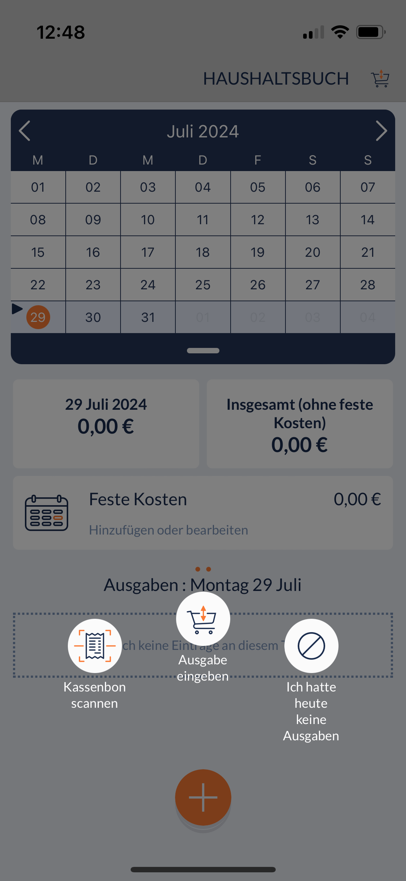
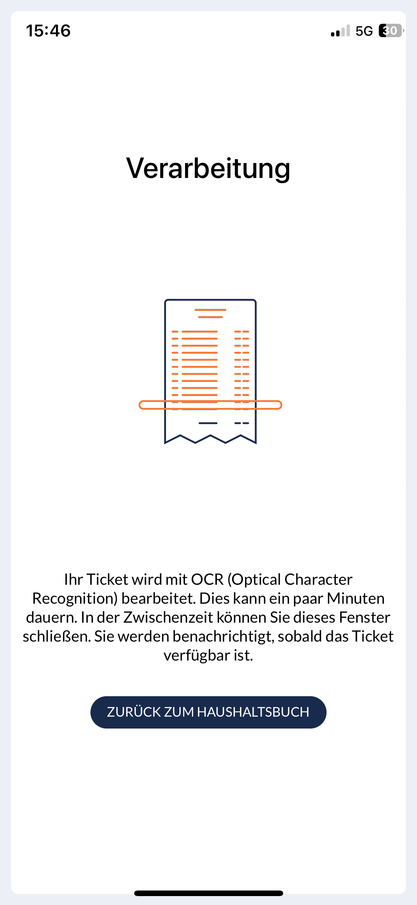
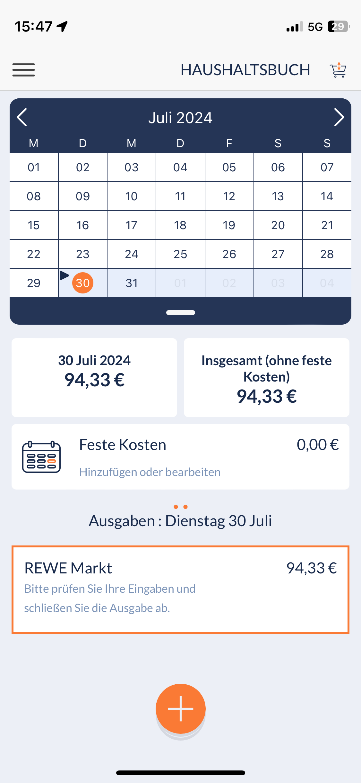
From research to production
Smart data collection: From research to production
From digital to smart surveys

Slide 13
Lessons learned

Slide 14
Lessons learned
Smart data collection: From research to production
Costs
IT
Project management
Methodology
Service attitude
Quality control
Change management

Slide 15
Lessons learned
Smart data collection: From research to production
Costs
IT
Project management
Methodology
Service attitude
Quality control
Change management
Digitalization is often framed as a means to save money
Ideally, this is true in the long run
Short-term: Investment costs outweigh gains in productivity
Process optimization and modernization are about more than the short-term costs
They are meant to shape the future ways of working

Slide 16
Lessons learned
Smart data collection: From research to production
Costs
IT
Project management
Methodology
Service attitude
Quality control
Change management
There is a demand for knowledgeable and experienced…
IT-personnel with interest in statistics
methodologists with interests in IT

Slide 17
Lessons learned
Smart data collection: From research to production
Costs
IT
Project management
Methodology
Service attitude
Quality control
Change management
Experienced IT-project management needed
Defined stop criteria, risk management, fast escalations, shared vision throughout all hierarchies
Increased risk tolerance
Involved staff must be willing to accept certain risk levels
Clear timeline – you cannot pretest your methods forever

Slide 18
Lessons learned
Smart data collection: From research to production
Costs
IT
Project management
Methodology
Service attitude
Quality control
Change management
Official statistics is shaped by paper questionnaires
Digitalization can result in “digital paper questionnaires”
Take a deep dive into online survey methods
Database structure, question formats
Online will dominate – keeping PAPI and online in sync will be a challenge if old structures are recycled

Slide 19
Lessons learned
Smart data collection: From research to production
Costs
IT
Project management
Methodology
Service attitude
Quality control
Change management
Survey Managers instead of interviewers (in DE)
Technical support is added to the subject-matter support
Communication: A more transparent fieldwork means:
NSIs must take on a service mentality
e.g., call and offer support to inactive participants

Slide 20
Lessons learned
Smart data collection: From research to production
Costs
IT
Project management
Methodology
Service attitude
Quality control
Change management
Automation and trust
85% of COICOP codes in the German HBS 2023 were results of either ML predictions or search algorithm interactions of users
Risk of unseen bias in the data
Less manual work → More quality control
Stay in the loop

Slide 21
Lessons learned
Smart data collection: From research to production
Costs
IT
Project management
Methodology
Service attitude
Quality control
Change management
All this results in change…
… and people often struggle with change
Do not neglect change management
Communicate before you impose changes
Shape the change together
Keep refining and communicating

Slide 22
Summary
Smart data collection: From research to production
The digital transformation of TUS and HBS at Destatis is a successful project, with a lot of room for future additions and improvements
Destatis will strive to…
… further develop and drive digital transformation
… share practices with other NSIs and Eurostat
with the aim to …
… develop tools, that make participation in rather burdensome official statistics easier
… increase efficiency of the production process within the NSI

Slide 23
Contact
Statistisches Bundesamt 65180 Wiesbaden
Germany
Contact person
Dr. Jerome Olsen
Jerome.Olsen@destatis.de
www.destatis.de
www.destatis.de/kontakt

