Slide 2
SSI Energy Use: Dongle Pilot
Jeldrik Bakker, Maaike Kompier, Barry Schouten, Remco Paulussen, Daphne Debije, Noël Mingels & Gaston Hayen
Smart Survey Implementation Conference, Heerlen
04-04-2025

Slide 3
Introduction & Motivation
Context: Learn how to build, test and evaluate a smart energy survey while considering methodology, IT, logistics and legal aspects
Problems:
  Traditional surveys are burdensome
  Response rates are declining
  Information requirements/desires are increasing

Slide 4
Energy Information Requirements & Desires
Dimension | Must-Have | Should-Have
1. Acceleration | Yearly data | Monthly data
2. Detail | Electricity: • Transportation • Heating • Cooling • Cooking • Hot water • Lighting Gas: • Heating • Cooking • Hot water | HETUS Activities (from the Time Use Survey)
3. Broadening | Solar panel Heat pumps | Indoor temperature

Slide 5
Study Design & Method
Participants: 13 CBS colleagues recruited; 11 completed the pilot.
What we did:
  Start questionnaire at the beginning
  Installed a Homewizard P1 dongle
  Collected data for 8 + 22 days per 15 minutes (electricity, gas, solar export, peak power)
  Respondents kept an energy diary for the first 8 days
  Evaluation questionnaire at the end
Why this setup?
  Quick to implement and no need to develop ourselves
  Compare passive measurements to reported behaviour
  Assess feasibility, user experience and data quality

Slide 6
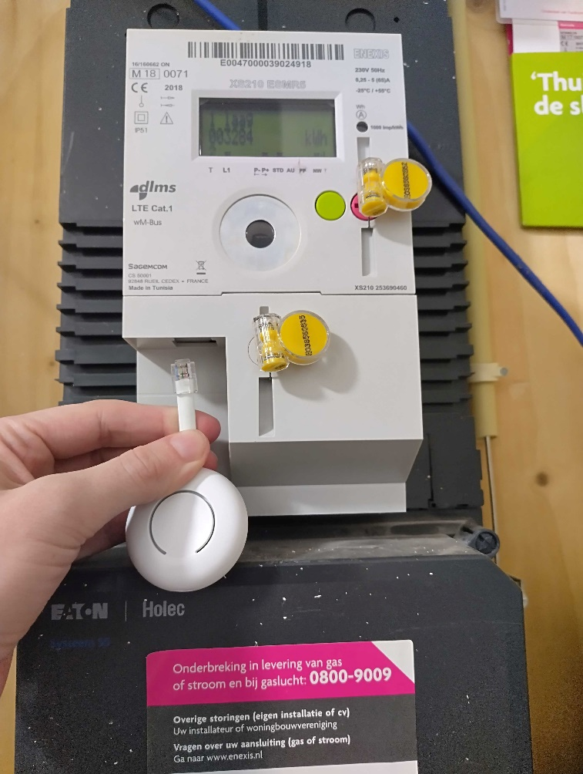
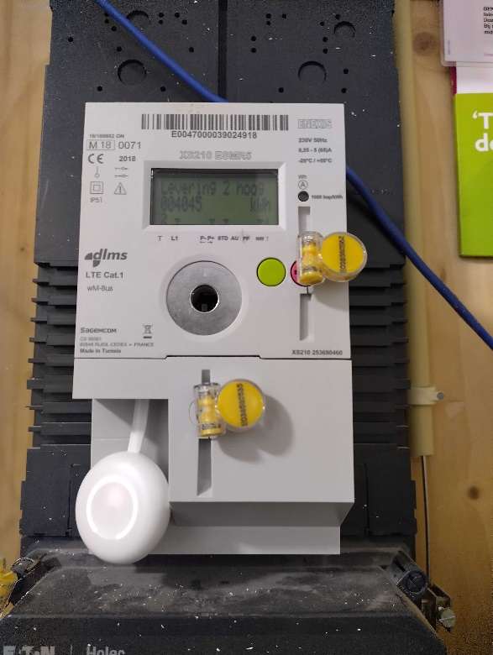
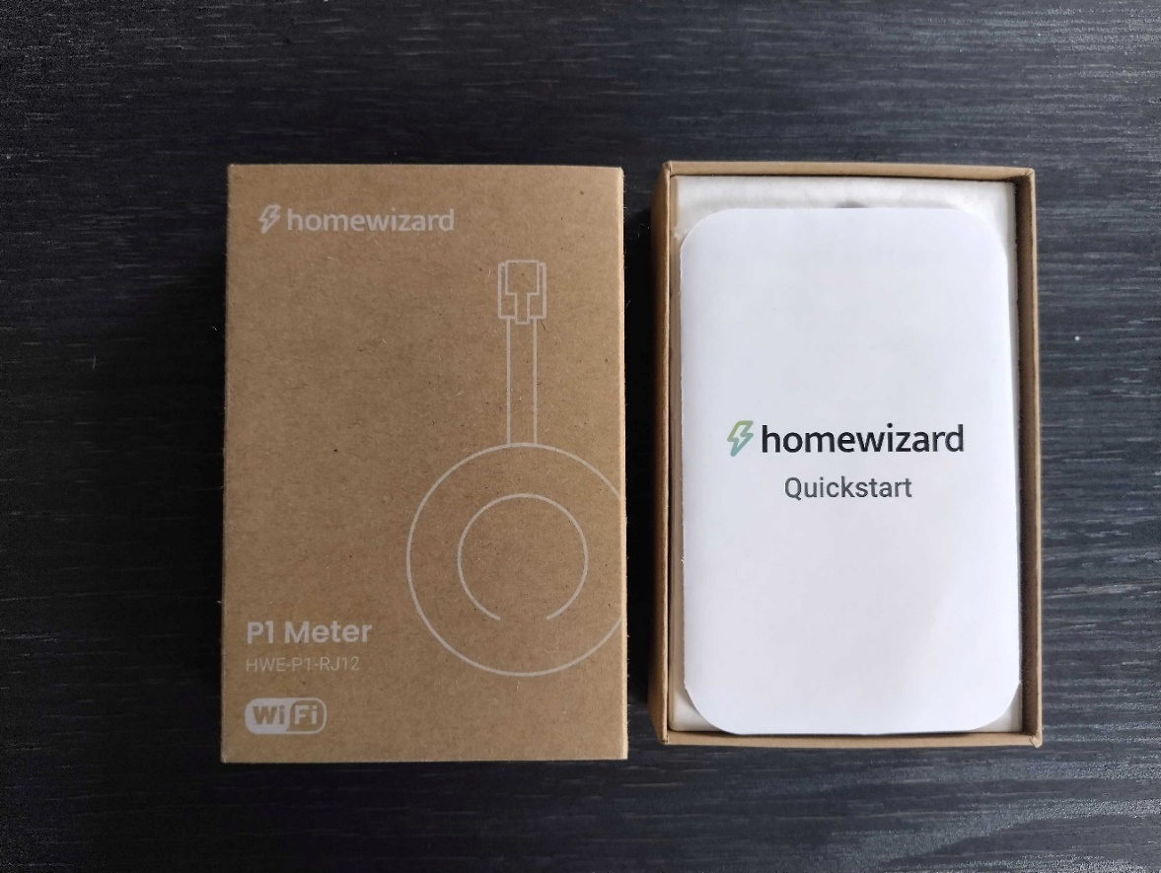
Homewizard P1 Dongle

Slide 7
Installation of the Dongle

Slide 8
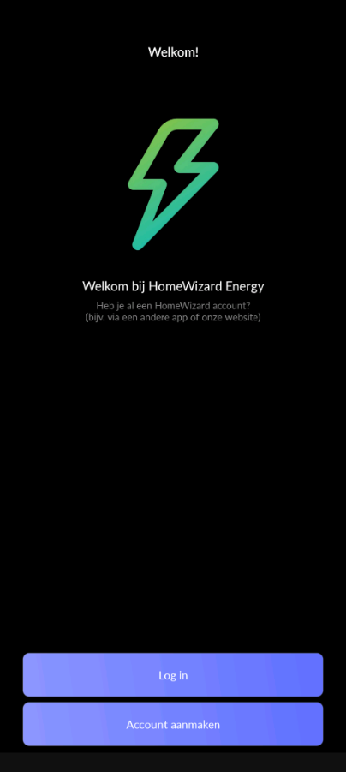
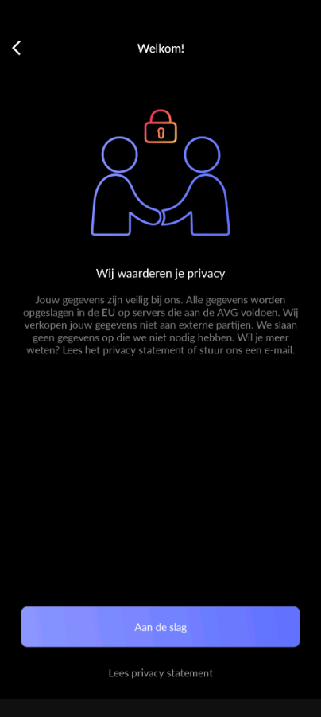
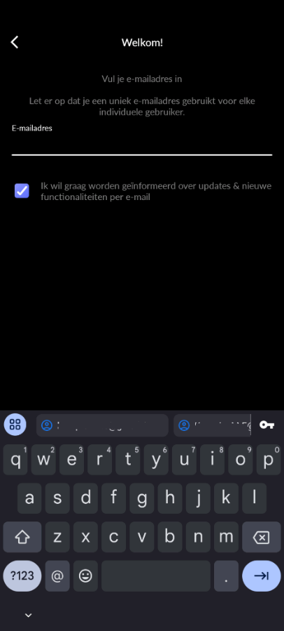
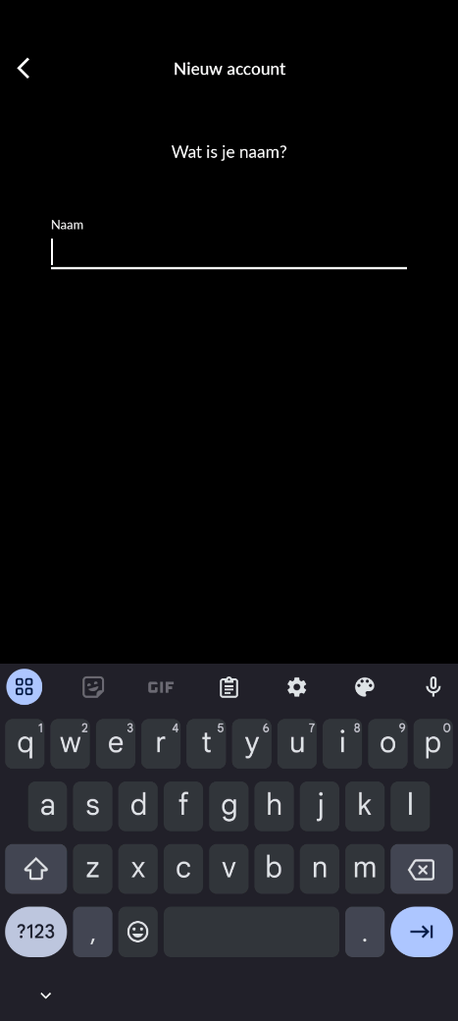
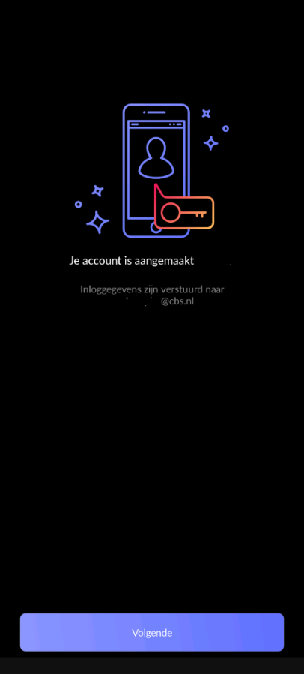
The Homewizard App: Create Account

Slide 9
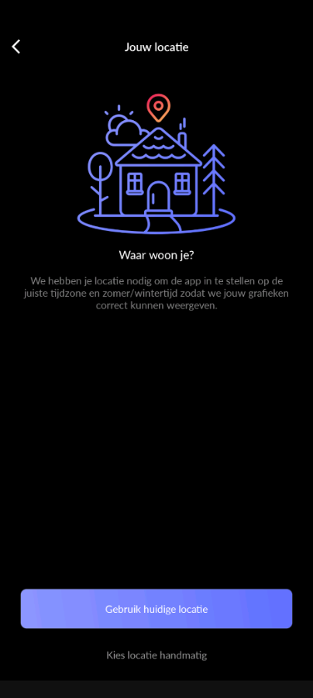
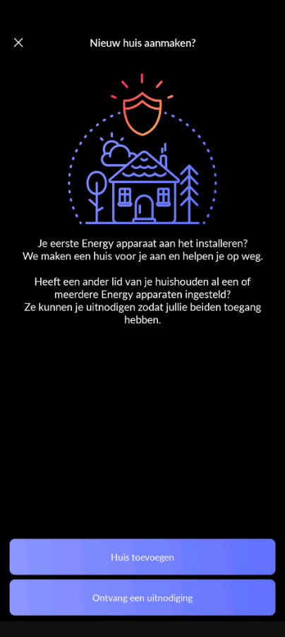
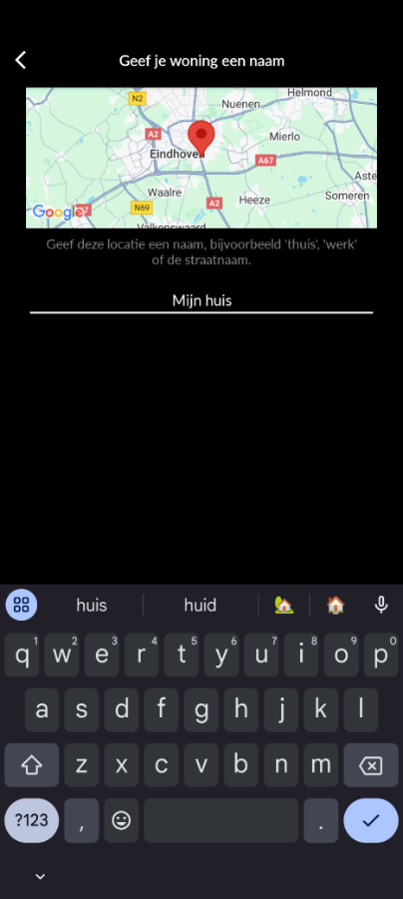
The Homewizard App: Add your House

Slide 10
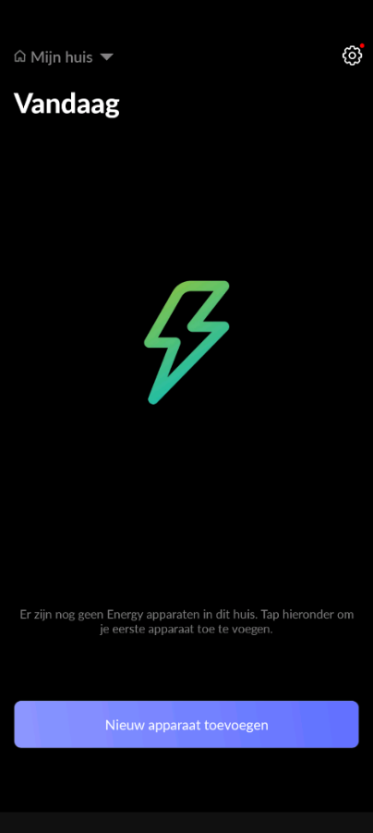
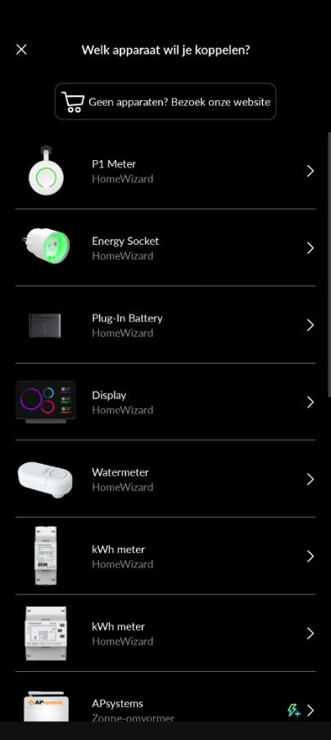
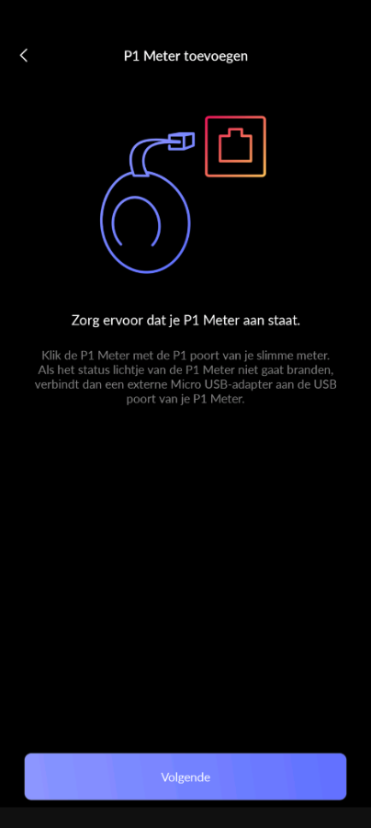
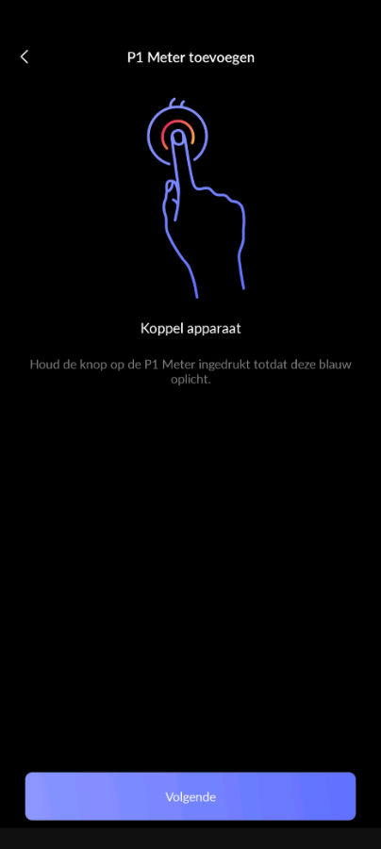
The Homewizard App: Connect with Dongle (1)

Slide 11
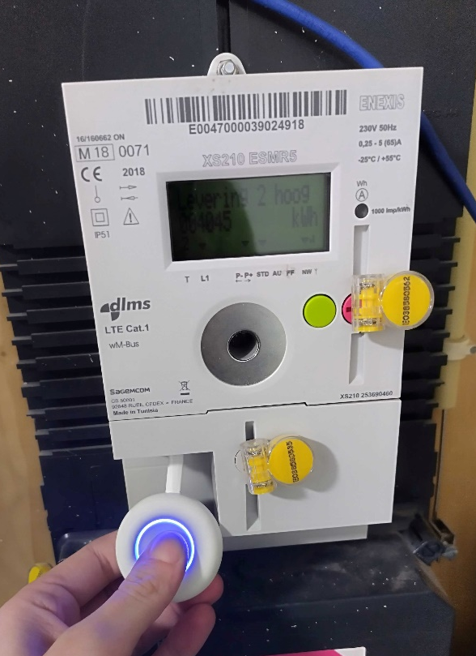
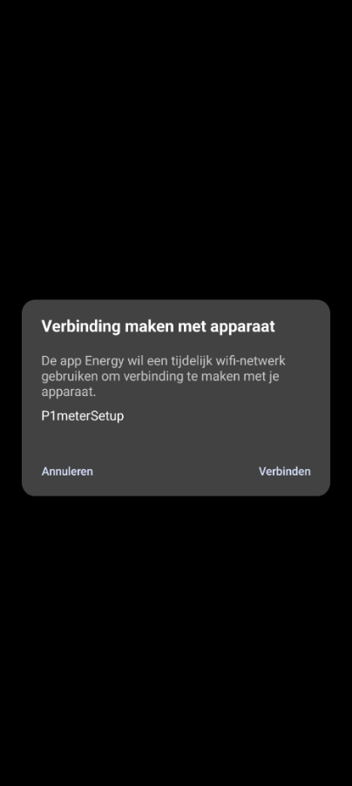
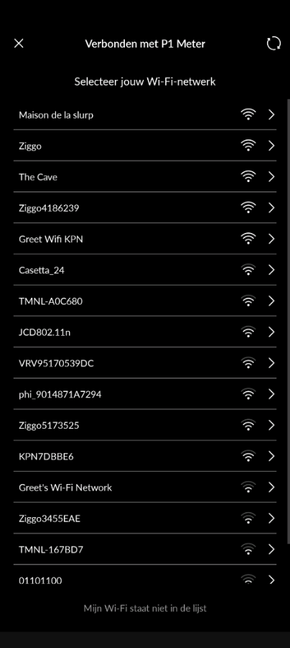
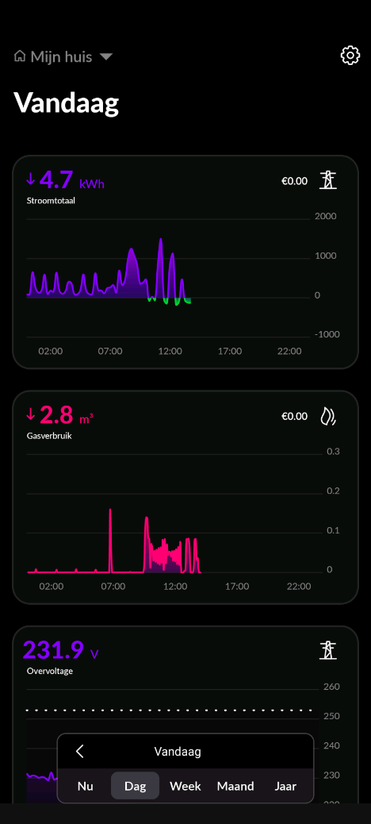
The Homewizard App: Connect with Dongle (2)

Slide 12
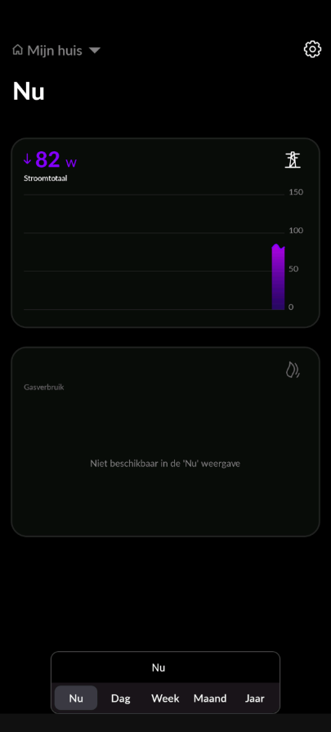
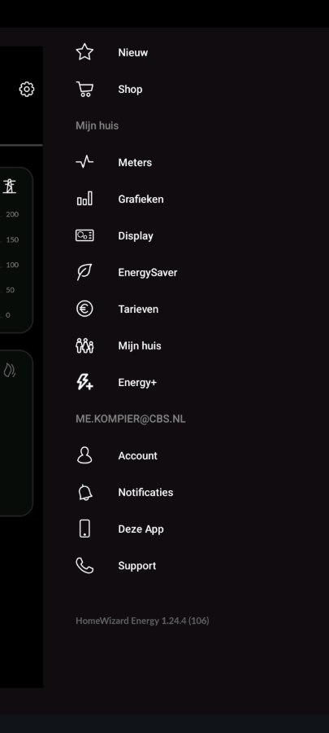
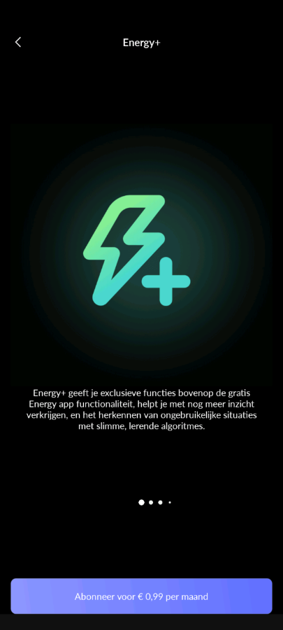
The Homewizard App: Get Subscription

Slide 13
Results
Ease of use: 10 out of 11 found installation (very) easy
Technical issues:
  One participant needed an extra USB-C cable
Behavioural insight:
  Participants can become more aware of their usage
  3 people adjusted their behaviour
Data quality issues:
  One participant provided daily data instead of 15-minute data
Burden:
  One participant explicitly mentioned that it was burdensome
Privacy Issues
  Half of the participants raised concerns about privacy

Slide 14
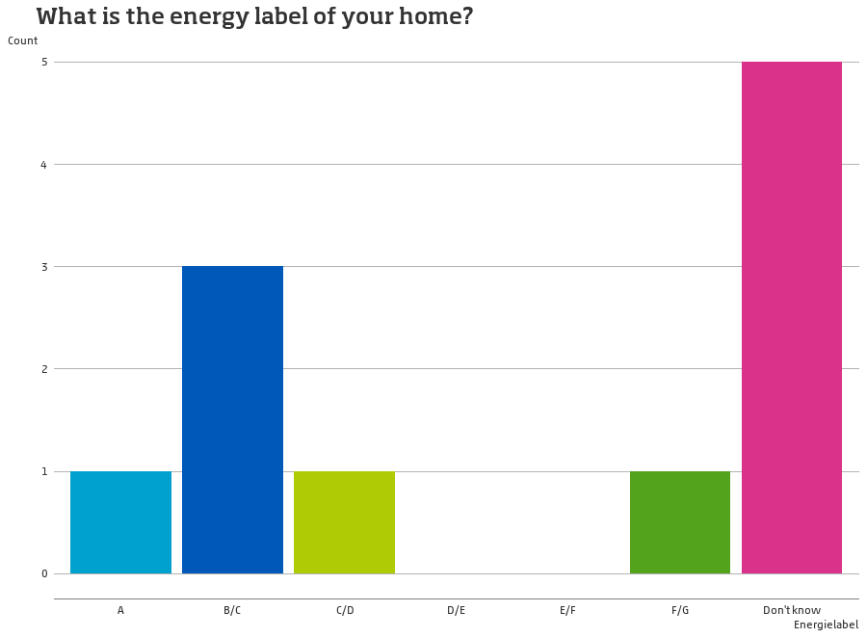

Slide 15
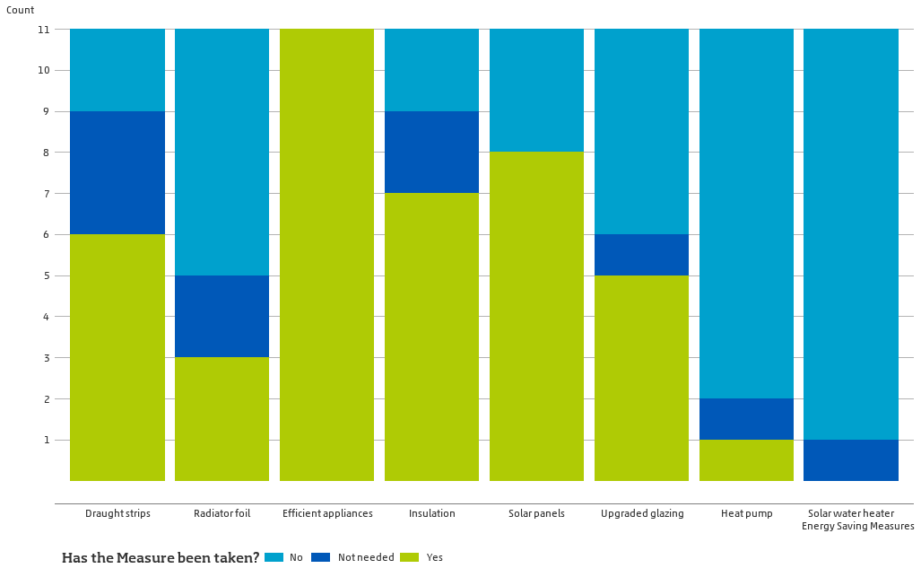
Energy Saving Measures

Slide 16
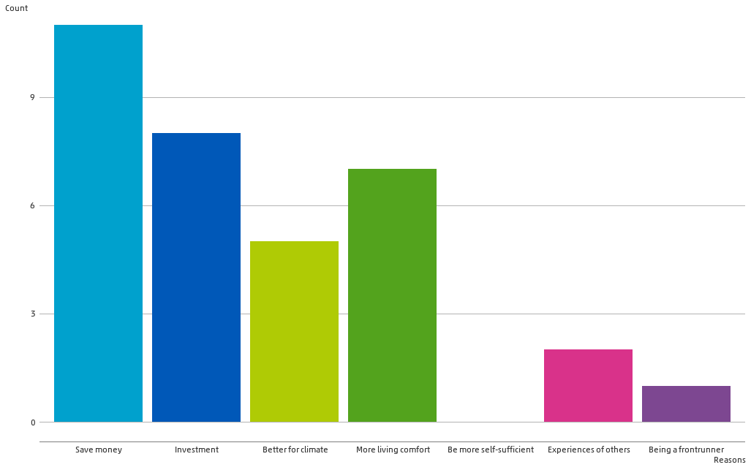
Motivation for energy saving measures

Slide 17
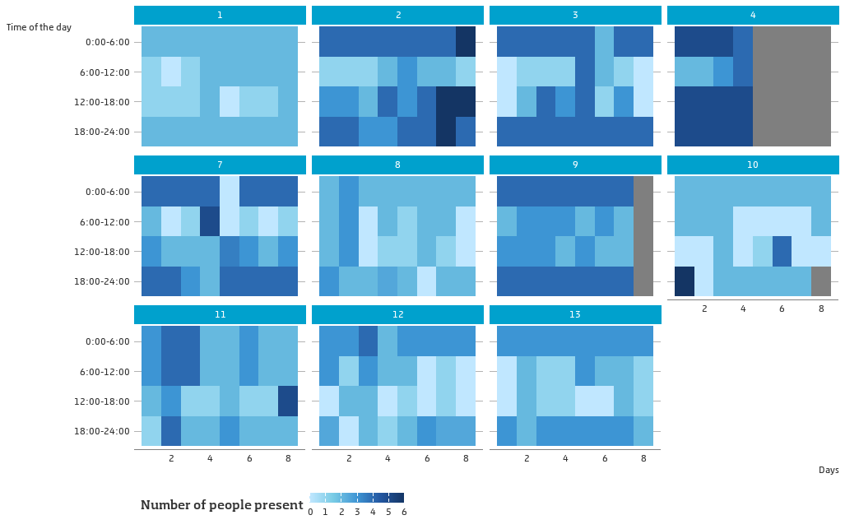

Slide 18
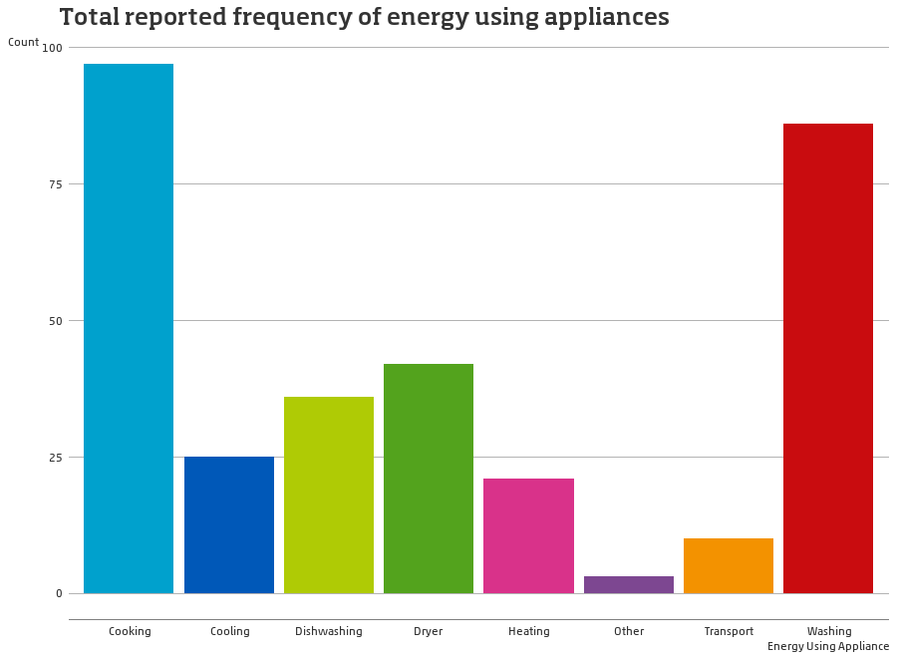

Slide 19
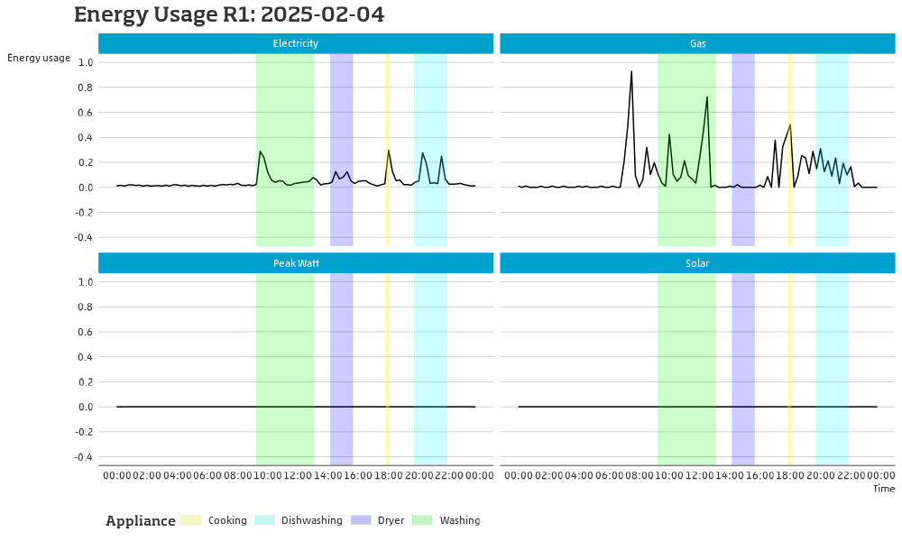

Slide 20
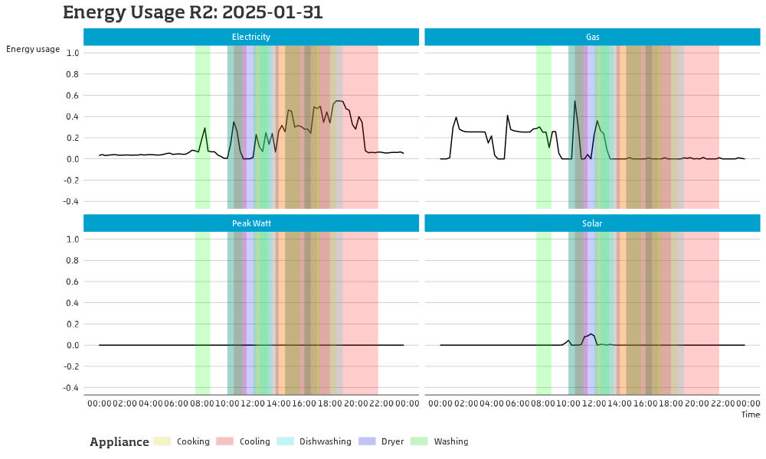

Slide 21
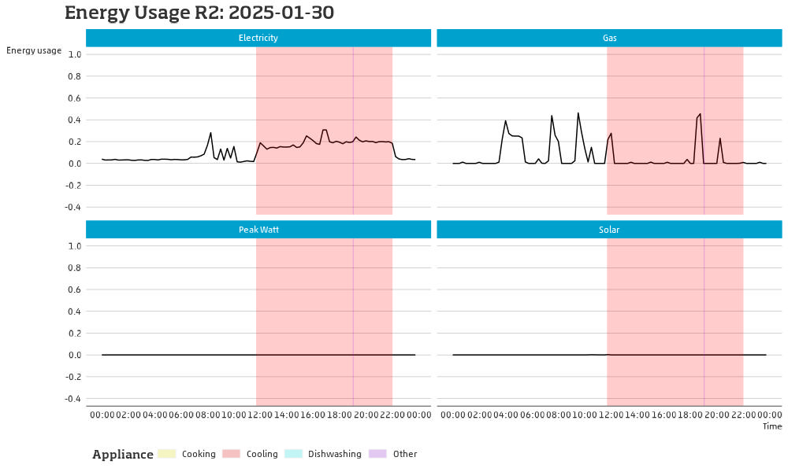

Slide 22
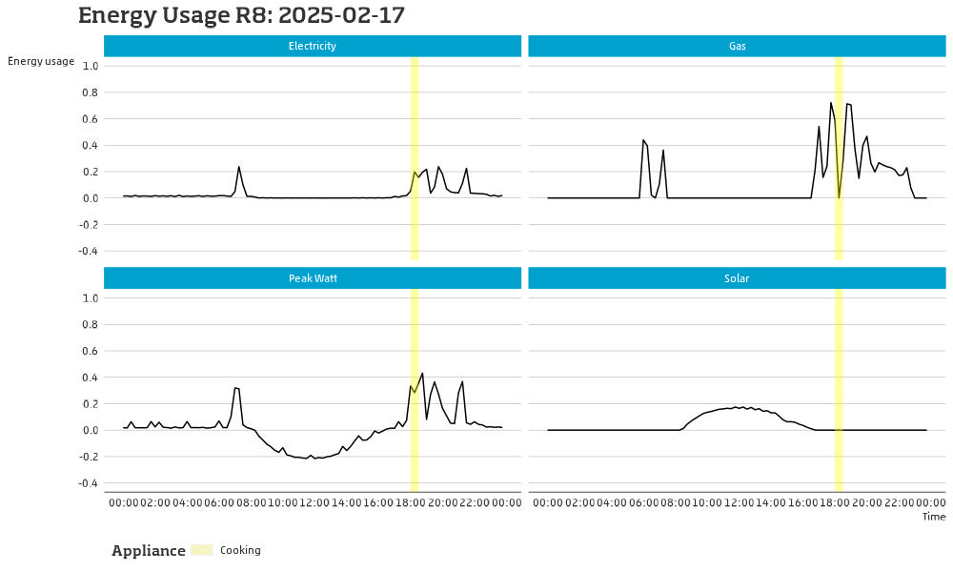

Slide 23
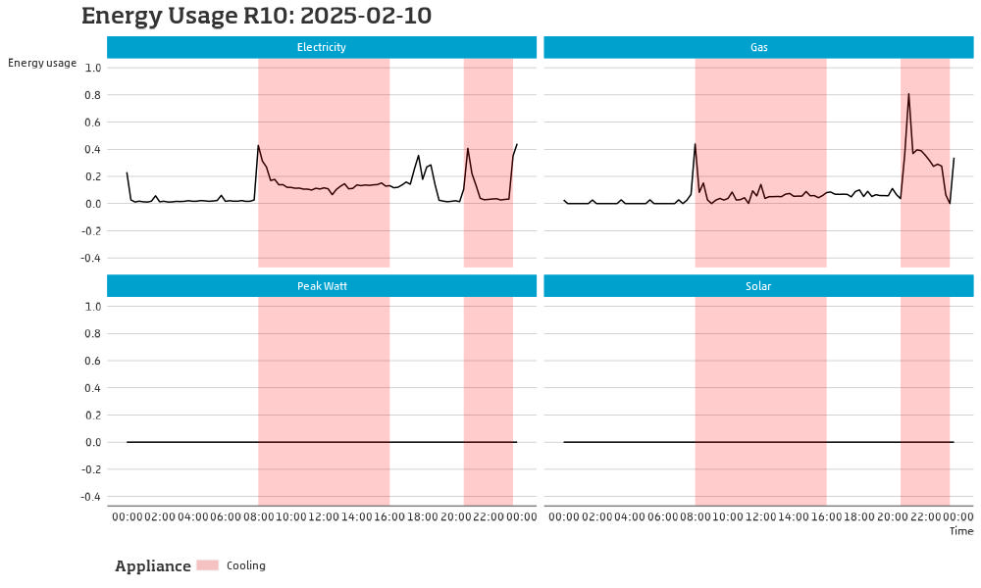

Slide 24
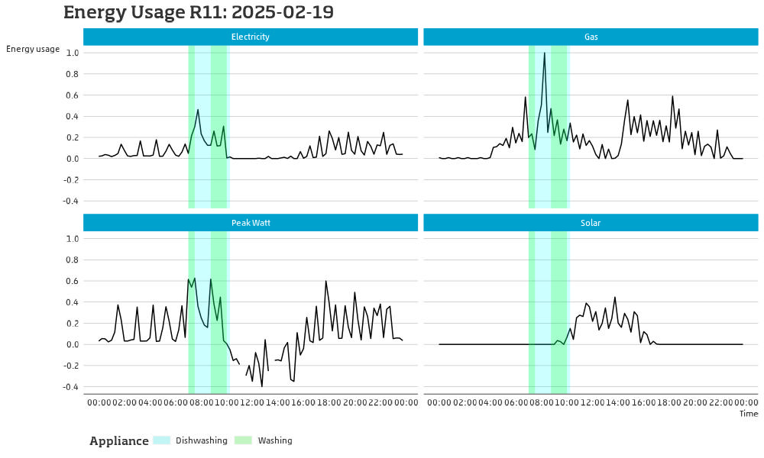

Slide 25
Lessons Learned & Future Outlook
What works well:
  Passive collection is feasible and low-burden (once installed)
  Real-time insight is valuable to participants
Limitations:
  Very small pilot
  15-minute data not detailed enough to identify devices automatically
  Diaries still needed for context
  Help might be needed for both installation and sending data back
Future study ideas:
  Develop secure microservice for data retrieval
  Consider energy panel for gas, electricity, water
  Need better onboarding strategy (possibly using interviewers)
  Devices as incentive: appreciated, but costs need consideration

Slide 26
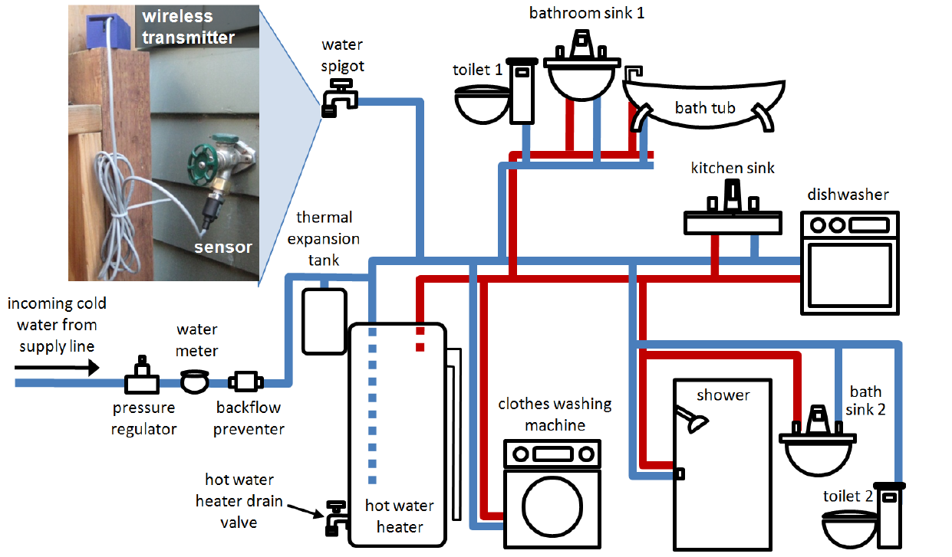
Water cyclus within a household
Froehlich et al. (2009)

Slide 27
Smart watermeter measurments

