Slide 1












Smart Survey Implementation
Grant Agreement Number: 101119594 (2023-NL-SSI)
Workpackage 4: Business process perspective
Disclaimer: Views and opinions expressed are however those of the author(s) only and do not necessarily reflect those of the European Union or Eurostat.
Neither the European Union nor the granting authority can be held responsible for them.

Slide 2
Workpackage 4: Business process perspective
The main objective of WP4 is to deliver guidelines that will help National Statistical Institutes (NSIs) to extend their business processes to adopt smart solutions in their surveys.
Two topics
Today: Business process building blocks
Tomorrow: Smart survey maturity model

Slide 3
Topic 1
Business process building blocks

Slide 4
WP4
The main objective of WP4 is to deliver guidelines that will help NSIs to extend their business process to adopt smart solutions in their surveys.
Part of this is to help NSIs to model their business process and to identify the capabilities/roles needed.
One of the objectives of WP4 is to provide an NSI with a description of process building blocks
  a ‘library’ with business process activities, relevant for smart surveys

Slide 5
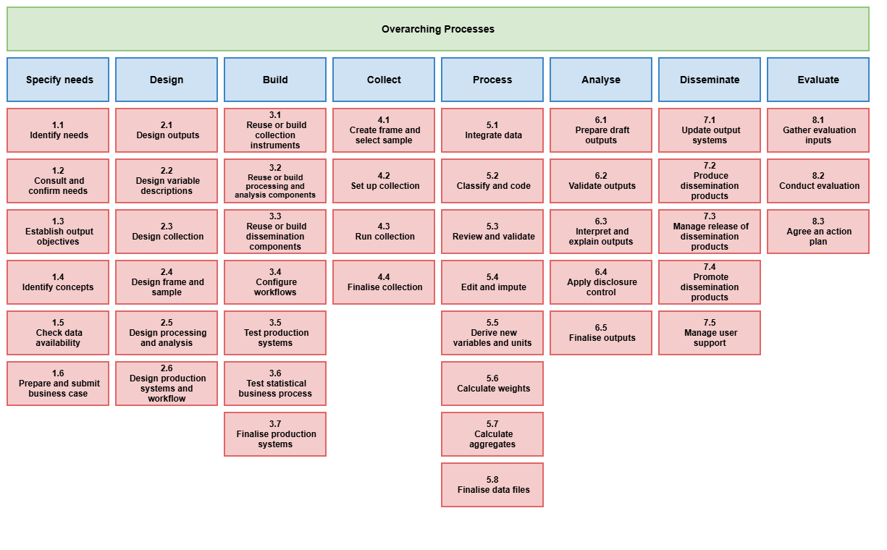
Setting the stage: GSBPM
Phases =>
Sub-processes =>

Slide 6
A process in general
Sub process
e.g. ‘5.2 Classify and code’
exists of
supports
IT tool
IT tool
<= could e.g. also be a microservice developed by SSI workpackage 3

Slide 7
Process (in general)
start
result

Slide 8
Building blocks: process activities
Phases =>
Sub-processes =>
We described 63 process building blocks

Slide 9
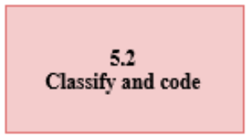
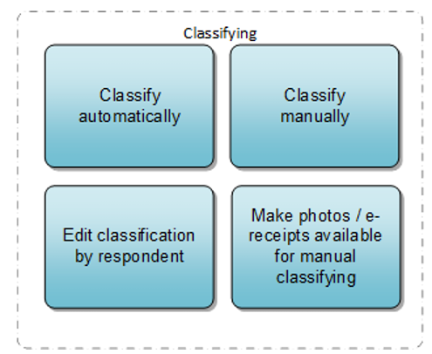
Process building blocks examples
GSBPM sub process
Building blocks (Proces activities)

Slide 10
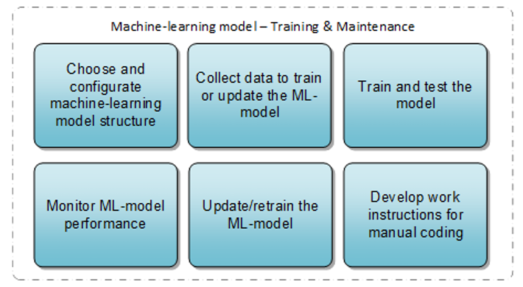
Other examples

Slide 11
Scope of the ‘library’
Two types:
it’s a process activity that is new; so non-existing for non-smart surveys.
E.g. ‘Develop app’
it’s a process activity that is not specific as such for a smart survey, but needs extra attention.
          E.g. ‘Train helpdesk employees’
Type of smart solution:
Some process activities are general usable/applicable, thus not specific to the type of smart solution
Other activities are specific to the type of solution. In this respect we restricted ourselves to the three SSI use cases HBS, TUS and energy usage meters.
          E.g. “OCR of the receipt” [HBS]

Slide 12
Parts of building block description
We provide the following:
A general description of the process activity
Certain specific points requiring attention when using the activity in your process. When applicable also link to other WP.
The role(s) needed/involved in the process activity
A link to the GSBPM and BREAL framework (as an appendix in our deliverable)

Slide 13
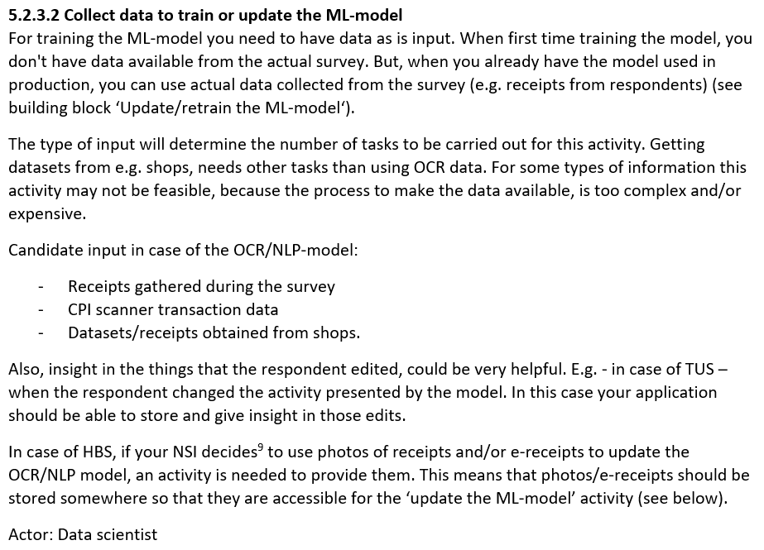
A concrete example of a building block description

Slide 14
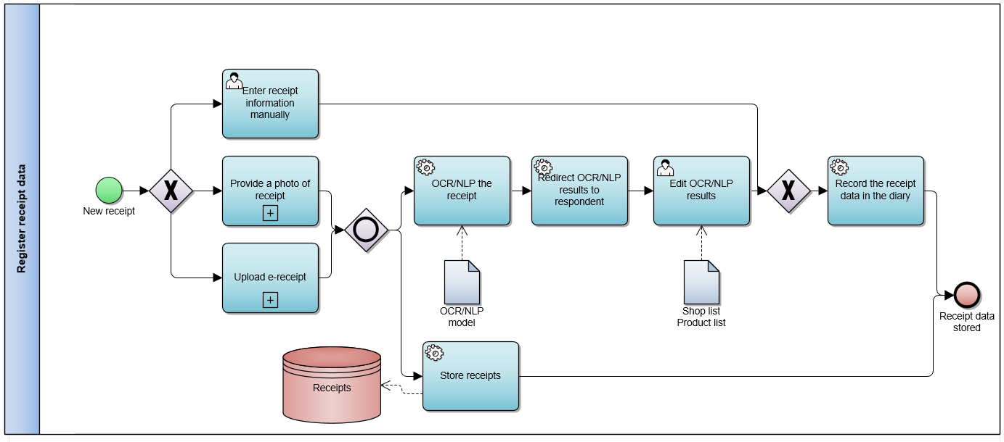
Also process examples provided
In our deliverable we also provide (parts of) example processes. This gives an NSI an idea how to use the building blocks. These are not ‘best practices’; it is not a prescriptive process! Each NSI has its own needs and should develop its own process.

Slide 15
Thank you for listening!
                Marc Houben
                Statistics Netherlands
                mhf.houben@cbs.nl

Slide 16
Smart Survey Implementation
Grant Agreement Number: 101119594 (2023-NL-SSI)
Workpackage 4: Business process perspective
Disclaimer: Views and opinions expressed are however those of the author(s) only and do not necessarily reflect those of the European Union or Eurostat.
Neither the European Union nor the granting authority can be held responsible for them.

Slide 17
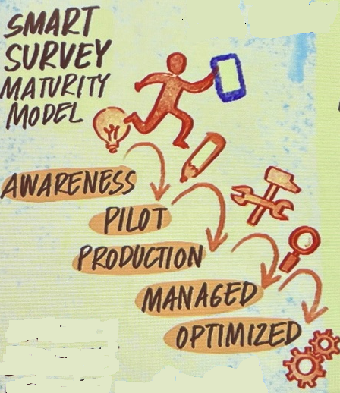
Topic 2
Smart survey maturity model
Drawing by Maria Foulquie (NTTS 2025)

Slide 18
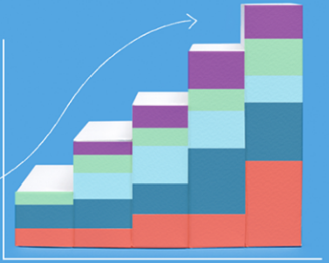
Maturity model
Goal of the Smart Survey Maturity Model:
  To help an NSI to assess how mature it is concerning the implementation of smart surveys.
  To give insight how to become more mature
The idea is that
an NSI should be mature enough to use smart solutions succesfully in surveys.

Slide 19
Inspiration
There are many examples of maturity models in this world:
We took them as an inspiration, but we needed a model with focus on smart surveys…
Model | Focus on
Capability maturity model (CMM) | Software development
Capability maturity model integration (CMMI) | Improving processes
Business maturity model (BMM) | Internal business administration
Data maturity model (DMM) | Data
Business process maturity model (BPMM) | Business process
…

Slide 20
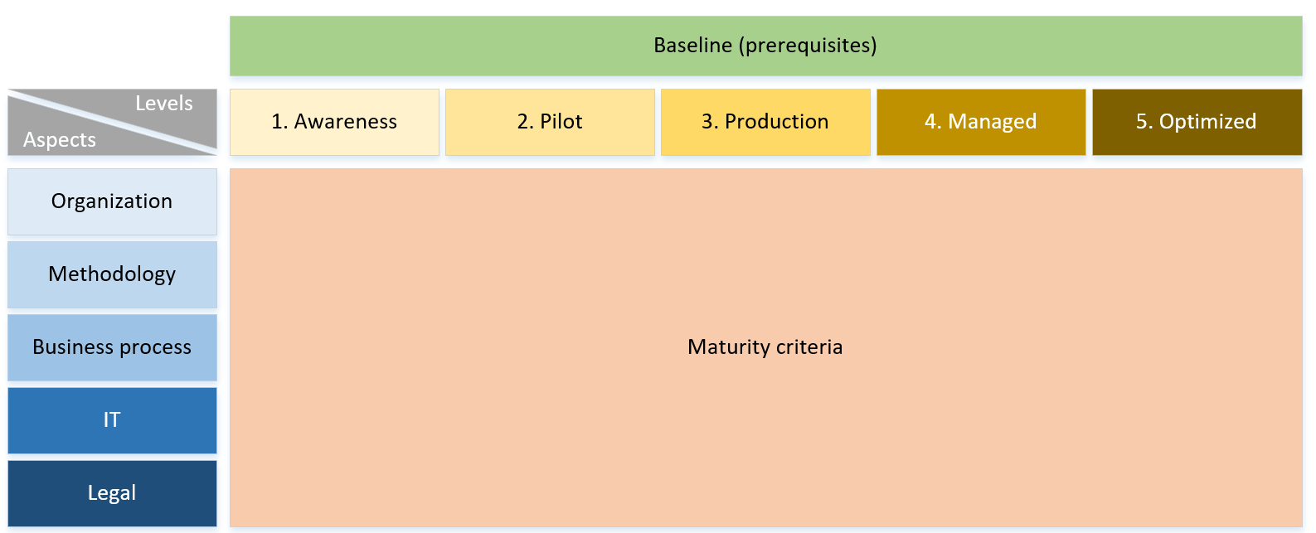
The framework of our model

Slide 21
Baseline
The Baseline shows some prerequisites to start with smart solutions and to use the model
Some example conditions:
  The NSI is organised in such a way that CAWI can be used as a collection mode, and cawi is suited for mobile devices
  The organization aims to innovate in the field of surveys
  Resources are available for innovation
  Sufficient infrastructure in country (e.g. GSM network)
  …

Slide 22
Focus areas
Methodology
Organization
- Survey & recruitment strategies, machine learning, …
- People/resources, business vision, business case, …
Business process
- Process, standardization, quality, actors, …
IT
Legal
- Development, functionality, infra, agility, …
- DPIA, risk assessment, compliance, privacy, …

Slide 23
Levels of maturity
Optimized
Continuous improvement, excellence, best in class
Managed
Standardized, in control, integrated, sharable
Production
Implemented, used in production process, applied, separate solutions
Pilot
Exploratory, investigating, starting, start-up, business case
Awareness
Pioneer, thinking, beginning, learning, literature

Slide 24

Level 1: Awareness
At the awareness level, an idea is initially suggested to use smart surveys as an observation mode. It is suspected that smart surveys can help with some issues that an NSI encounters or where an NSI sees opportunities to improve the process.
Some example criteria:
Methodologists (Research and Development) are in the lead. It leans on individuals. Some methodologists are very enthusiastic. Others sceptical. The rest of the organization is rather unaware.
The organization is still thinking in which situations smart surveys would add value
Some basic standalone proof-of-concepts are devised

Slide 25

Level 2: Pilot
More roles are involved at this level, although the number of roles is still limited. While the previous level was mainly focused on the idea of smart surveys (not how to apply the solution within the NSI), this level focuses more on the application of the solution within the organization. However, the application is not yet so specific that a statistic is created with the result.
Some example criteria:
Smart solution, as a subject, is mentioned in the vision of the NSI. The vision says that the subject should be investigated.
In-app respondent interaction is being evaluated and optimized through usability tests. Field tests are conducted.
A DPIA (including risk analysis) is available for each smart solution pilot and assessed by a legal officer.

Slide 26
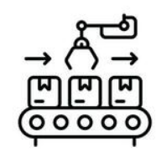
Level 3: Production
The organization is confident that it can create statistics with smart survey data, however the focus is probably on only one smart solution (e.g. receipt scanning). The process, IT, methodology and legal aspects are not standardized or generic, or in other words, are specific to one statistic. Processes are stovepipes, lot is custom-made.
Some example criteria:
The production department has the lead. The focus is on: “the job has to be done”.
The methodology used is proven and effective
There is a process for the data collection, but also for the processing and analyses sub processes.
A DPIA (including risk analysis) is available for each smart solution and assessed by a legal officer.

Slide 27
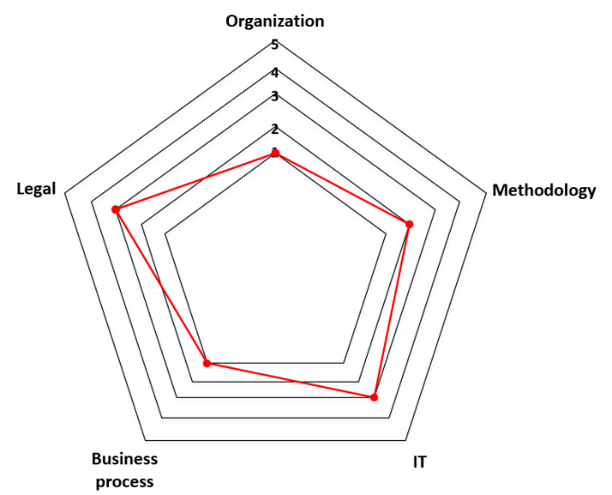
Maturity level
The idea is that the NSI scores each of the 5 aspects.
And perhaps the conclusion is that there is an imbalance between the aspects

Slide 28
When are you mature enough for using smart solutions?
Optimized
Continuous improvement, excellence, best in class
Managed
Standardized, in control, integrated, sharable
Production
Implemented, used in production process, applied, separate solutions
Pilot
Exploratory, investigating, starting, start-up, business case
Awareness
Pioneer, thinking, beginning, learning, literature

Slide 29
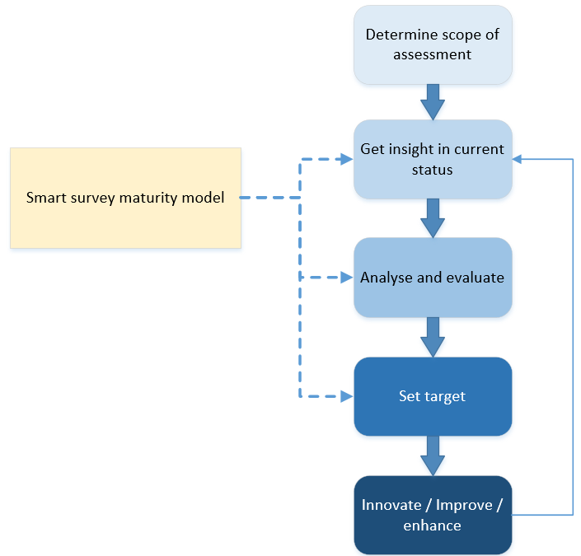
Maturity Assessment process

Slide 30
Maturity model
An NSI can have different business drivers (triggers) to conduct the maturity assessment:
Organizational readiness for process improvement: An NSI recognizes a need to use smart features in data collection and begins by assessing its current state.
Governance: The governance of smart surveys requires a maturity assessment for planning and establishing governance concerning smart solutions.
New technology: Advancements in technology offers new ways to use smart features. The NSI wants to understand the likelihood of successful adoption.
Smart survey issues: The NSI is confronted with smart survey issues, and the NSI wants to baseline its current state in order to make better decisions about how to address and solve the issues.

Slide 31
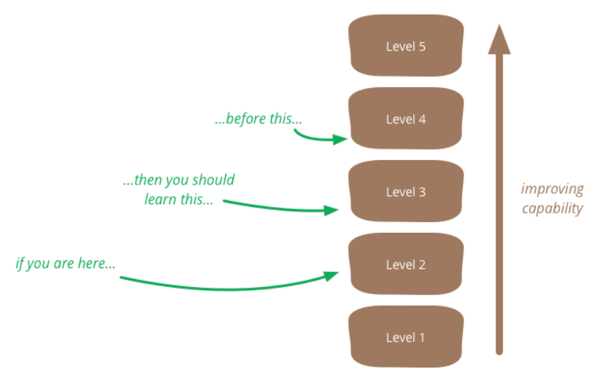
Setting the target

Slide 32

Manual
We also provide a manual
how to use the model
it gives alternatives on how to organise your assessment process

Slide 33
Thank you for listening!
                Marc Houben
                Statistics Netherlands
                mhf.houben@cbs.nl

