Slide 1












Smart Survey Implementation
Grant Agreement Number: 101119594 (2023-NL-SSI)
Development and Integration of Microservices
Thursday, 2025-04-03
Disclaimer: Views and opinions expressed are however those of the author(s) only and do not necessarily reflect those of the European Union or Eurostat.
Neither the European Union nor the granting authority can be held responsible for them.

Slide 2





Goals WP3 + integration to WP2.3
Development and Integration of Microservices
For Smart End-to-End Surveys
HBS
TUS
WP3
Joeri Minnen - hbits
HBS
Florian Keusch/Lasse Häufglöckner – UMA/Destatis
Joël Van Hoorde – Destatis
Jerome Olsen/Chris Lam – Destatis/CBS
WP2.3 - Theun Pieter van Tienoven - VUB
Noël Mingels - CBS
TUS
Enak Cortebeeck - hbits
Jonas Klingwort/Yvonne Gootzen - CBS
Claudia De Vitiis/Monica Perez - ISTAT
WP2.3 - Theun Pieter van Tienoven - VUB
Other authors besides the presenters: Pieter Beyens (hbits), Fabrizio De Fausti, Francesca Inglese, Angela Pappagallo, Marco Terribili (ISTAT)

Slide 3


Thursday 11am
Tasks in SSI
Task 1
Task 2
Task 3
Task 4
General Microservice Architecture
Integration Microservice(s)
Specific solution 1: HBS
Specific solution 2: TUS
Deployment strategies

Slide 4





European funded project to leverage Smart Survey Implementation (SSI): 8 countries
1
2
3
Receipt Scanning
GeoService
Energy usage
3 developments, one reusable and shareable architecture
Funded by the European Union. Views and opinions expressed are however those of the author(s) only and do not necessarily reflect those of the European Union or the European Research Executive Agency. Neither the European Union nor the granting authority can be held responsible for them

Slide 5
Road to production: challenges, stakeholders and innovation
1
Citizens: role as active contributors and stakeholders
2
Institutions: role as data collectors, funders and stakeholders
3
End-to-End solutions: integration of online methodes and modes + smart data collection solutions
4
Trustworthiness: guaranteeing strong privacy and security safeguards
Design
Collect
Smart data
Production

Slide 6


Non-Domain -and- Domain specific microservices for diary studies
First solution for HBS
Second solution for TUS
X
X
Receipt Scanning
COICOP classification
GeoService
HETUS classification
Non-domain
Domain
Non-domain
Domain

Slide 7
Task 1: General Microservice Architecture
Task 1
Task 2
Task 3
Task 4
General Microservice Architecture
Integration Microservice(s)
Specific solution 1: HBS
Specific solution 2: TUS
Deployment strategies

Slide 8
Microservice architecture and Integration to (any) data collection platform(s)
Data Collection Platform – Not part of the microservice
push message
push message
call
call
Message bus – Asynchronous Interface
API: request results, adds users
GUI: browse, edit, entries to db
Synchronous Interfaces
Websocket API
Synchronous Interface
push message
push message
push message
Datawriter
Writes/saves data from the backend to the microservice db
DataProcessor
Processes data
DataProcessor
DataProcessor
data
processor scaling
ro calculated results
rw
data
rw calculated results
Processor result DB
Avoid unnecessary recalculation in distributed environment
rw
data
ro
ro
Microservice DB master
Microservice DB replica
ro slave
replication
db scaling

Slide 9
Task 2: Integrate microservice to achieve End-to-End Solution
Task 1
Task 2
Task 3
Task 4
General Microservice Architecture
Integration Microservice(s)
Specific solution 1: HBS
Specific solution 2: TUS
Deployment strategies

Slide 10



Integration in 2 SSI platforms
Output Microservices
Adaptor APIs
Known
formats

Slide 11
End-to-End solution: integrating microservices to become smart
mobile app
Platform
-
Back-office
Configuration
Platform
-
Front-office
UI/UX app
Platform
-
Core
Microservice 1
AI/ML models
Platform
-
Core
Research
Database
-
Eurostat/NSI
Platform
-
Back-office
Platform
-
Front-office
UI/UX app
Platform
-
Core
Microservice 2
AI/ML models
Research
mobile/web app

Slide 12

Smart Data = Tentative data
User side
Tentative data
(measured data)
Committed data
Any type of smart data
Integration
UI/UX

Slide 13
Overall task: Deployment strategies
Task 1
Task 2
Task 3
Task 4
General Microservice Architecture
Integration Microservice(s)
Specific solution 1: HBS
Specific solution 2: TUS
Deployment strategies

Slide 14
Deployment strategies
Preferred
Scalability
High availibility
Maintainability
Security
hbits
external
Prod domain - #SaaS
Namespace - #NaaS
Containers - #CaaS
Native platform - #PaaS
Hosting product owner
Decoupling hardware infra
Full product infrastructure
All security updates
Only group role BO
MOTUS app hbits store
Connected services hbits
Short/exp. dev. cycle
Hosting product owner
Decoupling hardware infra
Logical & db isolation
All security updates
Admin role BO (db PO)
Namespace app hbits store
Connected services Client
Stories/issues/bugs inflow
Hosting by Client
Decoupling hardware infra
Images (managing, scaling)
Container/hardware Client
Own Core/BO installation
Domain app Client store
Connected services Client
Stories/issues/bugs inflow
Hosting by Client
Coupling hardware infra
Packages; own eco-system
Hardware security Client
Own Core/BO installation
Domain app Client store
Connected services Client
Periodic version release
Updates and support
Own control over privacy and security

Slide 15
Thursday 1pm
Task 3: Specific solution for HBS
Task 1
Task 2
Task 3
Task 4
General Microservice Architecture
Integration Microservice(s)
Specific solution 1: HBS
Specific solution 2: TUS
Deployment strategies

Slide 16
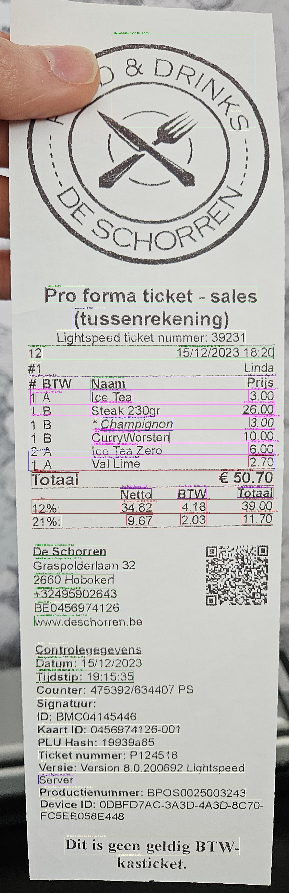
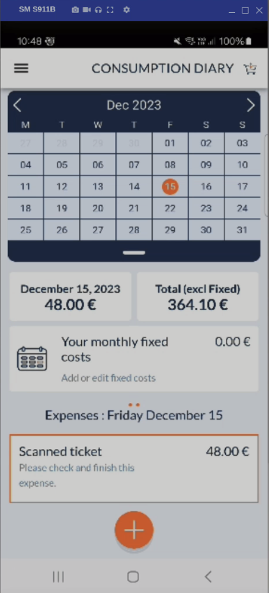
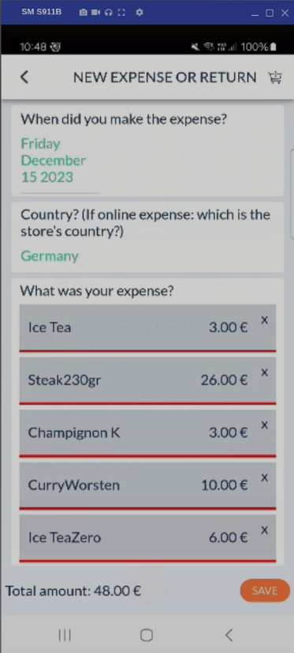

Recording: scan + front-office (non-domain)
Boxing text
1. OCR
2. Document understanding
Understanding text
Joeri

Slide 17
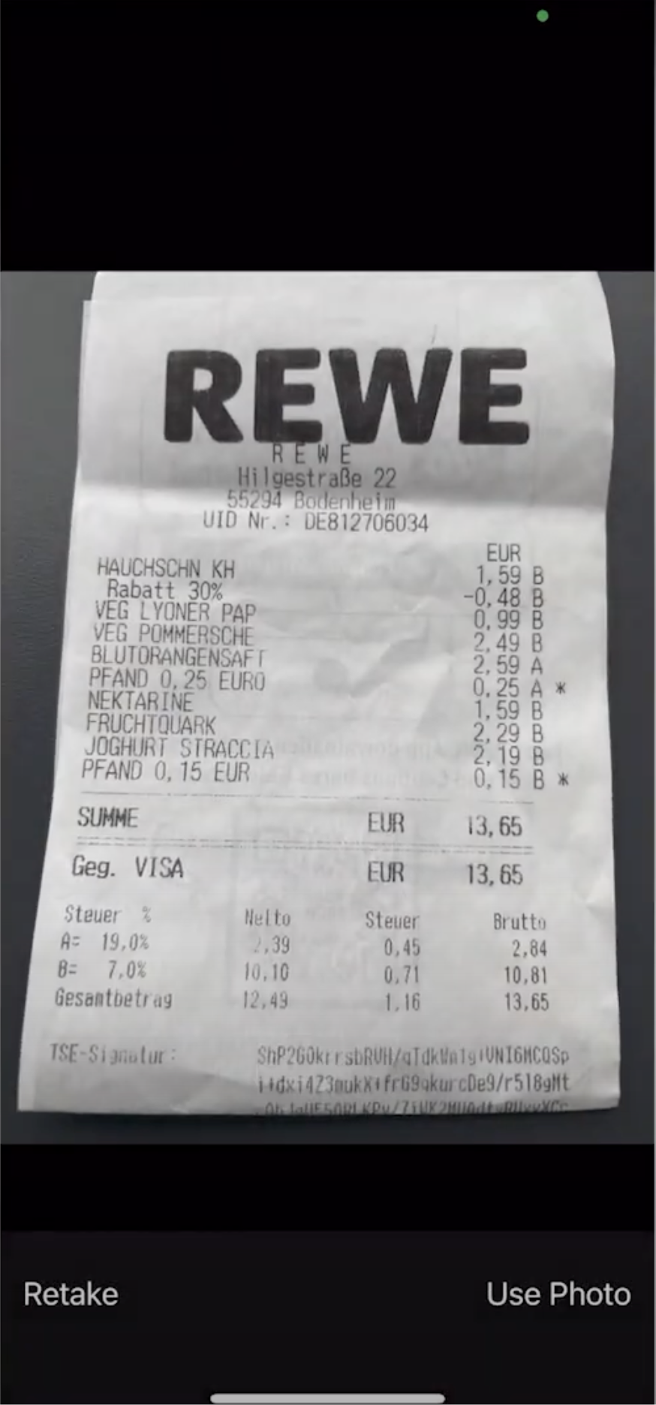
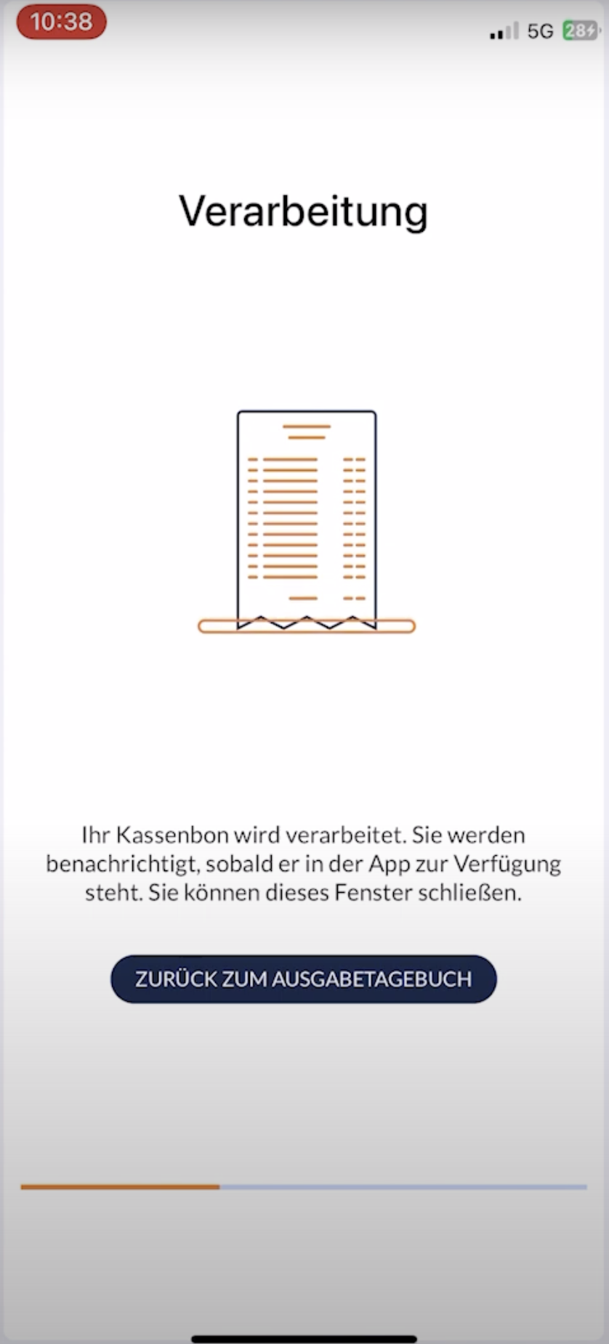
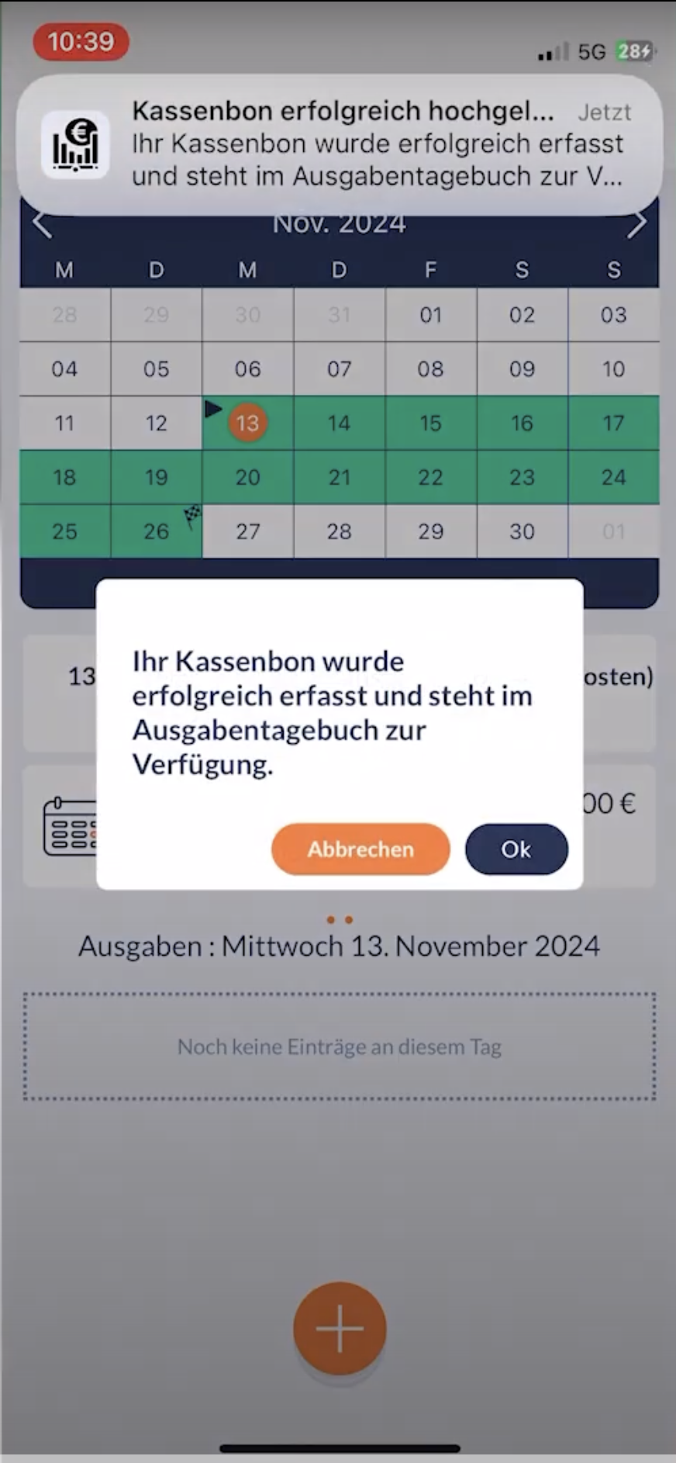
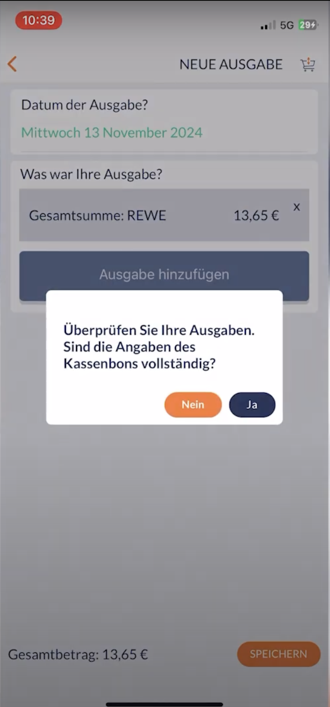
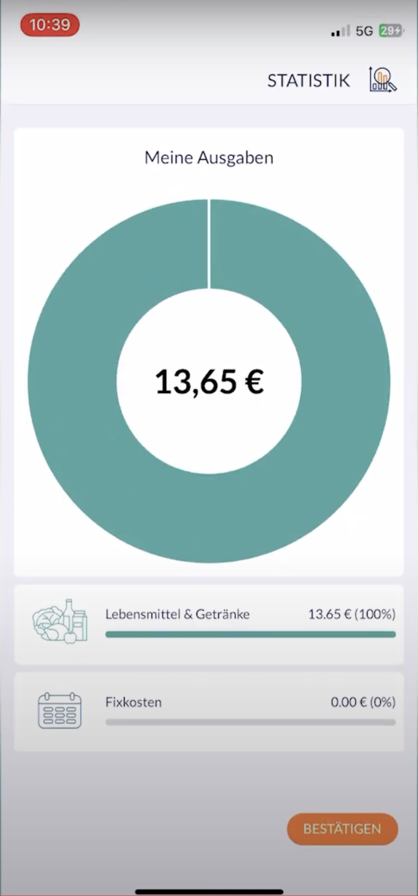

Recording: Namespace AusgabenAtlas UMA fieldwork
2. Document understanding
Shop
Total Price
Accounts with Maren
Florian & Lasse
Notes:
https://youtu.be/pXNSD5IW1zA

Slide 18
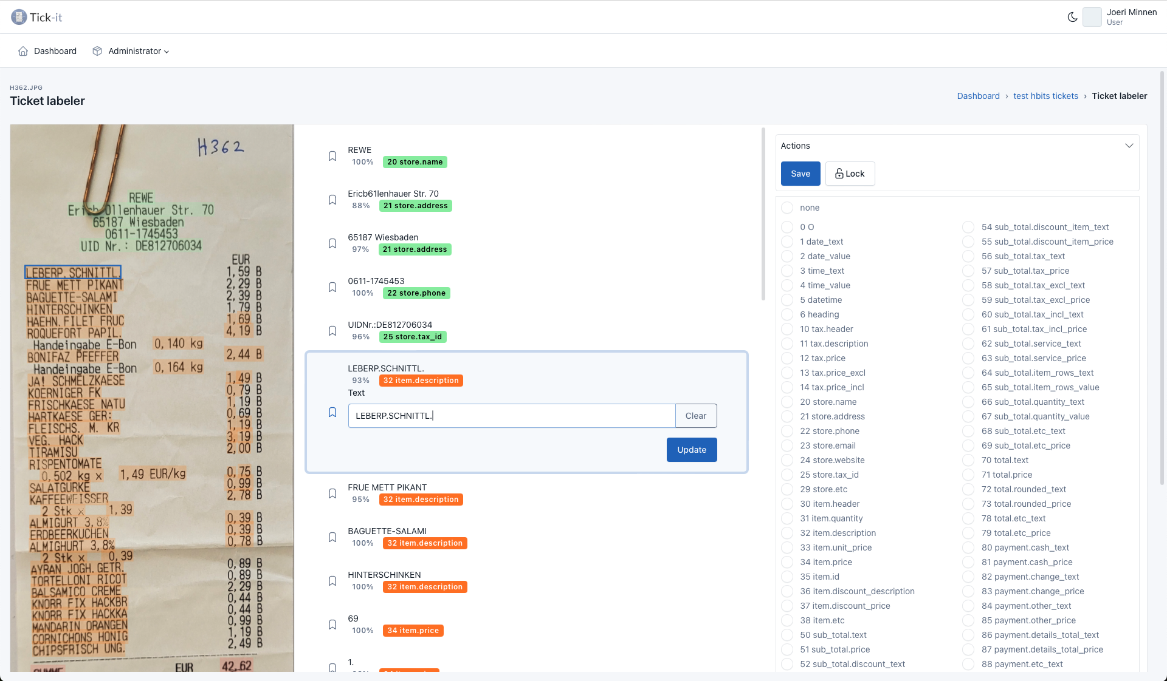
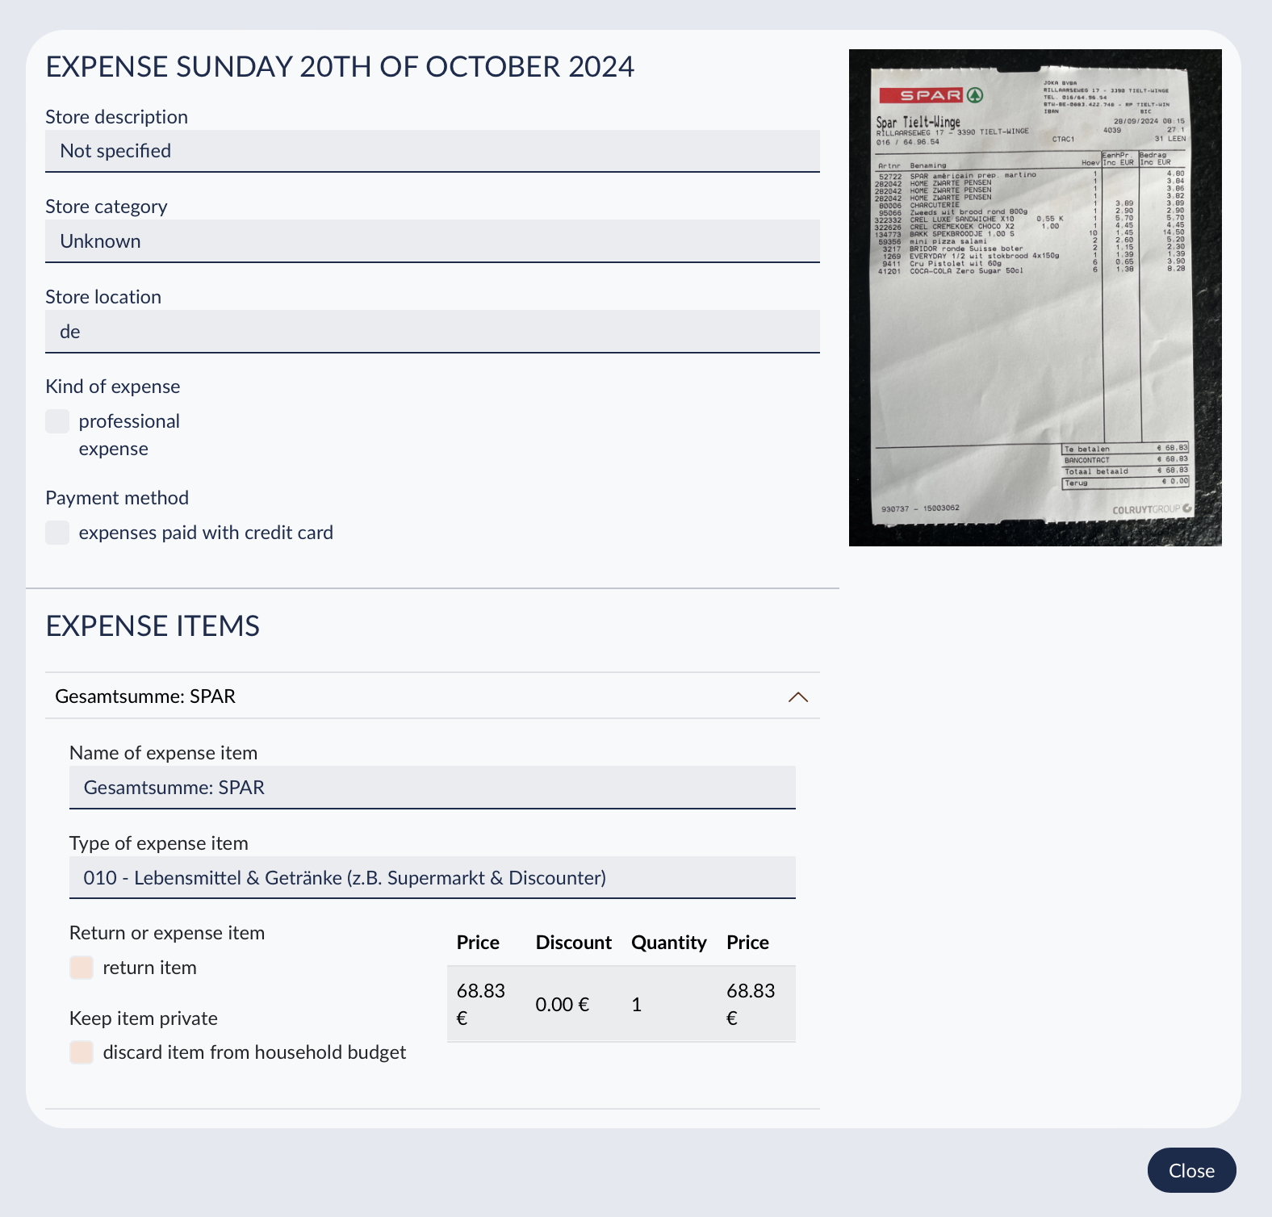

Recording: scan + annotation/training platform (training non-domain)
Tick-it – extending the pipeline to a training environment to create trained data or update data to new realities (https://tick-it.motusbuilder.io)
OCR’ed text
Researchers view
Label
Need for training data
Joël

Slide 19


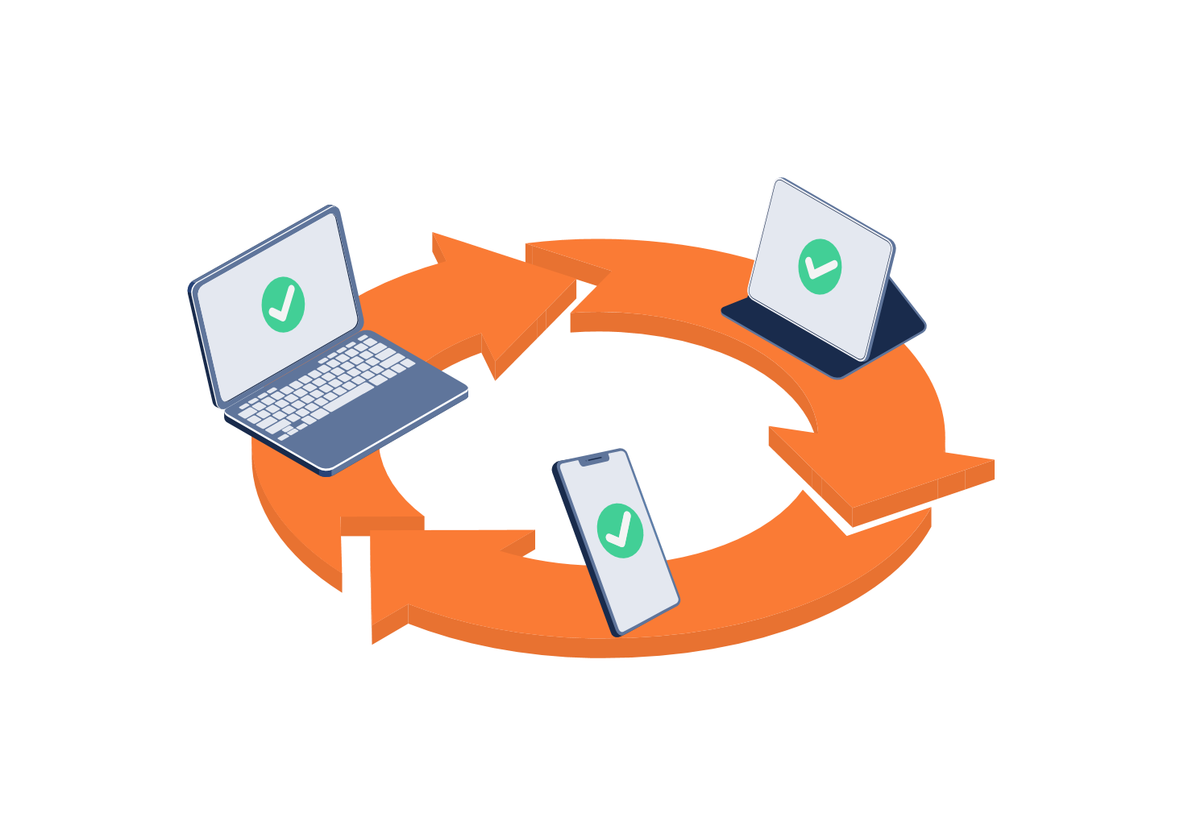
COICOP pipeline (domain)
Product descriptions
from receipt
Microservice
Post-survey
Matching/
training
data
COICOP code
Receipt
data
ATT1: Data corpus with data linked to COICOP-code
3. Manual coding by user
Pipeline
ATT2: Data corpus can be limited to specific domain(s)
1. String matching techniques
4. Post-coding by coders
2. Machine learning algorithms
Product ID matching
N-gram w/ logic regression
Str_which (exact)
N-gram w/ radom forest
Stringsim (similarity score)
Fast text
Jerome & Chris
Str_split (tokenized)

Slide 20
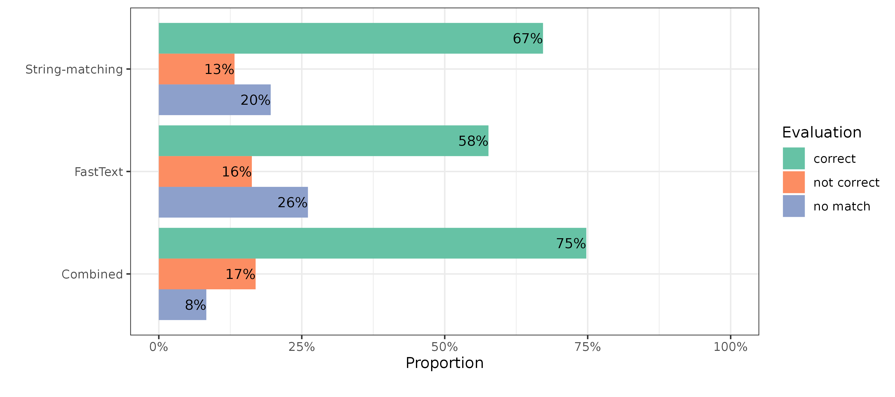
COICOP pipeline results with uncorrected strings (OCR errors)
Pipeline
Text with N = 2,274 product descriptions extracted from receipts
Jerome & Chris

Slide 21
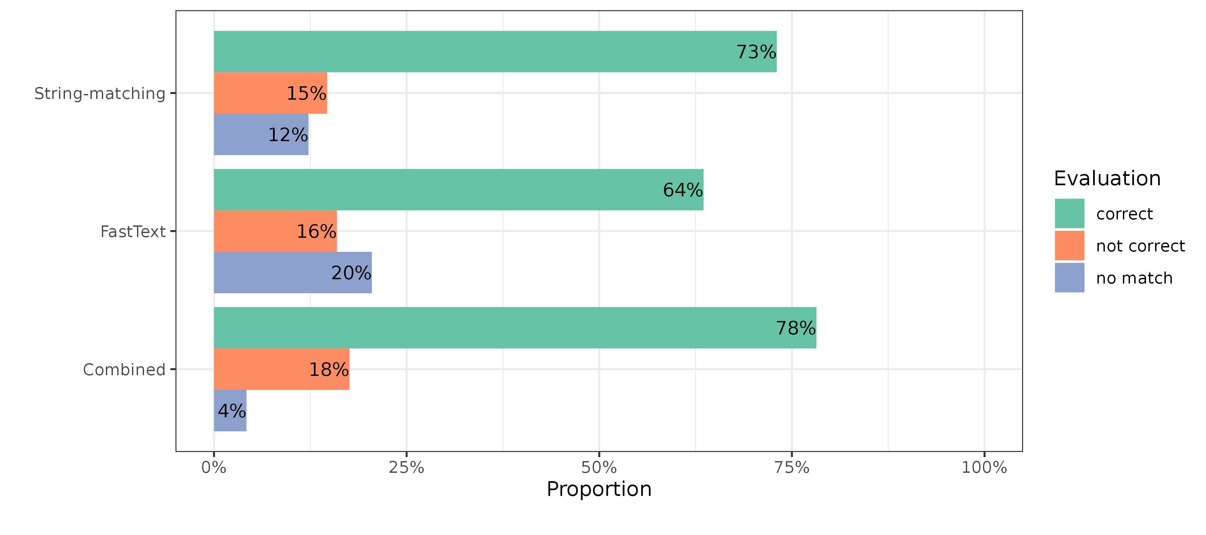
COICOP pipeline results with corrected strings (no OCR errors)
Pipeline
Text with N = 2,274 product descriptions extracted from receipts
Jerome & Chris

Slide 22
WP 2.3
Usability testing – Receipt Scanning
Context
Complex diary studies
Microservice linked to UI/UX
Smart solution
Clever solution
Trustworthy solution
Theun Pieter van Tienoven
Destatis – Insee – SSB – CSB – VUB

Slide 23
WP 2.3
Usability testing – Receipt Scanning
Context
Complex diary studies
Microservice linked to UI/UX
Smart solution
Clever solution
Trustworthy solution
Understand purpose and responsibility
No shared history or perspective
Theun Pieter van Tienoven
Destatis – Insee – SSB – CSB – VUB

Slide 24
WP 2.3
Usability testing – Receipt Scanning
Context
Complex diary studies
Microservice linked to UI/UX
Smart solution
Clever solution
Trustworthy solution
No one size fits all…
... but general points of attention
Theun Pieter van Tienoven
Destatis – Insee – SSB – CSB – VUB

Slide 25
WP 2.3
Usability testing – Receipt Scanning
Context
Complex diary studies
Microservice linked to UI/UX
Smart solution
Clever solution
Trustworthy solution
It is expected…
… but expectations are high
Theun Pieter van Tienoven
Destatis – Insee – SSB – CSB – VUB

Slide 26
WP 2.3
Usability testing – Receipt Scanning
Context
Complex diary studies
Microservice linked to UI/UX
Smart solution
Clever solution
Trustworthy solution
Yes and no
Tentative vs committed
Theun Pieter van Tienoven
Destatis – Insee – SSB – CSB – VUB

Slide 27
WP 2.3
Usability testing – Receipt Scanning
Context
Complex diary studies
Microservice linked to UI/UX
Smart solution
Clever solution
Trustworthy solution
Yes, if trust in issuing institute
Yes, if purpose is clear
Theun Pieter van Tienoven
Destatis – Insee – SSB – CSB – VUB

Slide 28
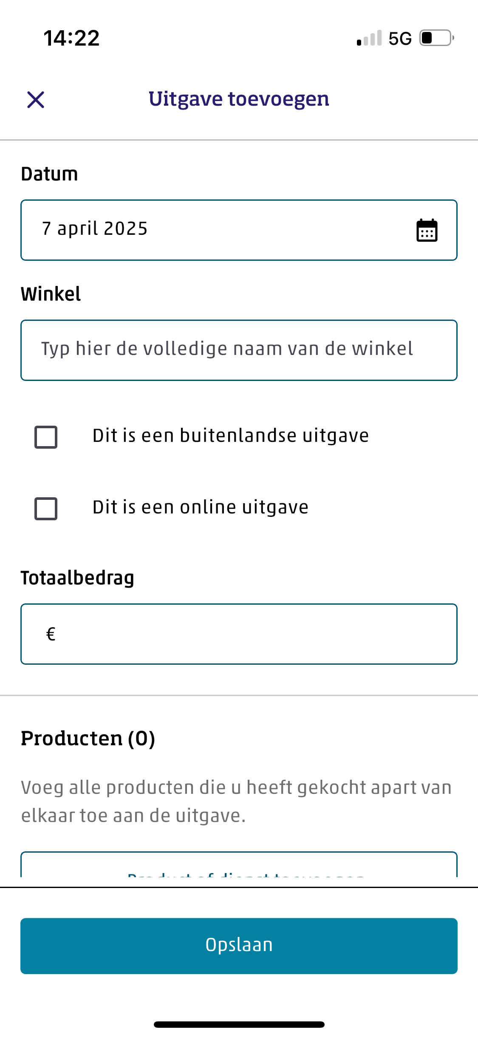
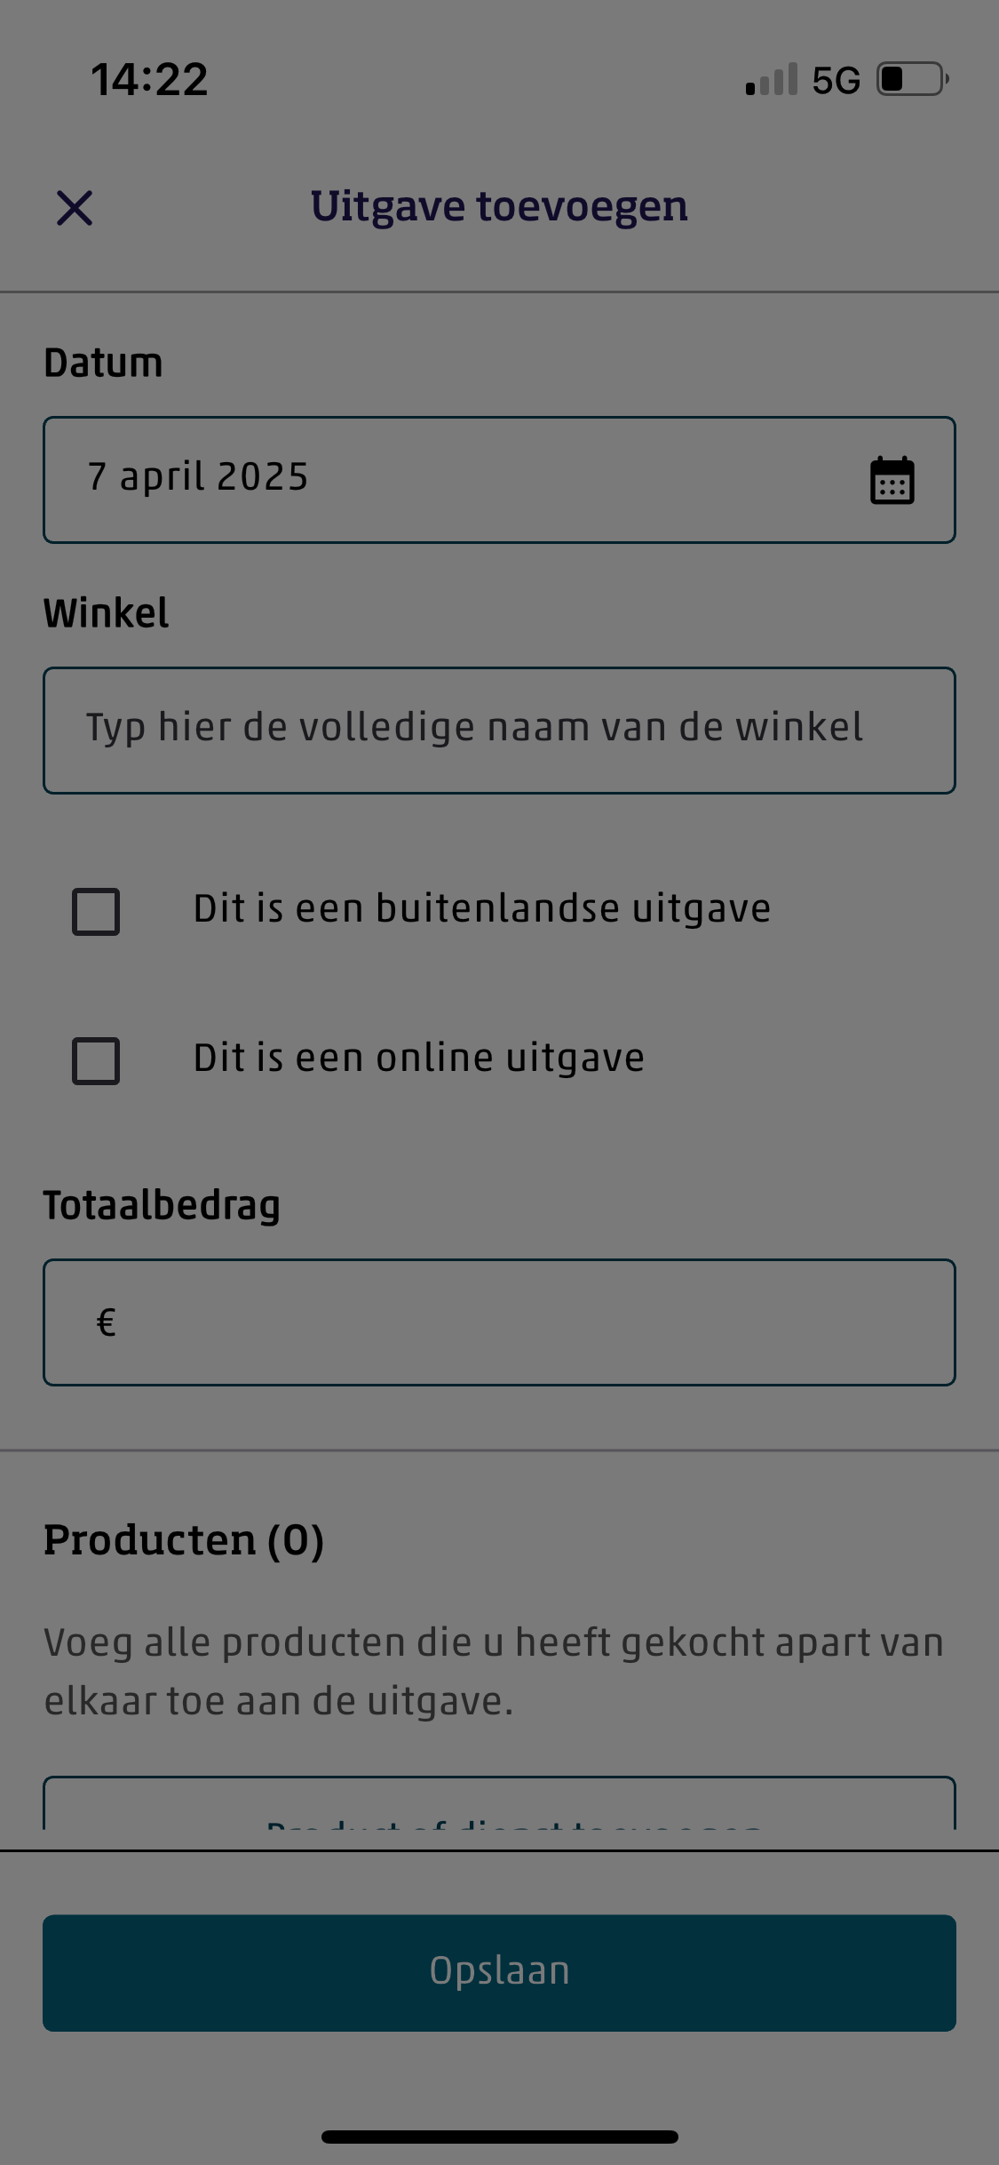
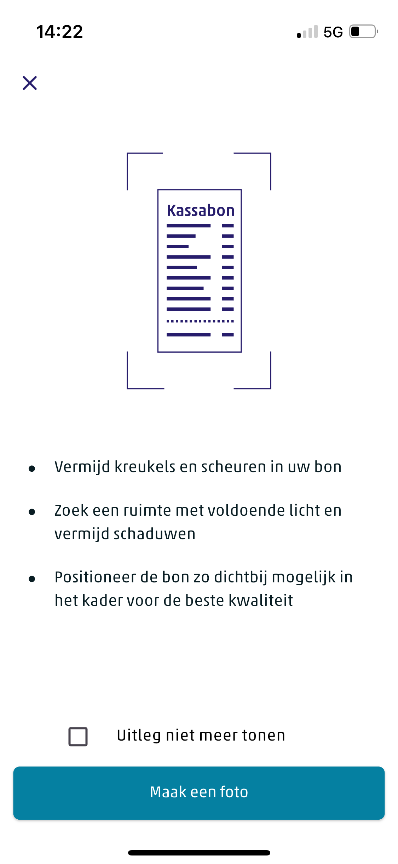
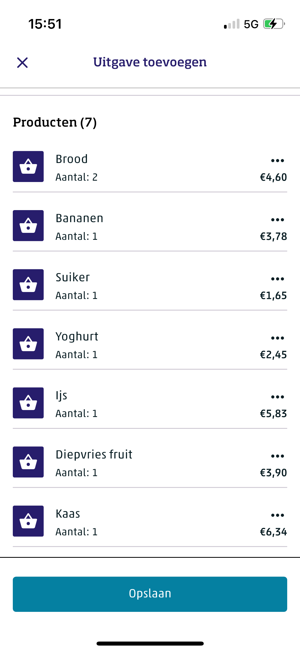
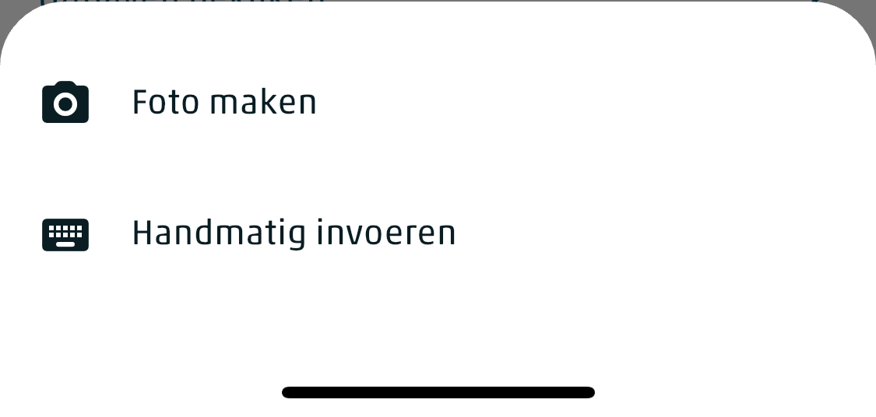
Planned integration OCR microservice
Instructions based on usability test
Choosing between receipt scanning or manual
Starting with some general information
Respondent checks OCR and document understanding results
Noël

Slide 29
Thursday 3pm
Task 4: Specific solution for TUS
Task 1
Task 2
Task 3
Task 4
General Microservice Architecture
Integration Microservice(s)
Specific solution 1: HBS
Specific solution 2: TUS
Deployment strategies

Slide 30
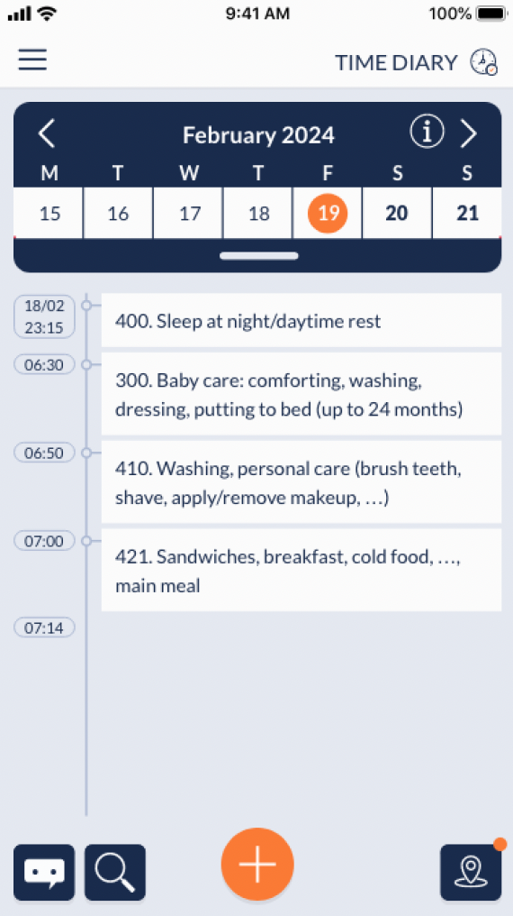
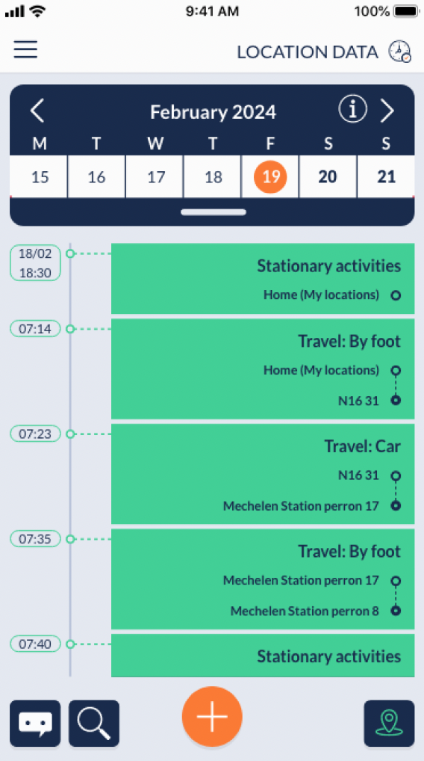
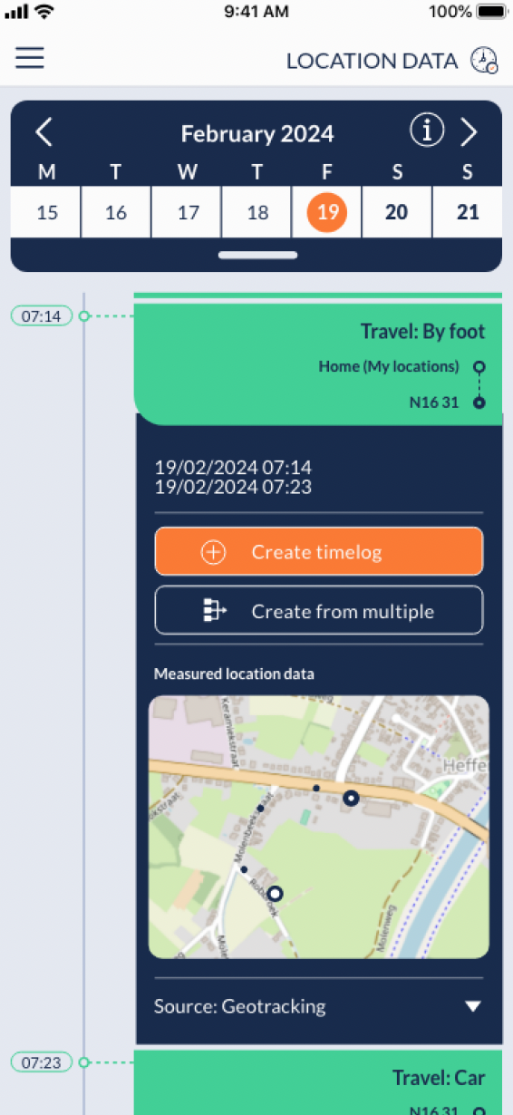
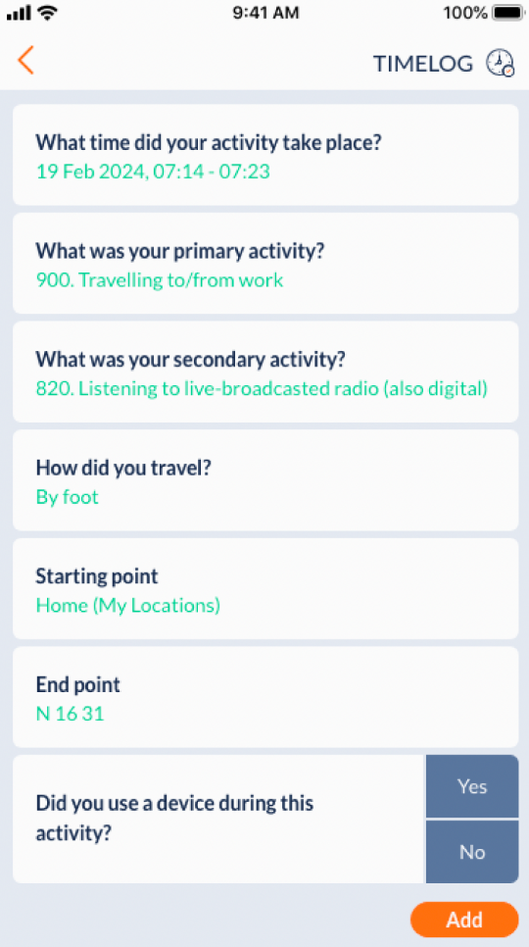
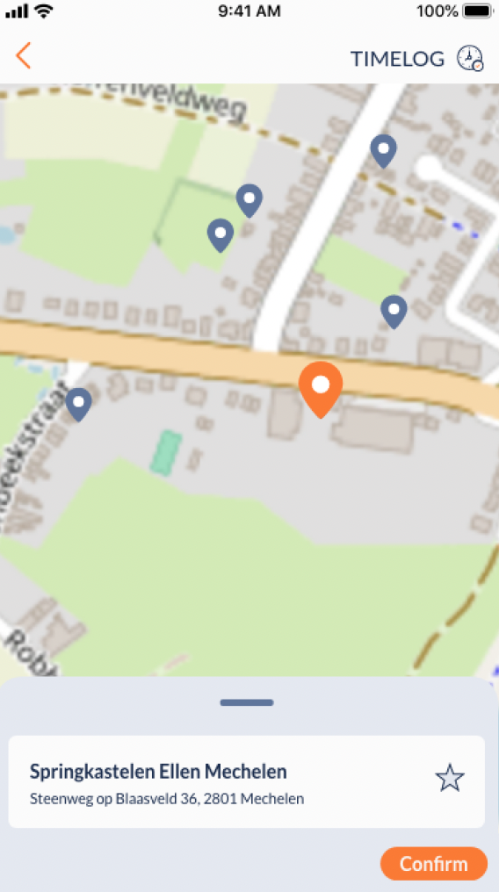

Recording: geopoints + back-office (visualisation domain/non-domain)
Timeline
Measured data
Detailed view
Adding context
Map visualisation
Enak

Slide 31
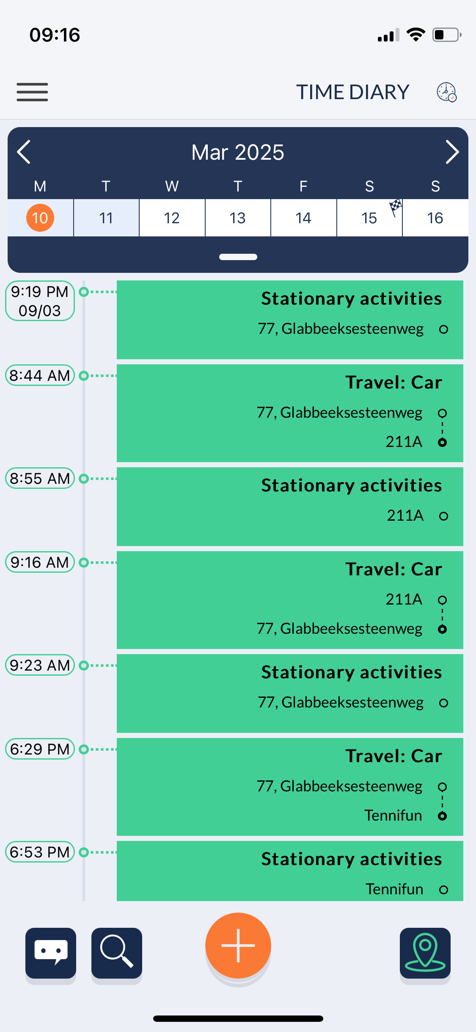
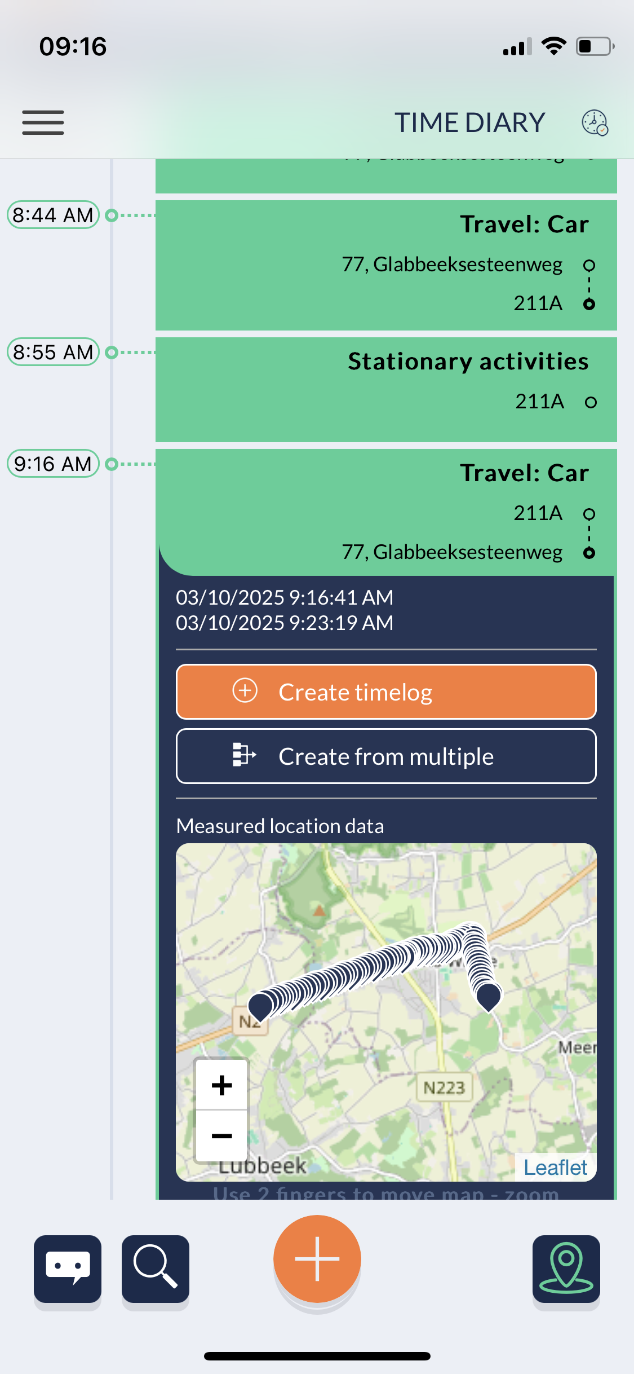
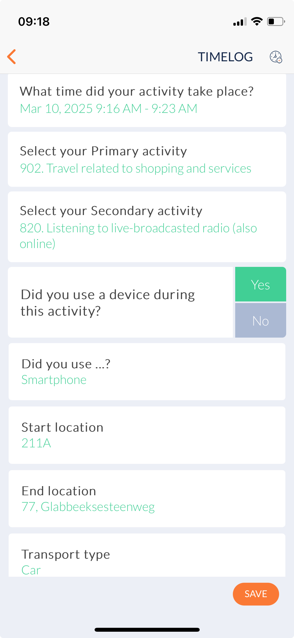
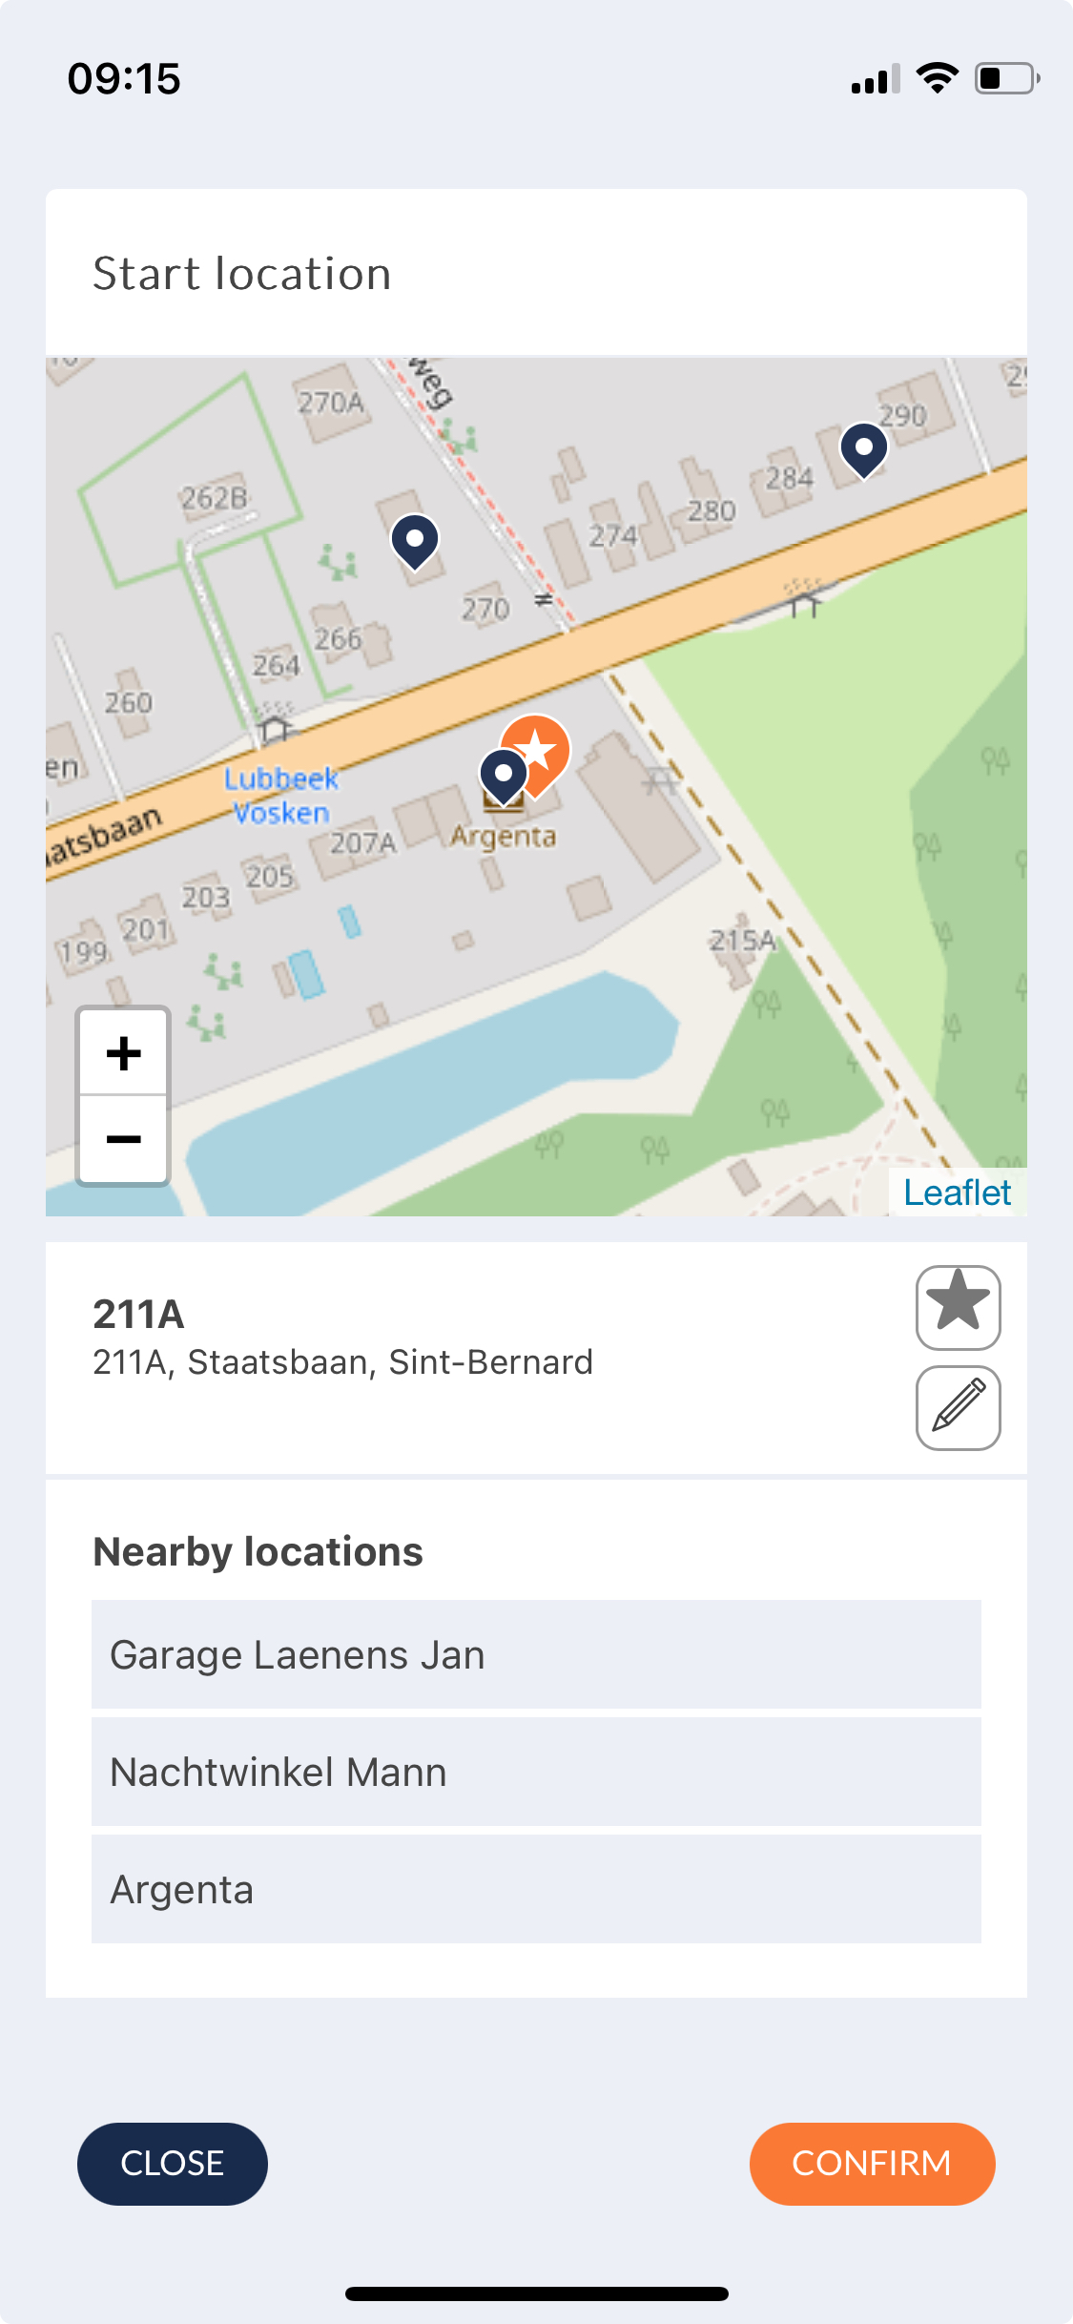
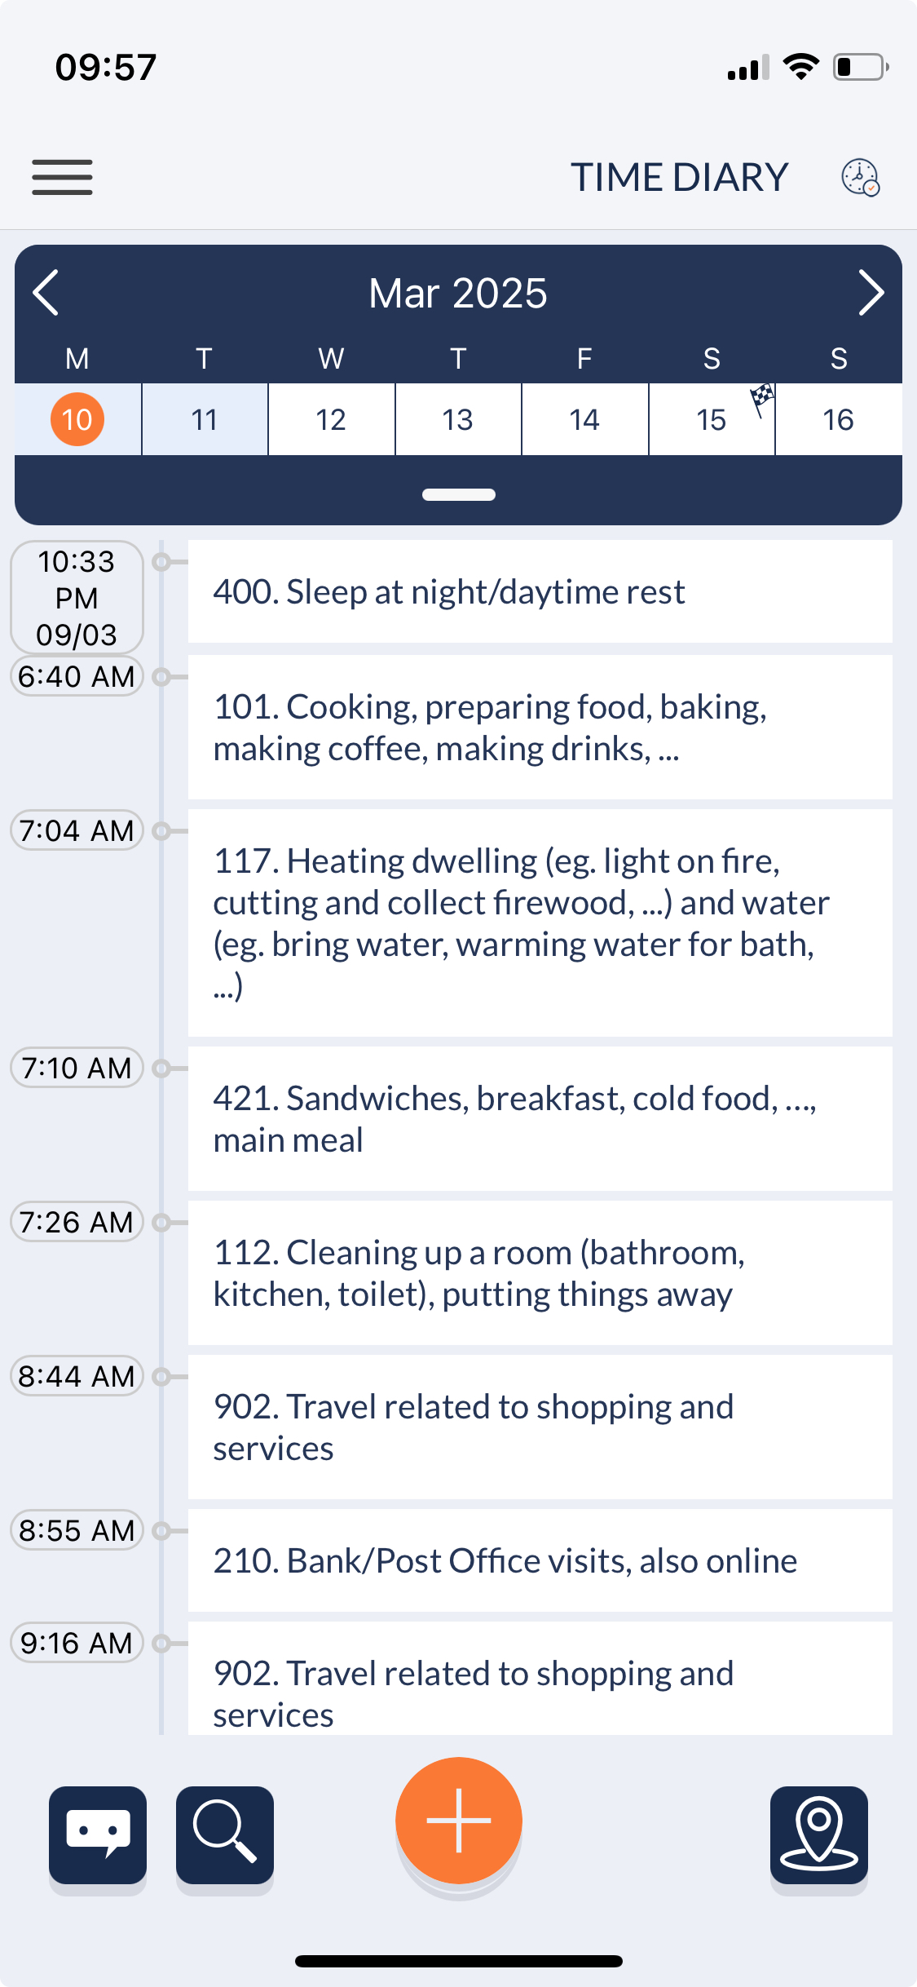
Front-office - March 10th – Car drive from home to bank (service)
Based on stop/track model ATS-OPTICS + OSM integration
Enak

Slide 32
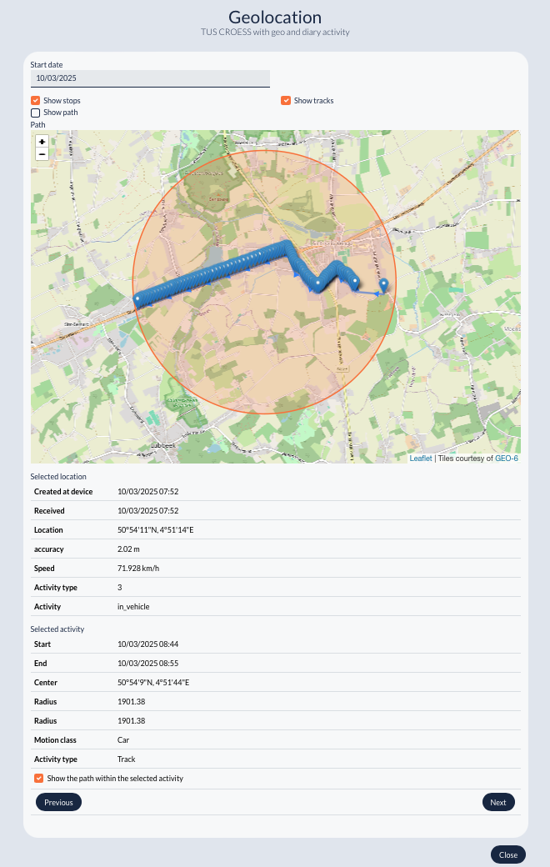
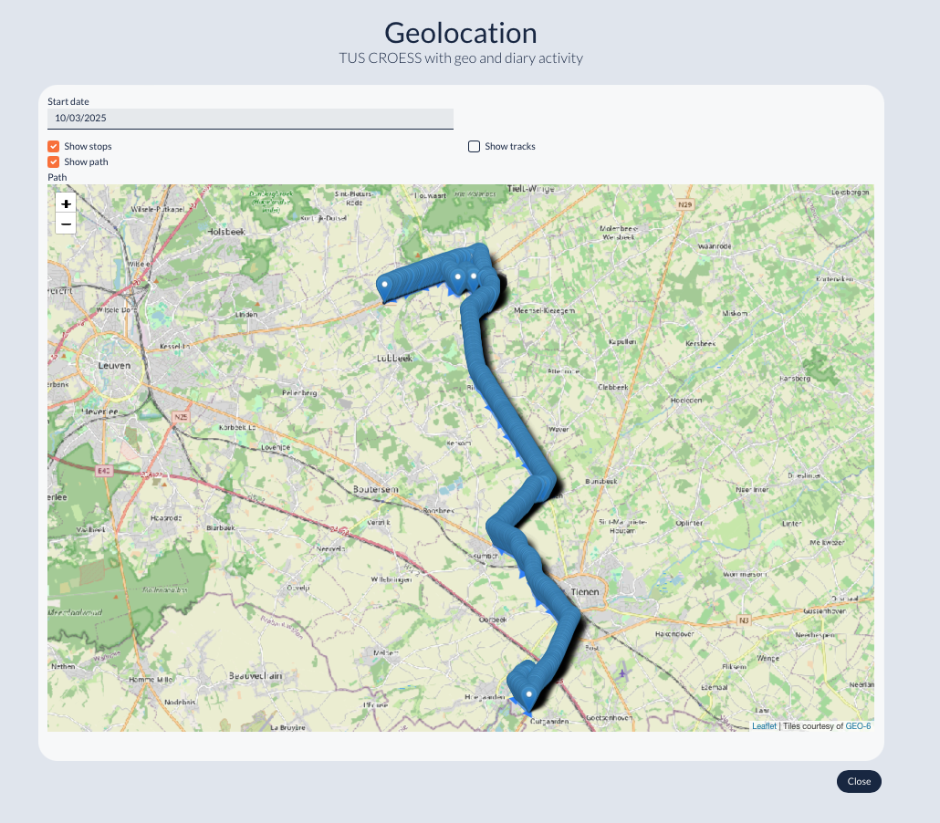
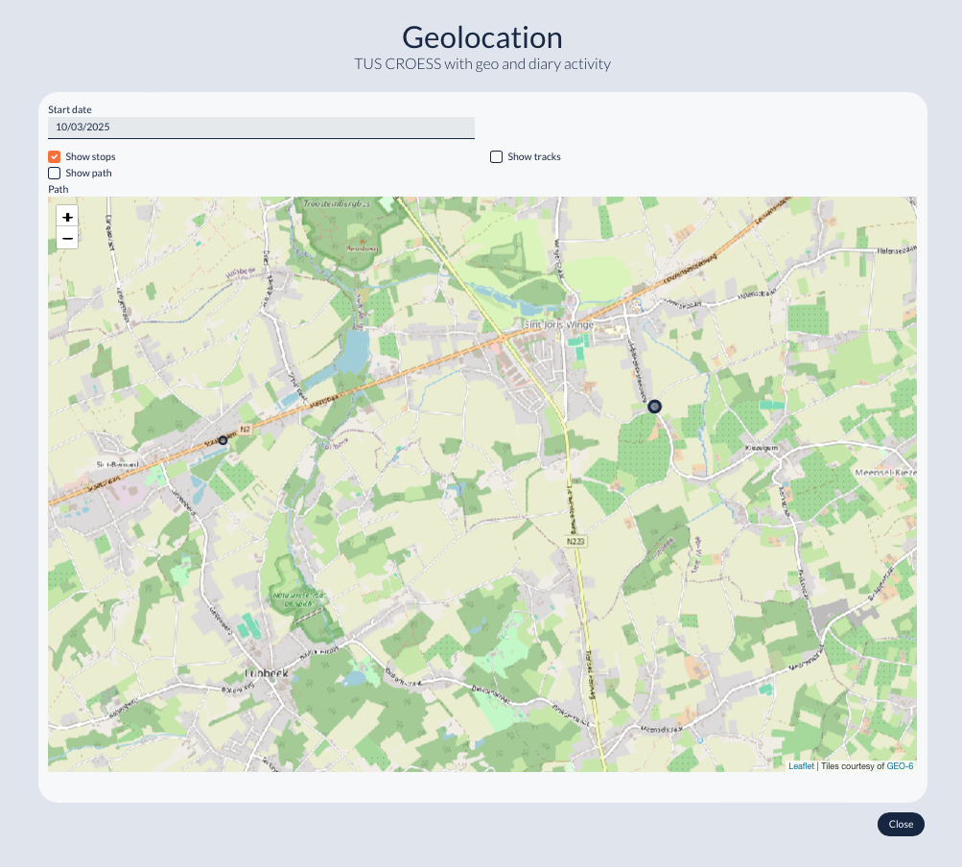
Back-office - March 10th – Car drive from home to bank (service)
Track (home-bank) + info
Geopoints 10.03
Related stop clusters (home-bank)
Enak

Slide 33
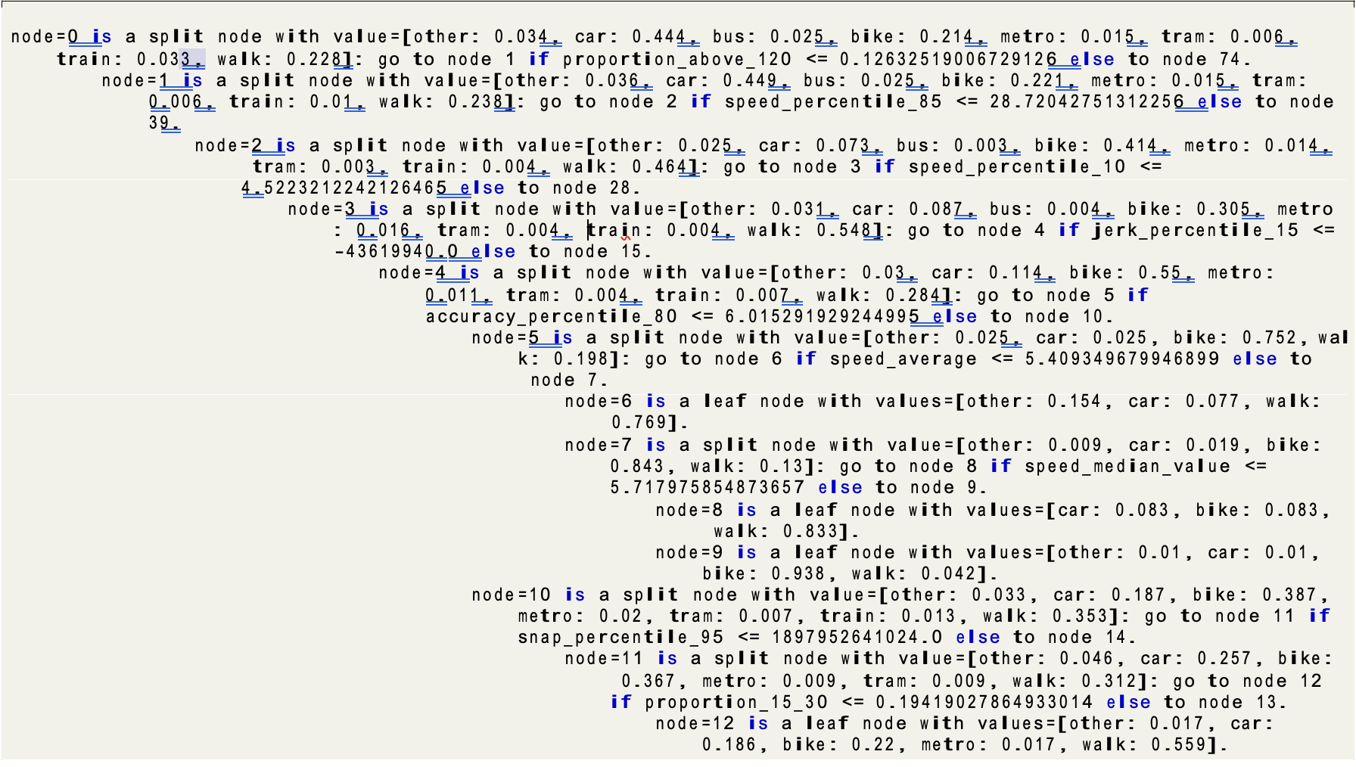
Geopoints + mode of transport (non-domain)
Decision-tree based prediction
Test data sets
Infrastructure data
+ interpretability
+ simplicity
Prediction algorithm
v
node = x
CBS dataset
  2022/2023
  N=255
  20 million GPS points
  4298 tracks, 7 modes
SSI dataset
  2024
  N=5
  420.000 GPS points
  137 tracks, 7 modes
  No car tracks
OSM data
200 features
  39 features select by decision tree
Most important
  GPS speed
  OSM proximity
Jonas & Yvonne

Slide 34
Results – CBS test set (non-domain)
Class | Precision | Recall | F1 | Support
Other | 0.00 | 0.00 | 0.00 | 8
Car | 0.89 | 0.82 | 0.85 | 559
Bus | 0.00 | 0.00 | 0.00 | 21
Bike | 0.71 | 0.82 | 0.76 | 303
Metro | 0.15 | 0.31 | 0.21 | 13
Tram | 0.00 | 0.00 | 0.00 | 14
Train | 0.78 | 0.87 | 0.82 | 62
Walk | 0.82 | 0.86 | 0.84 | 318
Performance varies widely across classes.
Car, bike, walking, and train -> good performance
Bus, metro, tram, and other -> poor performance
Model biased towards common classes, struggling to capture the nuances of less common transport modes.
Overall 80% accuracy
–
46% balanced accuracy
Jonas & Yvonne

Slide 35
Results – open geo-data test set (non-domain)
Class | Precision | Recall | F1 | Support
Bus | 0.00 | 0.00 | 0.00 | 5
Ferry | 0.00 | 0.00 | 0.00 | 3
Bike | 0.21 | 0.70 | 0.32 | 10
Metro | 0.11 | 0.20 | 0.14 | 5
Tram | 0.00 | 0.00 | 0.00 | 27
Train | 0.86 | 0.67 | 0.75 | 9
Walking | 0.96 | 0.67 | 0.79 | 78
Walking and train -> relatively good performance
Bike -> moderate performance
Bus, tram, metro -> poor performance
Substantial class imbalances and misclassification issues.
Overall 48% accuracy
–
32% balanced accuracy
Jonas & Yvonne

Slide 36
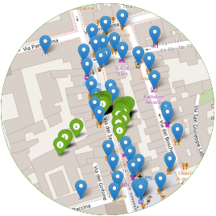
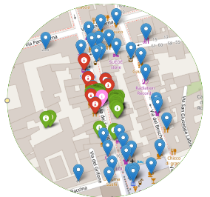
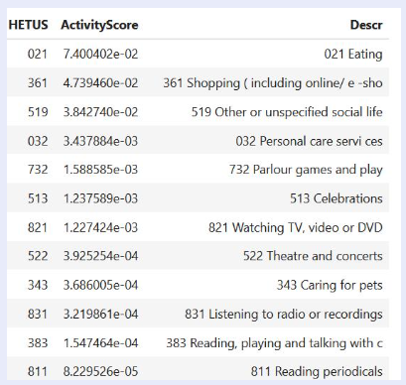
HETUS pipeline (domain)
1
GPS points (blue)
POIs (green)
MOTUS app
with sensors
OSM database
MOTUS core
GeoService
2
POIs short list
HETUS classification
3
Stop
x
ordered list HETUS
Claudia

Slide 37
HETUS pipeline (domain)
1
Time, Duration
Tracking plugin
GPS points (blue)
POI attributes (name, place category, opening/closing hours)
POIs (green)
MOTUS app
with sensors
Centroid Coordinates, Radius, GPS accurancy
OSM database
MOTUS core
GeoService
2
POIs short list
HETUS classification
Background information
3
Stop
x
ordered list HETUS
Claudia

Slide 38
HETUS pipeline (domain)
1
Time, Duration
Tracking plugin
GPS points (blue)
POI attributes (name, place category, opening/closing hours)
POIs (green)
MOTUS app
with sensors
Centroid Coordinates, Radius, GPS accurancy
OSM database
MOTUS core
GeoService
2
POIs short list
HETUS classification
1. Selection of candidate POIs
  POI-score (weighted median distance POI x GPS)
  Short list POIs
2. Activity prediction based on TUS probabilistic model
  Conditional (Bayesian decomposition) x TUS data + background data
  Stop x ordered list HETUS codes
Background information
3
Stop
x
ordered list HETUS
Claudia

Slide 39
HETUS Activity prediction (domain)
Segmented STOPS |  | Google places | OSM
Stop segmented by ATS/OPTICS |  | 111 | 11
Stop with duration > 5 min |  | 83 | 83
Stop with POIs useful for activity prediction |  | 71 | 56
Stops with identified POIs (not labelled home/work) |  | 21 | 24
Rank | Evaluation | Google places | OSM
Top 1 | CORRECT | 11 | 7
(highest score) | NOT CORRECT | 10 | 17
Top 2 | CORRECT | 12 | 8
(two highest scores) | NOT CORRECT | 9 | 16
Top 3 | CORRECT | 13 | 8
(three highest scores) | NOT CORRECT | 8 | 16
The algorithm works well when the auxiliary information is available.
If there are no POIs, the prediction is not obtainable (most of the cases)
The prediction improves when more than one activity is selected
OSM is a lower quality auxiliary source then Google Places as it contains fewer POIs and this affects the activity prediction
CBS-odin app, few users Italy

Slide 40
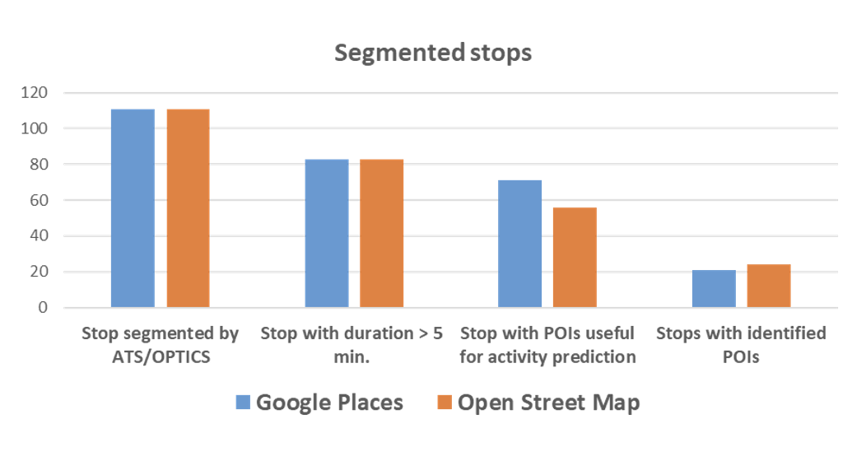
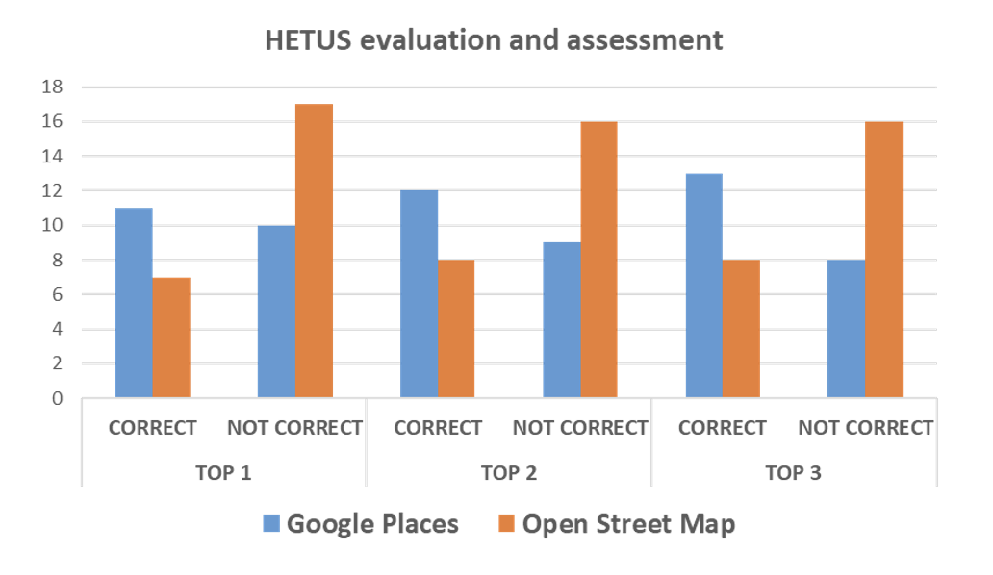
HETUS Activity prediction (domain)
CBS-odin app, few users Italy

Slide 41
WP 2.3
Usability testing – Geolocation
Context
Difference between microservices
Microservice linked to UI/UX
Smart solution
Clever solution
Trustworthy solution
Theun Pieter van Tienoven
Destatis – Istat –Statbel/VUB

Slide 42
WP 2.3
Usability testing – Geolocation
Context
Difference between microservices
Microservice linked to UI/UX
Smart solution
Clever solution
Trustworthy solution
Not single task-oriented
Versatile microservice
Theun Pieter van Tienoven
Destatis – Istat –Statbel VUB

Slide 43
WP 2.3
Usability testing – Geolocation
Context
Difference between microservices
Microservice linked to UI/UX
Smart solution
Clever solution
Trustworthy solution
No one size fits all…
... but general points of attention
Theun Pieter van Tienoven
Destatis – Istat –Statbel/VUB

Slide 44
WP 2.3
Usability testing – Geolocation
Context
Difference between microservices
Microservice linked to UI/UX
Smart solution
Clever solution
Trustworthy solution
Yes, for mobility…
… but limited for TUS
Theun Pieter van Tienoven
Destatis – Istat –Statbel/VUB

Slide 45
WP 2.3
Usability testing – Geolocation
Context
Difference between microservices
Microservice linked to UI/UX
Smart solution
Clever solution
Trustworthy solution
“The devil’s in the detail” (2 times)
Theun Pieter van Tienoven
Destatis – Istat –Statbel/VUB

Slide 46
WP 2.3
Usability testing – Geolocation
Context
Difference between microservices
Microservice linked to UI/UX
Smart solution
Clever solution
Trustworthy solution
Yes, for supportive geolocation…
... no, for controlling geolocation
Theun Pieter van Tienoven
Destatis – Istat –Statbel/VUB

Slide 47

Contact details
hbits CV
Joeri Minnen – Managing Director
Joeri.Minnen@hbits.io
Joeri.Minnen@vub.be (as volunteer)

