Slide 1












Smart Survey Implementation
Grant Agreement Number: 101119594 (2023-NL-SSI)
Workpackage 2: an end-to-end methodology final SSI conference, thursday, 2025-04-03, Heerlen
Disclaimer: Views and opinions expressed are however those of the author(s) only and do not necessarily reflect those of the European Union or Eurostat.
Neither the European Union nor the granting authority can be held responsible for them.

Slide 2
Authors workpackage 2
Maren Fritz & Florian Keusch, University of Mannheim, Germany
Johannes Volk, Lasse Häufglöckner & Karen Blanke, DESTATIS, Germany
Claudia de Vitiis, Fabrizio de Fausti, Francesca Inglese, Marco Terribili & Monica Perez, ISTAT, Italy
Theun-Pieter van Tienoven, Vrije Universiteit Brussel, Belgium
Patrick Lusyne, Statistics Belgium, Belgium
Danielle McCool, Peter Lugtig & Bella Struminskaya, Utrecht University, the Netherlands
Anne Elevelt, Jelmer de Groot, Maaike Kompier, Barry Schouten, Jonas Klingwort & Janelle van den Heuvel, Statistics Netherlands, the Netherlands
Julie Solard, Simon Quentin, Fanny Mikkol, INSEE, France
Nina Berg & Aina Holmøy, SSB, Norway

Slide 3
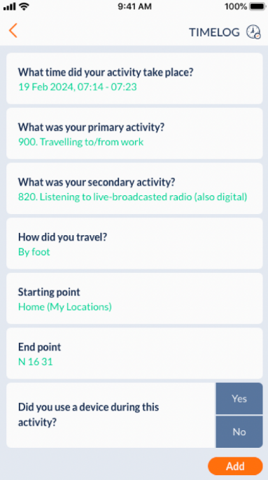
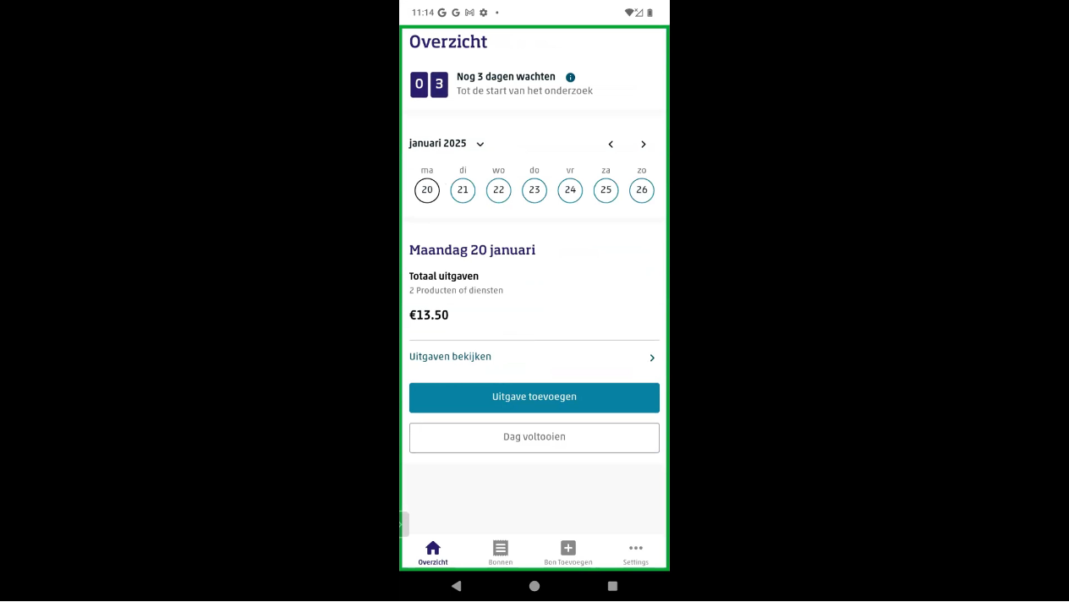
Workpackage 2 – smart diary studies
Time use
Household budget survey

Slide 4
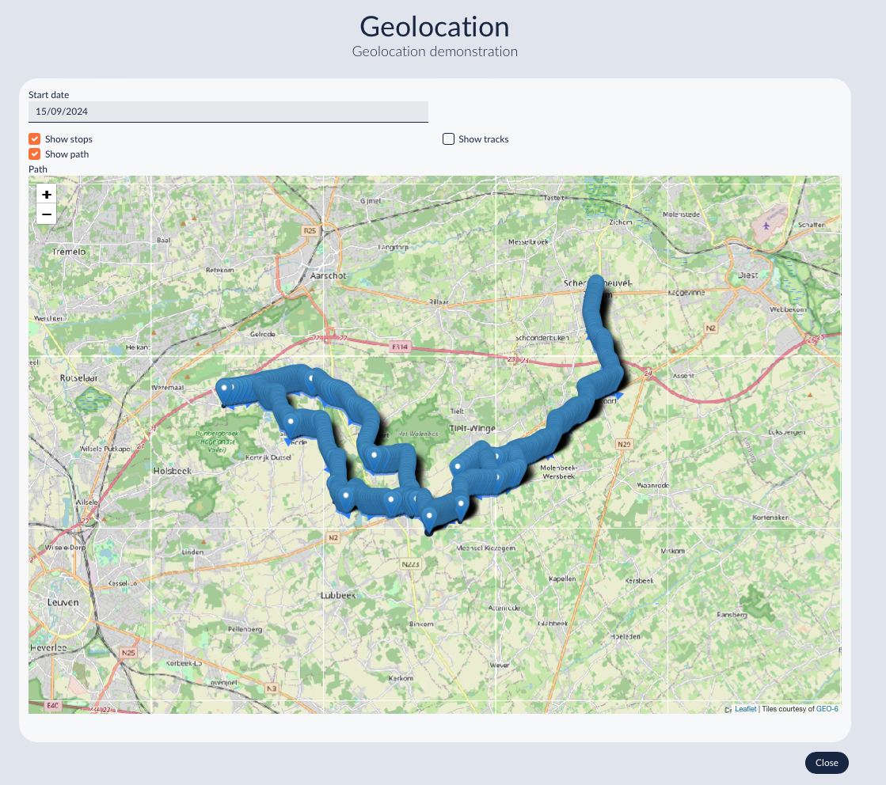
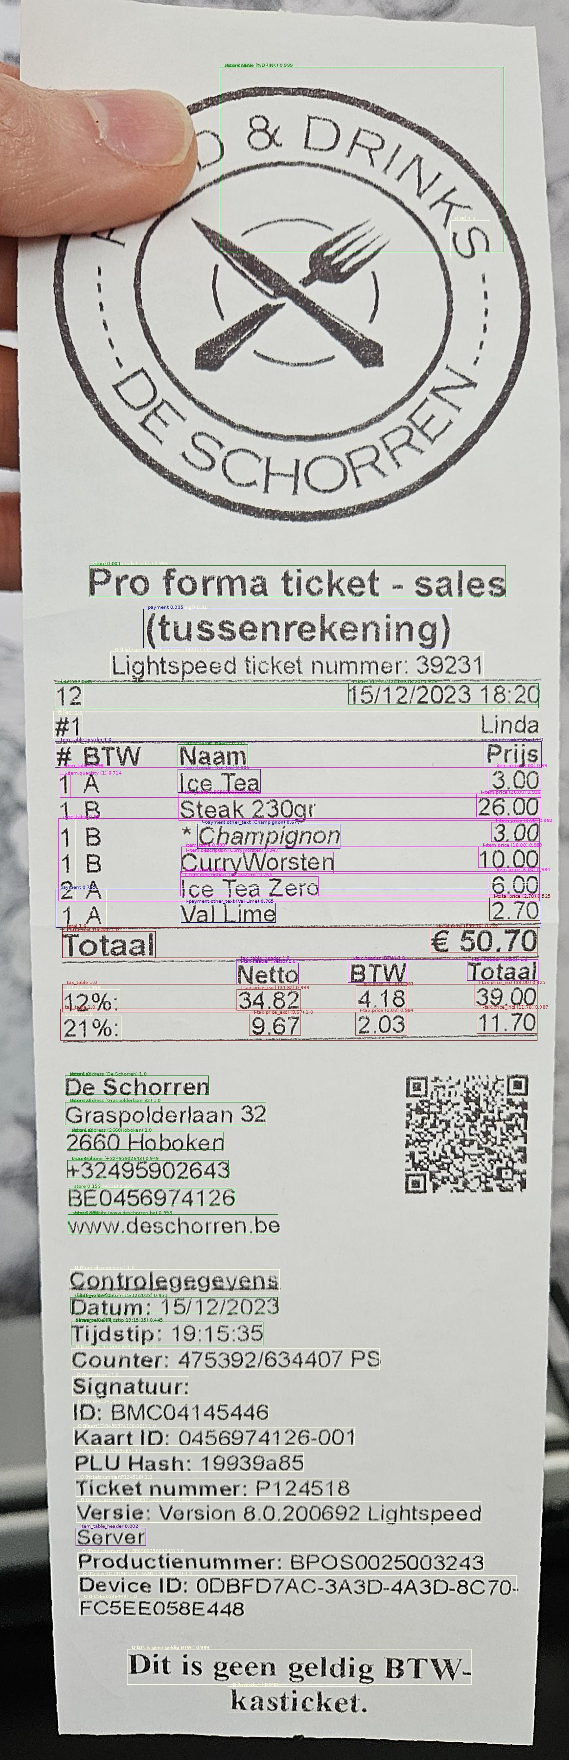
Workpackage 2 – smart data in diaries
Geotracking using location sensors
Time use
Household budget survey
Receipts using camera

Slide 5
Workpackage 2 - subtasks
Task 1: How do we recruit respondents succesfully for smart surveys? (University Mannheim)

Slide 6
Workpackage 2
Task 1: How do we recruit respondents succesfully for smart surveys? (University Mannheim)
Task 2: How should we use Machine Learning to use smart data succesfully (Istat)

Slide 7
Workpackage 2
Task 1: How do we recruit respondents succesfully for smart surveys? (University Mannheim)
Task 2: How should we use Machine Learning to use smart data succesfully? (Istat)
Task 3: Issues of User Experience & User interaction. How do we let respondents interact with smart data? (Vrije Universiteit Brussel)
Task 4: how do we combine data from smart surveys with traditional data (web or paper diaries)? (Utrecht University)

Slide 8
Workpackage 2
M6 deliverable: review and key questions
M14 deliverable: design of studies
What have we done?
Small-scale tests in all SSI countries to test different UX/UI issues across different apps, countries and use cases (Time Use, Budget study)
Large scale experiments in France, Belgium, Norway & Germany to test how to recruit respondents, and how to combine data
Review smart data collected, how to process, (re)train models, when to feed to respondents

Slide 9
Task 1: Recruitment for Smart Surveys
Success of smart surveys highly depends on getting participants to commit
Aim: ensure participation of sample close to population to obtain reliable and valid data for official statistics in Europe
Recruitment experiments carried out in Belgium, Germany, and Norway as part of large field tests with smart surveys
Goal: refining and improving recruitment strategies for smart surveys
  Simplifying data collection by utilizing smart features for documenting daily activities or scanning receipts → reducing effort required for participation
  But mentioning of smart features may raise privacy concerns

Slide 10
Task 1: Large Field Tests
Country | Survey | Field period | Gross sample | Invitation mode | Incentive | App | Experiment
BEL | TUS (7-/2-day) | 04-06 & 09-12 ’24 | 6,313 | Letter | 15€ | MOTUS (not smart) | Survey invitation, PAPI follow-up
GER | HBS (14-day) | 11-12 ’24 | 7,049 | Letter | 20€ | MOTUS (camera) | Survey invitation
NOR | HBS (7-day) | 04-05 ‘24 | 1,973 | SMS | 500NOK | PWA (camera) | CATI recruitment, Access link

Slide 11
Task 1: Study Design – Belgium
Population: All persons legally residing in Belgium, except for asylum seekers
Sampling: from population register – in each household, one contact person was selected
  Proportionally across all three Belgian regions
  Brussels Capital region was excluded from the study after the original sample was drawn
Postal invitations with two experimental factors in 2x2 design:
  Letter: traditional vs. “user-friendly” (differences in tone, layout, and engagement approach)
  For non-responding households: half of them received an offer of alternative mode (PAPI) at follow-up vs. no PAPI at follow-up
Mobile diary app for TUS (MOTUS)
Conditional incentive: 15€
Notes:
traditional letters (more formal style, focusing on the official nature of the study and the importance of cooperation) vs. user friendly letters (more casual, conversational tone, emphasizing the personal benefit and impact of participation)
Non-responding households allocated to the PAPI follow-up condition were also sent the full PAPI diary along with a self-addressed, prepaid envelope, containing an additional section at the end explaining how to complete and return the paper diary should the household prefer this version. These reminder letters differed in content according to the Design condition allocation of the household.
MOTUS: Developed by hbits

Slide 12
Task 1: Study Design – Germany
Population: German residents born between Sep 1, 1953 and Aug 31, 2006
Sampling: two-stage sample based on official municipality registries
  60 municipalities stratified by state and size
Postal invitations with three experimental groups varying whether camera function is presented and how participant’s effort is stressed
  Postal reminders sent to all non-responding persons with same variation 12 days after initial invitation
Mobile diary app for HBS with receipt scanning function (MOTUS)
Conditional incentive: 20€ Amazon voucher

Slide 13
Task 1: Study Design – Norway
Population: private households containing at least one person in age group of 18-79 years in Norway
Sampling: from Statistics Norway's household register – in each household one contact person was selected
2x2 experiment varying factors of recruitment
  All sample members received SMS (and letter on official Altinn homepage)
  Use of interviewers for recruitment: additional CATI recruitment with interviewer follow ups vs. no CATI
  SMS with link to web application: direct link (“low trust”) vs. link via official Altinn homepage (“high trust”)
Progressive Web Application (PWA) for HBS with receipt scanning function (developed by SSB)
Conditional incentive: NOK 500 gift card
Notes:
SMS were sent on the diary start date

Slide 14



Task 1: Participation Rates
Country | Gross sample (n) | Completed interviews (n) | Break-offs (n) | App download rate (ADR; %) | Break-off rate (BOR; %) | Response Rate 1 (RR1; %)
BEL | 6,313 | 147 | 508 | 10.4% | 77.6% | 2.3%
GER | 7,049 | 245/126* | 152 | 5.6% | 38.3%/68.3%* | 3.5%/1.8%*
NOR | 1,973 | 444 | 66 | 25.3% | 11.2% | 22.5%
*7-day diary completed: 245; 14-day diary completed: 126
Notes:
Highest response rate: Norway
Clarify difference in rate in Germany
Highest break-off rate: Belgium (4 out of 5 people)

Slide 15
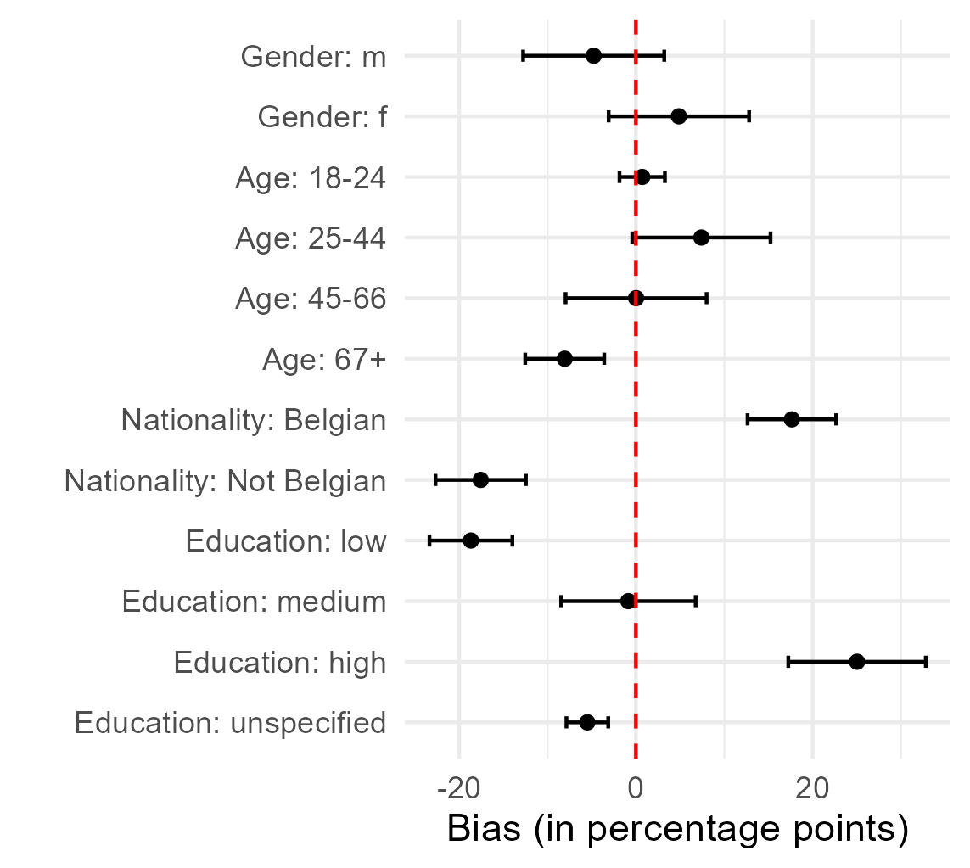
Task 2: Non-participation Bias in Belgium
Notes:
Comparison of gross to net sample (invited people / people who participated)
Information from propulation registers
Bars are 95% confidence intervals
Among the participants people in the age groups 67+ are clearly underrepresented, in the age groups 25-44 people are overrepresented

Slide 16
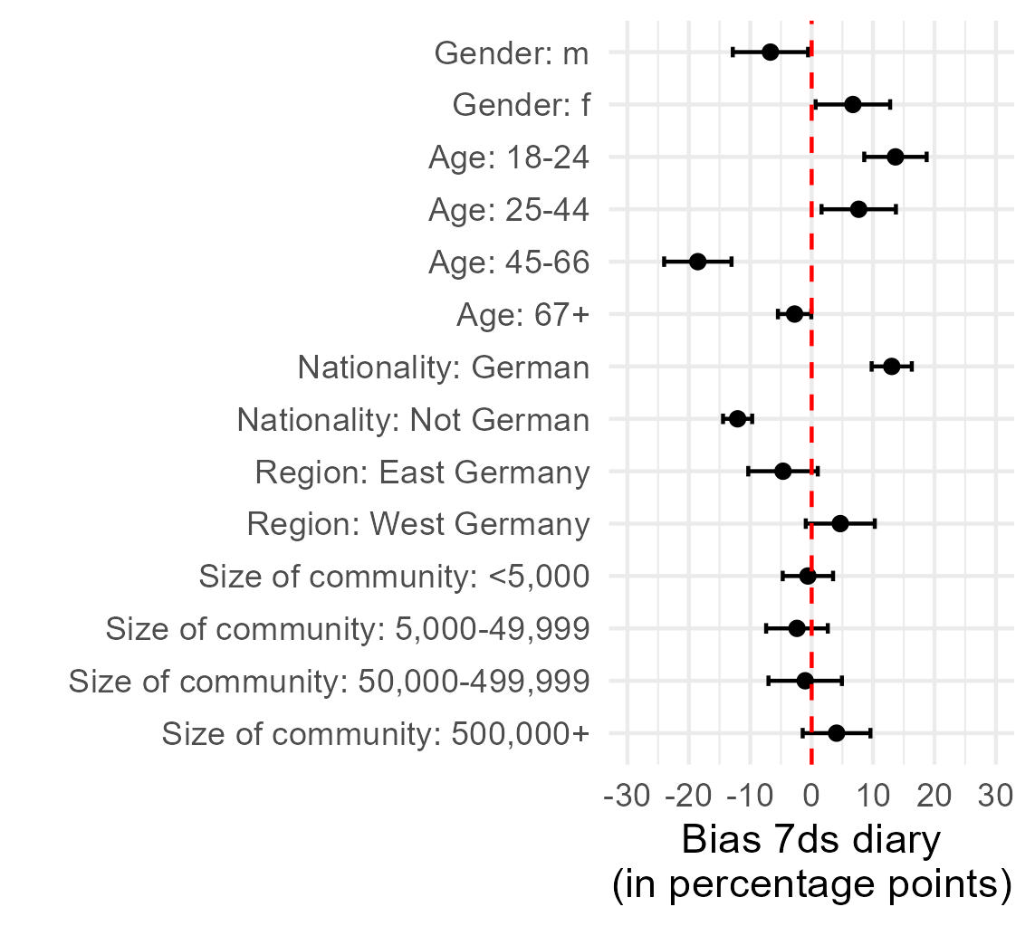
Task 2: Non-participation Bias in Germany
Notes:
Compare both graphs: 7 days / 14 days -> gender, age, nationality

Slide 17
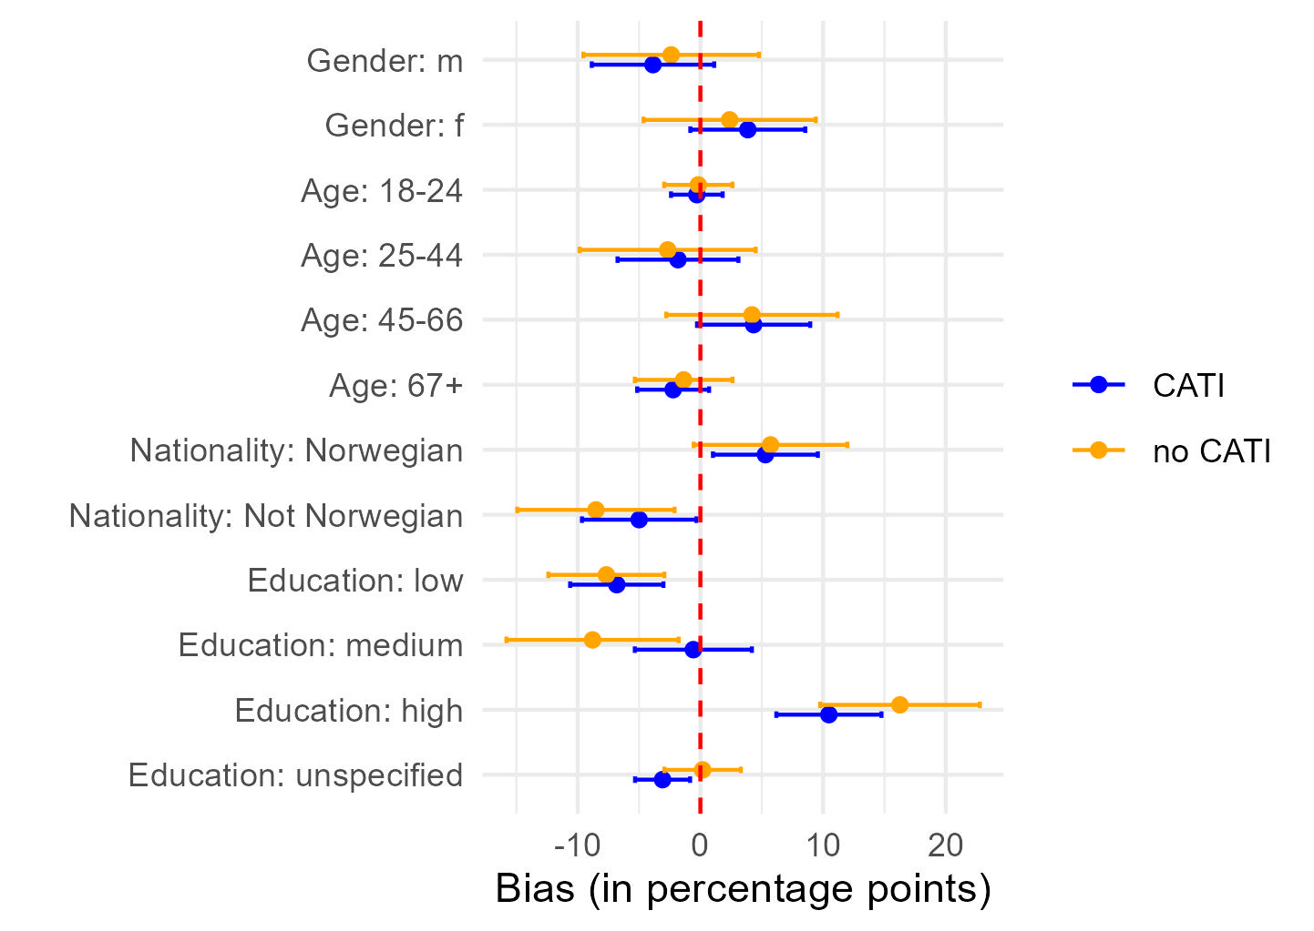
Task 2: Non-participation Bias in Norway
Notes:
Bias, split up for CATI and no CATI – age bias is different than in Belgium and Germany, education bias is reduced once CATI is used

Slide 18
Task 2: Recruitment Experiments
Belgium
  Letter design: n.s.
  PAPI option in follow-up: n.s.
Germany
  Letter stressing effort reduces download rate, but no effect on RR
  Mentioning camera function increases use of scanner in diary, but no effect on RR
Norway
  CATI recruiters increase starting and finishing rate
  Type of download link: n.s.

Slide 19
Task 2: Discussion & Conclusion
Recruitment for smart surveys extremely difficult if no interviewers used
  Use of CATI interviewers significantly increases the starting and finishing rate in Norway
Relatively consistent non-participation bias regarding gender, age, nationality, and education across all three countries
  CATI reduces education bias in Norway
Manipulations in invitation letters had little effect on RR
  Stressing effort in invitations should be avoided (Germany)
  But mentioning camera feature increases likelihood of scanning
Notes:
Manipulations in the invitation letters had very little effect, with the exception we found in Germany that stressing effort in invitations should be avoided

Slide 20
Task WP2.2 - Machine Learning and algorithm for smart data processing
Methodological developments around algorithms
Purpose of Task 2 was draw conclusions about ML/algorithms for smart data processing, to account for the improvements in the domains of HBS and TUS:
  How to enhance the quality of the prediction
  How far automation be pushed
The SSI project has worked on many algorithms for processing smart data, some of them belong to the category of machine learning, others are unsupervised algorithms
Implementing new algorithm for smart survey require a time consuming activity of methodological research, training data acquisition and testing
The algorithms require very demanding input and training data, that the user has to produce
The output can be committed or tentative data
  The automation of smart data processing has been improved significantly but human intervention remains crucial
Claudia De Vitiis - ISTAT

Slide 21
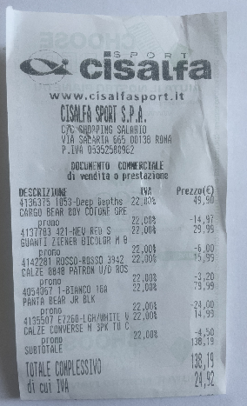
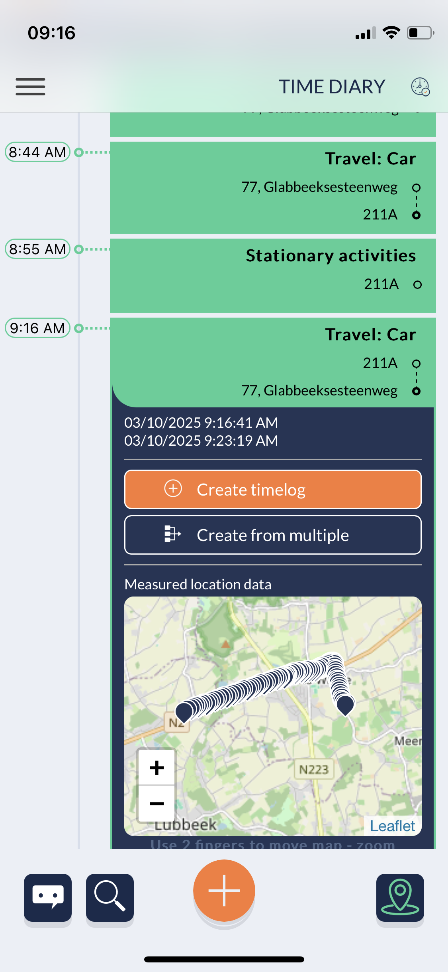
Task WP2.2 - Machine Learning and algorithm for smart data processing
Smart data
Relevant activities
methodological research
training data acquisition
testing
OUTPUT
Machine learning models
or unsupervised algorithms
Tentative data
(measured data)
Human intervention
NSI resources
respondent
or
Committed data
Core algorithms
Post-processing
Data preparation
complex pipelines to meet the requirements
  Trade-off between accuracy and speed or between granularity and computational complexity
  In some cases, alternative algorithms have been implemented, from which the user can choose
Claudia De Vitiis - ISTAT

Slide 22
Task WP2.2 - Machine Learning and algorithm for smart data processing
Final report fo WP2.2: Methodological perspective about the implemented ML/algorithms
Choice of the algorithms and why
Measuring of the quality of data
Test phase, results
Large / Small Test results (if any)
Limitations and country specificities
Recommendations for NSIs and users
Receipt scanning microservice
  OCR
  COICOP classification
Geoservice microservice
  GPS trajection segmentation
  Transport mode prediction
  HETUS activity prediction
Claudia De Vitiis - ISTAT

Slide 23
Task WP2.2 - Machine Learning and algorithm for smart data processing
Receipt scanning microservice – methodological outcomes
Input data are training data, annotated receipt, country specific data
For OCR and COICOP classification complex pipelines are defined in order to enhance the quality of both OCR and COICOP output
OCR accuracy relies on the Pre-OCR and Post-OCR steps and on the training of the OCR model
For an NSIs that plans to use RSM, is necessary to represent the retail market variability as much as possible in the collection of receipts to be labelled and used for training
For the COICOP classification accuracy
  Matching data preparation is the relevant phase (coverage and timeliness are crucial quality dimensions for matching data)
  Chaining the various string-matching sub-steps with the machine learning approach adds predictive power
  ML models classify product descriptions well, but only for supermarkets on which they are trained. They classify poorly on supermarkets absent from the matching data set. All models perform worse over time
  Calibrating thresholds at each sub-step is a crucial issue, vital for NSIs to dedicate time and resources to this calibration process (accuracy vs human resources)
Claudia De Vitiis - ISTAT

Slide 24
Task WP2.2 - Machine Learning and algorithm for smart data processing
GeoService microservice – methodological outcomes
Quality of GPS signal and map services (OSM and GP) is a crucial issue for prediction accuracy (tentative data)
  Errors and missing data are due to sensor failure or map problems
Segmentation algorithm has been strongly improved (ATS/Optics)
For transport mode a decision tree algorithm has been chosen for the GSM, preferred to the initial rule-based method
  The model performs well in identifying high-frequency classes
  The feature importance highlights that speed-related features predominantly drive the decision-making process
  Additional user information can improve the prediction
For the classification of HETUS activities the probability algorithm (based on TUS aggregated data and POIs) produces good results if there are good POIs
  The algorithm performs better if using Google Places, a higher number of POIs and more updated
Claudia De Vitiis - ISTAT

Slide 25
Example: Transport mode prediction (CBS data: 2022-2023 large-scale field test - 4298 labeled events)
Algorithm based on a decision tree, using smartphone GPS data and infrastructure information from OpenStreetMap (OSM).
Classification report for training data
Classification report for test data
Class | Precision | Recall | F1-Score | Support
Bike | 0,73 | 0,86 | 0,79 | 643
Bus | 0,60 | 0,04 | 0,07 | 75
Car | 0,85 | 0,87 | 0,86 | 1.333
Metro | 0,61 | 0,60 | 0,61 | 45
Train | 0,66 | 0,83 | 0,73 | 99
Tram | 0,00 | 0,00 | 0,00 | 18
Walk | 0,85 | 0,87 | 0,86 | 684
Other | 0,00 | 0,00 | 0,00 | 103
Accuracy |  |  | 0,81 | 3.000
Macro avg. | 0,54 | 0,51 | 0,49 | 3.000
Weighted avg. | 0,77 | 0,81 | 0,78 | 3.000
Class | Precision | Recall | F1-Score | Support
Bike | 0,71 | 0,82 | 0,76 | 303
Bus | 0,00 | 0,00 | 0,00 | 21
Car | 0,89 | 0,82 | 0,85 | 559
Metro | 0,15 | 0,31 | 0,21 | 13
Train | 0,78 | 0,87 | 0,82 | 62
Tram | 0,00 | 0,00 | 0,00 | 14
Walk | 0,82 | 0,86 | 0,84 | 318
Other | 0,00 | 0,00 | 0,00 | 8
Accuracy |  |  | 0,80 | 1.298
Macro avg. | 0,42 | 0,46 | 0,44 | 1.298
Weighted avg. | 0,79 | 0,80 | 0,79 | 1.298
Claudia De Vitiis - ISTAT

Slide 26
Example: HETUS activity prediction
  Google Places vs Open Street Maps (GPS data collected using the app CBS-Odin few users in Italy)
Segmented STOPS | Google Places | Open Street Map
Stop segmented by ATS/OPTICS | 111 | 111
Stop with duration > 5 min. | 83 | 83
Stop with POIs useful for activity prediction | 71 | 56
Stops with identified POIs (not labeled home/work ) | 21 | 24
RANK | Evaluation | Google Places | Open Street Map
TOP 1 | CORRECT | 11 | 7
 | NOT CORRECT | 10 | 17
TOP 2 | CORRECT | 12 | 8
 | NOT CORRECT | 9 | 16
TOP 3 | CORRECT | 13 | 8
 | NOT CORRECT | 8 | 16
  Matches Top 1: Number of stops where the activity with the highest prediction score is correctly predicted by the algorithm;
  Matches Top 2: Number of stops where one of the two highest-scoring activities is correctly predicted by the algorithm;
  Matches Top 3: Number of stops where one of the three activities with the highest scores is correctly predicted by the algorithm.
Claudia De Vitiis - ISTAT

Slide 27
Task WP2.2 - Machine Learning and algorithm for smart data processing
Methodological developments - synthesis
Microservice | Component | INPUT data | Algorithms | Training data needed | Main issues
Receipt scanning | OCR | Scanned receipt | SegFormer YOLOS PaddleOCR LiLT | Receipts, country specific | Quality of the photo, involvement of respondent in quality enhancing
 | Coicop classification | OCR output Matching data | String matching N-gram FastText Logistic Random Forest | Matching data, country specific | Country specificity Trade-off accuracy/resources for human intervention
GeoService | Trajection Segmentation | GPS data | ATS/Optics | NO | Quality of GPS signal
 | Transport mode prediction | GPS data, OSM | Decision Tree | Survey data (CBS) | GPS configuration Map quality
 | Hetus activity prediction | Segmentation output (GPS, Stop, OSM/GP), TUS data, User info | Probability model | TUS aggregated data | Dependence on the quality of map service (OSM/GP)
Claudia De Vitiis - ISTAT

Slide 28
Task 3
Usability testing – study design
Receipt Scanning Microservice
Think Aloud Test
Harmonised task list
Harmonised sample
GeoService Microservice
TUS or Mobility Survey
Harmonised post-use interview
Harmonised sample
Partner | Platform | Receipt Scanning
Destatis | MOTUS app | SSI Microservice
VUB | MOTUS app | SSI Microservice
SSB | HBS pwa | Veryfi
Insee | HSB app | None (post-survey)
CBS | @HBS app | None (simulation)
Partner | Platform | Receipt Scanning
Destatis | MOTUS app | SSI Microservice
VUB/Statbel | MOTUS app | SSI Microservice
Istat | MOTUS app | SSI Microservice

Slide 29
Task 3
Usability testing – Receipt Scanning
Respondents expect
a receipt scanning microservice
processing time to be fast
processed data to be very accurate
Respondents do not expect
to commit (correct) data
to classify expenses
to provide additional context
to read many notifications
Future challenges lie with
training microservice
dealing with steep learning curve
communication with respondents
adding and training classification algorithms
alternatives for paper receipts

Slide 30
Task 3
Usability testing – Geolocation
Respondents expect
geolocation to be readily available and accurate
to use geolocation as tentative data in mobility studies
to use geolocation as anchor points in TUS
toggle geo tracking on/off in the app
Respondents do not expect
to use geolocation as tentative data in TUS
to use geolocation for stationary locations
to use geolocation when experienced as controlling
Future challenges lie with
exploring different uses of geolocation data
finetuning/expanding geolocation data
balancing supportive vs controlling geolocation data
in terms of UI/UX presenting and making entries from geolocation data

Slide 31
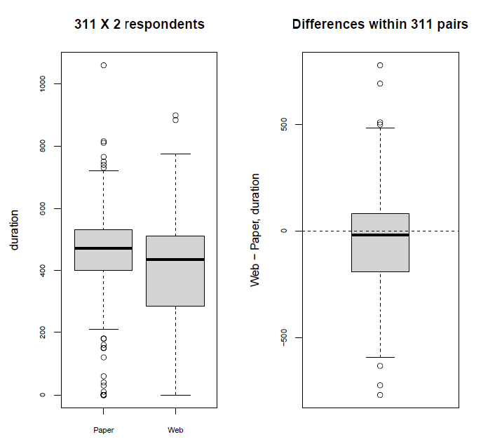
TUS Mode Differences
Notes:
Hard to compare measurement differences between modes without a ground truth
France’s experiment for comparison between modes: AB/BA crossover experiment where people completed both paper and web diaries
Analyzed in two ways: as the crossover experiment, and with matching.
But sometimes useful to look for something common-sense, like sleep.
Total sleep duration from the matched pairs analysis has a median difference of 20 minutes in favor of paper responders, but a mean difference of almost 100 minutes.
Rather than web resp. reporting a little less sleep all the time, mostly an imbalance of a lot less sleep in some of the pairs.

Slide 32
TUS differences in total sleep duration
28% of internet-responders < 2 sleep periods
14% of paper-responders < 2 sleep periods
Notes:
Additionally, 28% of internet responders report fewer than 2 periods of sleep, twice the frequency of paper responders
Since the diaries run from 4am to 4am, this seems pretty high
So there’s definitely a clear difference here, but where does it come from?

Slide 33
TUS differences in total sleep duration
28% of internet-responders < 2 sleep periods
14% of paper-responders < 2 sleep periods
Possible explanations
Missing data
Interviewer effects
Endogenous differences (differential response/dropout)
Notes:
Differential missing data between modes
Interviewer/coding effects that differ between modes
Residual endogenous differences

Slide 34
Missing data differences between modes
90% in both modes start at 4am
  87% of paper diaries end at 4am
  74% of web diaries end at 4am
70% of web respondents¹ with < 2 sleeping periods have missing ends
¹ From the matched-pairs analysis
Notes:
Some evidence on the missing data side: people are more likely to leave the ends of their day blank in the internet mode, despite similar rates of completeness at the beginning of the days.
And of the web-responders reporting fewer than 2 sleeping slots, 70% of them have blank ends of their days

Slide 35
Interviewer/coding differences between modes
Easier for interviewers to correct paper (e.g. for missing day ends)
Coding
  Web mode -> users code
  Paper mode -> algorithm codes
Notes:
More missingness seems clear, but the reason for it could be more complex
Interviewers reported that they found it much easier to assist respondents in correcting the paper version for this sort of error when they went back to pick up the diaries.
Similarly, while web respondents classify their own activities, the paper diaries are classified algorithmically, which could induce differences.

Slide 36
Endogenous differences between modes
Non-diary question at the end of both modes: estimate of total travel duration
Lower estimates from web respondents
Notes:
Finally, residual representational differences could be a cause. France used a non-diary item at the end of both modes asking about the total travel duration.
In both analyses, participants in the web version had lower estimates
Could indicate residual differences

Slide 37
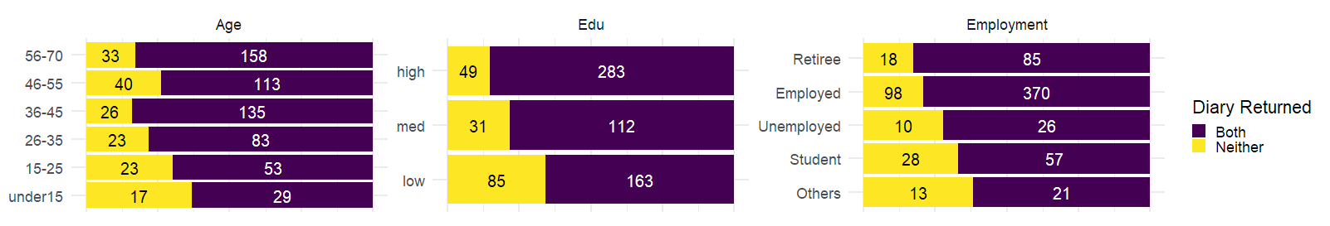
TUS response
By respondent characteristics
Significant differences in response across key variables
Older
More education
Retirees/
Employed
Notes:
But, while we do see significant differences in overall response rates across key variables in the expected directions

Slide 38
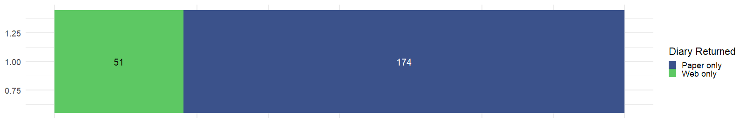
TUS response
By mode
Significant differences in response across key variables
Significant differences in mode-specific RRs
Paper
Notes:
And there’s also mode-specific non-response and dropout, favoring paper

Slide 39
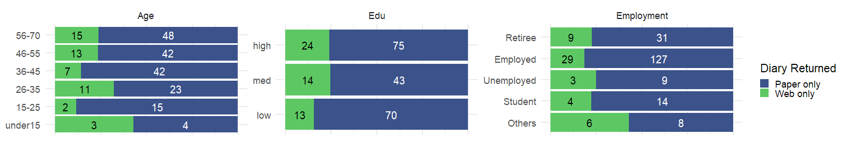
TUS response
By mode and respondent characteristics
Significant differences in overall RR across key variables
Significant differences in mode-specific RR
Non-significant differences in mode-specific RRs across key variables
Notes:
The differences are pretty small when we look at mode-specific response across key variables

Slide 40
TUS duration differences in other activities
 | Crossover-based constant effect | Matching-based mean effect
Personal and physiological time | -1 [-20; 18] | -5 [-36; 25]
Working and studying | -8[-24; 8] | -22 [-50; 7]
Housework and recreation | -7 [-16; 3] | 6 [-11; 23]
Care | 4 [0; 8] | 4 [-4; 11]
Sociability | 25 [17; 33] * | 27 [14; 40] *
Leisure | -51 [-64; -38] * | -45 [-67; -24] *
Travelling | -20 [-27; -14] * | -32 [-43; -20] *
Note: * p < .05
More sociability
Less travel/
leisure
Notes:
Wrapping up:
Many activities showed similarly large differences between the modes
Web-respondents record more socialization
and a lower amount of leisure and travelling time

Slide 41
Overall conclusions
Work Package 2 | Task 1 | Recruitment to smart surveys very difficult without interviewers
 |  | Bias along lines of traditional digital divide
 | Task 2 | Quality of input data
 |  | Need for country-specific model/training (HBS)
 | Task 3 | Smart microservices also needs to be clever
 |  | Smart microservices lower respondent burden but not complexity of survey
 | Task 4 | Large measurement differences between modes
 |  | Likely a combination of causes

