Slide 1
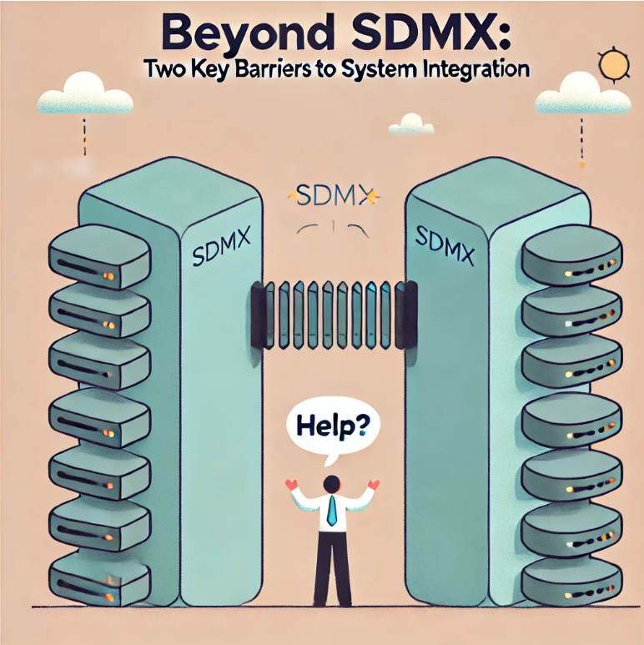
Pedro Carranza – Oct 2024
Image Credits: ChatGPT / OpenAI, 2024

Slide 2
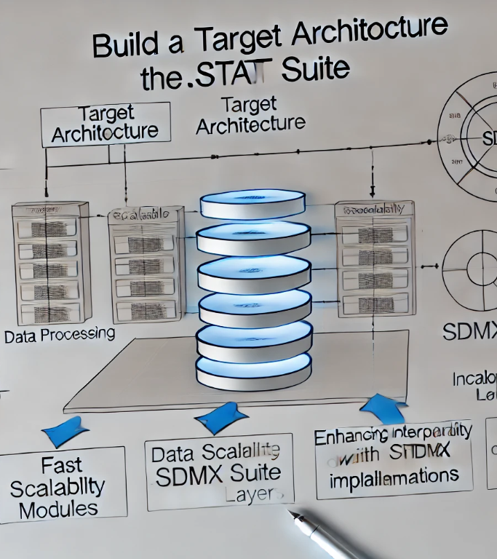
.Stat Suite Target Architecture
Performance
Scalability
Interoperability
Image Credits: ChatGPT / OpenAI, 2024

Slide 3
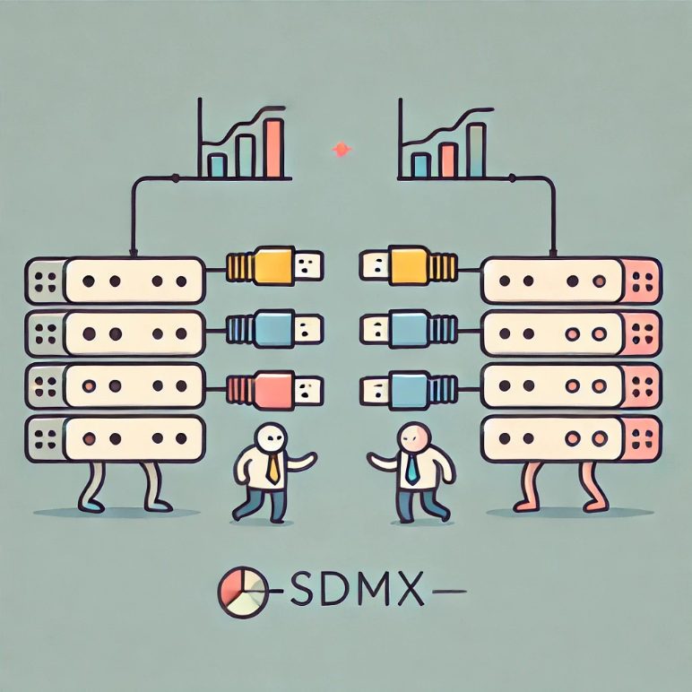
Enhance Interoperability
Improve the user experience in a multi-platform environment.
Improve reusability and cooperation with tool producers.
Image Credits: ChatGPT / OpenAI, 2024

Slide 4
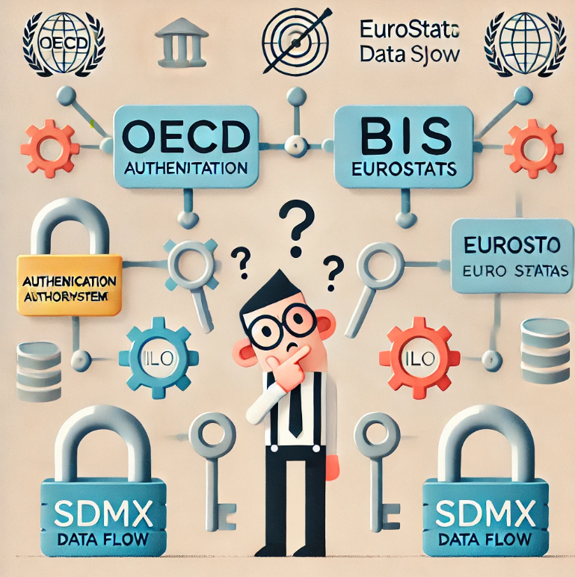
Two key barriers to system integration: Authentication & Authorization
Image Credits: ChatGPT / OpenAI, 2024

Slide 5
Authentication
Different authentication protocols:
Each organization use different authentication protocols, or custom solutions.
OECD .Stat Suite OAuth & OpenID
Eurostat EU Login
BIS ?
Users are required to log in multiple times & inconsistent access management.
SDMX recommends “Basic authentication”
But is it secure enough for your internal security policies?

Slide 6
Authorization
Different authorization models:
Complexity to enforce consistent permissions across platforms.
May result in security gaps and unauthorized access.
Current landscape:
Eurostat Custom
OECD .Stat Suite Custom based on Eurostat
BIS ?

Slide 7
Image Credits: ChatGPT / OpenAI, 2024

Slide 8
What can we do?
Authentication
Could SDMX adopt or recommend secure common standards?
OAuth 2.0, OpenID Connect, or SAML
Do we let this job to implementers to figure out?
Identity Brokers
API Gateways with integrated Authentication
Authorization
Do we make it part of the SDMX standard?
HTTP GET IsAuthorized/{v}/{user|group}/{action}/{artefactId}
Do we define an interface?
IAuthorization -> bool IsAuthorized(user, action, artefactId);
Do we just make plugins for each implementation?

Slide 9
Image Credits: ChatGPT / OpenAI, 2024

