Slide 1
SDMX and Interoperability of standards
Amsterdam, 09.10.2024

Slide 2
Table of Contents
Generic approach → SDMX
XBRL → DPM, ESRS …
Technical
Technical
Slide 4
Data Architecture
Data Architecture
Slide 5
Software, Systems
Slide 3
Software, Systems
Functional
Functional
Data Science
Supervisory Review
Slide 6
Fiscal Policies
Monetary strategies

Slide 3
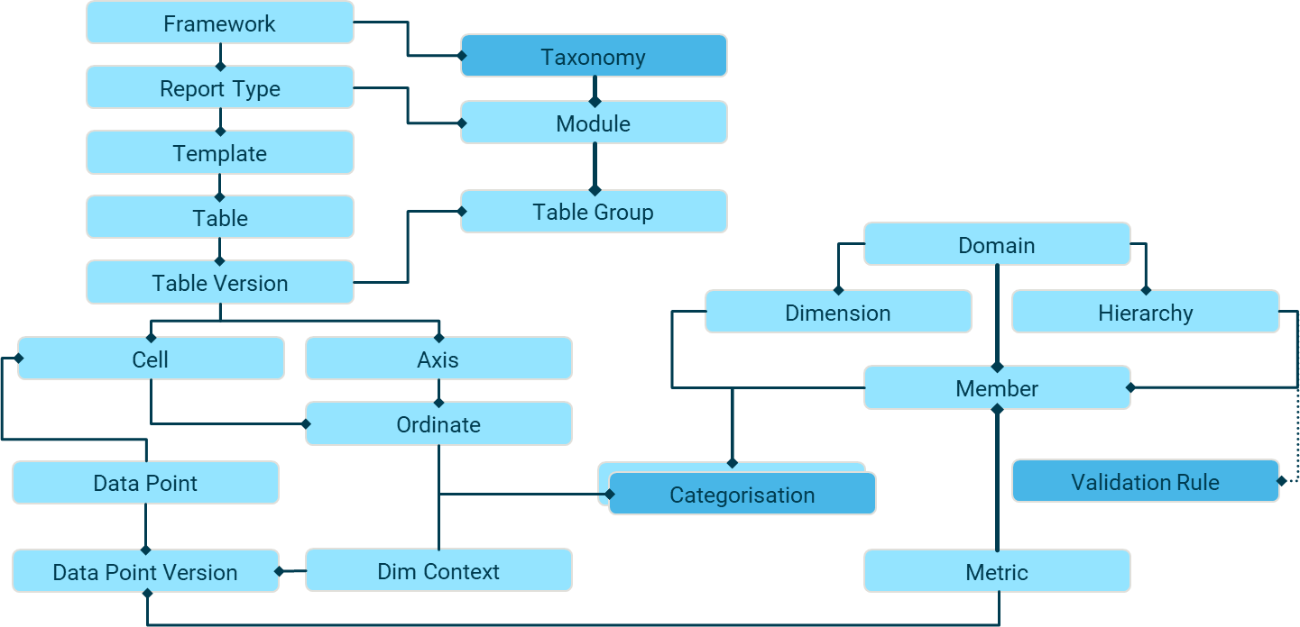
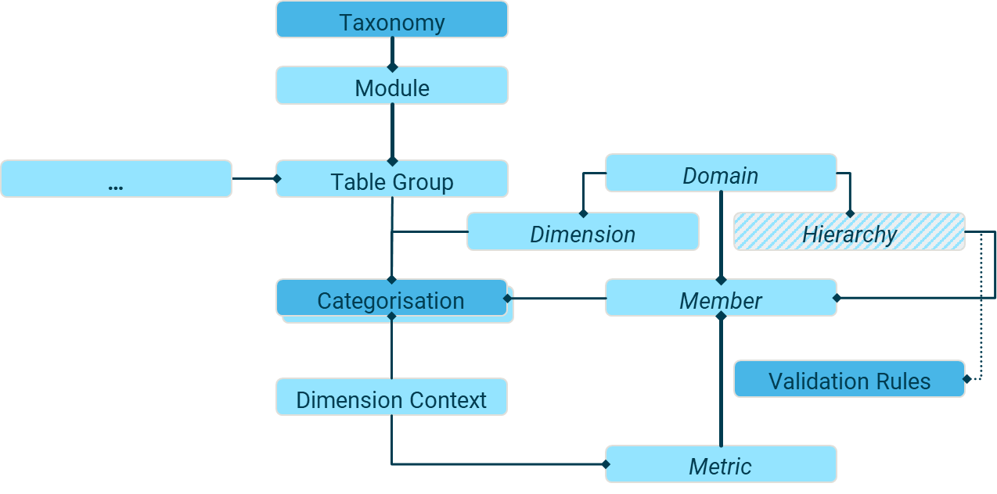
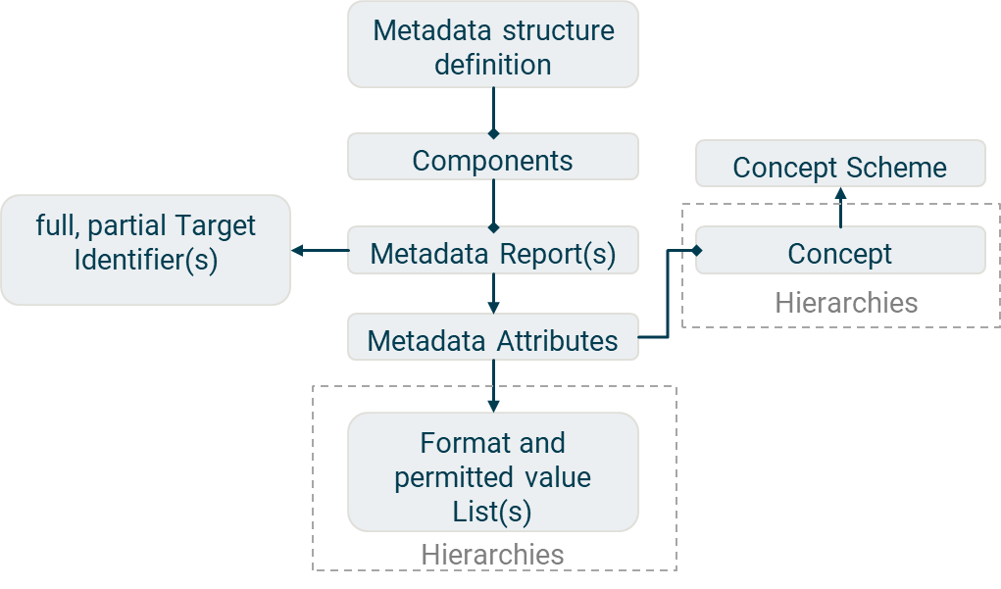
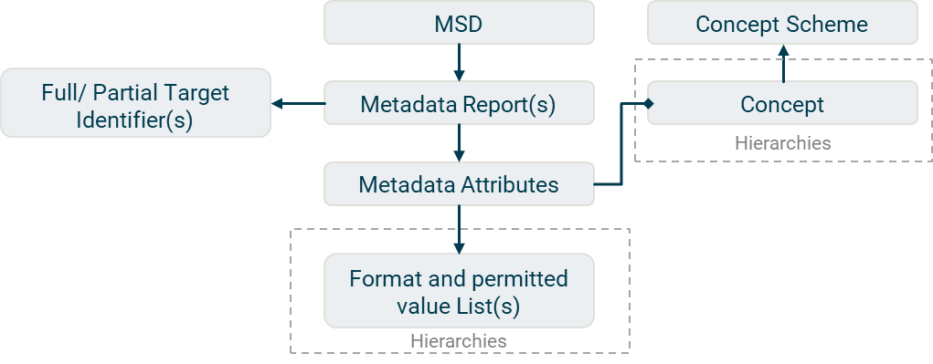
Drawing parallels between the Data Point Model of EBA and the SDMX Information Model requires a thorough functional understanding of both
1
SDMX Data/Metadata Structure Definition
The metadata attributes (coded representation of a code lists or uncoded texts, organized as hierarchical child-parents) take their semantic or context form from concepts, usually defined in concept schemes.
Both attributes and concepts can have hierarchies.
SDMX represents a scalable generalization to data models.
CSRD, ESRS
3
Taxonomy
Module
…
Table Group
Domain
Dimension
Hierarchy
2
EBA’s Data Point Model (DPM)
Contains tables, structures, data point concepts and their relationships in combination of DPM’s functional allocation rules
The EBA adds new content or updates the data model with newer versions of the templates → establishes a revised categorization.
Historical tracking of equivalence classes is achievable.
Categorisation
Member
Validation Rules
Dimension Context
Metric
SDMX represents a generalization of self-describing data standards with XBRL serving as a specific example of this concept. Achieving a transformation to SDMX from any existing metadata model is a realistic goal.
DSD / MSD
Metadata structure definition
List of dimensions /groups ||
Full and partial Identifiers / report structure
Components
Concept Scheme
Keys
full, partial Target Identifier(s)
Metadata Report(s)
Concept
Dimensions / Identifier Components
Hierarchies
Metadata Attributes
Series / Target Objects
Format and permitted value List(s)
Data / Metadata
Attributes
Hierarchies

Slide 4
Effective data-driven metadata modeling, transformation and architectural design begin with a strong domain expertise foundation
1
Workloads
2
Patterns
3
Architecture
Business Identification
Recognition of Design Patterns
Application and workload-driven
Business domain expertise
Requirements, forecasted scenarios and data growth
Production logs and statistics
Methodological assessment of the quantity and quality of business operations
Reads prevail writes
Never recompute what you can precompute
Compute on write is less work than compute on read
Summary records and caching
Calculate on demand
Principles
Apps, Service Workloads
Entities, Service CRD
Scalable, flexible Architecture
Assessment of data size
Ranking of operations
Operational assumptions and schema versioning
Shared clusters, replica sets
Expected telemetry metrics
Prioritization of schema patterns
Identification of the most frequently used queries, indices and components
Data federation → data archiving
Concurrent process models
Logging and monitoring
Meaningful enhancements should reflect evolving requirements
Estimation of effort and complexity
Expected Outcomes
To foster a flexible, data-driven architecture with optimal performance enhanced user experience, it is essential to consider business logic alongside efficient transformation workloads and design patterns.

Slide 5
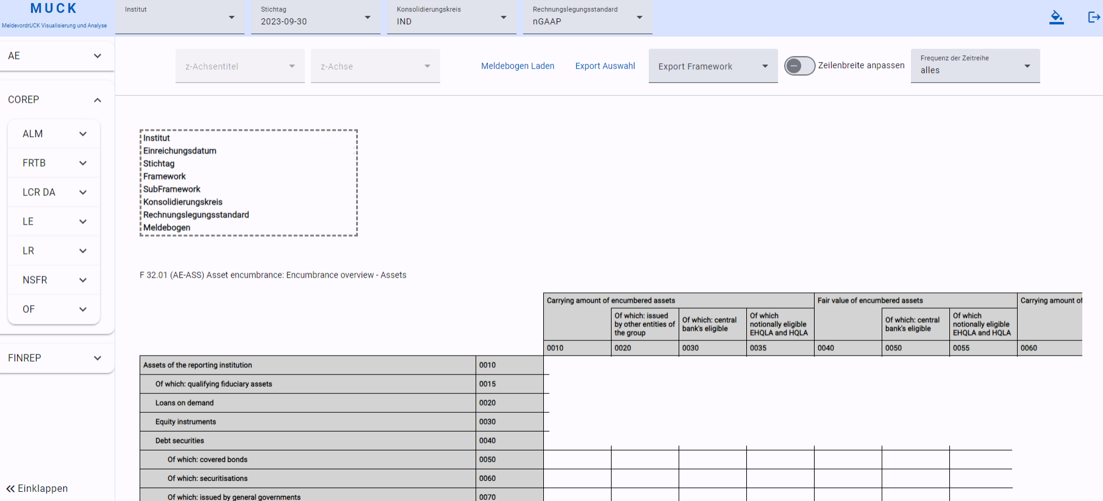
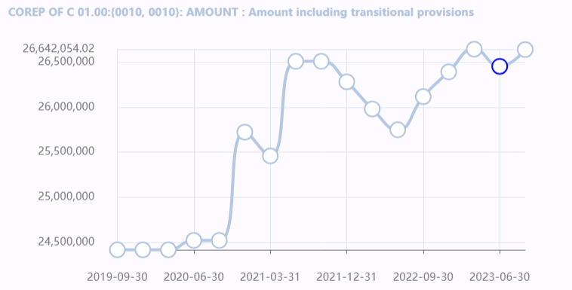
Highly efficient taxonomy-independent visualization and analytics of any report, data or metadata structure, such as the DPM, require coherence
On-premise and container-based
Visualization, analysis, and export of any multi-dimensional report
Accommodates irregular headers and open or closed coordinates
In any data format without storage
1
Taxonomy- and version- independent
Frequency-adjustable
Time Series of any Data Point
2
Incorporating flexible, data-driven workloads and patterns, highly performant and containerized generic applications also exhibit significantly low maintenance costs.

Slide 6
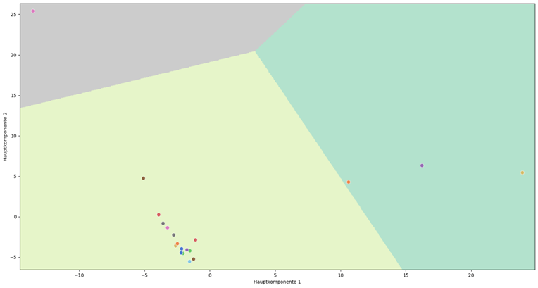
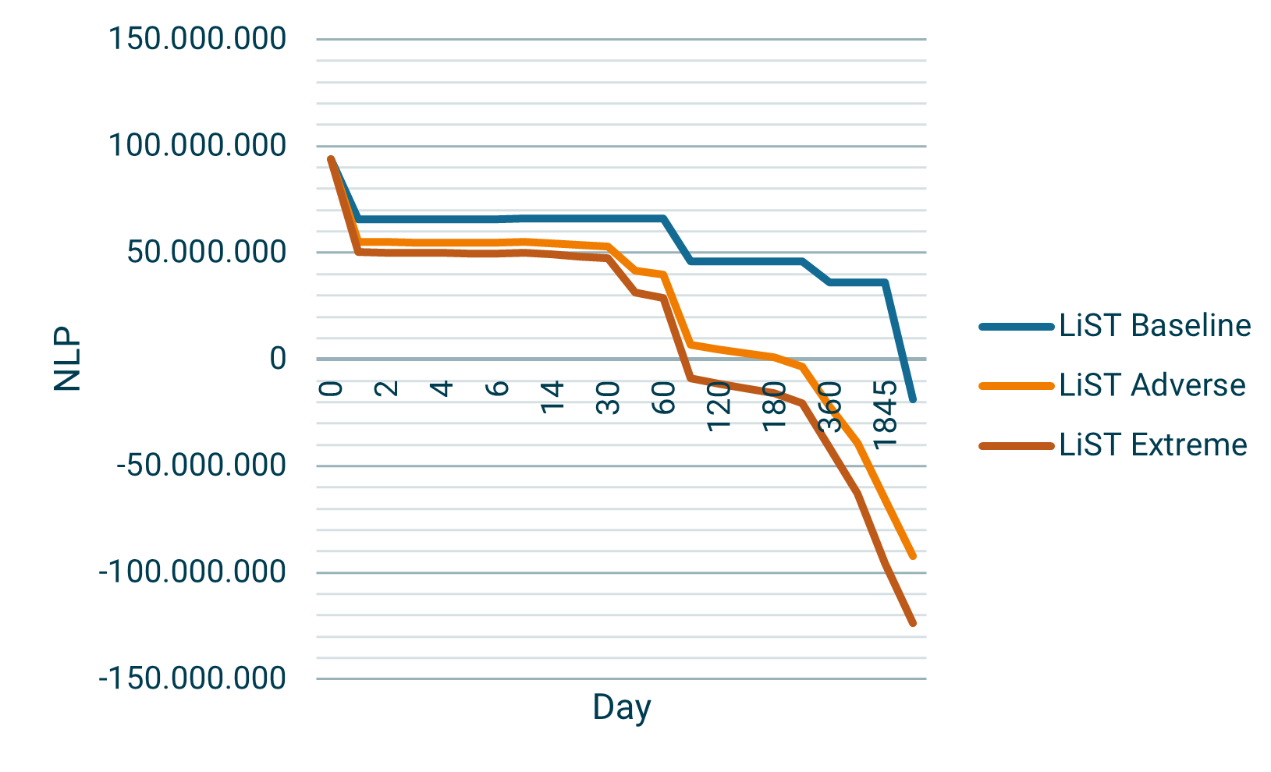
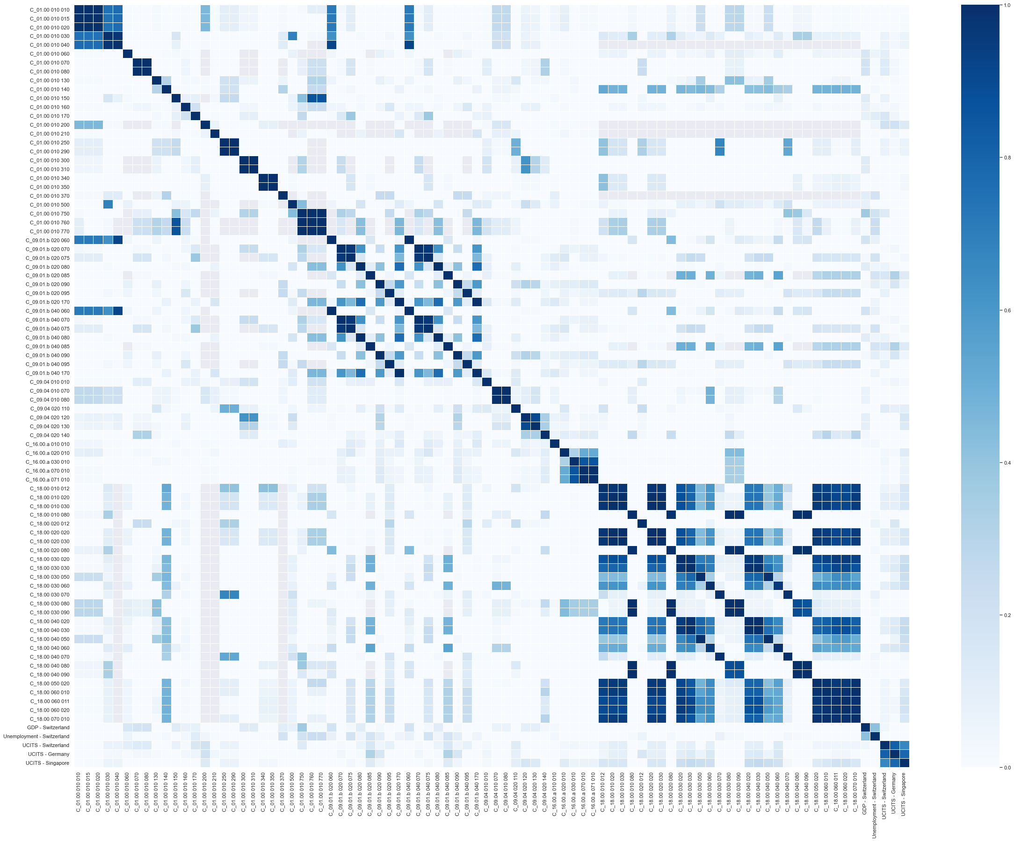
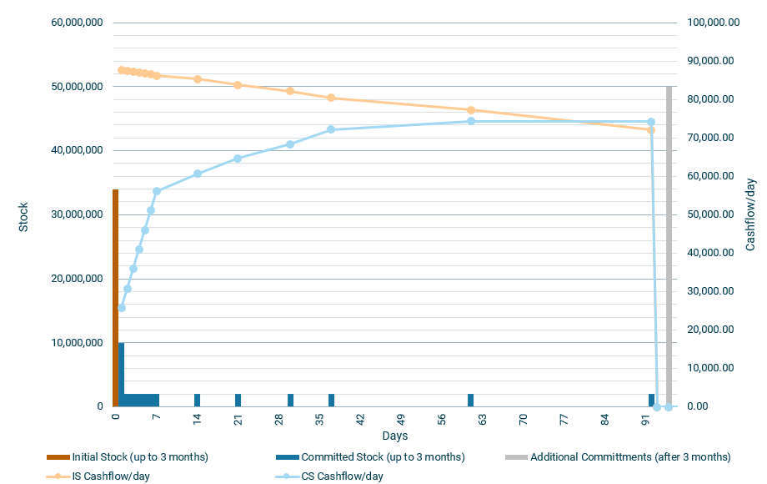
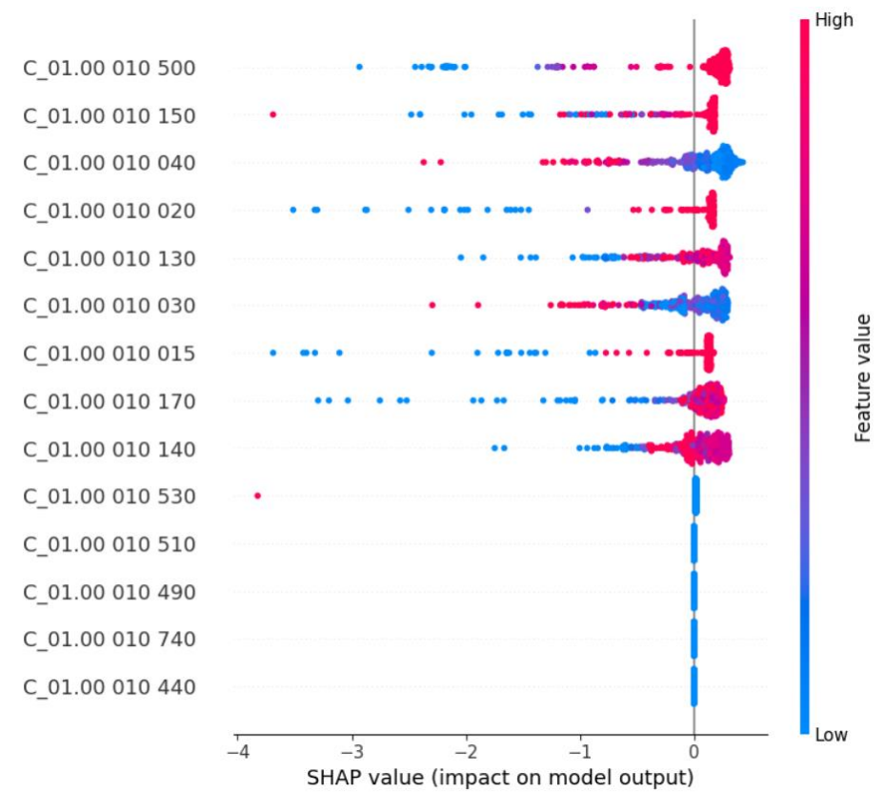
Real-time methodological and data-driven statistics of financial data beyond pure Artificial Intelligence requires coherent and flexible systems
Complexity-reduced clustering and classification
1
Granular relationship visualizations and dashboards
2
3
Advanced stress testing
e.g., modelling contractual cashflows, counter-balancing capacity, market value effects in liquidity stress tests
Any Data Point at any time:
Granular correlations
Shapley Additive exPlanations
Predictive Power Scores
Extensions to Codependency
4
High-performing and interoperable systems not only facilitate more effective on-demand statistics but also aim to uncover true (information-theoretic) codependent relationships beyond the multivariate Normal case.

Slide 7
Some essential insights
By leveraging the strengths of each standard, organizations can create a unified reporting environment, as harmonizing data formats through efficient transformation rules simplifies the statistical analysis of financial data.
Never recompute what you can precompute, inducing more substance rather than methodology.
Highly performant and efficient systems are achievable upon consideration of ranking lists and efficient storage of relevant functional data structures.
Statistical approaches prioritize functional understanding over complex analytics, while an interoperable system allows organizations to adapt quickly to evolving data requirements and new standards without extensive reengineering.
No need to prioritize design over coherent data for effective data visualization (~ Data-to-Ink Ratio, E. Tuft).

Slide 8
Thank you for your time!
Dr Mario Rusev Manager Tel +43 1 5121792-0 Mobile +43 699 18262586 Mario.Rusev@d-fine.com

Slide 9
Backup

Slide 10
Addressing questions beyond the scope of a single metadata model needs an appropriate use case-driven functional link or interface between them
2
Monetary policy use case
Statistical evaluation
1
2
New report or statement not directly addressed within the DPM, ESRS or SDMX classification
Use case specific
Taxonomy data points alongside e.g., AnaCredit details
Example
Equivalent Concepts
3
4
3
Functional Interface
Equivalent Chains
SDMX
DPM
Equivalence Classes → “where” filters
Codependency filters
AnaCredit
CoRep
5
CoRep C … RWA
DPM data point
AnaCredit SDMX Deal 1
Info 1
Info ..
AnaCredit SDMX Deal …
Info 1
Info …
To tackle equivalence, codependency, or granular filters, begin by analyzing the equivalence classes of each model. Subsequently, implement a use case-driven transformation or distance, provided the use case permits.

Slide 11
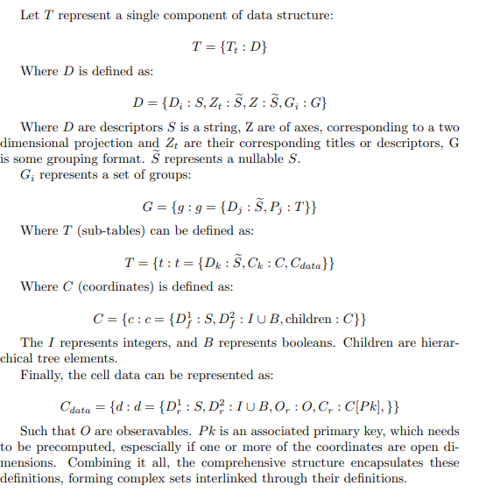
Generalizing a transformation to or from SDMX necessitates understanding the dynamics of allocation rules in the initial data model
Transformation
should be
Transmission Format
Can do API Transformation to or from any standard
Transforming needs to hash the allocation rules and their dynamics considering evolving equivalence classes
$$≪{O(n}^{2})$$
Ideally for $n$ data points
$$\sim O(n\log{n})$$
Service
paginate
Optional Frontend
Spring Boot 3+ for managed Beans and AOP
If database → MongoDB → embed and reference
Container shards, replica sets
Telemetry and Normalization
Logging and Monitoring
Quality Control Gates
Angular 18+ for signals, material and hydration
Structure in components, directives and services
Define metrics on leaf nodes or any relevant data structure
Gateway for concurrent or conflicting calls
Data mapping, normalization, schema integration and understanding the semantics of a data model allows for effective integration of data, adapted to evolving analytical needs, integrity and usability.

Slide 12
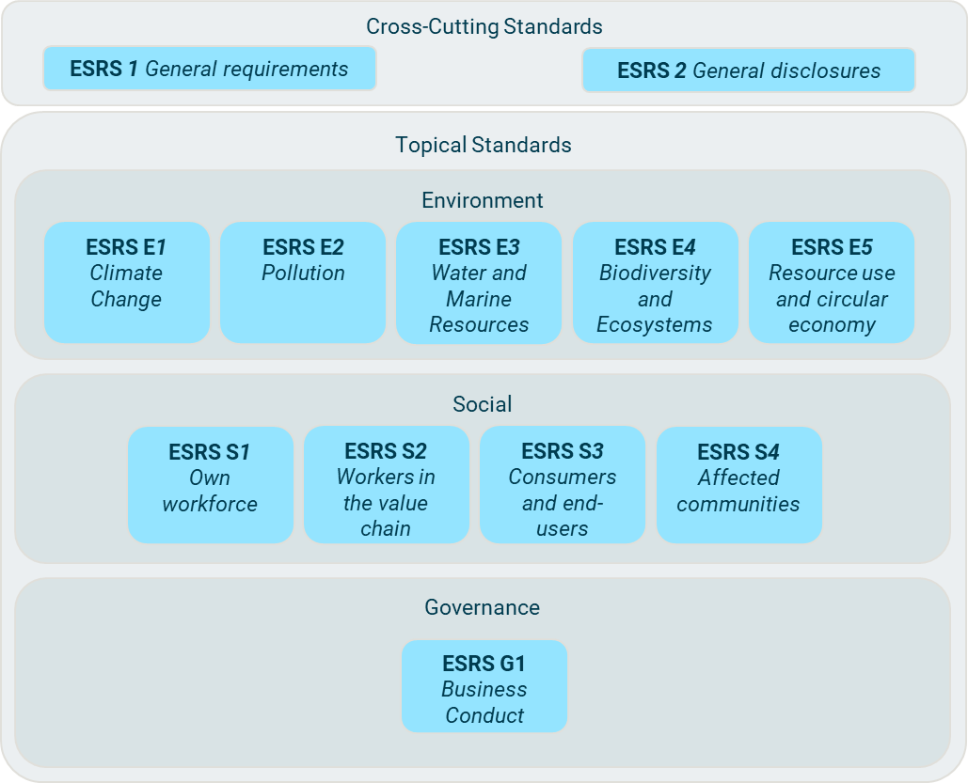
ESRS XBRL Taxonomy is the digital transposition of the human-readable ESRS text (CSRD/ESRS regulatory reporting framework)
Cross-Cutting Standards
Corporate Sustainability Reporting Directive (CSRD) → ESRS
The CSRD mandates use of a double materiality assessment, considering both impact and financial perspectives.
For each material matter, information must be reported in accordance with the cross-cutting or topical standards.
The taxonomy consists of a set of XBRL elements (concepts and tags), tagged in an inline XBRL report.
In addition to defining quantitative (numerical) and qualitative (narrative) XBRL elements for ESRS datapoints, the ESRS Taxonomy includes dimensions (axes) for disaggregating disclosures with specific dimension members.
The taxonomy includes explicit dimensions being predefined lists of elements, and typed entity-specific dimensions.
ESRS 1 General requirements
ESRS 2 General disclosures
Topical Standards
Environment
ESRS E1
Climate Change
ESRS E2
Pollution
ESRS E3
Water and Marine Resources
ESRS E4
Biodiversity and Ecosystems
ESRS E5
Resource use and circular economy
Social
ESRS S1
Own workforce
ESRS S2
Workers in the value chain
ESRS S3
Consumers and end-users
ESRS S4
Affected communities
Governance
ESRS G1
Business Conduct
Understanding the functional profile of XBRL concepts in general and the DPM makes any technical process surrounding CSRD/ESRS XBRL a quickly realizable task.

