Slide 1
Interoperability of DPM 2.0 with SDMX
ECB-RESTRICTED
ECB-RESTRICTED
DRAFT
Overview of DPM 2.0
Case example
Usage of IReF
9 October 2024

Slide 2
Overview
1
Introduction to the Data Point Model
2
Overview of DPM 2.0 data model
3
Examples of usage of the DPM
4
Usage of DPM by IReF

Slide 3
1. Introduction to the Data Point Model

Slide 4
Introduction to the Data Point Model
History of DPM
The Data Point Model (DPM) started in 2012, to support the EBA and the Solvency 2 reporting frameworks
The first DPM model was published in 2013, as part of the ITS 2.0 technical package
The data dictionary included in the DPM track changes and maintains the full historization of all templates structure, data points categorisation, validation rules, and taxonomies across all releases
The core structure of the DPM model has not changed significantly since its first publication
Since 2013, the DPM model has been used by the EBA and EIOPA as data dictionary repository, publicly available
4
Notes:
Remove green subtitles

Slide 5
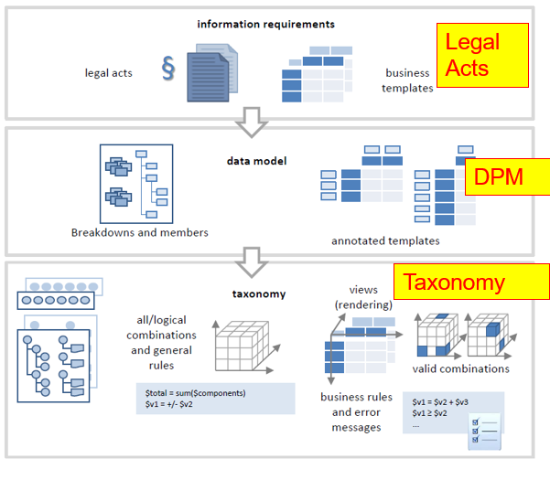
Introduction to the Data Point Model
ECB-RESTRICTED
The DPM is a data model that includes
Definition of Modules, Templates, and Data Points
Dimensional characteristics of each Data Point so that they can be described unambiguosly
Data Point’s Coordinates (Template-Row-Column-Sheet)
Validation rules
Etc.
The EBA produces a database with the content of the DPM (dictionary)
The EBA XBRL taxonomy is the technical exchange format established for supervisory data
5

Slide 6
Introduction to the Data Point Model
[Please select]
[Please select]
What is the DPM Data dictionary?
Methodology for defining regulatory data requirements, using specific data modelling techniques
Methods
Rules
Metamodel defining the data modelling language, and the metadata storage model
Syntactic structure
Metadata describing concepts and regulatory requirements of all reporting framework releases
Semantic
Content
Tool set that supports the work of reporting experts for the continuous development of the DPM releases
Infrastructure

Slide 7
Introduction to the Data Point Model
DPM 2.0 Improvements from DPM
Definition of a role for each individual reporting value (fact or key variables, attributes)
Definition of relationships between reporting values
Definition of global variables
Definition of concepts whose definition combines/is based on other concepts
Grouping of categories (super categories)
….
Enhancement of interoperability with similar standards (SDMX)
7
Notes:
Remove green subtitles

Slide 8
DPM Refit vision
[Please select]
[Please select]
DPM Methodology defined as ISO standard
Unified metamodel applicable to all data exchanges, from highly aggregated data points to very granular data sets
Total convergence of EBA and EIOPA methods, models, processes, and tools used for the development of data modelling techniques
Enabling subsequent semantic harmonisation of data dictionaries across different domains

Slide 9
2. Overview of DPM 2.0 data model

Slide 10
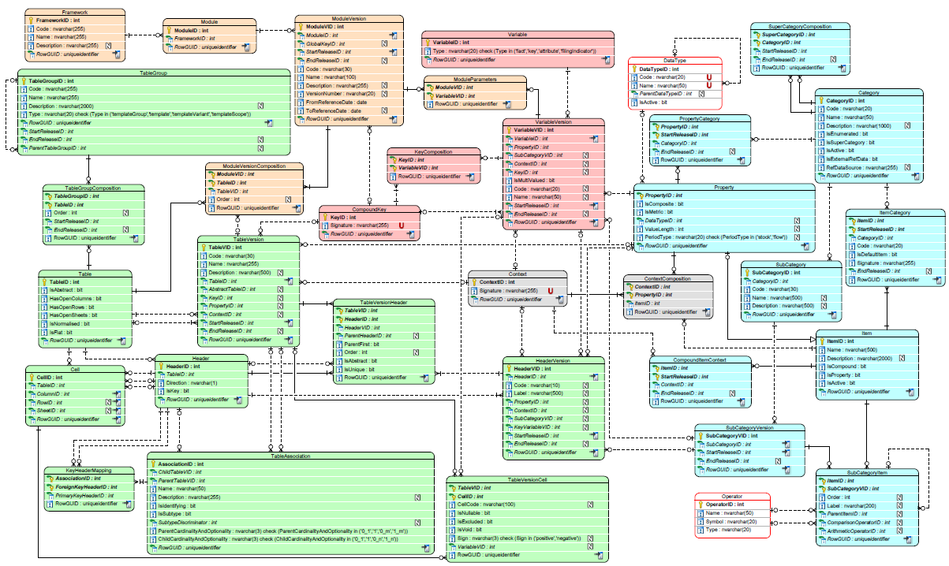
Overview of the DPM 2.0 Data Model
ECB-RESTRICTED
Variables
Packaging
Glossary
Rendering
10

Slide 11
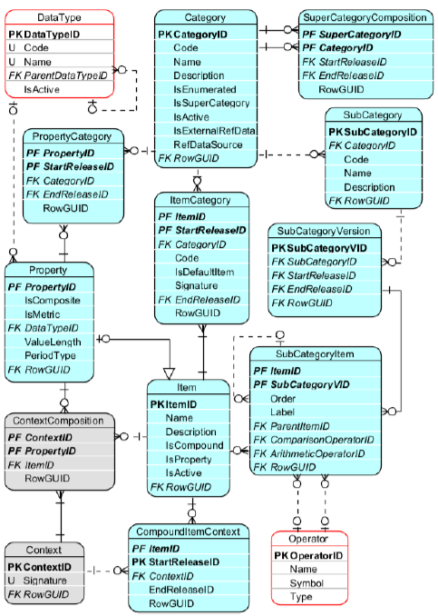
Overview of the DPM 2.0 Data Model
ECB-RESTRICTED
The Glossary includes the definition of:
Categories Codelists
Items Code
Hierarchies (subcategories) HCL
Properties Dimension
Some interesting characteristics
Categories can be enumerated (closed list of values) or Not-enumerated
Properties can be quantitative (metrics measures) or qualitative
Properties can be applied to Tables, Headers or Variables
Optionally, pairs Property-Item can be associated in Contexts
New elements added in DPM 2.0
Compound Items
Super Categories
Historisation of several dictionary elements
11

Slide 12
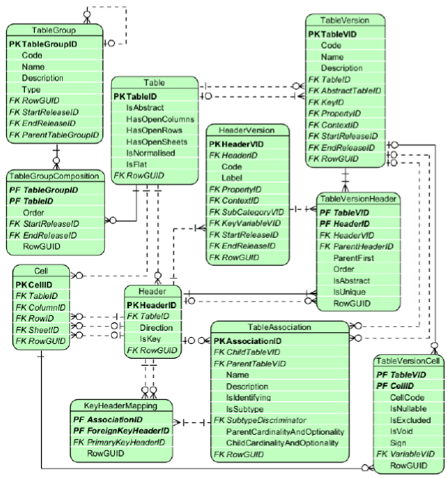
Overview of the DPM 2.0 Data Model
ECB-RESTRICTED
The Rendering includes the definition of:
Tables
Headers
Cells
Some interesting characteristics
Tables can be grouped and associated to another tables
Headers direction can be Row/Column/Sheet (open tables only require columns)
A cell can point to between one and three headers (row-column-sheet). A cell can be mandatory or excluded
A table can be broken down into several abstract tables
New elements added in DPM 2.0
Definition of Key Variable
Point to a Property and may point to a SubCategory
Does not result in a Cell
Links to a Variable
12

Slide 13
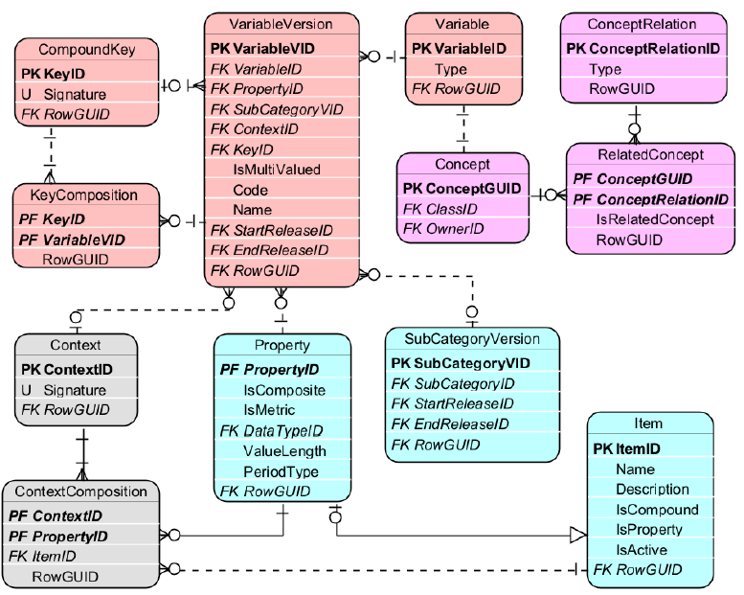
Overview of the DPM 2.0 Data Model
ECB-RESTRICTED
The Variables includes the definition of:
Fact Variables
Key Variables
Attributes
Filing indicators
Some interesting characteristics
A Variable must refer to a Property
A Variable may refer to a SubCategory or to a Context
The composition of a Variable may change between releases
Fact Variables are propagated to Cells on intersection of the Headers
Key Variables are derived from headers which have no cells
Table refers to a KeyComposition
A KeyComposition arranges Key Vars
13

Slide 14
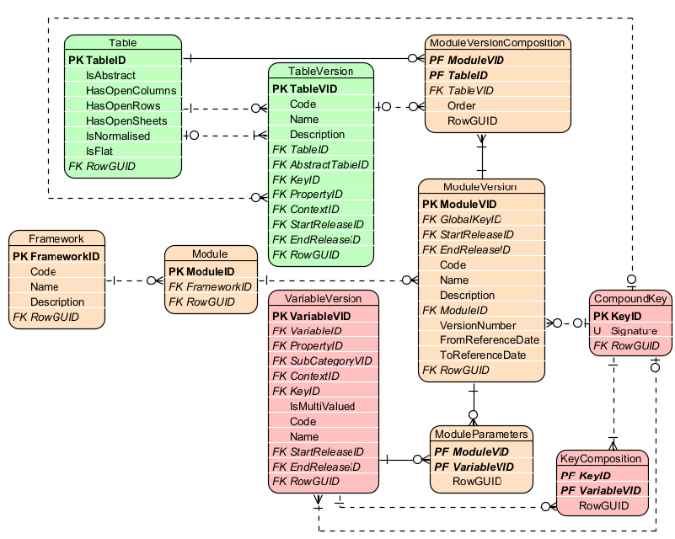
Overview of the DPM 2.0 Data Model
ECB-RESTRICTED
The Packaging includes the definition of:
Modules
Module parameters
Frameworks
Some interesting characteristics
A Framework is a group of regulatory reporting requirements
A Module is a set of information to be reported together (in one report)
Module parameters are Variables applied globally to all Fact Variables of a Module
14

Slide 15
3. Examples of usage of the DPM

Slide 16
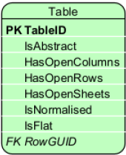
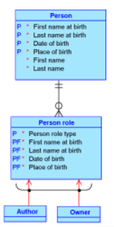
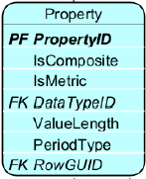
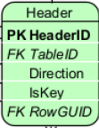
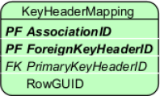
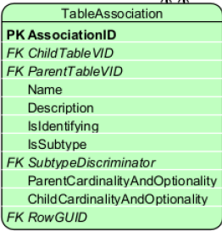
Example of usage of the DPM as ERM
ECB-RESTRICTED
Subset of a data model
16

Slide 17
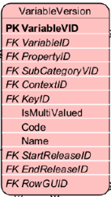
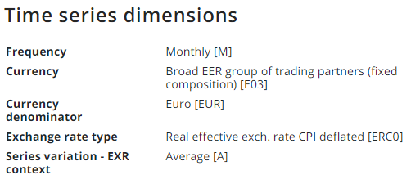
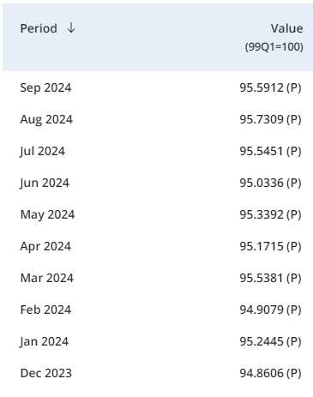
Example of usage of the DPM with SDMX
ECB-RESTRICTED
E.g. Series key: EXR.M.E03.EUR.ERC0.A
Dataset =Exchange rate
Time series
Any collection in SDMX can be modelled in DPM 2.0 with the following mapping:
Each data structure definition can be represented by a Table
Code Lists are mapped to Categories
Codes are mapped to Items
Hierarchical Code Lists are mapped to Subcategories
Dimensions are mapped to Properties
Key Variables are composed of Properties
Attributes are mapped to Attribute Variables
17

Slide 18
4. Usage of DPM by IReF

Slide 19
Usage of DPM by IReF
ECB-RESTRICTED
Assessment and Proof of Concept
In scope
Assessment of DPM (refit) meta model (“metamodel”) capability “[…] for modelling and hosting the IReF implementation model as well as its underlying logical data model”
PoC reflecting DPM refit metamodel structure populated by EBA based on use case provided by IReF PO
Only initial population of the metamodel, no further updates / changes to the IReF models have been assessed
Out of scope
Assessment of tools, user interfaces and usability by users
Integration of the metamodel into IT environments, compatibility with other dictionaries / software
19

Slide 20
Usage of DPM by IReF
ECB-RESTRICTED
Main conclusions of the EG on DPM Refit
DPM ReFit is a valid metamodel for covering IReF requirements
The PoC was performed using the approach of modelling the DPM as a ERM
The main condition is that a governance model needs to be put in place
Additional considerations:
“the modelling approaches used at the EBA for defining the supervisory reports and by IReF are different resulting in practice in a different level of detail on the Metadata”
IT solutions for maintaining the data models & the dictionary using DPM Refit would need to be investigated separately
Semantic considerations were not taken into account when analysing feasibility of DPM Refit metamodel
20

Slide 21
Annex

