Slide 1
SDMX in a FAIR official statistics landscape
Statistics Netherlands
uRos23
COSMOS24
Olav ten Bosch, Edwin de Jonge, Henk Laloli
CC BY 4.0
12th SDMX Experts workshop, 7-11 Oct. Amsterdam

Slide 2
Contents
The official statistics landscape
Open source software for access; awesome list
Features commonly offered: towards FAIRness
And what about linked data?
Wrap-up

Slide 3
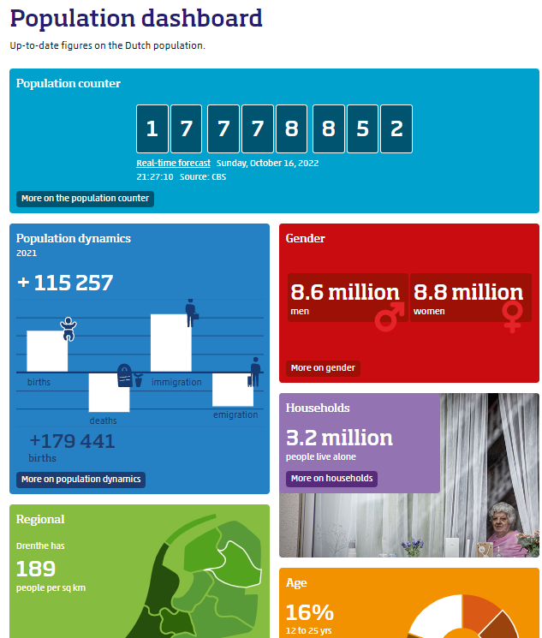
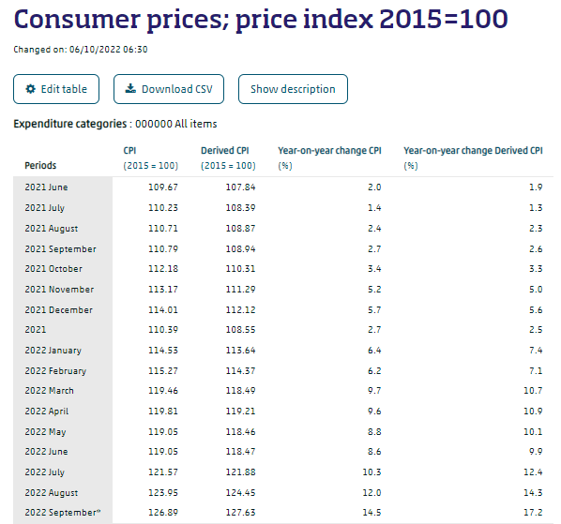
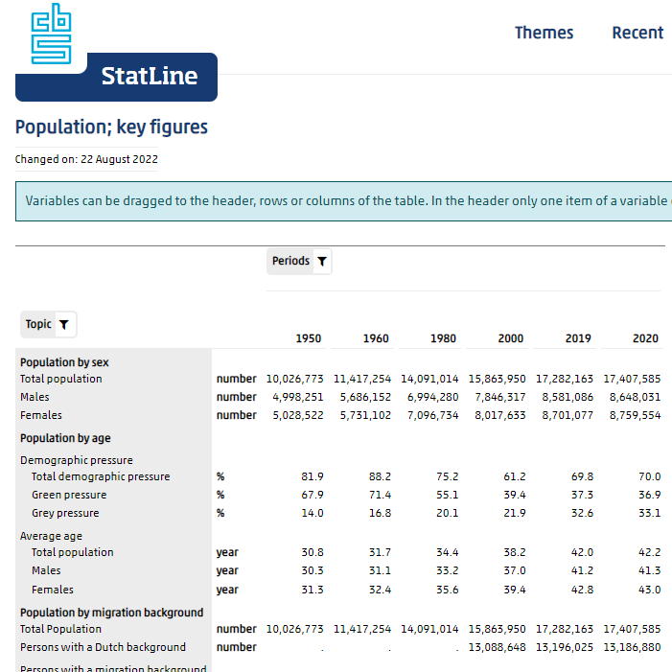
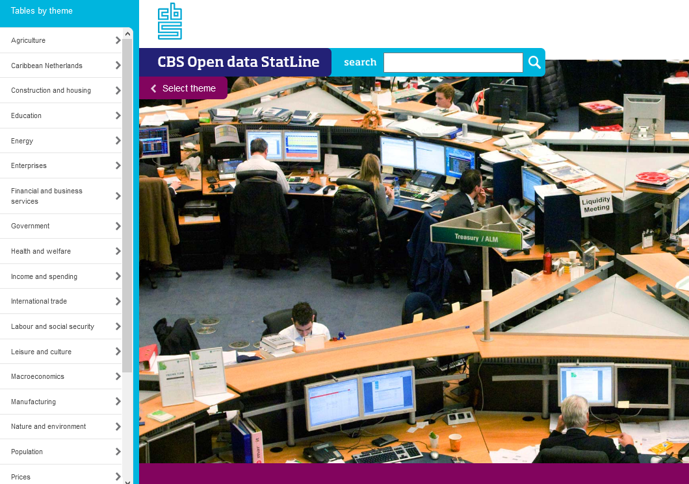
Statistics Netherlands output
Layered Open
Data architecture
News articles
Thematic pages & visualisations
Selected data slices
Statistical Estimates

Slide 4
Statistical dissemination database
At the core is a statistical database:
e.g. at Statistics Netherlands / CBS:
~ 4.500 multidimensional tables
~ 2.4 Billion statistical estimates (active tables)
Publicly available
Search, select / filter, download
Rich metadata, on our way to SDMX
Application programming interface (API): Odata
Convenience packages in R and Python

Slide 5
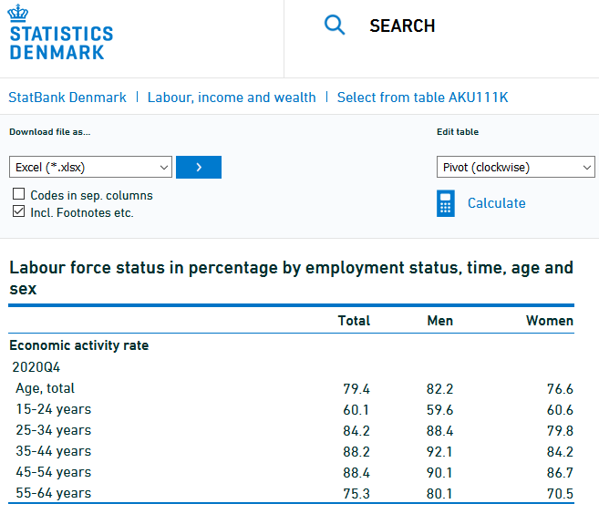
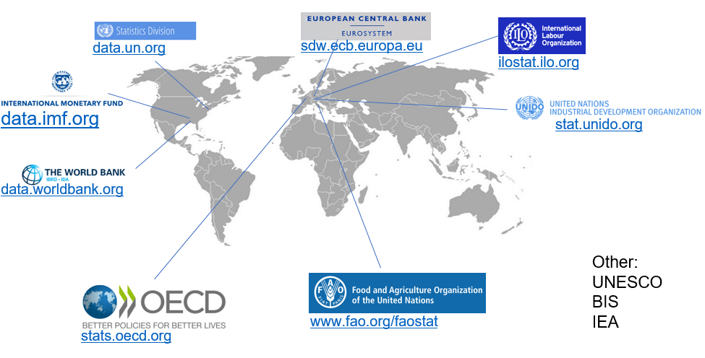
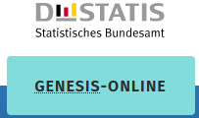
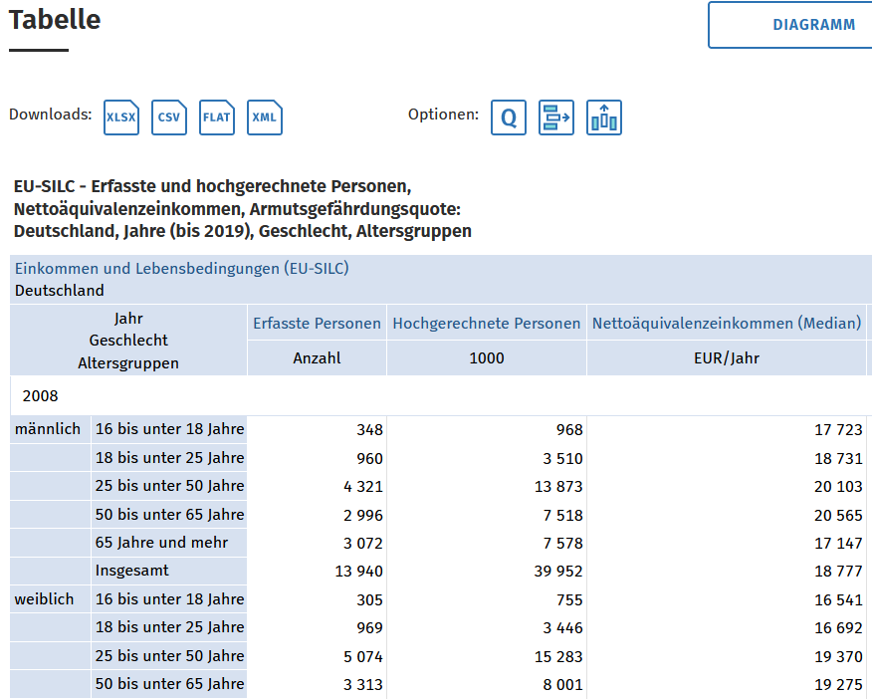
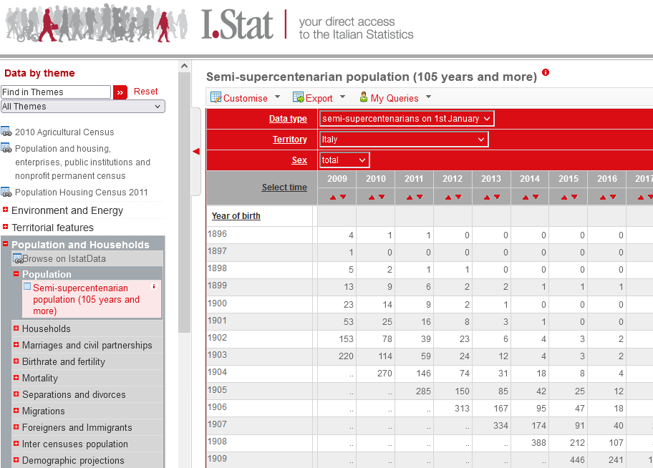
Official Statistics landscape (OSL)
DK
OSL = collective output of all official statistics organizations
NL
DE
IT

Slide 6
Official Statistics landscape (OSL)
DK
OSL = collective output of all official statistics organizations
NL
Happy user?
DE
IT

Slide 7
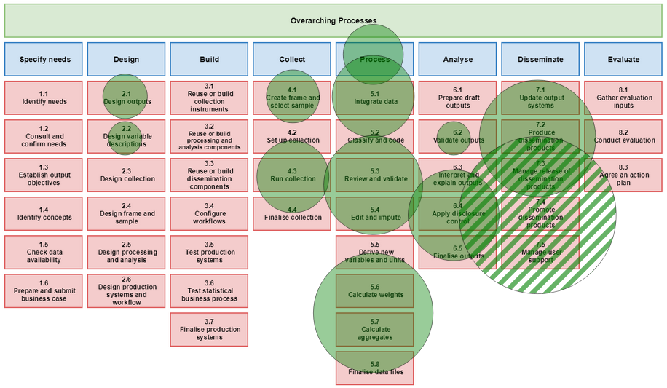
Awesome list of statistical software
A community approach to knowledge management
To collectively remember useful software in official statistics
Started UNECE SDE 2017
Maintained by statistical community
How:
Using awesome concept
awesomeofficialstatistics.org
Largest category: “Access to official statistics”
uRos17-23
# awesome packages by GSBPM

Slide 8
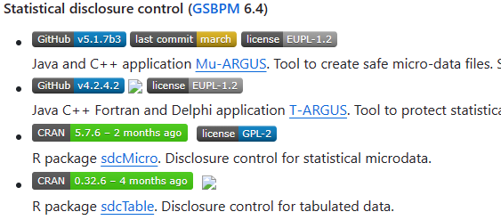
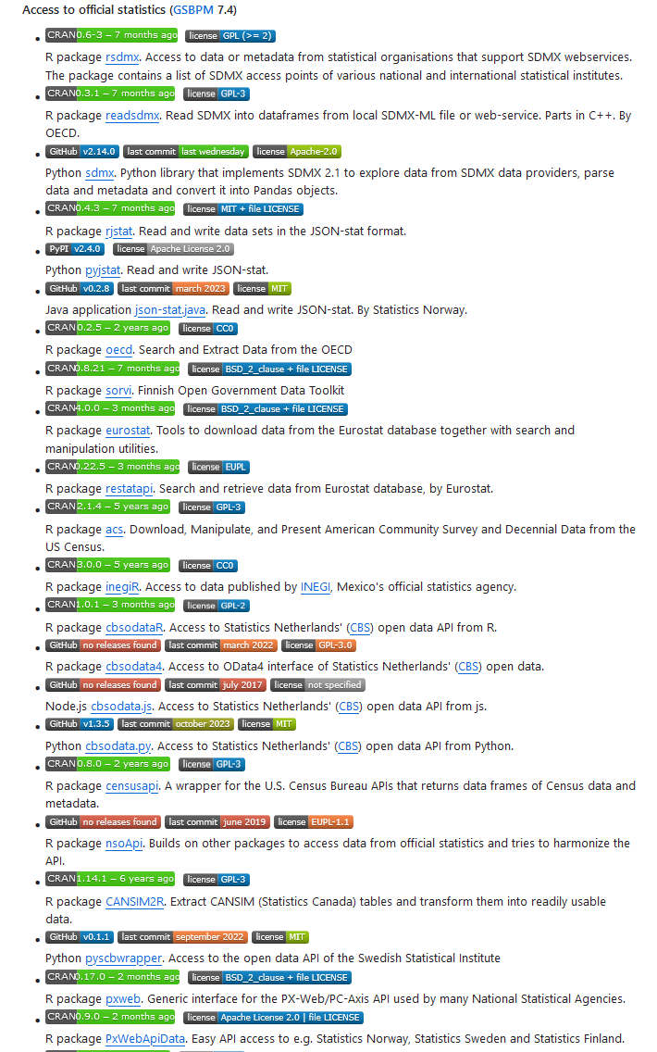
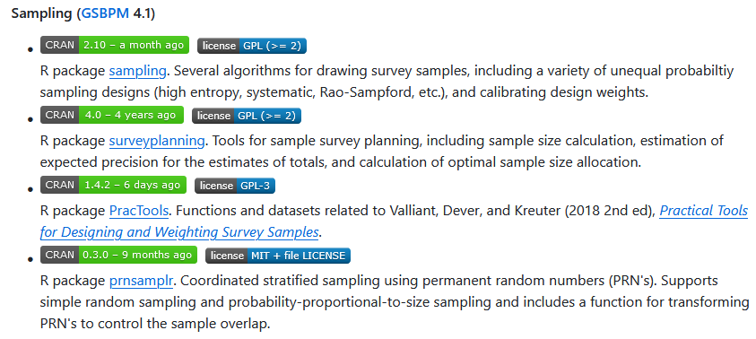
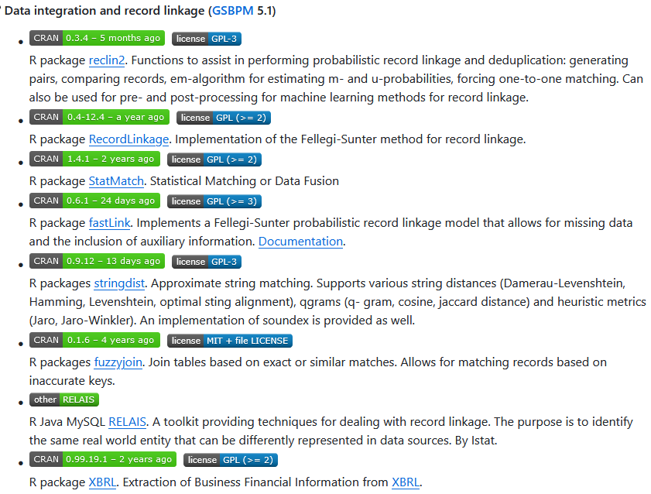
Over 30 software packages, giving access to > 60 dataproviders, majority are R-packages

Slide 9
Software layer surrounding OSL
> 30 software packages
> 60 dataproviders
> majority R-packages
> Some use SDMX
DK
OSL
NL
Data user
DE
IT

Slide 10
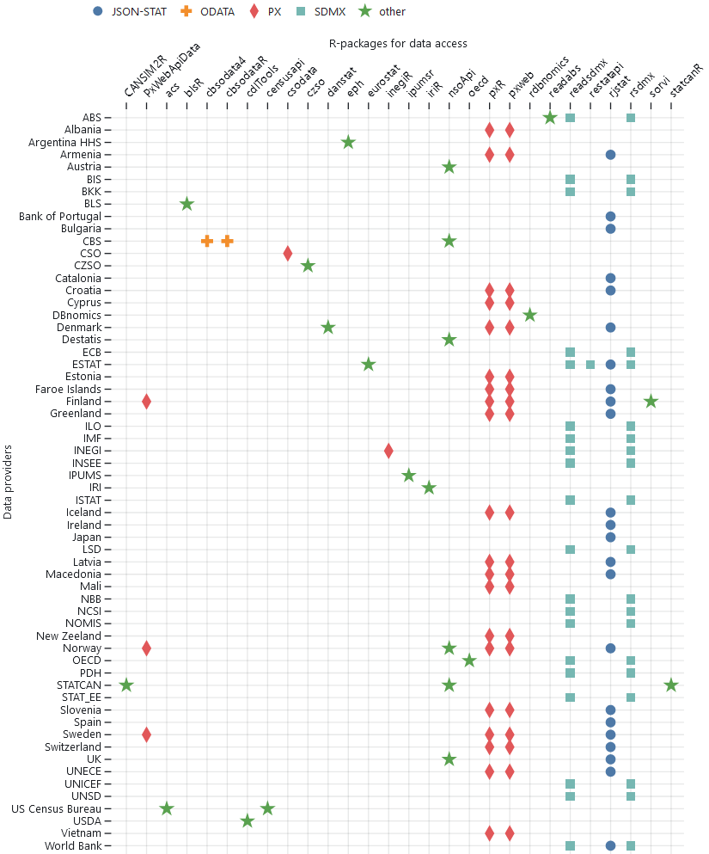
“access to official statistics” software landscape
Matrix derived from documentation and links to web pages and packages execution:
packages (38) x dataproviders (60) x standards (5)
Standards:
https://observablehq.com/@olavtenbosch/access_to_official_statistics

Slide 11
“access to official statistics” software landscape
Matrix from docs, links to web pages and packages execution:
packages (38) x dataproviders (60) x standards (5)
Standards:
JSON-STAT/PX v. SDMX: almost disjunct worlds
ODATA: CBS only
https://observablehq.com/@olavtenbosch/access_to_official_statistics

Slide 12
“access to official statistics” software landscape
Standards-oriented packages:
rsdmx, readsdmx, rjstat, px*
Data provider-centric packages:
inegiR, readabs, statcanR, eurostat
Official statistics aggregator sites:
rdbnomics: economic data ipumsr: census & survey data time&space harmonised
https://observablehq.com/@olavtenbosch/access_to_official_statistics

Slide 13
Features commonly offered
endpoint hiding: wrapping the preconfigured endpoint(s) in a function
catalogue retrieval: to list the availability datasets on the endpoint(s)
search: to search for datasets or within datasets
endpoint queries: query for subsets / slices on the endpoint(s) side
local queries: the ability to easily slice or filter on the client
caching: preventing unnecessary roundtrips
cartographic queries: retrieve a geo data or a map with the data
registry access: access to coordinated metadata in registries
Could we build a “one-for-all” solution with all features?
Notes:
Link to COSMOS paper (continuation of research)

Slide 14
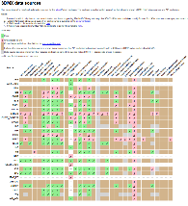
Features powerful in SDMX (1)
R
Node
rsdmx
sdmx
-rest
endpoint hiding: wrapping the preconfigured endpoint(s) in a function
catalogue retrieval: to list the availability datasets on the endpoint(s)
search: to search for datasets or within datasets
endpoint queries: query for subsets / slices on the endpoint(s) side
local queries: the ability to easily slice or filter on the client
caching: preventing unnecessary roundtrips
cartographic queries: retrieve a geo data or a map with the data
registry access: access to coordinated metadata in registries
Py
sdmx1
khaeru.github.io/sdmx/
Notes:
Link to COSMOS paper (continuation of research)

Slide 15
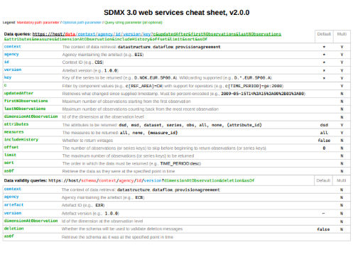
Features powerful in SDMX (2)
endpoint hiding: wrapping the preconfigured endpoint(s) in a function
catalogue retrieval: to list the availability datasets on the endpoint(s)
search: to search for datasets or within datasets
endpoint queries: query for subsets / slices on the endpoint(s) side
local queries: the ability to easily slice or filter on the client
caching: preventing unnecessary roundtrips
cartographic queries: retrieve a geo data or a map with the data
registry access: access to coordinated metadata in registries
Rich API &
cheat sheets
Notes:
Link to COSMOS paper (continuation of research)

Slide 16
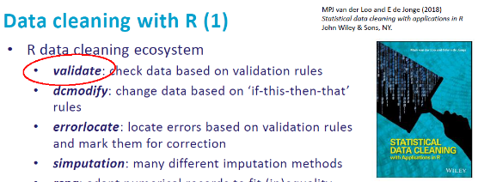
Features powerful in SDMX (3)
endpoint hiding: wrapping the preconfigured endpoint(s) in a function
catalogue retrieval: to list the availability datasets on the endpoint(s)
search: to search for datasets or within datasets
endpoint queries: query for subsets / slices on the endpoint(s) side
local queries: the ability to easily slice or filter on the client
caching: preventing unnecessary roundtrips
cartographic queries: retrieve a geo data or a map with the data
registry access: access to coordinated metadata in registries
2021
Validating data in R using SDMX registry
Notes:
Link to COSMOS paper (continuation of research)

Slide 17
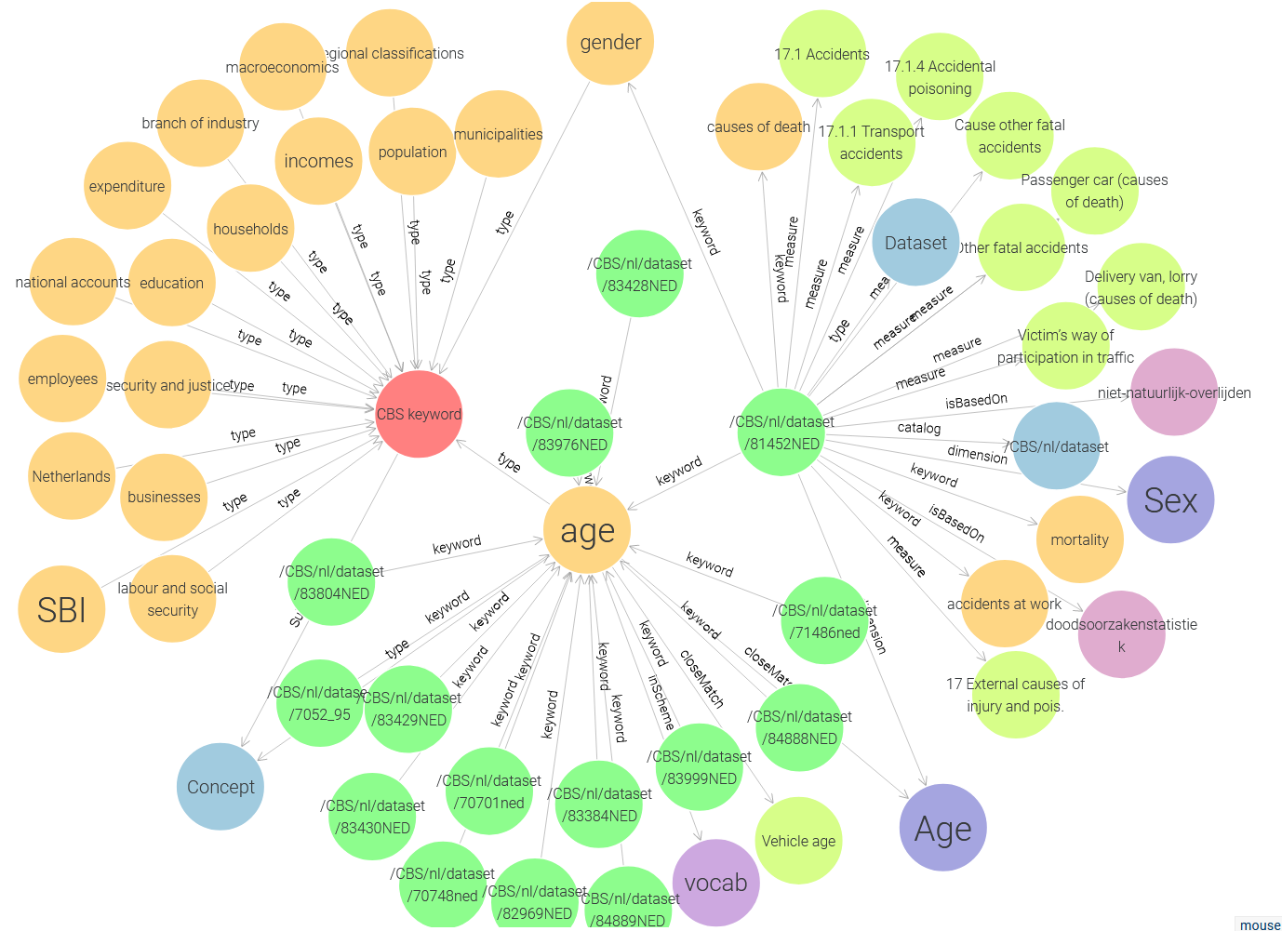
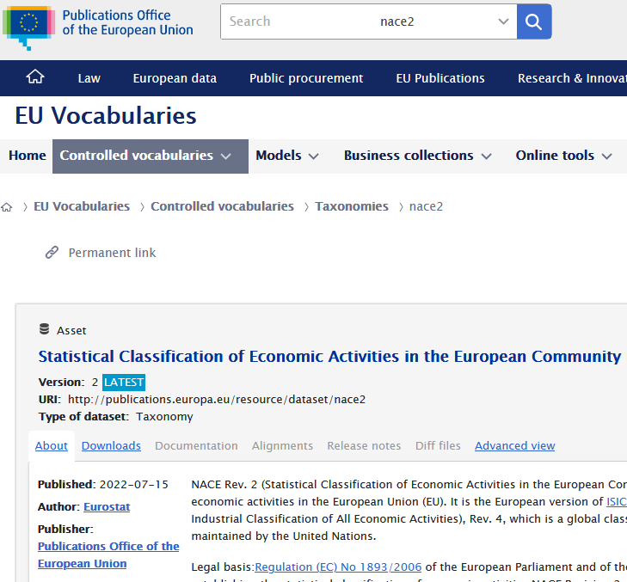
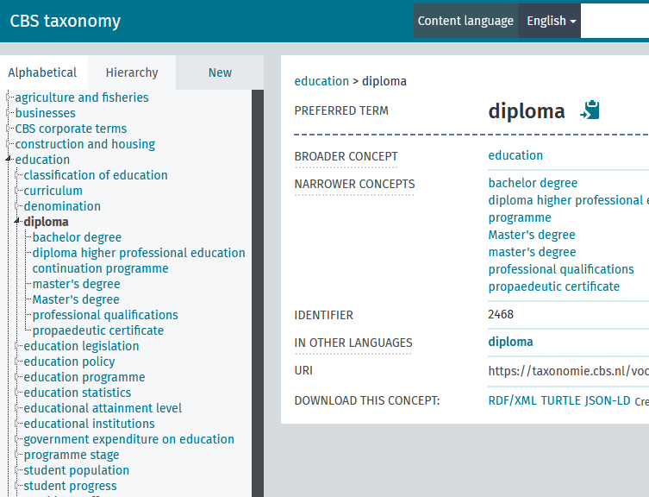
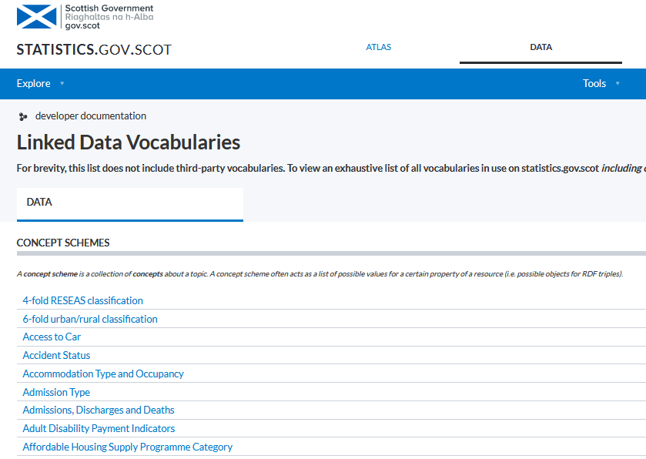
And what about linked data? (1)
Multiple organisations offer (meta)data as Linked Data (LD)
URIs, SKOS, XKOS, schema.org, SPARQL
CBS Knowledge graph
op.europa.eu/en/web/eu-vocabularies/eurostat
vocabs.cbs.nl/taxonomie
statistics.gov.scot

Slide 18
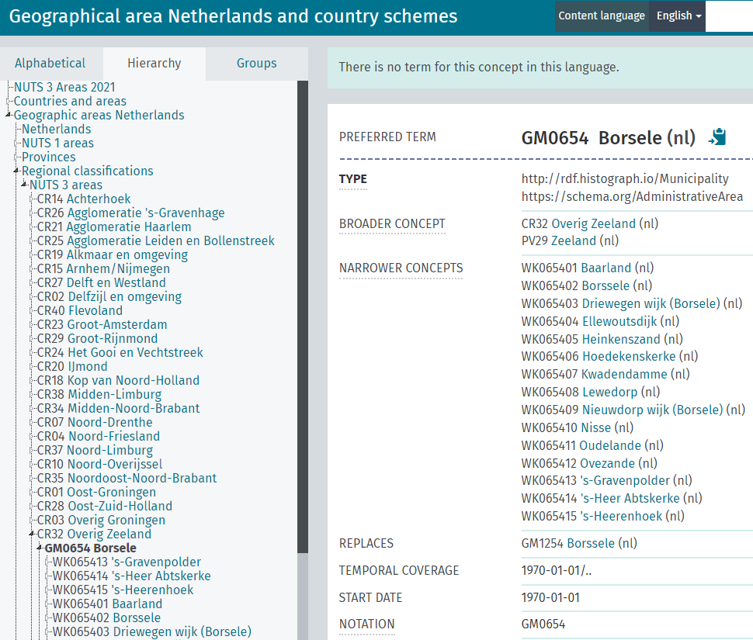
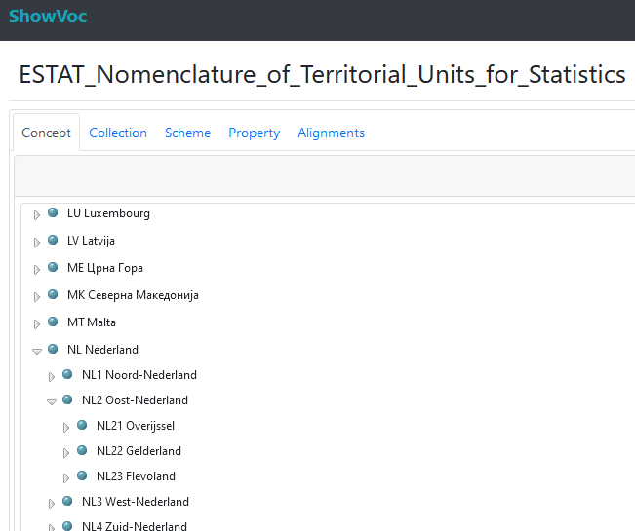
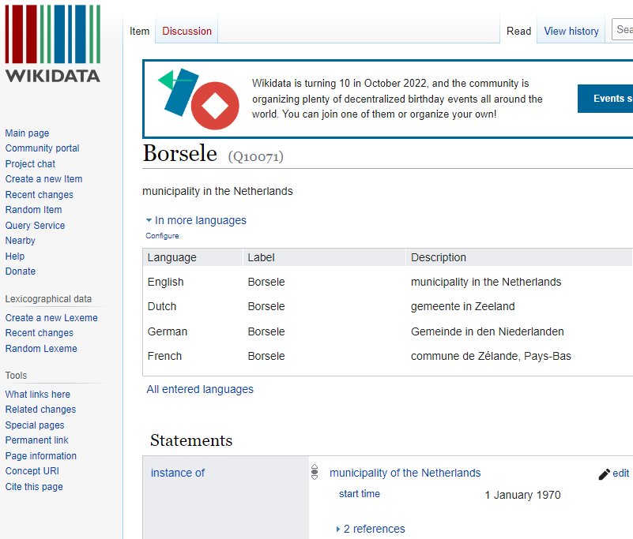
And what about linked data? (2)
Statistical metadata as LD helps modeling changes in metadata
& linkability
Linking within ESS
Linking outside ESS
vocabs.cbs.nl/cbs_geo/en

Slide 19
Reflections on linked data (LD) in offstats
LD is well suited to link across ESS and to non-ESS communities
LD suited to model complex statistical metadata dependencies
Example: a complete historical graph of Dutch geo-changes on municipality level for over two centuries
Challenges:
LD can be perceived complex to end-users => need for data stories
Flexibility of LD model gives room for different implementations among ESS => need for harmonization
Food for thought: with the current AI training data hunger: could statistical LD content more easily picked up than ESS-specific standards like SDMX?

Slide 20
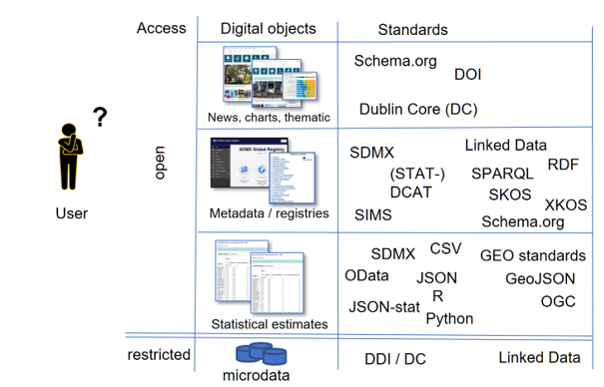
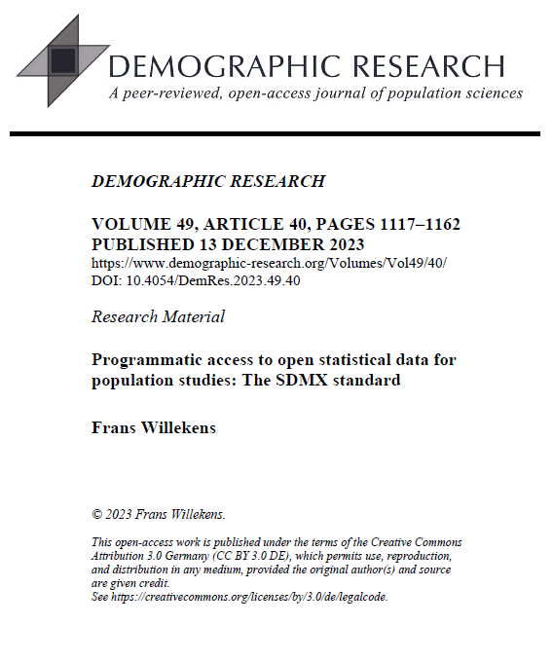
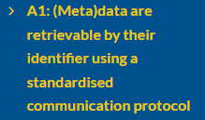
# standards
Identifiability
Note the software layer!
Work with communities
Becoming (more) FAIR…

Slide 21
Wrap-up
Official Statistics Landscape grows towards standardisation: SDMX, JSON-stat/PX
Data user can choose from over 30 open source software packages, each offering specific functionality to over 60 data sources
Many NSIs offer targeted (R-)packages for data and metadata access
Common features in software layer identifie
SDMX scores well on 3 of the features
There is no software package that provides access to all official statistics
Dream:
one generic (R-)package to access all official statistics content from all dataproviders supporting maximum FAIRness*
offstats community and the open source / data science community have to work together to reach that goal
* FAIR: Findable, Accesible, Interoperable, Reusable
Feedback: Olav ten Bosch o.tenbosch@cbs.nl pubs
awesomeofficialstatistics.org
Please !

