Slide 1
Evaluating VTL in the scope of the Common Data Management project of ESCB/SSM
Noah Börger and Sergy Grebenshchikov (Deutsche Bundesbank) and Katrin Heinze (European Central Bank)
12th SDMX Experts workshop
7-11 October 2024
Amsterdam, the Netherlands

Slide 2
Contents
Introduction: ESCB/SSM project “Common Data Management” (CDM)
“Integrated Reporting Framework” (IReF) as the first CDM use case
The role of VTL
Proof of Concepts in CDM: Evaluation of VTL for specific use cases
Summary and outlook

Slide 3
1
Introduction: ESCB/SSM project CDM

Slide 4
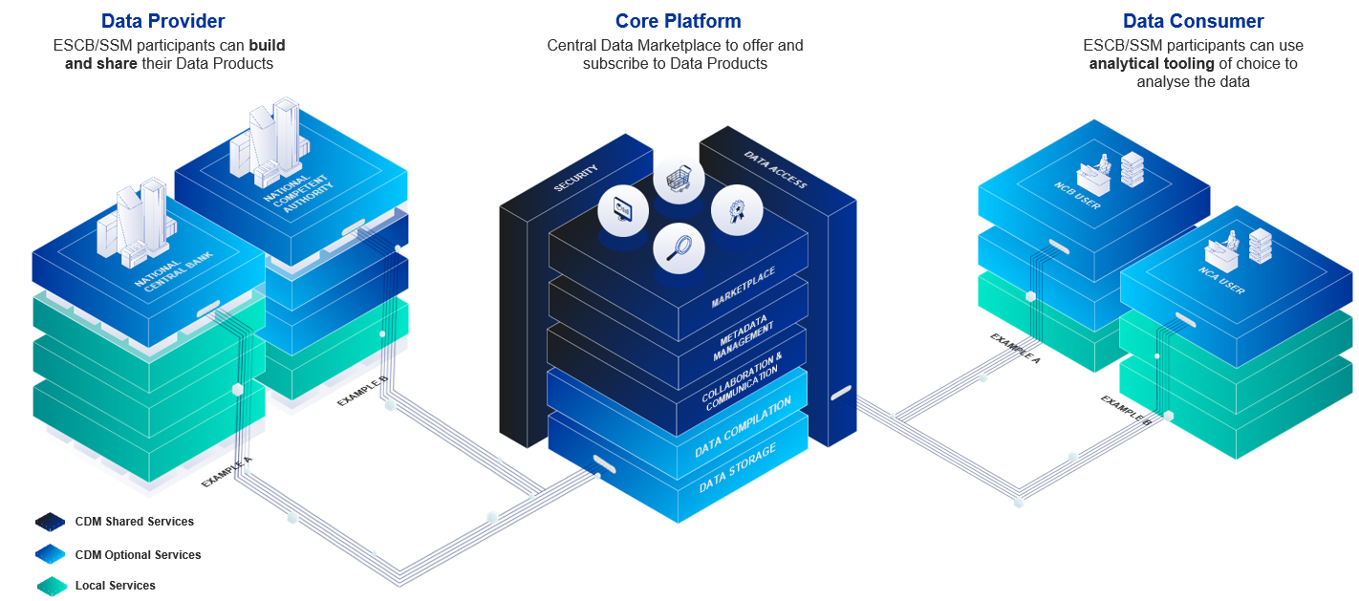
Introduction to CDM
Overview and pillars
European Scope: ESCB/SSM end-to-end data platform
End2End: From collection to insight generation
Equal analytical access: Collaboration on data products
Sources:
https://www.ecb.europa.eu/stats/ecb_statistics/reporting/shared/pdf/IReF_presentation240503.en.pdf
https://2024.eurofiling.info/wp-content/uploads/CDM_KatrinHeinze_Eurofiling_2024.pdf
https://www.bis.org/ifc/events/ifc_230716_20_agenda/IPS241PresentationFischer.pdf

Slide 5


Introduction to CDM
The main elements of CDM
CDM Platform
CDM Platform
Business Data Catalogue
To be selected
CDM Portal
Security
Internal Portal
External Portal
External user Identity
CDM Data Management Components
Authorisation Management
Data
Ingestion
Service
Business Collaboration Service
Management & Monitoring
Service
Reference Data Service
Metadata Services
Software Repositories | CI/CD
Data Authorization Platform
Legend
Data Production – Blueprints n
Data Consumption – Blueprints n
Data Access
ESCB User Interface
Data Production – Blueprints …
Data Consumption – Blueprints …
Other Engines (Search…)
Data Production – Blueprints 1
Data Consumption – Blueprints 1
ESCB API
Dashboards
Data IDE
SQL Query Engine
Generic Pipeline Service
Technical Validation
Service
Framework Pipeline Management & Monitoring
Cloud Provider UI (ESCB)
Cloud Provider API (ESCB)
File Access
Data Pipeline IT Workbench
Validation and Transformation
Analytics & ML Tooling
CDM SDK
Public Internet User Interface
Storage
Public Internet API
SaaS
CDM Landing Zone
Notes:
Reference: https://darwin.escb.eu/livelink/livelink/app/nodes/1695174055

Slide 6
2
IReF as first CDM use case

Slide 7
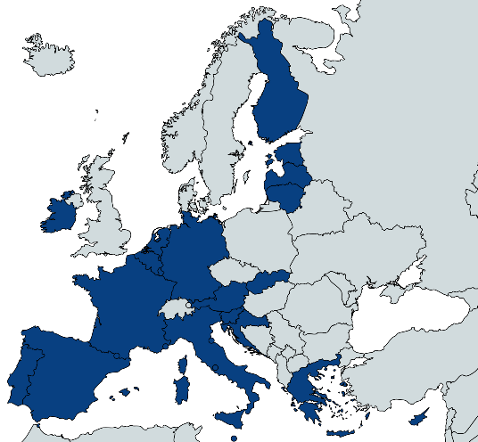
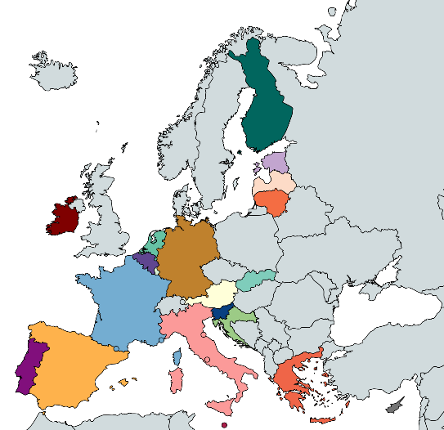
IReF
Goal for standardised reporting
Current Situation
Statistical requirements differ across European countries
20 countries 20 different national specifications 20 different implementations
Integrated Reporting Framework
Reducing reporting burden by integrating statistical reporting for banks
  define once, regulate once, collect once
  perform as a system
First step towards a common statistical, prudential and resolution reporting
  tangible achievements in this direction.
  Finrep Solo alignment, Logical Data Model, exchange format currently tested with industry and aligned with EBA
Source: https://www.ecb.europa.eu/stats/ecb_statistics/reporting/shared/pdf/IReF_presentation240503.en.pdf
Notes:
Reference: https://darwin.escb.eu/livelink/livelink/app/nodes/1695174055

Slide 8
IReF
IReF as a first major use case of CDM
CDM programme aims to standardize data management for the ESCB and SSM
It involes creating the required architecture for the data management use cases
The IReF represents the first use case of the CDM.
Potential
future
business use case
(ESCB/
SSM)
IReF
Business use case
(ESCB)
Common Data Management
Data infrastructure & platforms
(ESCB/SSM)
Sources:
https://www.ecb.europa.eu/stats/ecb_statistics/reporting/shared/pdf/IReF_presentation240503.en.pdf
https://talent.ecb.europa.eu/careers/JobDetail/Economist-Statisticians-IReF-Programme-Office-DG-Statistics/7803
Notes:
Reference: https://darwin.escb.eu/livelink/livelink/app/nodes/1695174055

Slide 9
3
The role of VTL

Slide 10
The role of VTL:
Validations and transformations designed by business users
Current business requirements include:
Providing ability to define validation and transformation rules via a business rule language
Providing convenient IDE with syntax highlighting and auto-complete capabilities
Setting up trainings and tutorials for the business rule language
✔️
❌
Detailed evaluation of VTL within CDM
Notes:
Reference: https://darwin.escb.eu/livelink/livelink/app/nodes/1695174055

Slide 11
4
PoCs in CDM: Evaluation of VTL for specific use cases

Slide 12
4.1 PoCs
Development tools to support user activity

Slide 13
PoCs in CDM:
Development Tooling: Interactive tutorial

Slide 19

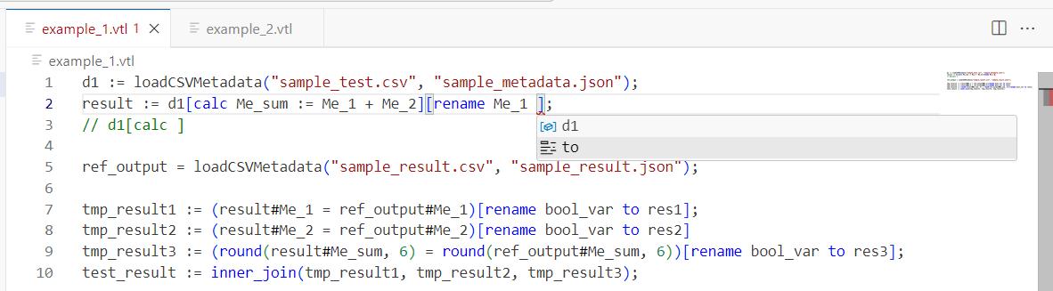
PoCs in CDM:
Development Tooling: Syntax highlighting and completion
LSP

Slide 20
4.2 PoCs
Comparison of VTL implementation with defined standard

Slide 21

PoCs in CDM:
Coverage of and deviation from the VTL standard
Trevas engine implements the VTL standard and can be used for spark and InMemory processing (Spark mode has been used for testing)
Test data: Large set of test cases from BdI (developed for tests of their own engine)
High level results:
  Minor syntactic deviations from the VTL standard (e.g. case sensitivity of variable names, regex pattern syntax, null handling, ...)
  Missing functionalities (e.g. missing functions and transformations)
  Sequence of transformations defined by the order in which statements are written (i.e. the Direct Acyclic Graph of the script is not constructed).
VTL TFs is putting efforts into providing a standardized test set for engine developers, ensuring stricter adherence to the VTL standard in the future.

Slide 22
4.3 PoCs
Performance assessment of VTL engines

Slide 23

PoCs in CDM:
Performance: Trevas on AWS Glue
Why AWS Glue?
Fully managed & Serverless
Spark ETL engine
Flexible scheduling and pricing model
Integration capabilities in current AWS architecture drafts of CDM
Trevas adjustment
The current latest version (4.0) of AWS Glue currently only supports JDK 8
Downgrade of Trevas to enable execution in Glue environment
Results
Runtime comparable with a PySpark-Job implementing the same transformations
The additoinal VTL layer on top of Spark does not introduce significant performance disadvantages
→ WIP: Improve setup of the spark environment in order to fulfill all of our performance requirements.

Slide 24

PoCs in CDM:
Performance: MeaningfulData Engine InMemory
Why InMemory?
Get rid of Spark shuffling & Glue provisioning for small datasets
Benefit from having the data locally in the memory
Combination of Spark & InMemory processing can be useful to benefit from both technologies
Tests with current AnaCredit-like validations
Engine and rules already available from MeaningfulData
Straight forward comparision with current validation runtimes of AnaCredit system
Results
Runtime comparable to current AnaCredit system
The additional layer of VTL does not introduce significant performance disadvantages

Slide 25
5
Summary and outlook

Slide 26
Summary and outlook
Future PoCs on performance requirements (VTL on Spark)
Expand contribution on resolving the VTL findings
Implement recovery for language server on invalid syntax findings
Extend current interactive user guide to enable business user a quick start on VTL

Slide 27




Acknowledgements:
Many thanks for fruitful collaboration!
Nicolas Laval, Hadrien Kohl, Romain Tailhurat
Antonio Olleros, Jesús Miguel Simón Martín,
Javier Hernandez, Gustavo Homem
and in particular the VTL Task Force

Slide 28
Appendix and optional slides

Slide 29
PoCs in CDM:
Coverage of and deviation from the VTL standard
Trevas engine implements the VTL standard and can be used for spark and InMemory processing with the following minor VTL standard deviations:
Not implemented functions
Deviations in the handling of null and zero values
Case sensitivity of variable names
Not standardized regular expression pattern syntax
Unsupported omission of a parameter with an underscore
Operator-specific errors and deviations
Limited support for scalars in Trevas transformations
Sequence of transformations defined by the order in which statements are written (i.e. DAG of the script is not constructed)
VTL TFs is putting efforts into providing a standardized test set for engine developers, ensuring stricter adherence to the VTL standard in the future.

Slide 30
Validation & Transformation (V & T) Engine
V&T Engine is a dedicated component which executes business language statements
V&T statements (business rules) are retrieved from the Metadata Service (BdI component, AAG presentation on 27.03.2024)
  As a first use case, VTL is a current candidate for a business language
  It is generally expected that business rules are stored in the metadata repository in a structured way (aligned with Metadata Service):
    Business rules are stored individually in metadata repository
    Dynamic enabling/disabling of business rules is completely metadata driven
    Historicity/versioning at single business rule level
V&T Engine guarantees that business rules are executed efficiently (e.g. as a single script, if needed and expected by business user) – even if they are separately defined, versioned, and stored.
V&T Engine supports multitenancy – e.g. can be run in specific accounts of specific teams.
Enable to use cache services where possible

Slide 31
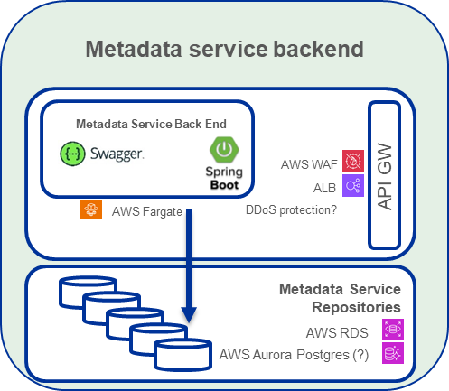








V&T Engine (submission level)
Input event
(incl input parameters, context, …)
AWS StepFunction
A2A / REST
Fetch metdata
(e.g. granular rules)
AWS Lambda
ElastiCache
AWS Glue – “supports Java versions <= 8”
TREVAS (VTL Engine) – JDK 11
Apache Spark on EMR – JDK 17
Script pre-procressor:
Parsing of granular rules
into a single VTL script
Resolve parametrization
in the VTL Script
(e.g. data version)
Resolve input data location
AWS Lambda
AWS Lambda
Spark Engine
(e.g. AWS Glue)
CDM Data Storage
CDM Data Storage
AWS Glue Job
Input data products (e.g. submission)
Reference data (RIAD snapshot, CSDB snapshot
AWS Lambda
Validation results/finidings
Transformation results
Query Engine
Fetch input data
& verify availability
VTL-on-Spark
Data processing
S3 Bucket/ Internal Temporary Data / automated expiring (lifecycle policy)
Write data access
AWS Lambda
Store results
Output event
(incl. monitoring)
Identity & Access Management System(s); Authorisazion Platform (?)

