Slide 1
Checklist for VTL project
12th SDMX Experts workshop
7-11 October 2024
Amsterdam, the Netherlands

Slide 2
Introducing VTL in a statistical business process
Pros
Standardization Advantages: Facilitates movement towards a standardized approach.
Internal and External Sharing: Enables the sharing of resources both within and outside the organization.
Community Collaboration: Provides the opportunity to benefits of a community actively working on the language.
Cons
Training Expenses: Costs associated with training personnel on the language.
Integration Costs: Expenses related to the introduction of the language into the existing statistical business process.

Slide 3
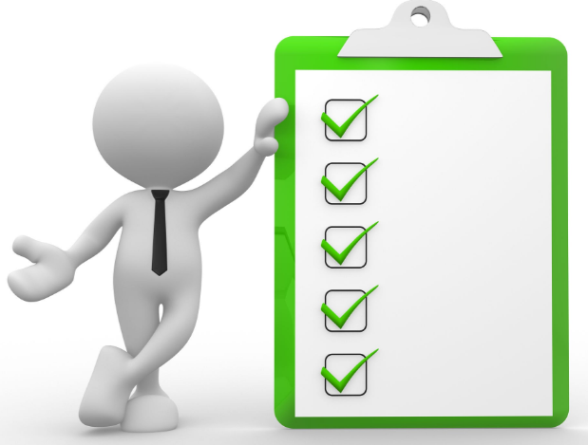
How to move on a new VTL project?
At what stage of the statistical business process?
Which kind of rules: validation, transformation or both?
On which process? Already existing or a new one?
Are there external projects, mandatory or not, to which country is required to participate?
Was management properly involved?
Define a checklist

Slide 4
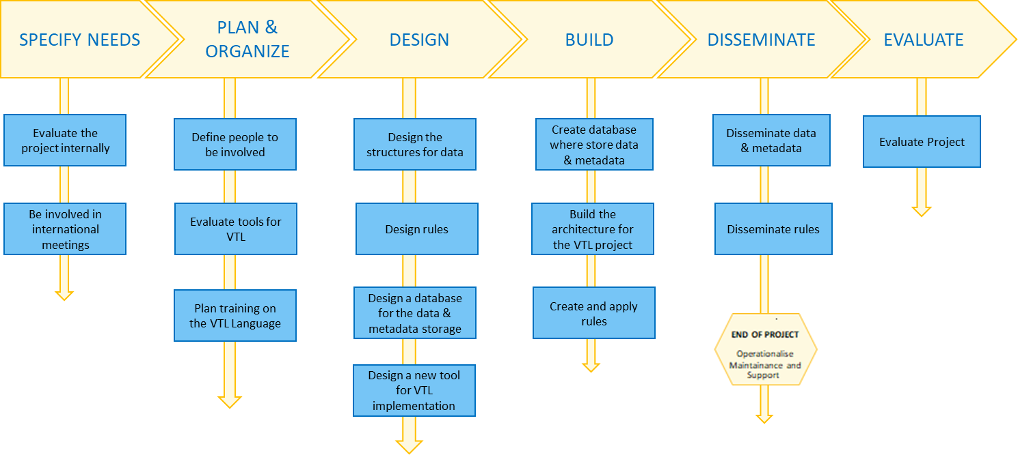
Checklist for VTL project

Slide 5
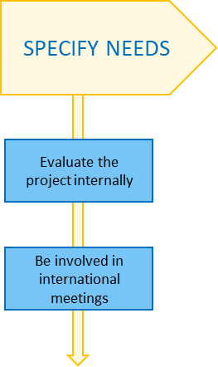
Specify needs (1/2)
Where to intervene:
Identify at which point in the statistical process you want to intervene in applying VTL.
What are the critical steps where transformation can bring the maximum benefits?
Identify the specific types (domain) of data within your statistical process on which adopt VTL.
Transformation Objective:
Clearly define what you aim to achieve through the data transformation (simplify the data life cycle, harmonize rules…)
What are the ultimate goals that should emerge from the transformation process? (data collection, data sharing, data lineage…)
Internal Communication
It is essential to share, internally, ideas and strategies. Fix periodical meetings to monitoring the project status and to keep management informed about the progress of the action. This internal communication ensures clear dissemination of information, facilitating effective project management.

Slide 6
Specify needs (2/2)
Participate to international meeting
When the project originates from a Eurostat initiative, such as macro data validation, active participation in international meetings is crucial. This involvement helps in gaining a deeper understanding of project requirements, the roadmap, and guidelines. It also allows for the identification of potential issues and critical points that may arise.
Sharing Experiences with Other Countries
By actively engaging in international meetings, there is an opportunity to share experiences with other countries. This collaborative exchange facilitates the creation of a supportive network among nations, enabling joint problem-solving and addressing common challenges.

Slide 7
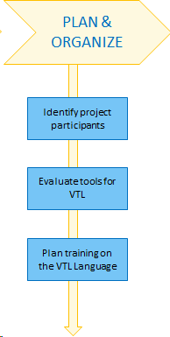
Plan & organize
Identify Project Participants:
Clearly identify individuals involved in the VTL project, categorizing them into statisticians and IT professionals.
Encourage Cross-Functional Collaboration: promote collaboration between statisticians and IT personnel by involving both profiles in the project.
Assess Knowledge Levels: understand the current level of knowledge among project participants regarding the Validation and Transformation Language (VTL). Assess participants' familiarity with VTL tools defined as relevant to the project.
Evaluate tools for VTL:
Determine Tool Suitability: depending existing architecture implemented in the internal statistical business process, identify the most suitable tools for VTL already existing.
Plan Implementation: If needed, think up a plan to implement new tools that align with the statistical business process architecture.
Plan Training on the VTL language:
Develop Training Programs: based on the assessed knowledge levels, design training programs to support proficiency levels in VTL.
External Trainers: if necessary, consider engaging external trainers to provide specialized training sessions.

Slide 8
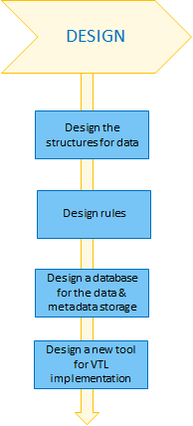
Design – Structures and rules
Design structures
Input:
Clearly outline the data on which work is required. Differentiate between scenarios where the data structure is already internally or externally predefined (e.g., by Eurostat), and cases where the structure needs to be defined.
Identify Metadata: define all metadata linked to the data structure. Identify value domains or subset value domains related to individual components.
If metadata are not organized using the VTL IM, evaluate the feasibility and benefits of adopting the VTL IM.
Output:
Specify Disseminated Outputs: clearly outline the outputs that should be disseminated.
Design Rules:
Validation and Transformation Rules:
Compile rules essential for the validation and transformation steps of the data.
Ensure rules cover all aspects of the data processing.
Exploration of previous experiences: investigate prior experiences with similar data at national or international levels, with a focus on experiences within the context of VTL.

Slide 9
Design - Rules
DATA COLLECTION
Implement VTL rules for Data Collection
MICRO DATA VALIDATION
Implement VTL rules:
Organise rules gruping by types (es. Level of validation).
Reuse when possible, rules defined for Data Collection.
TRASFORM and AGGREGATE DATA
Rules for data dissemination:
Reuse some rules for micro with aggregation functions (e.g. Hierarchical Ruleset).
Define, eventually, some other specific rules (e.g to modify Value domains).
Rules for output validation: Rules are often provided by Eurostat
Create New Data Sets: create further Data Sets or different aggregation depending also from the data disclosure
DATA COLLECTION
MICRO DATA VALIDATION
TRASFORM and AGGREGATE DATA

Slide 10
Design – Database schema
Design database
Design a vtl database where to store rules. Establish a dedicated database to store VTL rules, transformations, their inputs and output.
Should be data set stored in the same database? Should be useful to implement a data virtualization layer?
Decide whether to store structural metadata in the VTL database. If they not adhere to VTL IM, evaluate pros and cons:
Option1: In VTL Database
Option 2: Define mapping Between Environments

Slide 11
Design – A VTL compliant database
Mapping
VTL IM
Dataset
Value Domain
Value Domain Subset
Data Structure
Identifier
Measure
Attribute
Propretary Schema
SDMX Mapping
Data db
SDMX Schema
Structural Metadata

Slide 12
Design - Tools
Design a new tool for VTL:
Possible building blocks of the tool:
User Interface (UI) Implementation: develop an intuitive UI for users to input and manage VTL rules.
Syntax and Semantic Validation Module: implement a syntax validation module based on the provided EBNF for VTL.
Rule Management Module: develop a module for creating, editing, and deleting VTL rules.
Metadata Handling Module:
Implement a metadata handling module for managing associated data structures.
Ensure the module can easily integrate with external sources for metadata updates.
Validation and Transformation Engine Module: develop a validation and transformation engine as a reusable component for executing VTL rules on datasets.
Dissemination Block: develop a dissemination block for exporting validated and transformed data in various output formats and dissemination channels.
Security Module: implement a security module for user authentication and authorization.

Slide 13
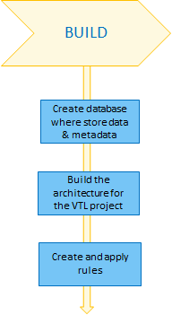
Build
Create Database:
Evaluate different Database Management Systems (DBMS) based on project requirements, scalability, and compatibility. Consider popular options such as MySQL, PostgreSQL, Oracle, or Microsoft SQL Server.
Define centralized and decentralized environment or virtualization layer: suggested centralized for metadata, decentralized for data
Implement the database: include tables for storing VTL rules, metadata, user information, and any other relevant entities.
Built the architecture:
Construct the architecture by assembling its various building blocks, ensuring it is designed with a consideration for the architecture's reusability in other VTL projects.
Create and apply rules:
Formulate VTL rules, execute them on the database, validate the output, and conduct thorough testing of the rules for accuracy and effectiveness.

Slide 14
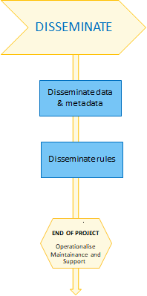
Disseminate
Disseminate data and metadata and rules:
Determine whether there is a requirement to disseminate information through secure channels (e.g., EDAMIS).
Can data be disseminated without security constraints?
Select an appropriate dissemination format (e.g., SDMX).
Operationalise Maintainence and Support
Establish a process for maintaining and upgrading metadata and rules.

Slide 15
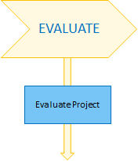
Evaluation
Evaluation of the project
Project Objectives: assess whether the project has achieved its stated objectives and delivered the expected outcomes.
Scope Adherence: evaluate if the project stayed within the defined scope and if any deviations were justified and documented.
Budget and Resource Management: evaluate how well the project adhered to the allocated budget and effectively managed resources.
Quality of Deliverables: assess the quality of the project's deliverables against the expectations.
Lessons Learned: analyze the lessons learned throughout the project and how those insights can be applied to future projects.

Slide 16
Checklist for VTL project
Thank you
camol@istat.it
giulia.penne@istat.it
vignola@istat.it

