Slide 1
VTL Engine
Amsterdam, 9th October 2024
SDMX Experts Workshop

Slide 2
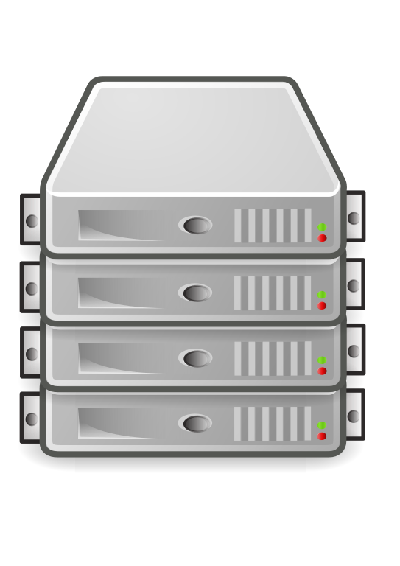
The context: The VTL Suite – VTL as a product
01
Business users
Automated pipelines
Friendly UI
Syntax highlight
VTL validation
...
Compatibility (ex: REST)
Performance
Stability
Business continuity
…
Our value added
components
vtlPlayground
vtlManager
Our contribution to the community
PySDMX
vtlEngine

Slide 3
VTL Engine main features
02
Based on Pandas and DuckDB
Full implementation of VTL 2.0
Single thread execution
Used in Production
Exhaustive semantic analysis
2800+ unit tests (~90% Code Cov)
Notes:
Used in production by several central banks and organisations
Total of 2834 unit tests, with around 90% of Code Coverage
Based on widely used data science libraries like Pandas and Numpy

Slide 4
What does the engine do?
03
C := round(D, 0);
B := C [keep var1];
A := B [filter var1 > 10];
1
Syntax validation
No errors!
2
Transformation graph generation
D
C
B
A

Slide 5
04
C := round(D, 0);
B := C [keep var1];
A := B [filter var1 > 10];
3
Semantic validation
Graph validation: Ok
Data types validation: OK
Data structures compatibility: OK
Calculation of derived Data structures
DataStructure dataset D
Code | role | dataType
Id1 | Identifier | Integer
var1 | Measure | Number
var2 | Measure | Number

Slide 6
05
DataSet D
id1 | var1 | var2
1 | 15,2 | 100,15
2 | 9,1 | 150,25
3 | 17,3 | 200,12
4 | 8,2 | 250,19
5 | 1,5 | 300,43
C := round(D, 0);
B := C [keep var1];
A := B [filter var1 > 10];
Interpreter
4
DataStructure dataset C
Code | role | dataType
Id1 | Identifier | Integer
var1 | Measure | Number
var2 | Measure | Number
DataStructure dataset B
Code | role | dataType
Id1 | Identifier | Integer
var1 | Measure | Number
DataStructure dataset A
code | role | dataType
id1 | Identifier | Integer
var1 | Measure | Number
id1 | var1 | var2
1 | 15 | 100
2 | 9 | 150
3 | 17 | 200
4 | 8 | 250
5 | 1 | 300
id1 | var1
1 | 15
2 | 9
3 | 17
4 | 8
5 | 1
id1 | var1
1 | 15
3 | 17
C := round(D, 0)
B := C[keep var1]
A := B[filter var1>10]

Slide 7
Simple API to validate VTL scripts
06
The semantic analysis takes all needed elements to validate the VTL script used
The result is the computed datasets with no datapoints
Notes:
As specified in previous slides, the Semantic Analysis takes

Slide 8
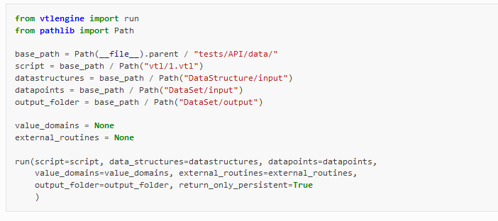
Simple API to run VTL scripts
07
Like the semantic_analysis, the run function will execute the VTL script using datapoints.
S3 URIs are supported
Memory efficiency if the user specifies paths for loading and saving datapoints
Supports any Pandas-compatible format and SDMX data messages
semantic_analysis and run can be executed independently
Notes:
The VTL engine will load the datapoints and execute the VTL script:
If any datapoint is wrong, or the data cannot be associated with any datasets, an InputValidationError will be raised
The datapoints will be loaded in memory once the Dataset is required to be present
Each transformation in the VTL script will be executed, if anything goes wrong, a RuntimeError will be raised
If an output folder is defined, the VTL Engine will save the datapoints once the Dataset is no longer required

Slide 9
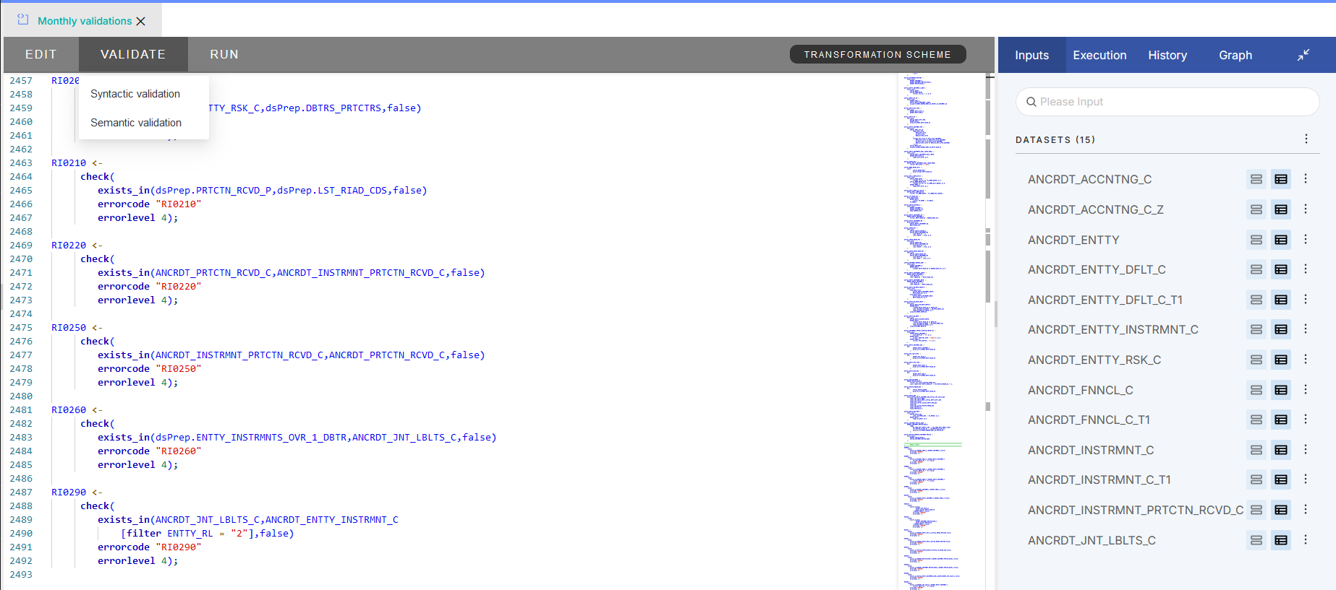
Performance (Semantic Analysis)
08
The Semantic Analysis can be included in any Web Application.
Even on the largest script we have (183 transformations), it takes less than 2 seconds.

Slide 10
Performance (Run)
09
Designed to be fast on small and medium sized files
Majority of use cases
Better maintainability and resource allocation forecast
Support for large executions (if they fit in memory)
Single thread execution:
Removing overhead on internal process synchronization
Easier to predict behavior on large executions
Cost-effective data pipelines
Notes:
The execution on VTL Engine is designed to be fast on small and medium sized files:
Memory footprint is low to ensure we can execute many files at the same time (as with the VTL Manager and its queue system). The datasets are loaded and saved to ensure they are kept in memory only when necessary.
Support for large executions if needed (if they fit in memory)
Single threaded process allows better handling of resources and linear progression over tasks in a server. It is a key feature to ensure the Infrastructure team can allocate only the necessary resources, as most executions should be on small or medium sized files (less than 25MB), as per our experience with our clients.
Permits cost-effective data pipelines
Easy installation on any Operating System and any machine

Slide 11
Next steps
10
Support to
VTL version
2.1 soon!
Support to SDMX-ML VTL Artifacts
Parallel execution / Spark R&D
2025

