Slide 1
Using VTL in statistical processes: successful implementations, issues and improvement requests
12th SDMX Experts workshop
7-11 October 2024
Amsterdam, the Netherlands

Slide 2
Where are we now?

Slide 3
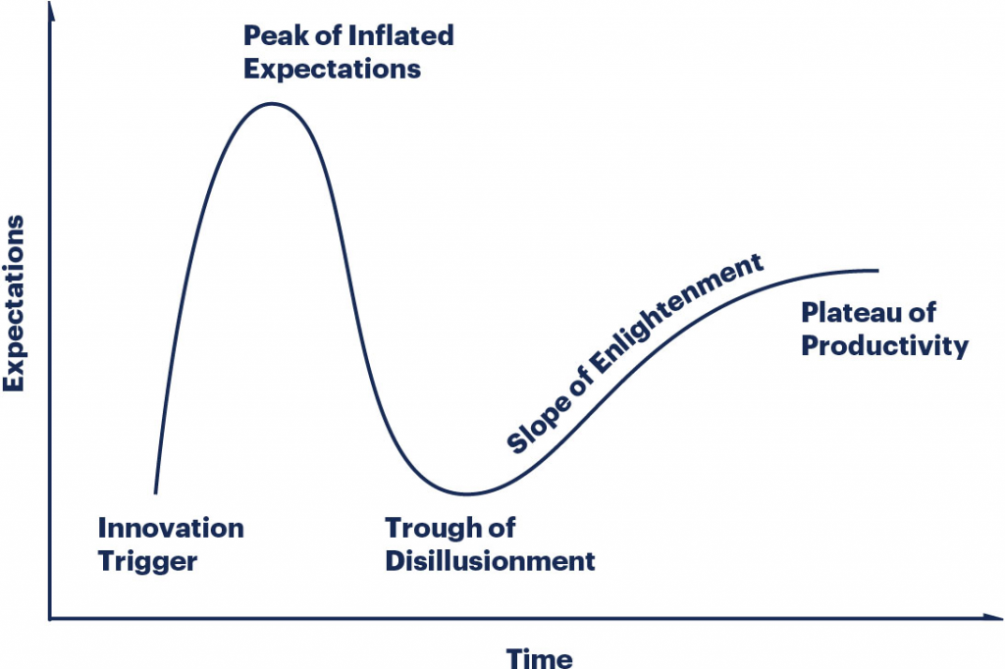
Gartner Hype Cycle…

Slide 4
Gartner Hype Cycle… for VTL
Language consolidation
2018-2020: VTL 2.0
2017: VTL 1.1
2015: VTL 1.0
Language adoption
PoCs and pilot projects
2021: Changes for SDMX 3.0
2013: VTL TF
2024: VTL 2.1
Language definition
Language implementation

Slide 5
VTL 2.1: language improvements
Bug fixes
New operators
Time operators: datediff, dateadd, year/month/quarter/dayofmonth/dayofyear, daystoyear, daystomonth, durationtodays
case (simple extension of if operator)
random (generating a random decimal number >= 0 and < 1)
Changes to existing operators
cast: the “cast matrix” will contain only implicit or explicit with mask (no optional mask)
ordering: some assumptions has been taken for some use cases (e.g. true > false)
changed default window clause for analytic operators

Slide 6
VTL 2.1: new documentation
Improve readability
Reduce inconsistencies between user and reference manual
Use of Markup language
For each example, input and output structure (json format) and input and output data (csv format) are available
More examples coming from tools’ implementers teams have been added
VTL grammar “semi-automatically” derived from the examples
Test-driven development enabled
Easier “catching on” to operators’ behaviour
Extend coverage of operators’ options
Increase number of test cases for better sw quality
Avoid divergences between manuals and grammar

Slide 7
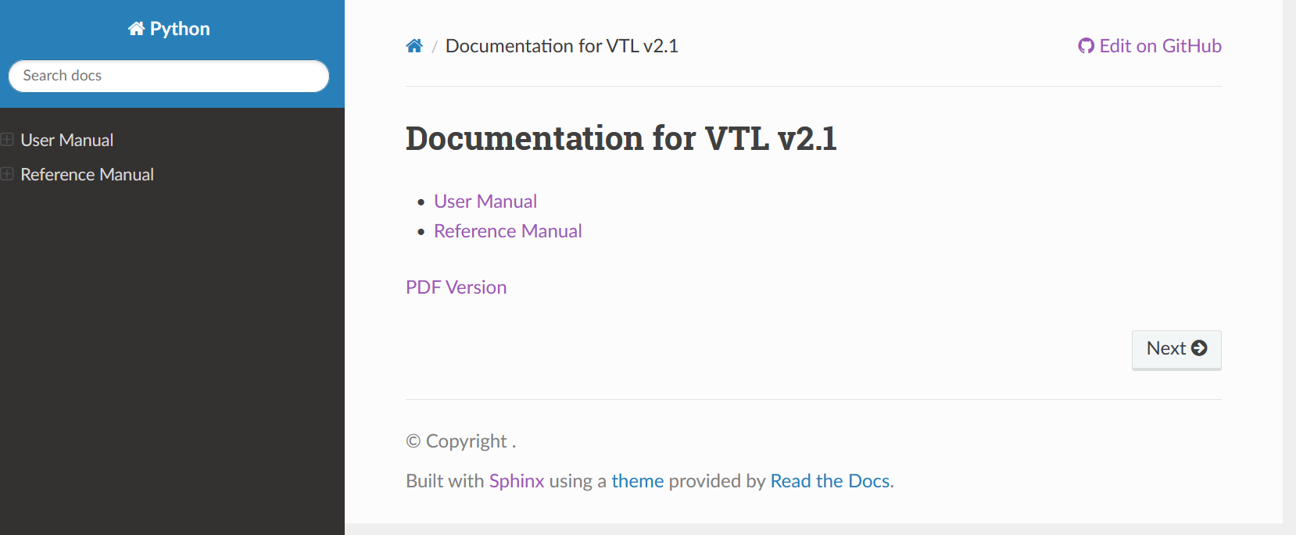
VTL 2.1: new documentation preview

Slide 8
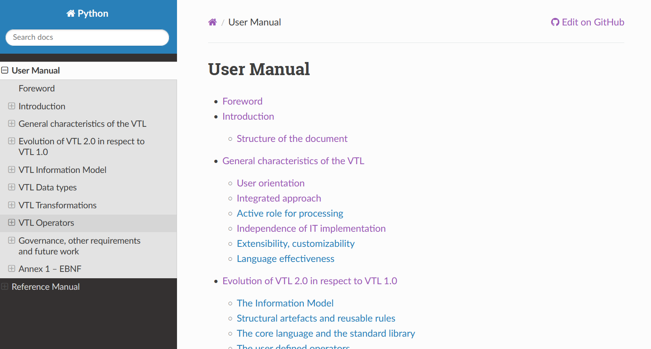
VTL 2.1: new documentation preview

Slide 9
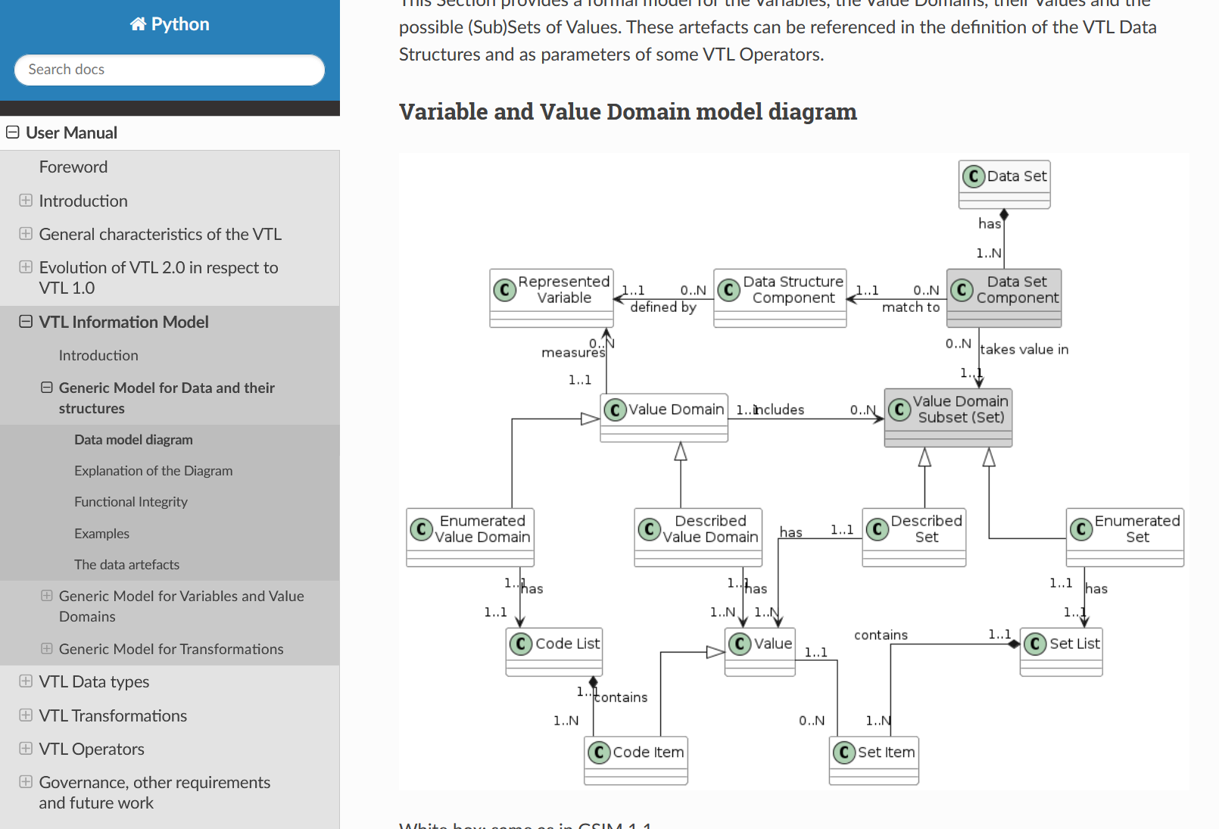
VTL 2.1: new documentation preview

Slide 10
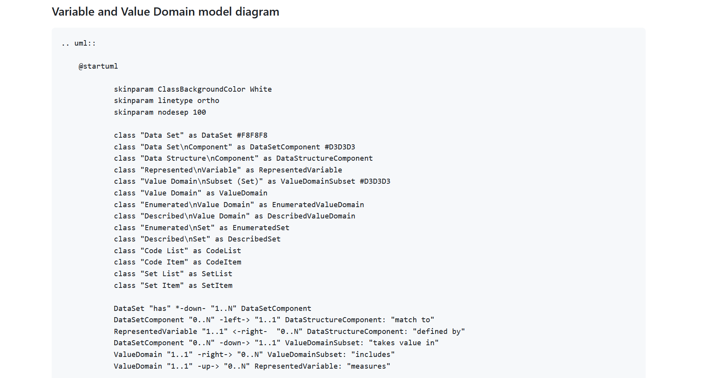
VTL 2.1: new documentation preview

Slide 11
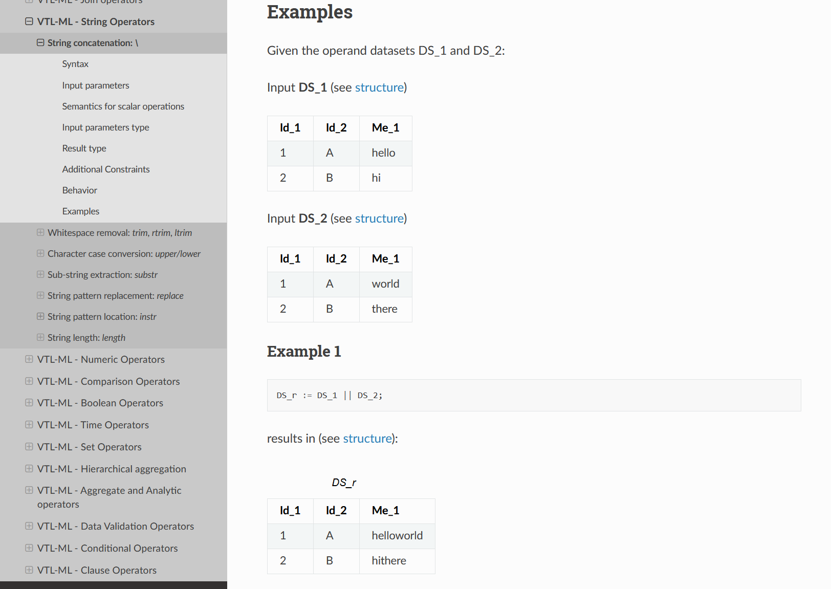
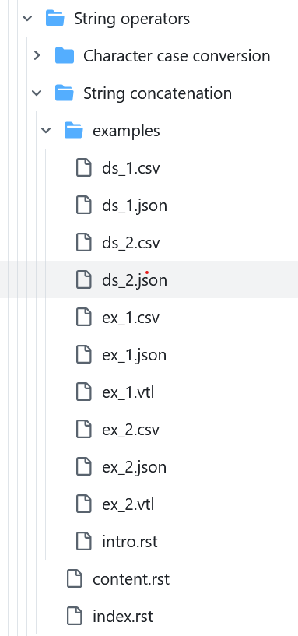
VTL 2.1: new documentation preview

Slide 12
Let’s go the presentations!

Slide 13
Back-up slide
https://amattioc.github.io/vtl/2.1/html/index.html
https://github.com/sdmx-twg/vtl/tree/docs-dev

