Slide 1
SDMX Global Discovery Service - Implementation
12th SDMX Experts workshop
7-11 October 2024
Amsterdam, the Netherlands

Slide 2
SGDS Problem Statement
As more SDMX Registries are deployed and used in production, the need for SDMX Artefacts discovery and sharing is becoming more important.
From the Global Registry, which maintains core Artefacts like the top-level Agency Schemes, to international or national Registries maintaining widely used Codelists.

Slide 3
The SDMX Global Discovery Service
A python application built using the Django web framework
Containerized and deployed on an OKD cluster
A MariaDB database for storage
Uses pysdmx for accessing SDMX endpoints

Slide 4
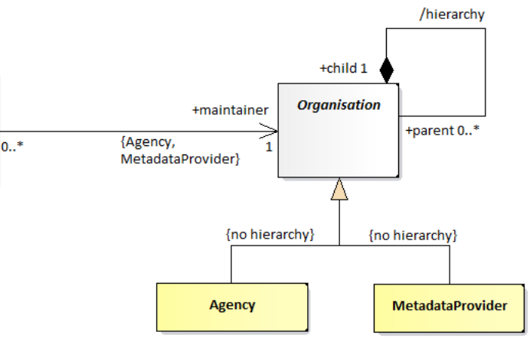
The Information Model
+maintainer
{Agency}
0..* 1
Three main entities:
Endpoint
Publishing Location
Agency

Slide 5
The (deprecated) API
All agencies: https://gds.sdmx.io/agency/
One agency: https://gds.sdmx.io/agency/BIS/
All endpoints: https://gds.sdmx.io/endpoint/
SDMX API versions: https://gds.sdmx.io/sdmxapi/

Slide 6
The new API
The new API addresses question like:
Where does agency XYZ publishes data or metadata?
Who publishes data or metadata on endpoint ABC?
Get the location of services by resource type, message format and/or SDMX API version
Resolve a URN, ie get the REST resource that returns the identified Artefact
Follows the SDMX reference resolution pattern
Endpoints refer to Agencies, hence the latter are children of the former
PubLocations refer to Agencies and Endpoints, hence both are children of PubLocations

Slide 7
The new API info page

Slide 8
Examples
Where does the BIS publish data?
/publocationscheme/BIS/PUB_SCHEME/+?resource=data
Who publishes data/metadata on the Global Registry?
/endpoint/SDMX/GR/1.0?references=parents
I need the OECD metadata, but only in JSON and SDMX API v1.5.0?
/publocationscheme/OECD/PUB_SCHEME/+?resource=metadata&format=json&api=1.5.0
Where can I find the artefact urn:sdmx:org.sdmx.infomodel.codelist.Codelist=SDMX:CL_FREQ(2.1)?
/urn_resolver/urn:sdmx:org.sdmx.infomodel.codelist.Codelist=SDMX:CL_FREQ(2.1)

Slide 9
The URN resolution
The process of resolving a URN is done based on the available registered endpoints:
Parse/validate the URN
Identify the AgencyID
Find the potential locations for the given AgencyID (could be more than one if the Agency has registered multiple PubLocations)
Check that the foreseen resource (eg the Codelist, Code, DSD, DF, etc) is supported by the Implementation of the Enpoint used in the PubLocation
Build the REST resource based on the URN, and on the implementation of the PubLocation
Check the generated resource and return it if it yields HTTP 200

Slide 10
The Response Messages
The SGDS responds with three types of messages, for the aforementioned entities (agency, endpoint, publocation)
The old (deprecated) API, included some nesting:
An Agency included all its PubLocations
Each PubLocation included all Endpoints that it uses
The new messages are using the SDMX reference pattern to avoid the nesting
All messages are reported at the same (top) level – no nesting
A convenience resolution mechanism is implemented when reporting PubLocations
Instead of a reference, a resolved endpoint is returned

Slide 11
GET
/agency/{agencyID}
Examples:
/agency/*/
/agency/SDMX/
/agency/BIS/
{
"structures": {
"agencies": [
{
"agencyID": "BIS",
"name": "BIS",
"description": "Bank for International Settlements",
"url": "https://bis.org"
}, {
"agencyID": "IMF",
"name": "IMF",
"description": "International Monetary Fund",
"url": "https://imf.org/en/Home"
}, {
"agencyID": "ILO",
"name": "ILO",
"description": "International Labour Organization",
"url": "https://ilo.org"
}, {
"agencyID": "SDMX",
"name": "SDMX",
"description": "The Statistical Data and Metadata eXchange standard",
"url": "https://sdmx.org"
}
]
} }

Slide 12
GET
/publocationscheme/{AgencyID}/{resourceID}/{version}/
url parameters:
resource_type={data|metadata}
format={xml|json|csv}
sdmx_api={api_version}
detail={full|raw}
references={none|children}
Examples:
/publocationscheme/*/
/publocationscheme/SDMX/
/publocationscheme/BIS/
?resource_type=data
&format=xml
&sdmx_api=2.0.0
{
"structures": {
"PubLocationSchemes": [
{
"agencyID": "IMF",
"id": "IMF_PUBS",
"version": "1.0",
"name": "IMF Pub Location Scheme",
"pub_locations": [
{
"id": "IMF_PUB",
"name": "IMF Pub Location",
"urn": null,
"description": null,
"endpoint": "urn:sdmx:org.sdmx.infomodel.discovery.Endpoint=IMF:IMF_EP(1.0)"
}, {
"id": "IMF_GR",
"name": "IMF @Global Registry",
"urn": null,
"description": null,
"endpoint": "urn:sdmx:org.sdmx.infomodel.discovery.Endpoint=SDMX:GR(1.0)"
}
]}
]}
}

Slide 13
GET
/publocationscheme/{AgencyID}/{resourceID}/{version}/
url parameters:
resource_type={data|metadata}
format={xml|json|csv}
sdmx_api={api_version}
detail={full|raw}
references={none|children}
Examples:
/publocationscheme/*/
/publocationscheme/SDMX/
/publocationscheme/BIS/
?resource_type=data
&format=xml
&sdmx_api=2.0.0
{
"structures“: {
"PubLocationSchemes": [
{
"agencyID": "IMF",
"id": "IMF_PUBS",
"version": "1.0",
"name": "IMF Pub Location Scheme",
"pubLocations": [
{ "api_version": "1.4.0",
"url": "http://dataservices.imf.org/SDMX_XML.svc",
"comments": "",
"message_formats": [ "data+xml+2.0.0", "structure+xml+2.0.0" ],
"rest_resources": [ "structure", "data", "availability" ]
}, {
"api_version": "1.4.0",
"url": "http://dataservices.imf.org/SDMX_JSON.svc",
"comments": "",
"message_formats": [ "data+json+2.0.0", "structure+json+2.0.0" ],
"rest_resources": [ "structure", "data", "availability" ]
}, {
"api_version": "2.0.0",
"url": "https://registry.sdmx.org/sdmx/v2",
"comments": "",
"message_formats": [ "structure+xml+2.1" ],
"rest_resources": [ "structure", "schema" ]

Slide 14
GET
/endpoint/{AgencyID}/{resourceID}/{version}/
Examples:
/endpoint/*/
/endpoint/SDMX/
[
{
"id": "GR",
"name": "Global Registry",
"version": "1.0",
"base": "https://registry.sdmx.org",
"owner": "SDMX",
"authentication": null,
"implementations": [
{
"api_version": "2.0.0",
"url": "/sdmx/v2",
"comments": "",
"message_formats": [ "structure+xml+2.1" ],
"rest_resources": [ "structure", "schema" ]
}
]
}, {
"id": "BIS_EP",
"name": "BIS_EndPoint",
"version": "1.0",
"base": "https://stats.bis.org/api",
"owner": "BIS",
"authentication": null,
"implementations": [
{
"api_version": "1.4.0",
"url": "/v1",
"comments": "",
"message_formats": [ "genericdata+xml+2.1", "structurespecificdata+xml+2.1", ...],
"rest_resources": [ "structure", "data", "schema", "availability" ]
}, {
"api_version": "2.0.0",
...

Slide 15
GET
/urn_resolver/{URN}/
/urn_resolver/urn:sdmx:org.sdmx.infomodel.codelist.Codelist=SDMX:CL_FREQ(2.1)
{
"urn": "urn:sdmx:org.sdmx.infomodel.codelist.Codelist=SDMX:CL_FREQ(2.1)",
"resource": "Codelist",
"agency": "SDMX",
"version": "2.1",
"id": "CL_FREQ",
"query": "https://registry.sdmx.org/sdmx/v2/structure/Codelist/SDMX/CL_FREQ/2.1?detail=allstubs",
"query_response": 200
}
{
"urn": "urn:sdmx:org.sdmx.infomodel.codelist.Codelist=SDMX:CL_FREQ(2.1)",
"resource": "Codelist",
"agency": "SDMX",
"version": "2.1",
"id": "CL_FREQ",
"query": "https://registry.sdmx.org/sdmx/v2/structure/Codelist/SDMX/CL_FREQ/2.1?detail=allstubs",
"query_response": 200
}

Slide 16
Thank you!

