Slide 1
Custom Structure Definitions
SDMX 3.2.0
Matthew Nelson 2024

Slide 2
Background
TWG tasked to design a solution for Presentational Metadata
Can / should SDMX be used to satisfy all data presentation use cases?
Is there a wider need for organisation specific metadata?
Notes:
Custom Structure Definitions is a new feature proposed for version 3.2.0 of SDMX which is planned to be released by the end of 2025
As some background to this feature – it actually came about to satisfy the request to extends SDMX data model to support data visualization metadata.
As a quick anecdote from the Bank of England about data visualization, it was that the bank had lots of table and charts and all of the comments were always on how something was presented in a chart, it was the wrong color or the legend was not in the right place, or it would be better if….so their solution was to remove all the charts from their website, and then no one complained anymore
And behind this anecdote is the reality that when it comes to data visualization we enter into a world of complexity, should we be creating a standard to say what all the properties of a Pie chart are, or capture everything about a line chart – because it is likely we do not satisfy everyone's requirements – and also even if this was captured in the metadata, who is going to use that metadata. If the OECD describe, for instance, how to present an OECD dataset in a line chart, would that only be used by the OECD themselves, in which case does it even need to be part of a standard which is intended for standardizing information so that it can be exchanged and used between parties?
This is the genesis of the Custom Structure Definition – and this is what I will present over the next few slides
So these are the two bullets – can we satisfy all cases, and who are we creating this for.
What if instead we say, we will give you the ability to design new structure types in your SDMX Registry like ‘Line Chart’ or ‘Pivot Table’ and be able to create instances of these so that you can use them in your systems, and share them with other parties if you want to – but it is not expanding out the SDMX standard. You have the freedom and capability to have a fully metadata driven solution, without increasing the complexity for all.
The problem with visualia

Slide 3
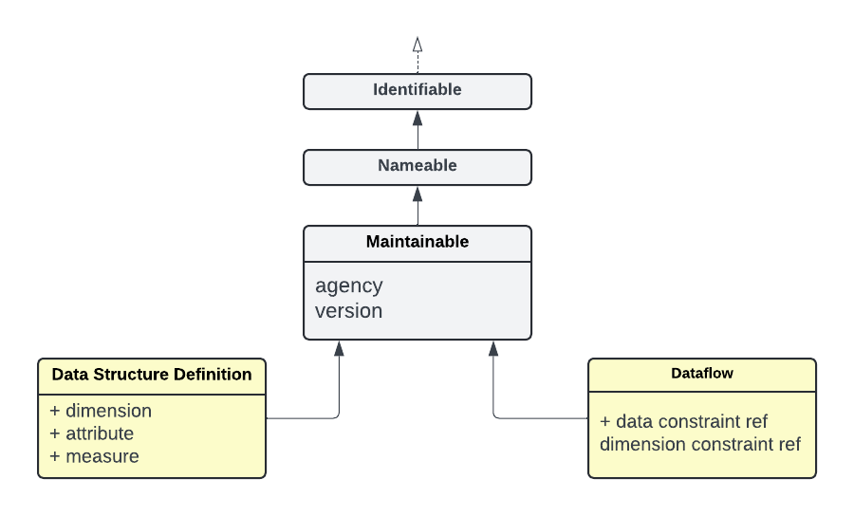
General Concept
Provide the ability to design custom Maintainable Structure Types
Notes:
The general concept is the following:
SDMX has a model, it is called the SDMX Information Model – the SDMX-IM has a number of classes and each class has properties. On this slide we see the abstract Classes in grey such as Identifiable (ID) Namebale (has a mandatory name, optional description) and Maintainable (has an agency, and a version) – we see then see the concrete subclasses, like DSD which inherits all these properties from the Maintainable and up the tree, but it also has its properties specific to it which are Dimensions, Attributes, Measures. A simpler structure type is the Dataflow which also has the properties up the tree, so there is a lot of overlap with the DSD – but the properties specific to it are the reference to the DSD, and the optional references to Constraints.

Slide 4
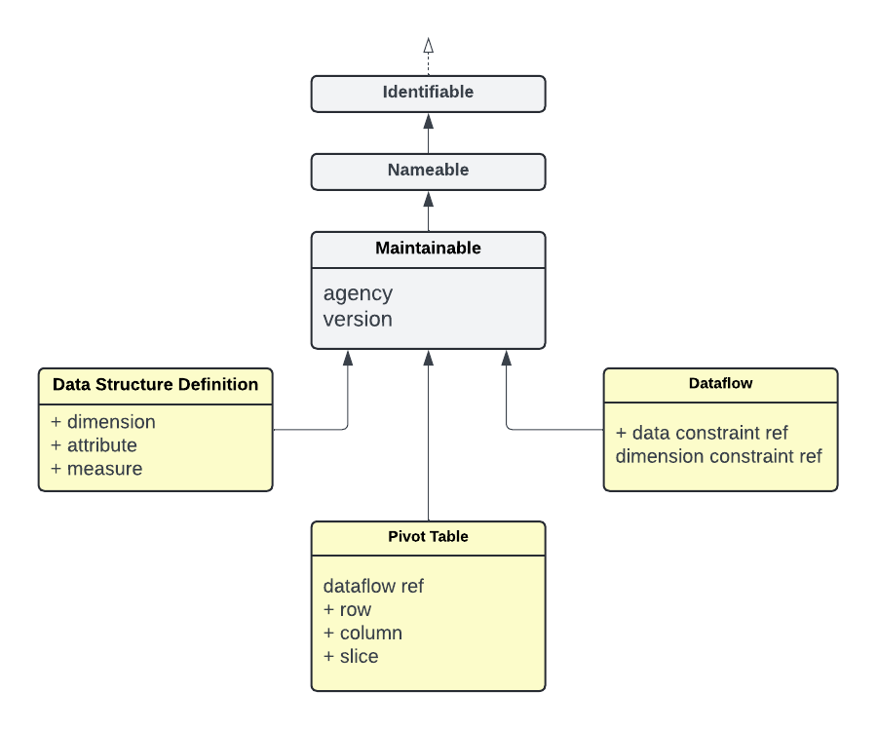
General Concept
Provide the ability to design custom Maintainable Structure Types
Notes:
The Custom Structure Definition allows us to define a new Class of Object which extends Maintainable (so it has an ID, Agency, Version, Name, Description) and add its own properties. In this example I created a structure type called Pivot Table and it has been given the properties of a Dataflow Reference (what is the table for) and row, column, and slice properties – so when I create an instance of a Pivotable I can define what Dataflow it is for, which Dimensions I want in the row, which Dimensions in the column and which Dimensions in the slice.
But what I have essentially done here is not create a PivotTable – but create a definition of the properties that a Pivot Table can have. In the same way that the SDMX-IM does not give you Data Structures like Balance of Payments and Exchange Rates what the SDMX-IM does is tell you what properties a DSD must have and what properties it can optionally have (i.e. it must have at least 1 Dimension and 1 Measure and it can optionally have Attributes)

Slide 5
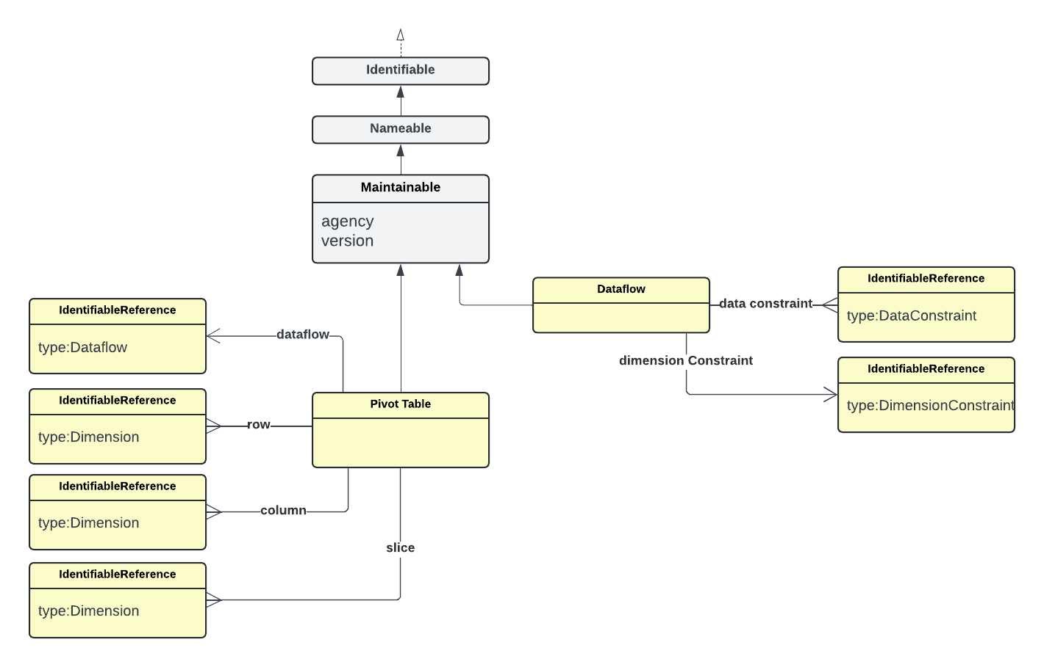
Cross References
Notes:
One of the nice things about the ability to define our own custom structure types in SDMX is that we can make use of the SDMX-IM
We can for instance say, this property or Dataflow Reference must reference a Dataflow – so we validate that when a user submits a PivotTable definition it is indeed referencing a Dataflow that is in our Registry.
Because we have created this connection, we are able to ensure referential integrity, the Registry can for instance prevent the Dataflow from being deleted because it is being used by a Pivot table
We can also start to traverse the metadata in our Registry because it knows what is connected to what – I can for instance ask, via the REST API, what PivotTables do you have for this Dataflow and the Registry is able to find all structures of type PivotTable which reference the Dataflow.

Slide 6
Custom Structure Instance (CSI)
Notes:
Once we define in our Registry a new structure type, in our example PivotTable – we have effectively extended the SDMX-IM for our own purpose, and what this means is we can now store structural metadata according to our new extension.
We can now create an instance of a Pivot Table, which contains values for each of the properties we have defined, and we can store this in our Registry, in the same way that we can store a Dataflow in our Registry because the SDMX-IM tells us what a Dataflow is and what properties it can have.

Slide 7
Benefits
Maintenance Custom Structure Instances are stored and maintained in SDMX structure repository alongside other structural metadata
Information Model Reuse Custom Structures inherit from existing interfaces: ID, Name, Description, Annotations,
Validation on submission that the referenced structures exist i.e., Dataflow, Dimensions
Integrity Assurance SDMX structure repository ensures referenced structures can not be deleted, they also benefit from semantic versioning (late bind)
Referenceable Custom metadata instances have URN and as such can have reference metadata attached, and be used by other custom structures
Shareable like all other metadata (Codelists, Data Structures, Concepts) Custom Structure Definitions can be shared with others
Discoverable The REST API will support querying for the structures directly, or indirectly (via references)

Slide 8
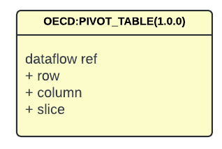
Discoverability
https://my-sdmx-service/structure/customstructure/OECD/PIVOT_TABLE/1.0.0
Notes:
The Custom Structure Definition is split into two parts – first is the definition of your new structure type, and this is stored as a custom structure
As such we are able to ask the Registry for our custom structures via the REST API in the same way we can ask for any other structure type

Slide 9
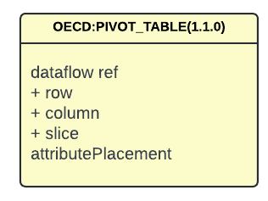
Discoverability
https://my-sdmx-service/structure/customstructure/OECD/PIVOT_TABLE/1.1.0
Notes:
We could allow revisions, if new properties are added

Slide 10
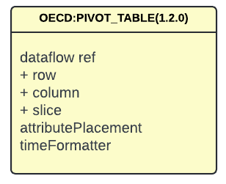
Discoverability
https://my-sdmx-service/structure/customstructure/OECD/PIVOT_TABLE/1.2.0
Notes:
And then be able to query for each version via the REST API – as you can see the version is a property of the REST query

Slide 11
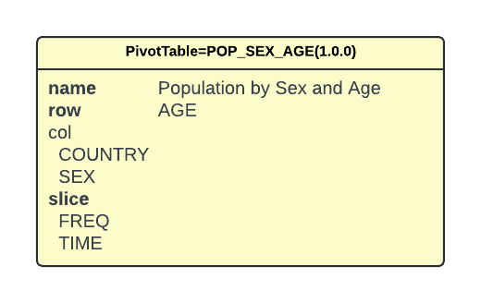
Discoverability
https://my-sdmx-service/structure/oecd:pivotable/OECD/POP_SEX_AGE/*
Notes:
The other part of the CSD is the instance itself, in the same way we have instances of Codelists CL_FREQ, CL_AREA we will have instances of your custom structure type
The REST API is able able to retrieve these instances in the same way it can retrieve any other type of structure, so we can ask for our PivotTable by AgencyID, ID, and version like above

Slide 12
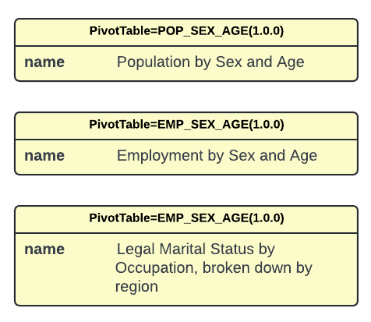
Discoverability
https://my-sdmx-service/structure/oecd:pivotable/OECD/*/*?detail=allStubs
Notes:
We could also use other parameters available to us in the REST API – for example list all of the pivot tables as stubs

Slide 13
Discoverability
https://my-sdmx-service/structure/dataflow/OECD/DE_POP/1.+?references=parents&detail=referenceStubs
Notes:
Or ask for a specific Dataflow DF_POP and all of the PivotTables that reference it.
Then when we build our visulaisation for the web, we can have a drop down of different tables for the data – for example

Slide 14
Beyond Visualisation Metadata
Notes:
The nice thing is about Custom Structure Definitions is that they are not coupled to visualization metadata, they could be used for any purpose at all – for where the agency wants to have a metadata driven process and wants to leverage SDMX metadata and the SDMX Information Model – but for a custom process

Slide 15
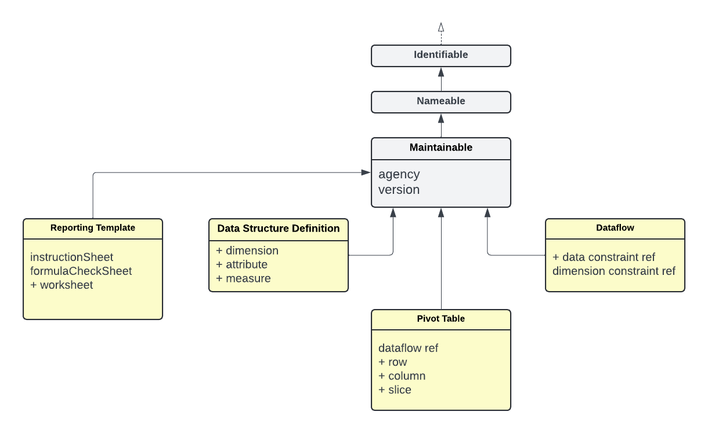
Beyond Visualisation Metadata
Notes:
We have for example created a structure called reporting template in the FMR, which is a structure used to define a template for generating an Excel form for the purpose of data collection.
This was added before a Custom Structure Definition existed, so it was hard coded into the product, but this could have been designed using a CSD if it existed, and that would have been a really nice solution to creating these extensions
And of course if custom structures are created which become heavily adopted between many agencies, then it provides a good basis to formally add this structure into the SDMX-IM – so you could consider the CSD as a nice way to prototype new structure types in SDMX before baking it into the standard

Slide 16
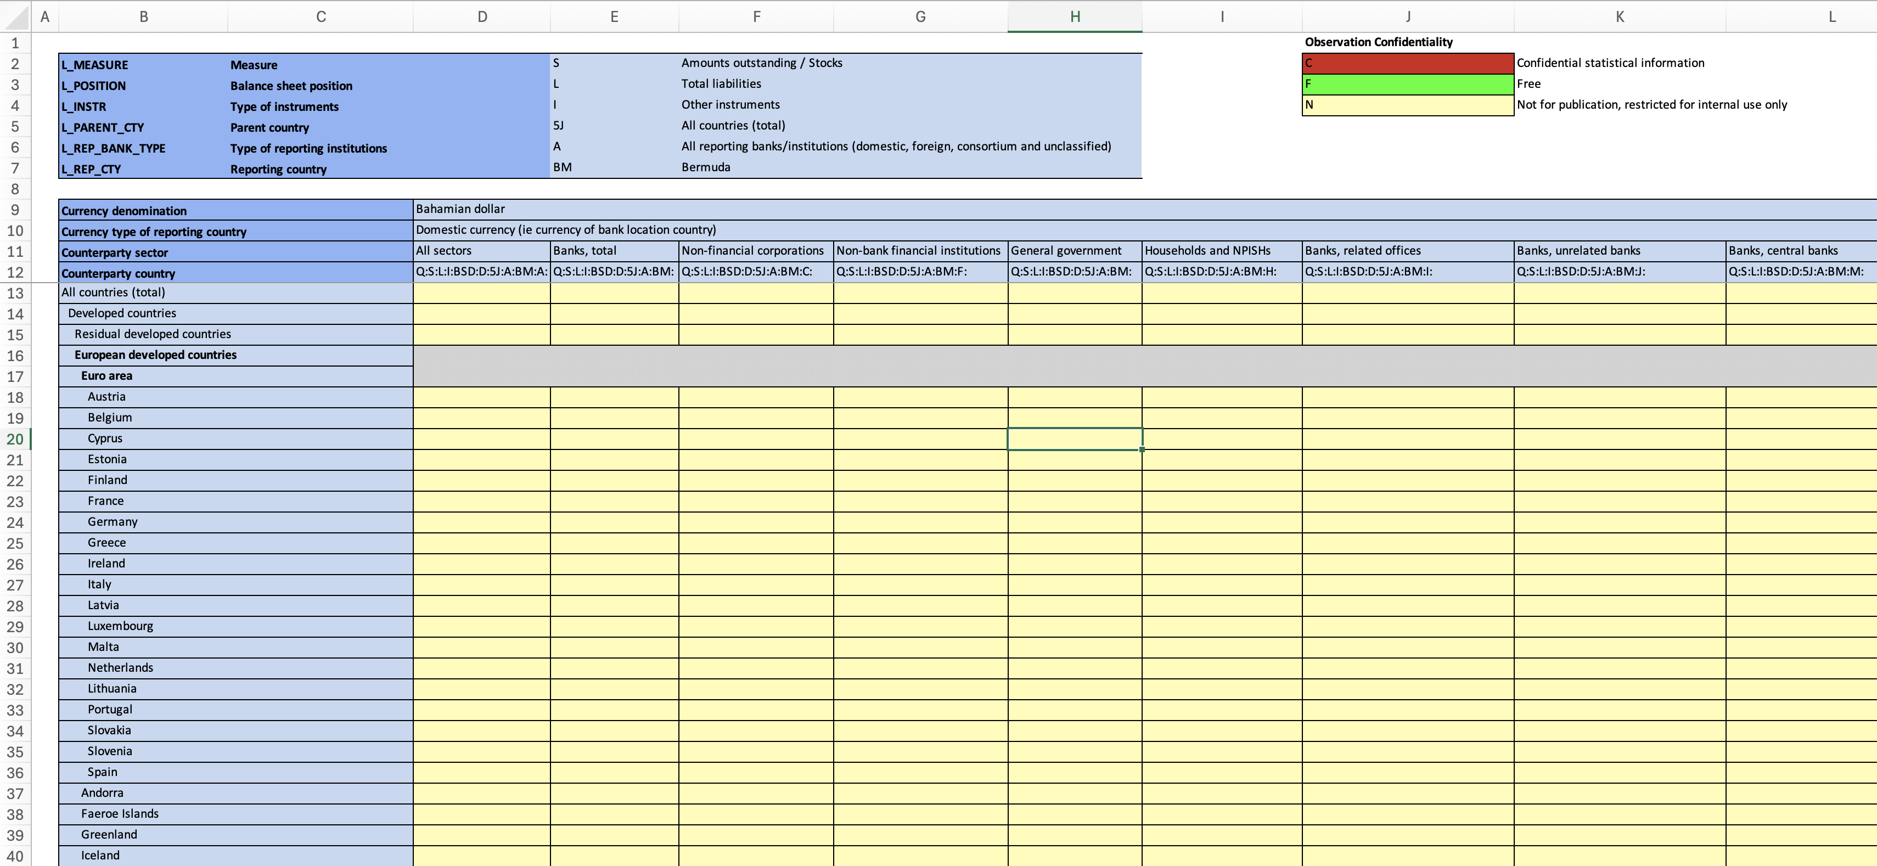
Report Template
Notes:
Just to conclude, here is an example of the output of a Reporting Template – this output is generated by taking the definition of a Reporting Template and then using this to generate an excel file – so the target audience for Custom Structure instances would typically be a metadata driven process such as this

Slide 17
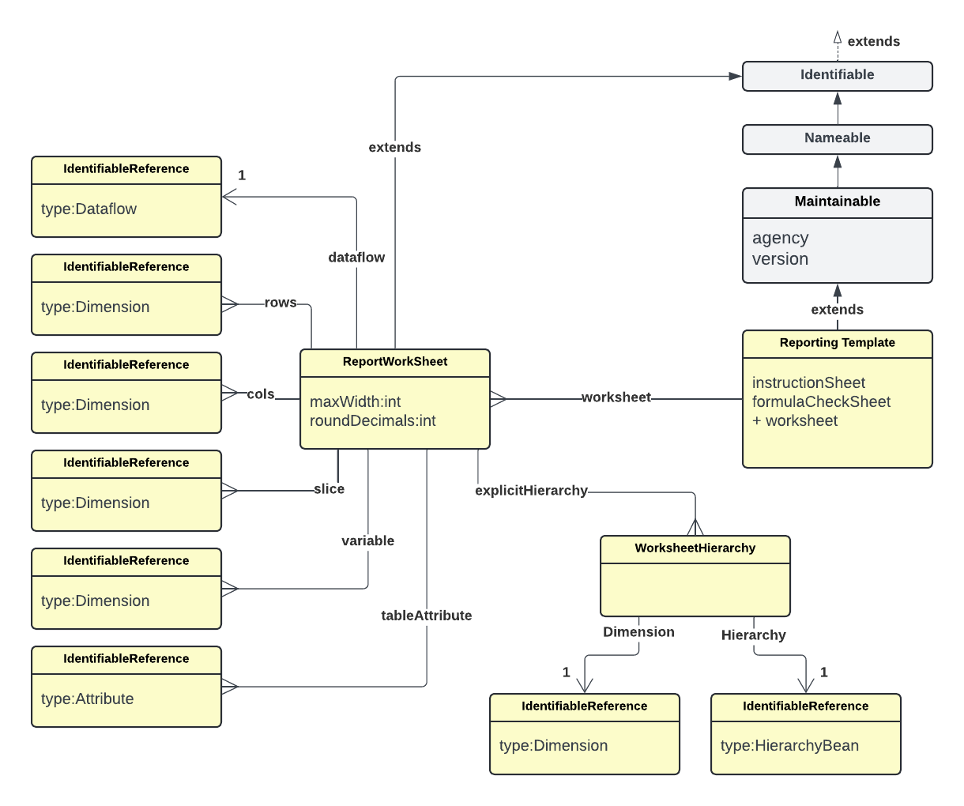
Report Template
Notes:
And on this final slide, I have drawn what a report template would look like if it was designed in as a custom structure
The Report Template extends Maintainable – inheriting properties of agency, id, version, and name
It has 1 or more worksheets and each worksheet can reference a dataflow, it can have rows, columns, slices, variables, attributes it can link to hierarchies in order to build hierarchical headers and columns – so you can see how much this custom structure interacts with SDMX metadata, even though it itself is not an official SDMX structure

