Slide 1
A Unified Approach to SDMX Interoperability
Leveraging Foundational Entities to Remove Metadata Stovepipes
Matthew Nelson 2024

Slide 2
Part 1: Interoperability and Metadata Stovepipes

Slide 3
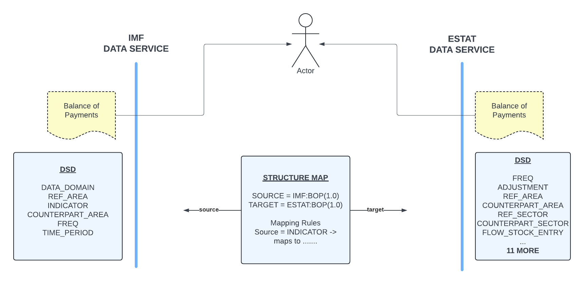
SDMX Interoperability Example

Slide 4
Thought Experiment Modelling a domain: Smart Cities
Create Smart City Metadata
Concepts
Codelist
Data Structure Definitions
Interoperability
Metadata reuse – is this possible?
Mappings – City to Country

Slide 5
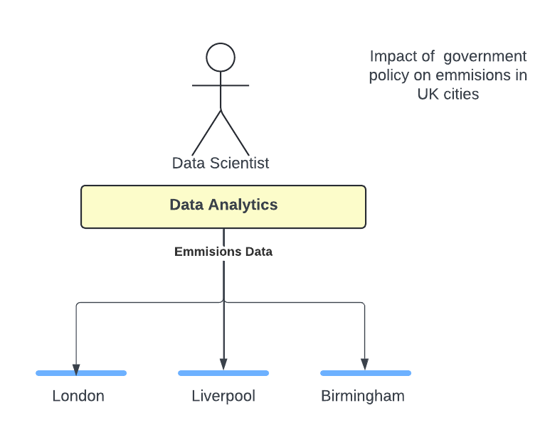
Thought Experiment Perspective of a Data Scientist

Slide 6
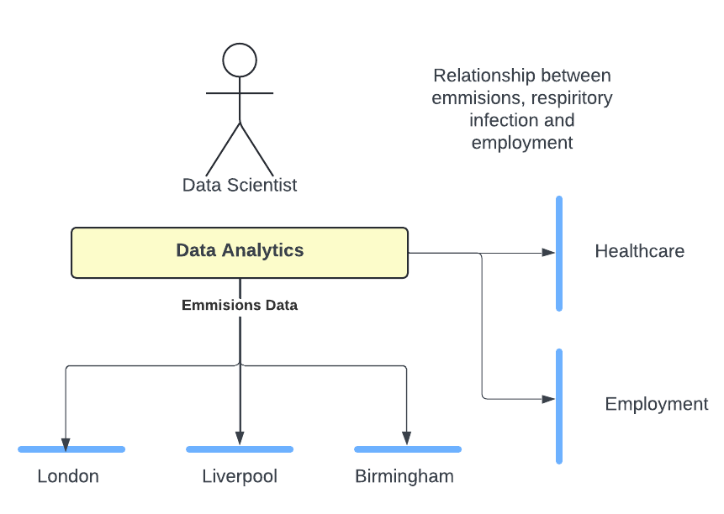
Thought Experiment Perspective of a Data Scientist

Slide 7
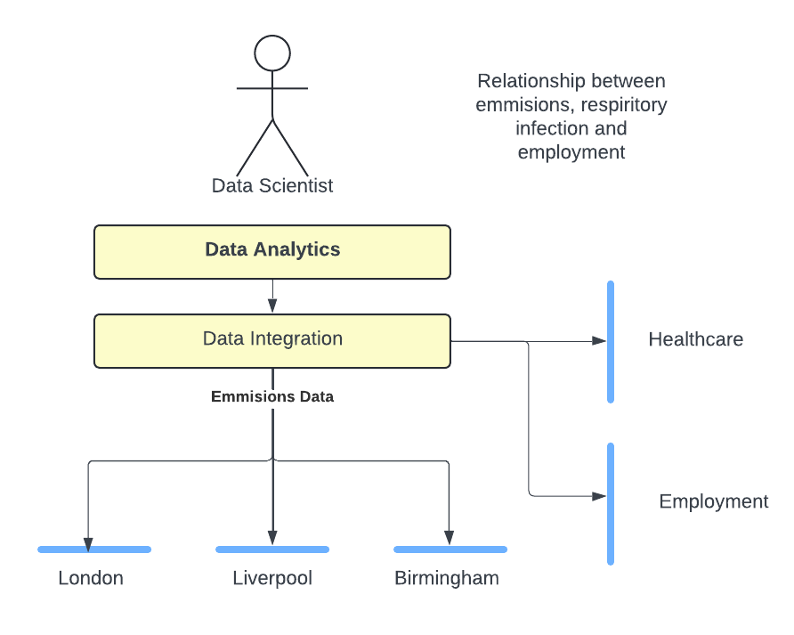
Thought Experiment Perspective of a Data Scientist

Slide 8
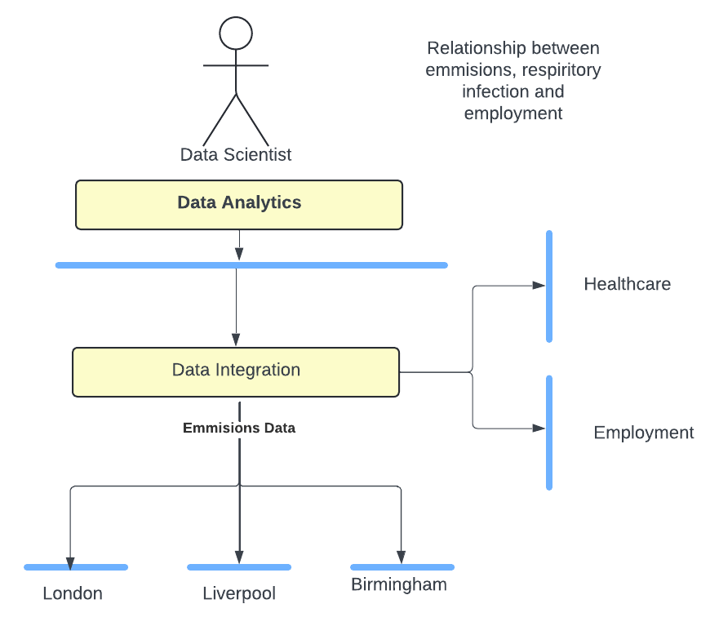
Thought Experiment Perspective of a Data Scientist

Slide 9
Part 2: The Complexities

Slide 10
All challenges start with a Codelist
What is Included?
Where is the master?
What does it even mean?
When is a Code not a Code?
Composite Codelists

Slide 11
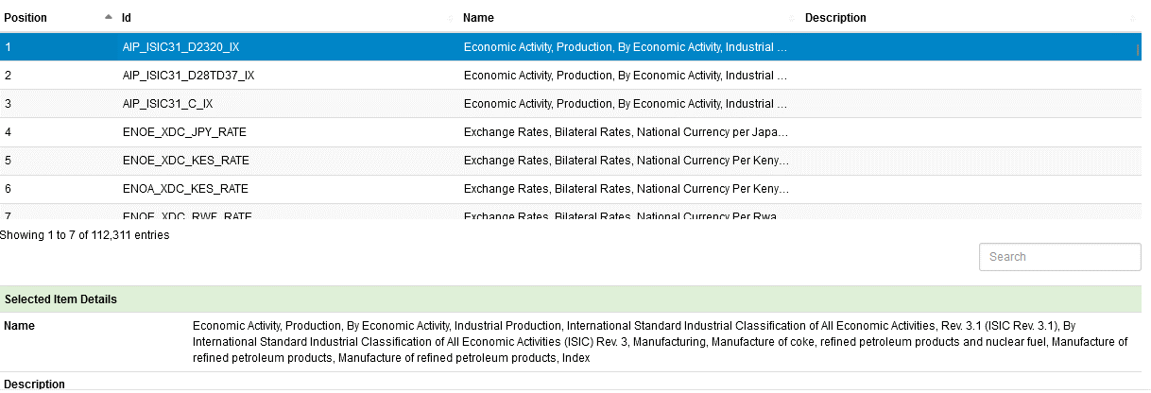
All challenges start with a Codelist

Slide 12
Part 3: Leveraging Foundational Entities

Slide 13
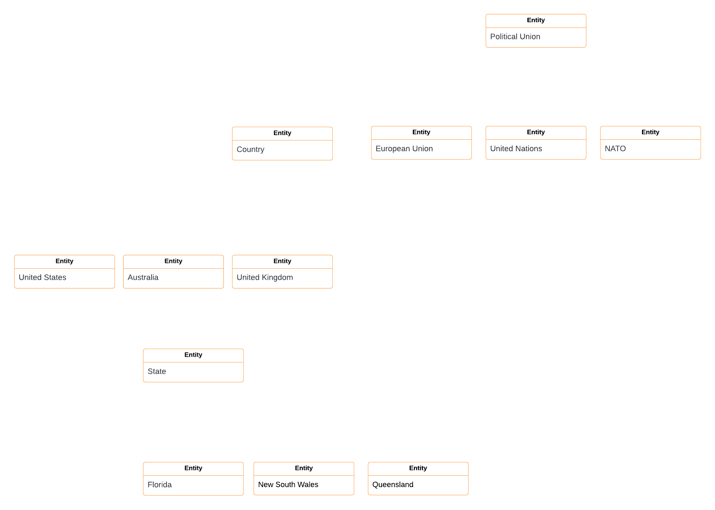

Slide 14
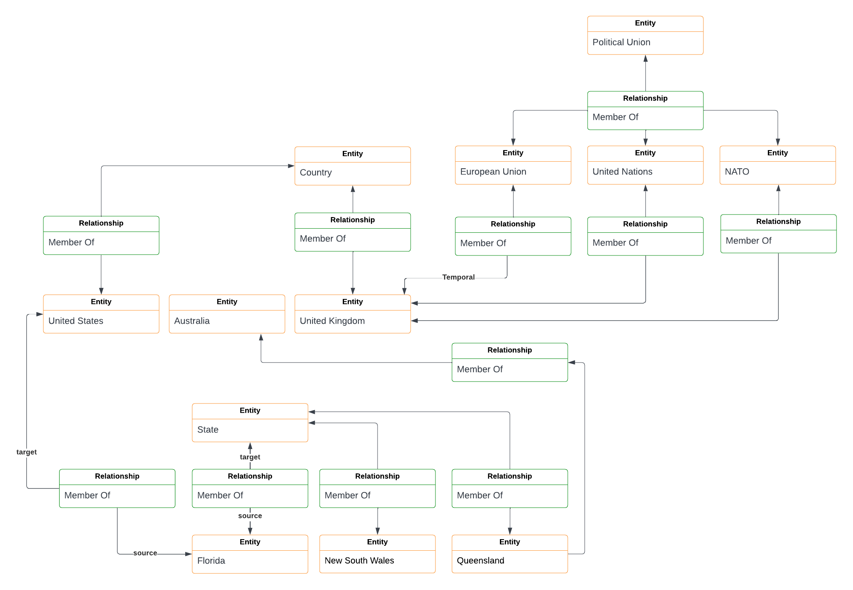

Slide 15
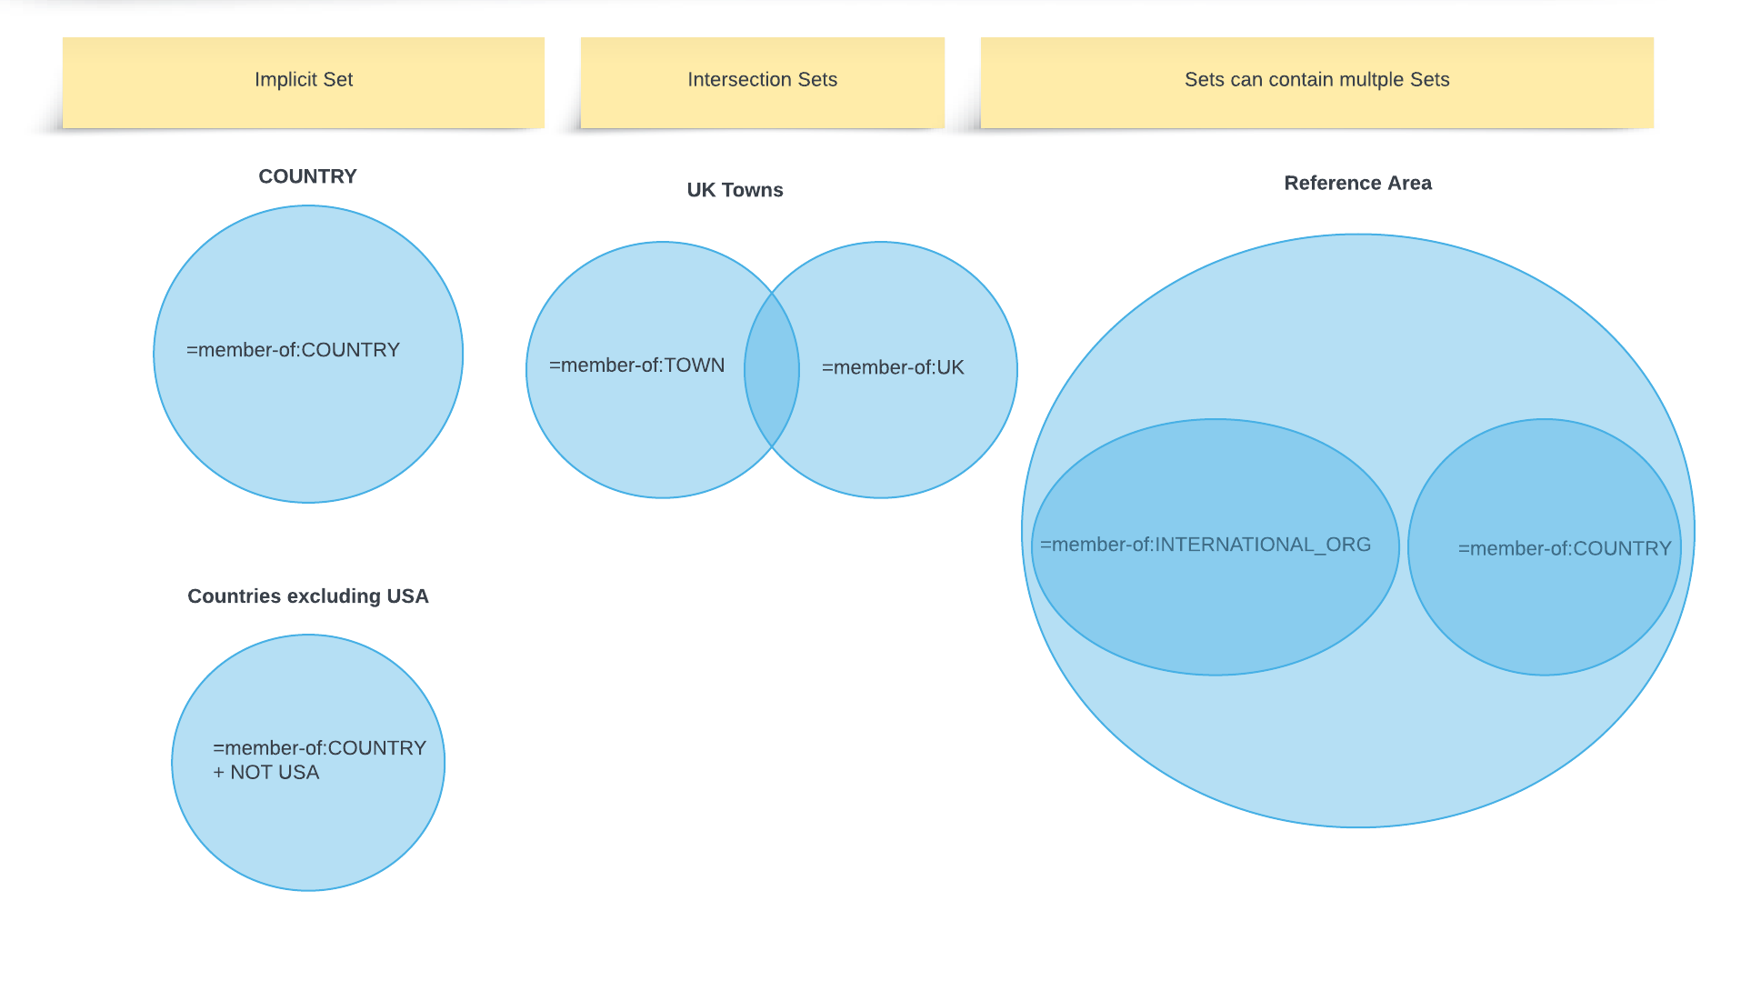

Slide 16
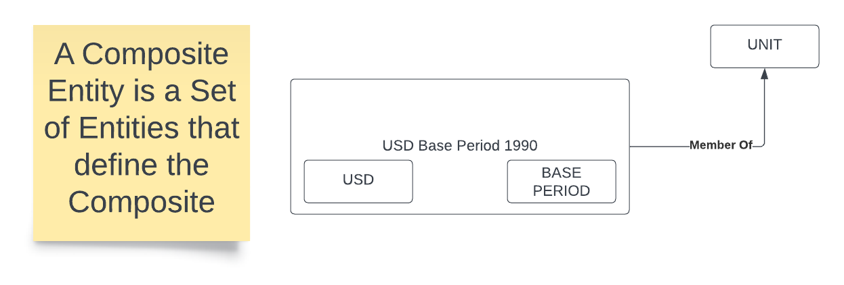

Slide 18
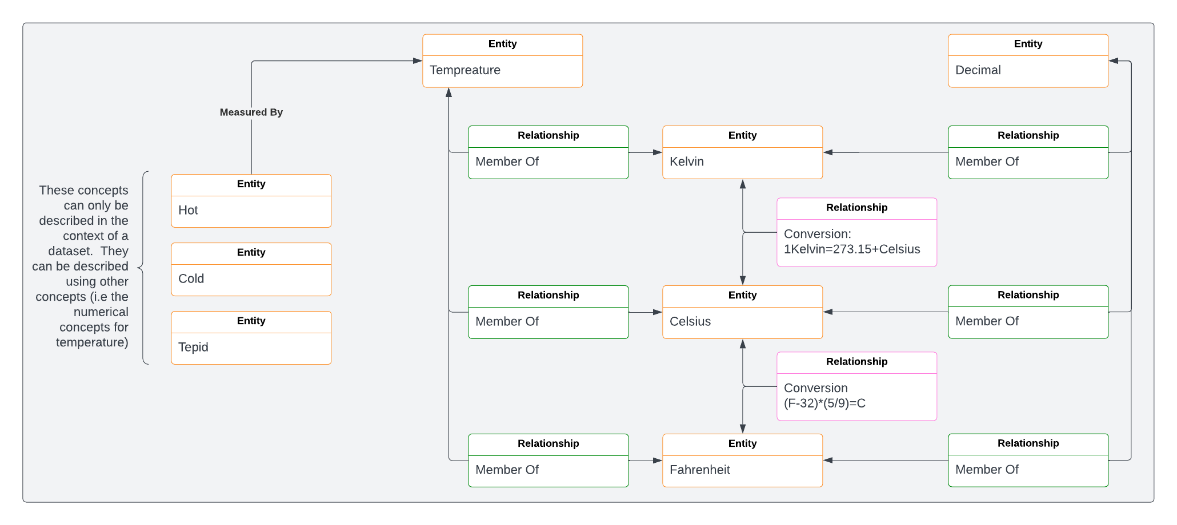

Slide 19
