Slide 1
The need to establish semantic relationships between related concepts (A use case based on OECD Data Explorer)
12th SDMX Experts Workshop
7 - 11 October 2024, Amsterdam
Presenter: Yavuz COBAN, OECD

Slide 2
Harmonization work completed !
Harmonised and centrally managed common code lists and concepts
Reference area, Counterpart area, Country of birth, Citizenship
(CL_AREA, CL_REGIONAL)
Economic Activity
(CL_ACTIVITY_ISIC4, CL_ACTIVITY_ISIC3, CL_ACTIVITY_ISIC2)

Slide 3
Shared code lists regular maintenance cycle
+10 to 12 Mths: Start revision (project process)
Users: Raise issues/requests in Algobank
SDPS: Agree moderator, WG participants
+9 to 10 Mths SDPS: If there are requests, announce revision to CoP

Slide 4
Shared code lists fast track maintenance
Ongoing
User has an urgent change request
User creates an issue labelled “Urgent” in Algobank list
<1 week after request
SDPS consults and assesses if a “fast-track” change is possible
<1 month after request
If assessment is positive, SDPS makes the change and publishes
SDPS informs user of assessment outcome
No major changes allowed

Slide 5
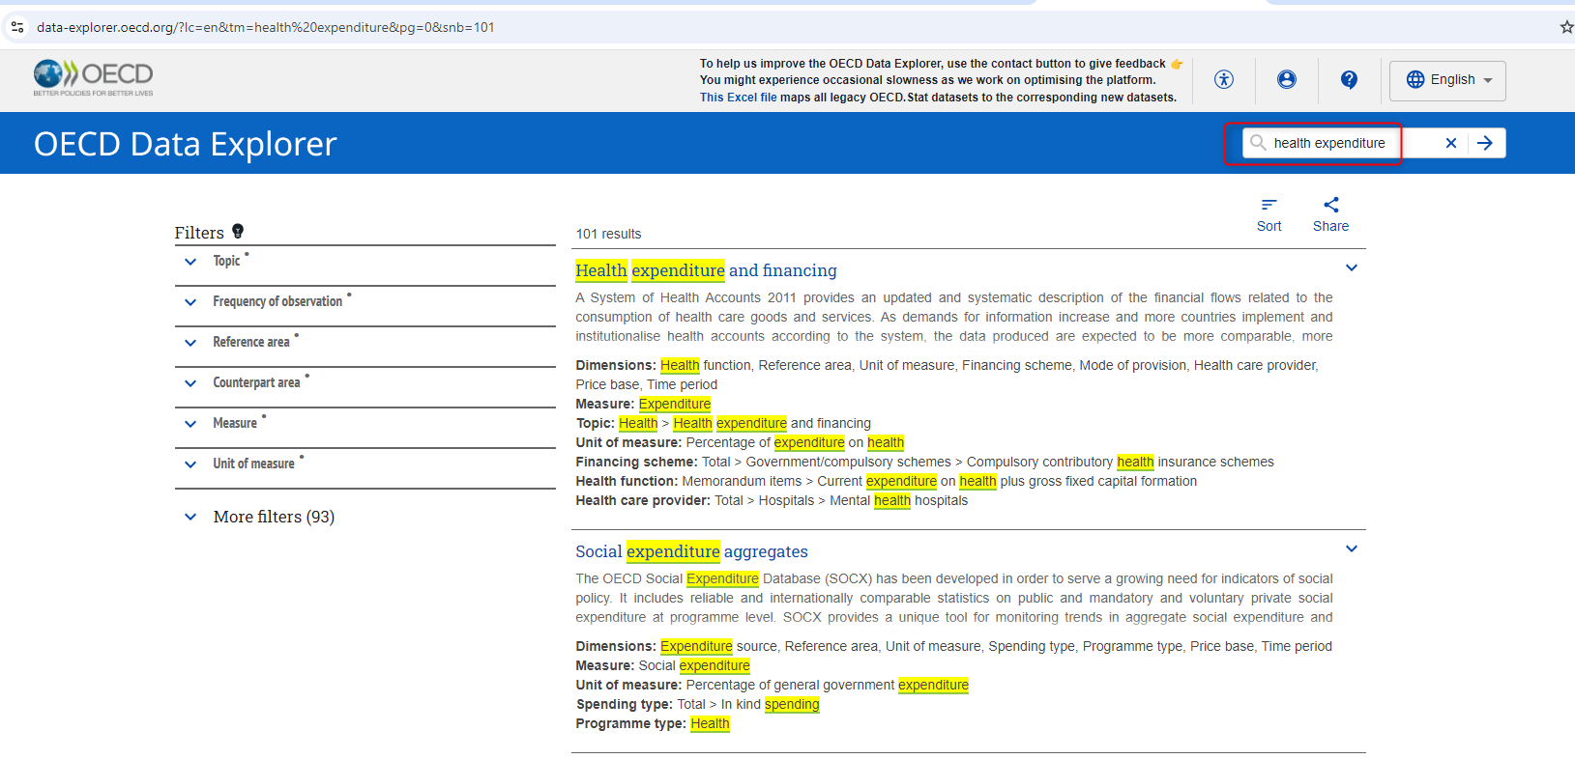
OECD Data Explorer dynamics
Faceted search – SOLR indexing

Slide 6
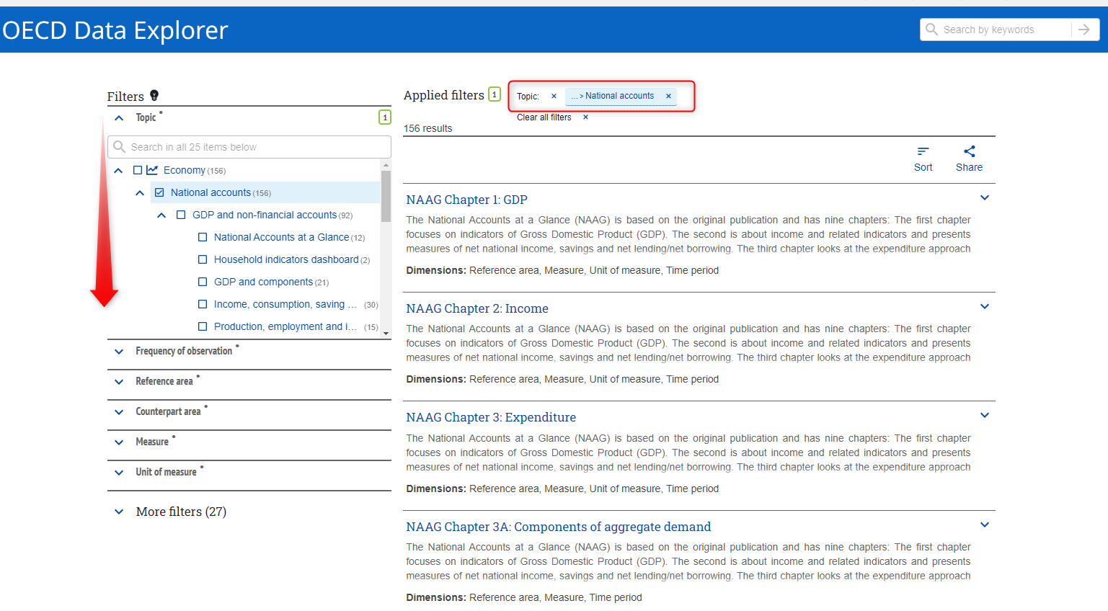
Data Explorer dynamics
Browse by Topic list (Category Scheme)
Notes:
Keyword search, calculate the scores and order the most relevant one on the top
To narrow down the available dataflows, topic filter could be useful

Slide 7
Problem statement – Concepts
Data modelling exercises for various domains revaled :
Reference area concept is relevant for most of the datasets
There are always good reasons to deviate and produce variants against commonly agreed concepts
Donor, Recipient concepts for the Development Assistance Committee or Creditor Reporting System
Exporter, Importer concepts for the various trade dataflows (Trade in Valued added, international trade etc.)
Notes:
Concept items refer sometimes geographical areas, political groups or even organizations

Slide 8
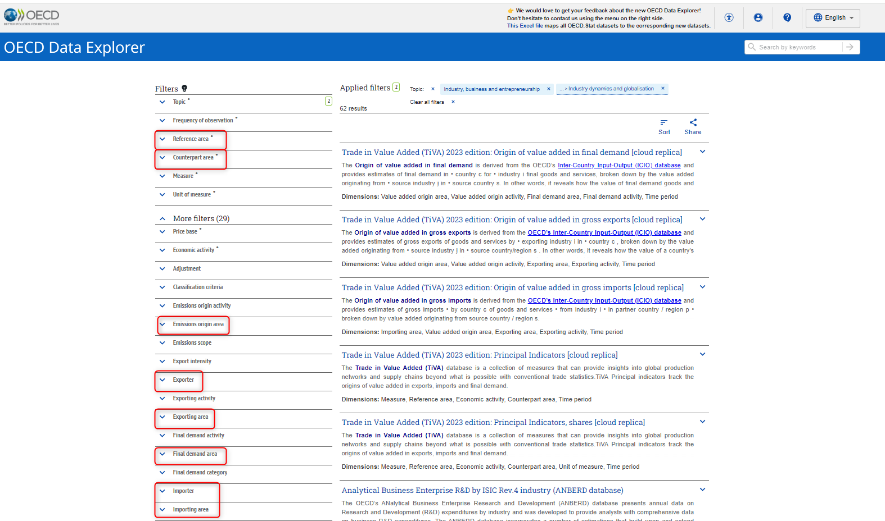
How variations effect the discoverability ?
Objective; list all the available trade dataflows for Netherlands

Slide 9
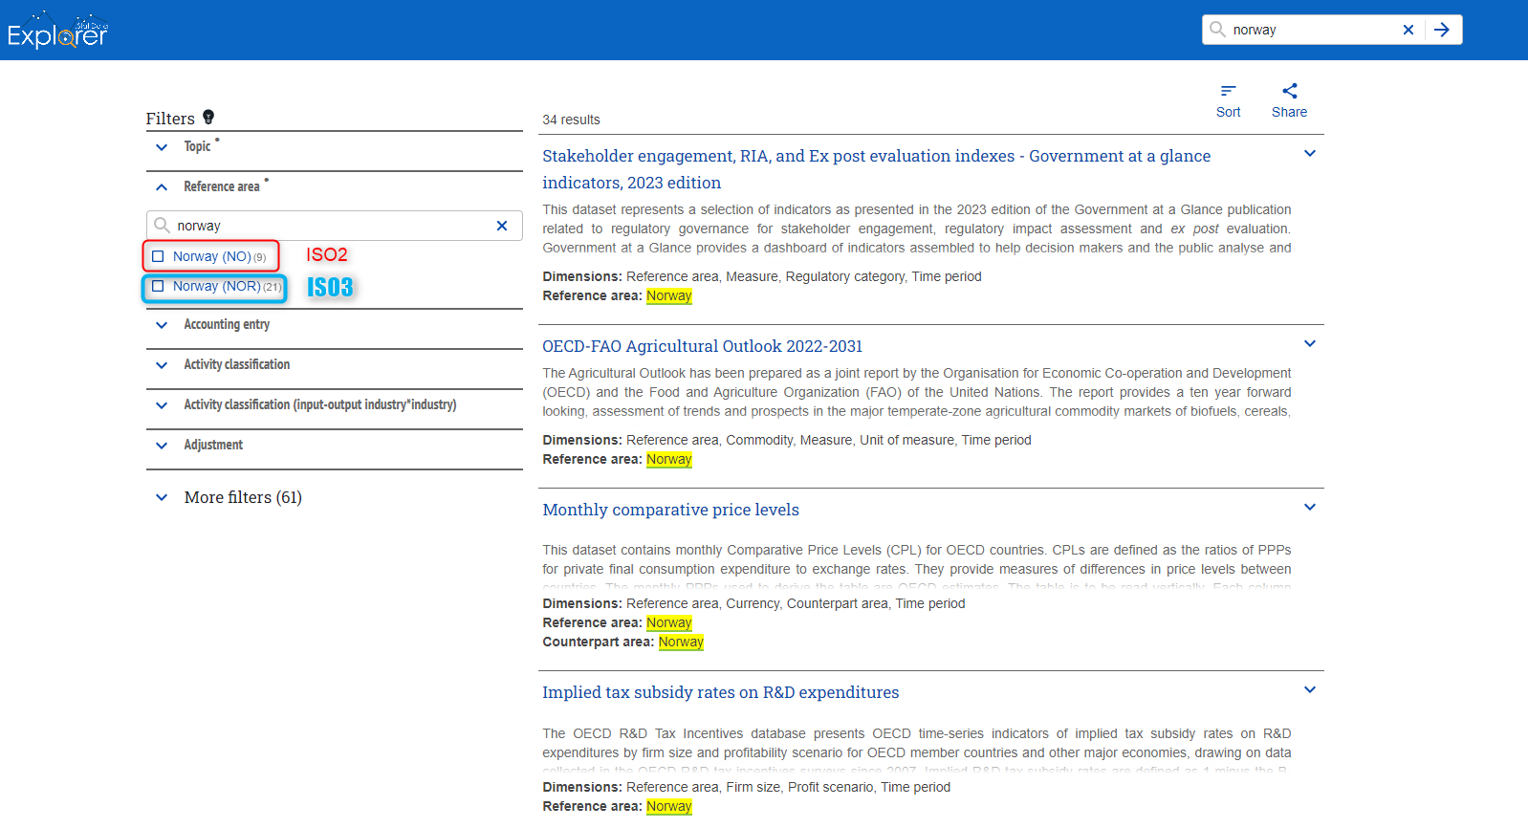
Problem statement – Code list variations
Objective; list all the available dataflows for Norway
Notes:
The issue could be also observed with the various product\commodity classifications HS, CPA, CPC

Slide 10
Conclusion and open questions
Potential risks for metadata silos
Built-in business rules and SOLR improvements ?
Would it be possible to create an umbrella concept for all geo-references ?
How: Concept-role, Annotations or Category Schemes ?
External semantic standards or knowledge graphs?

Slide 11
Thank you!

