Slide 1
Introduction to pysdmx
Javier Hernandez (Meaningful Data)
Xavier Sosnovsky (BIS)
Amsterdam, 2024-10-08

Slide 2
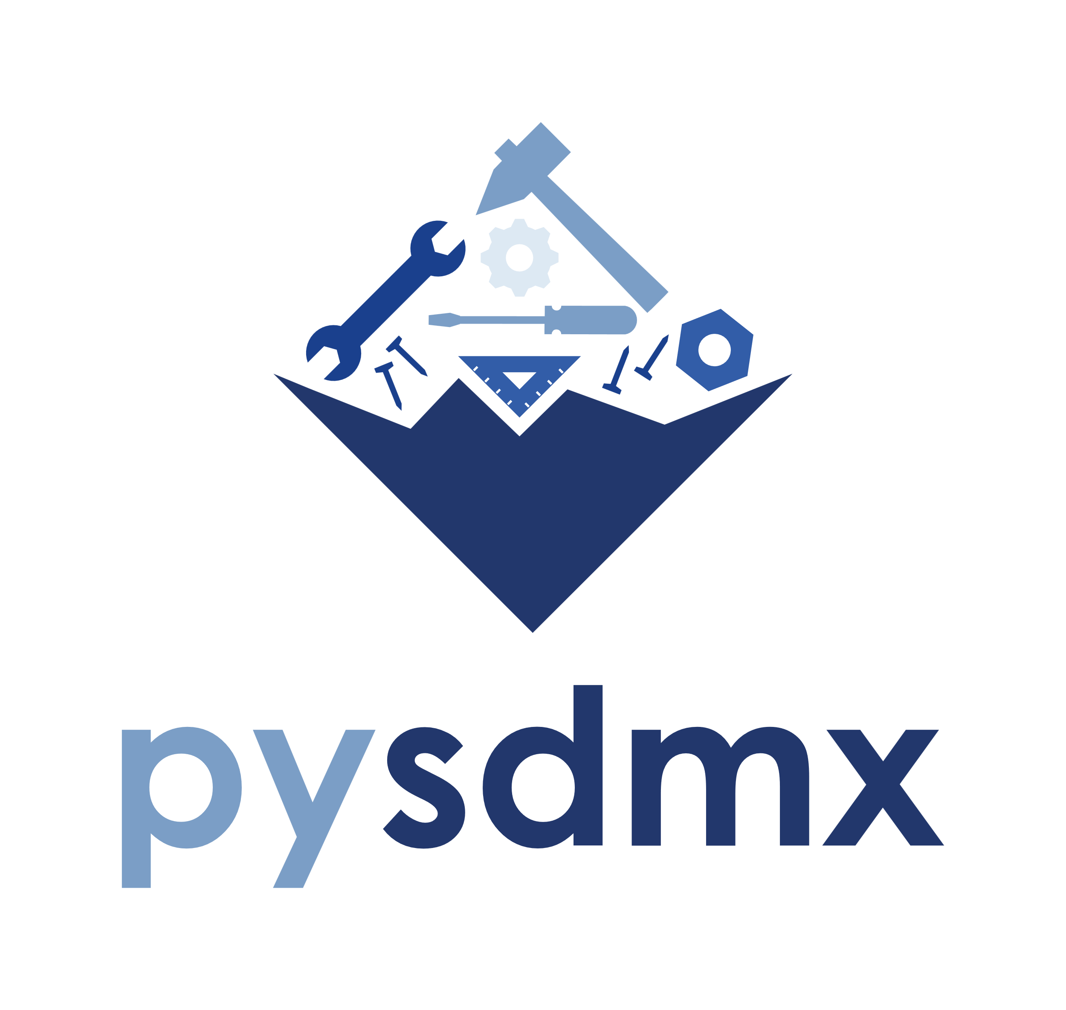
In a nutshell…
Python library for SDMX
Integrate with FMR (SDMX Registry)
Part of the Project LinkageX (BIS Open Tech)

Slide 3
What can it do today?
Provide an information model (Domain-driven development)
Retrieve SDMX metadata from SDMX Registries
Read SDMX data and returns a Pandas Data Frame (SDMXThon successor)
Version 1.0 to be released soon
SDMX 3.0

Slide 4
The role of pysdmx for the BIS
Feed BIS applications and processes with the required metadata to:
Generate the filesystem layout
Create the physical data model
Validate data
Map data
Configure functions behavior
And much more…
Data connectors (coming soon)
Supports data collection processes
Ease ad-hoc data analysis work

Slide 5
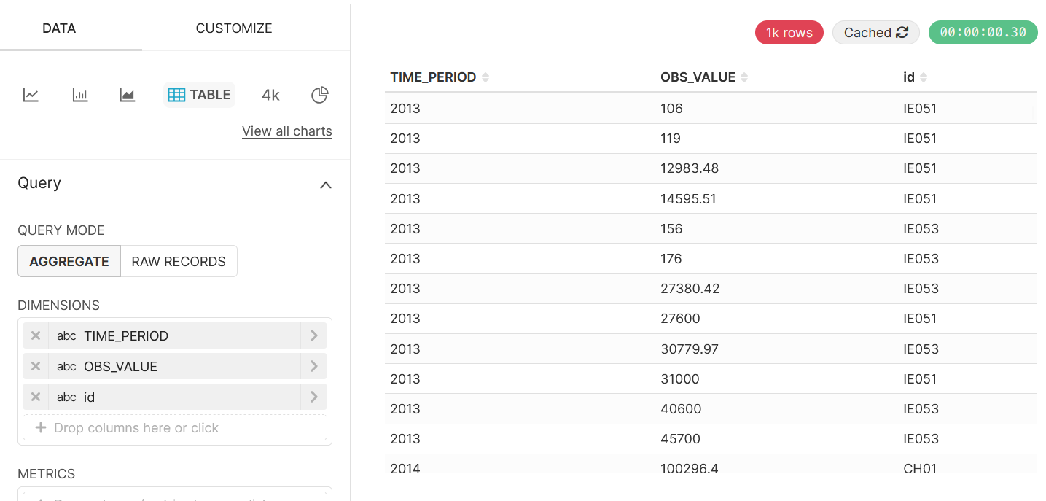
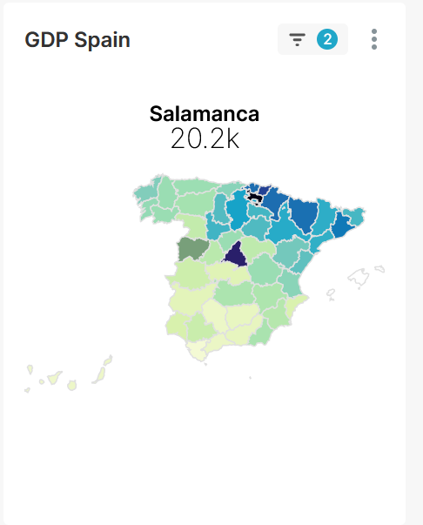
The role of pysdmx for Meaningful Data
Data visualization on SDMX Insight, a BI tool

Slide 6
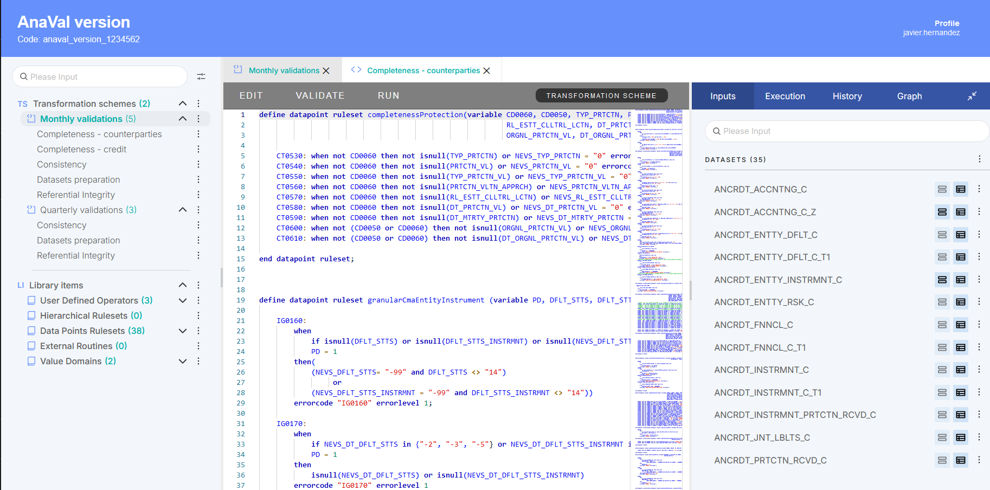
The role of pysdmx for Meaningful Data
Use of data and metadata in the VTL Suite

Slide 7
What’s next?
API
Support data discovery and data retrieval from SDMX services
IO operations
Support more SDMX formats
Support low memory scenarios
Data processing
Business functions (validate, map, summarize, convert, etc.) might be added later

Slide 8
Thank you!

