Slide 1
The SDMX Global Discovery Service
12th SDMX Experts workshop
7-11 October 2024
Amsterdam, the Netherlands

Slide 2
SGDS Problem Statement
As more SDMX Registries are deployed and used in production, the need for SDMX Artefacts discovery and sharing is becoming more important.
From the Global Registry, which maintains core Artefacts like the top-level Agency Schemes, to international or national Registries maintaining widely used Codelists.

Slide 3
Where we are today
A python application built using the Django web framework
  Containerized and deployed on an OKD cluster
  A MariaDB database for storage
  Uses pysdmx for accessing SDMX endpoints
Deployed under https://gds.sdmx.io exposing SDMX endpoints from providers participating in the SDMX TWG
A draft browser UI for exposing all endpoints has been developed
Feedback from the TWG is now being developed:
  Rationalization of the messages (closer to SDMX JSON messages)
  Client oriented requests (enhancing discoverability)
  Resolution of SDMX URNs

Slide 4
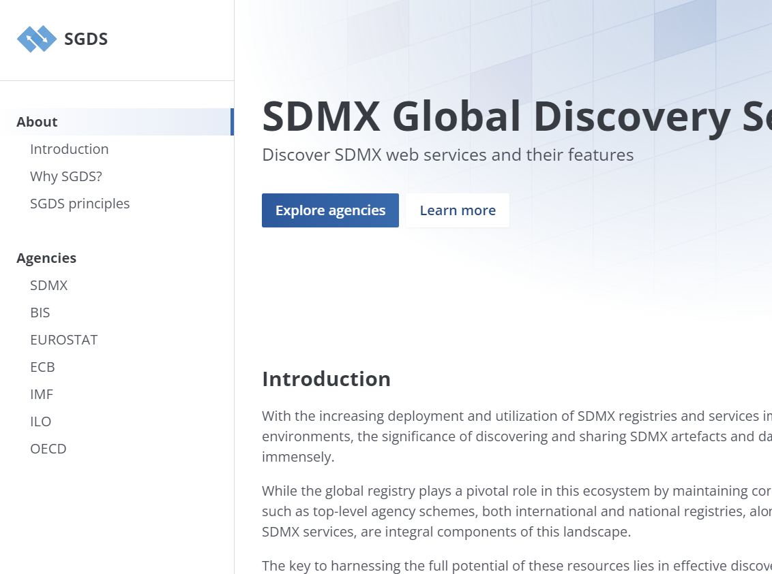
The SGDS browser
A simple UI for users
Browsing and searching

Slide 5
SGDS browser - demo

Slide 6
Where we want to go
Expose the new API to potential clients (mainly other services) that require discovery of SDMX endpoints
Expose the UI to the SDMX community under the sdmx.io, for comments and feedback
Work on the processes for:
  Onboarding new Agencies and their services
  Add TCK to test and configure the SDMX services entries (eg supported resources, formats, etc)

Slide 7
Thank you!

