Slide 1
2023 IFC survey results
Brian Buffett, Bianca Ligani – Bank for International Settlements
12th SDMX Experts workshop
7-11 October 2024 - Amsterdam, the Netherlands

Slide 2
Outline
Introduction
SDMX by statistical domain and data lifecycle
SDMX tools
Summary and Key Takeaways
Q&A
Notes:
Bianca
Good -- everyone. Today, I'll be presenting the results of the 2023 IFC survey on SDMX adoption and tool usage.
Our agenda includes:
An introduction to the survey
SDMX by statistical domain and data lifecycle
SDMX tools
Summary and key takeaways
And finally, a Q&A session

Slide 3
Overview of survey and background
What
Why
Assess the state of SDMX adoption and usage of SDMX tools
Statistical domain
SDMX implementation, tools in use and gaps in domain-specific learning materials
SDMX sophistication, adoption and tools in use
Organisation
Who
IFC members – 52 respondents
Statistical process
SDMX relevance, knowledge, tools in use, need for new tools and gaps in learning materials
When
Use cases, satisfaction, strengths, weaknesses, areas for improvement documentation and resources
Survey from March – August 2023
Tools
Notes:
Bianca
To give you an overview, the survey aimed to assess the current state of SDMX adoption and the usage of SDMX tools among IFC members.
We had participation from 52 central banks over a period that goes from March to August 2023.
The survey covered four main areas:
How SDMX is implemented in the various statistical domains, and through the statistical data lifecycle (from collection to dissemination)
Organisation: SDMX sophistication and adoption
The SDMX tools, with a focus on open source tools: use cases, satisfaction and learning amterial

Slide 4
SDMX adoption
Fig 1 – SDMX adoption state among respondent central banks
↑ 79% using or implementing SDMX, compared to 64% in 2016
67% using SDMX for 3+ years
13% evaluating or planning to implement SDMX
Notes:
Bianca
Since the previous time this was assessed in 2016, sdmx adoption increased to 79%.
A further 13% of institutions is evaluating or planning to adopt SDMX

Slide 5
Blocking factors
Adoption barriers most notable in Africa and Asia
Key barriers: adapt internal tools and lack of resources
Fig 2 – main blocking factors for SDMX adoption
Notes:
Bianca
Moving on, the survey assessed the main blocking factors against SDMX adoption
The main 2 factors are: the need to adapt internal tools and the Lack of resources
However, another notable blocking factor is the lack of support in open-source tools, a point on which the SDMX community and the developers of the tools can focus to ease the initial burden of SDMX adoption.

Slide 6
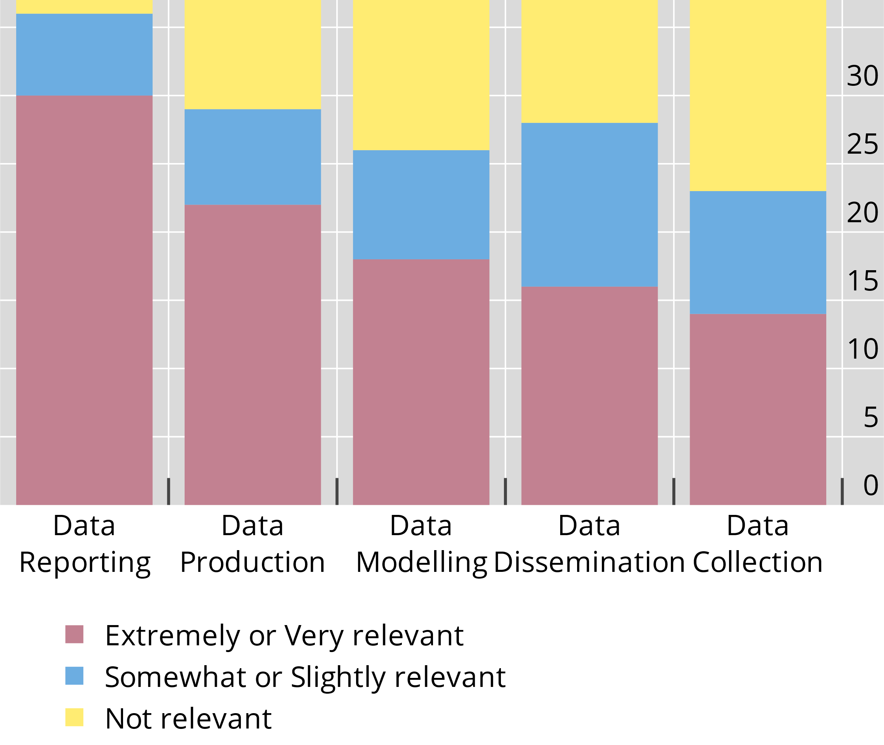
SDMX Relevance
Fig 3 – SDMX relevance in the data lifecycle
SDMX is perceived as extremely or very relevant especially for data reporting and data production
SDMX is perceived less relevant for data collection
Notes:
Bianca
Beyond encouraging SDMX adoption among those institutions that are not using the standard yet, the survey aimed to assess if there are institutions using the standard that are encountering any type of blocking factors. First, we assessed the relevance level of SDMX across the various steps of the data lifecycle.
SDMX is perceived as relevant by most respondents, especially for data reporting and data production.
On the other hand, SDMX is perceived less relevant for data collection.

Slide 7
SDMX Relevance
Fig 3 – SDMX relevance in the data lifecycle
Focus on central banks who see SDMX as extremely or highly relevant
How do they rate their SDMX knowledge?
Notes:
Bianca
We want now to focus on those institutions that see a high relevance in SDMX, in order to check if their knowledge of the standard is good enough to support the relevant activities.

Slide 8
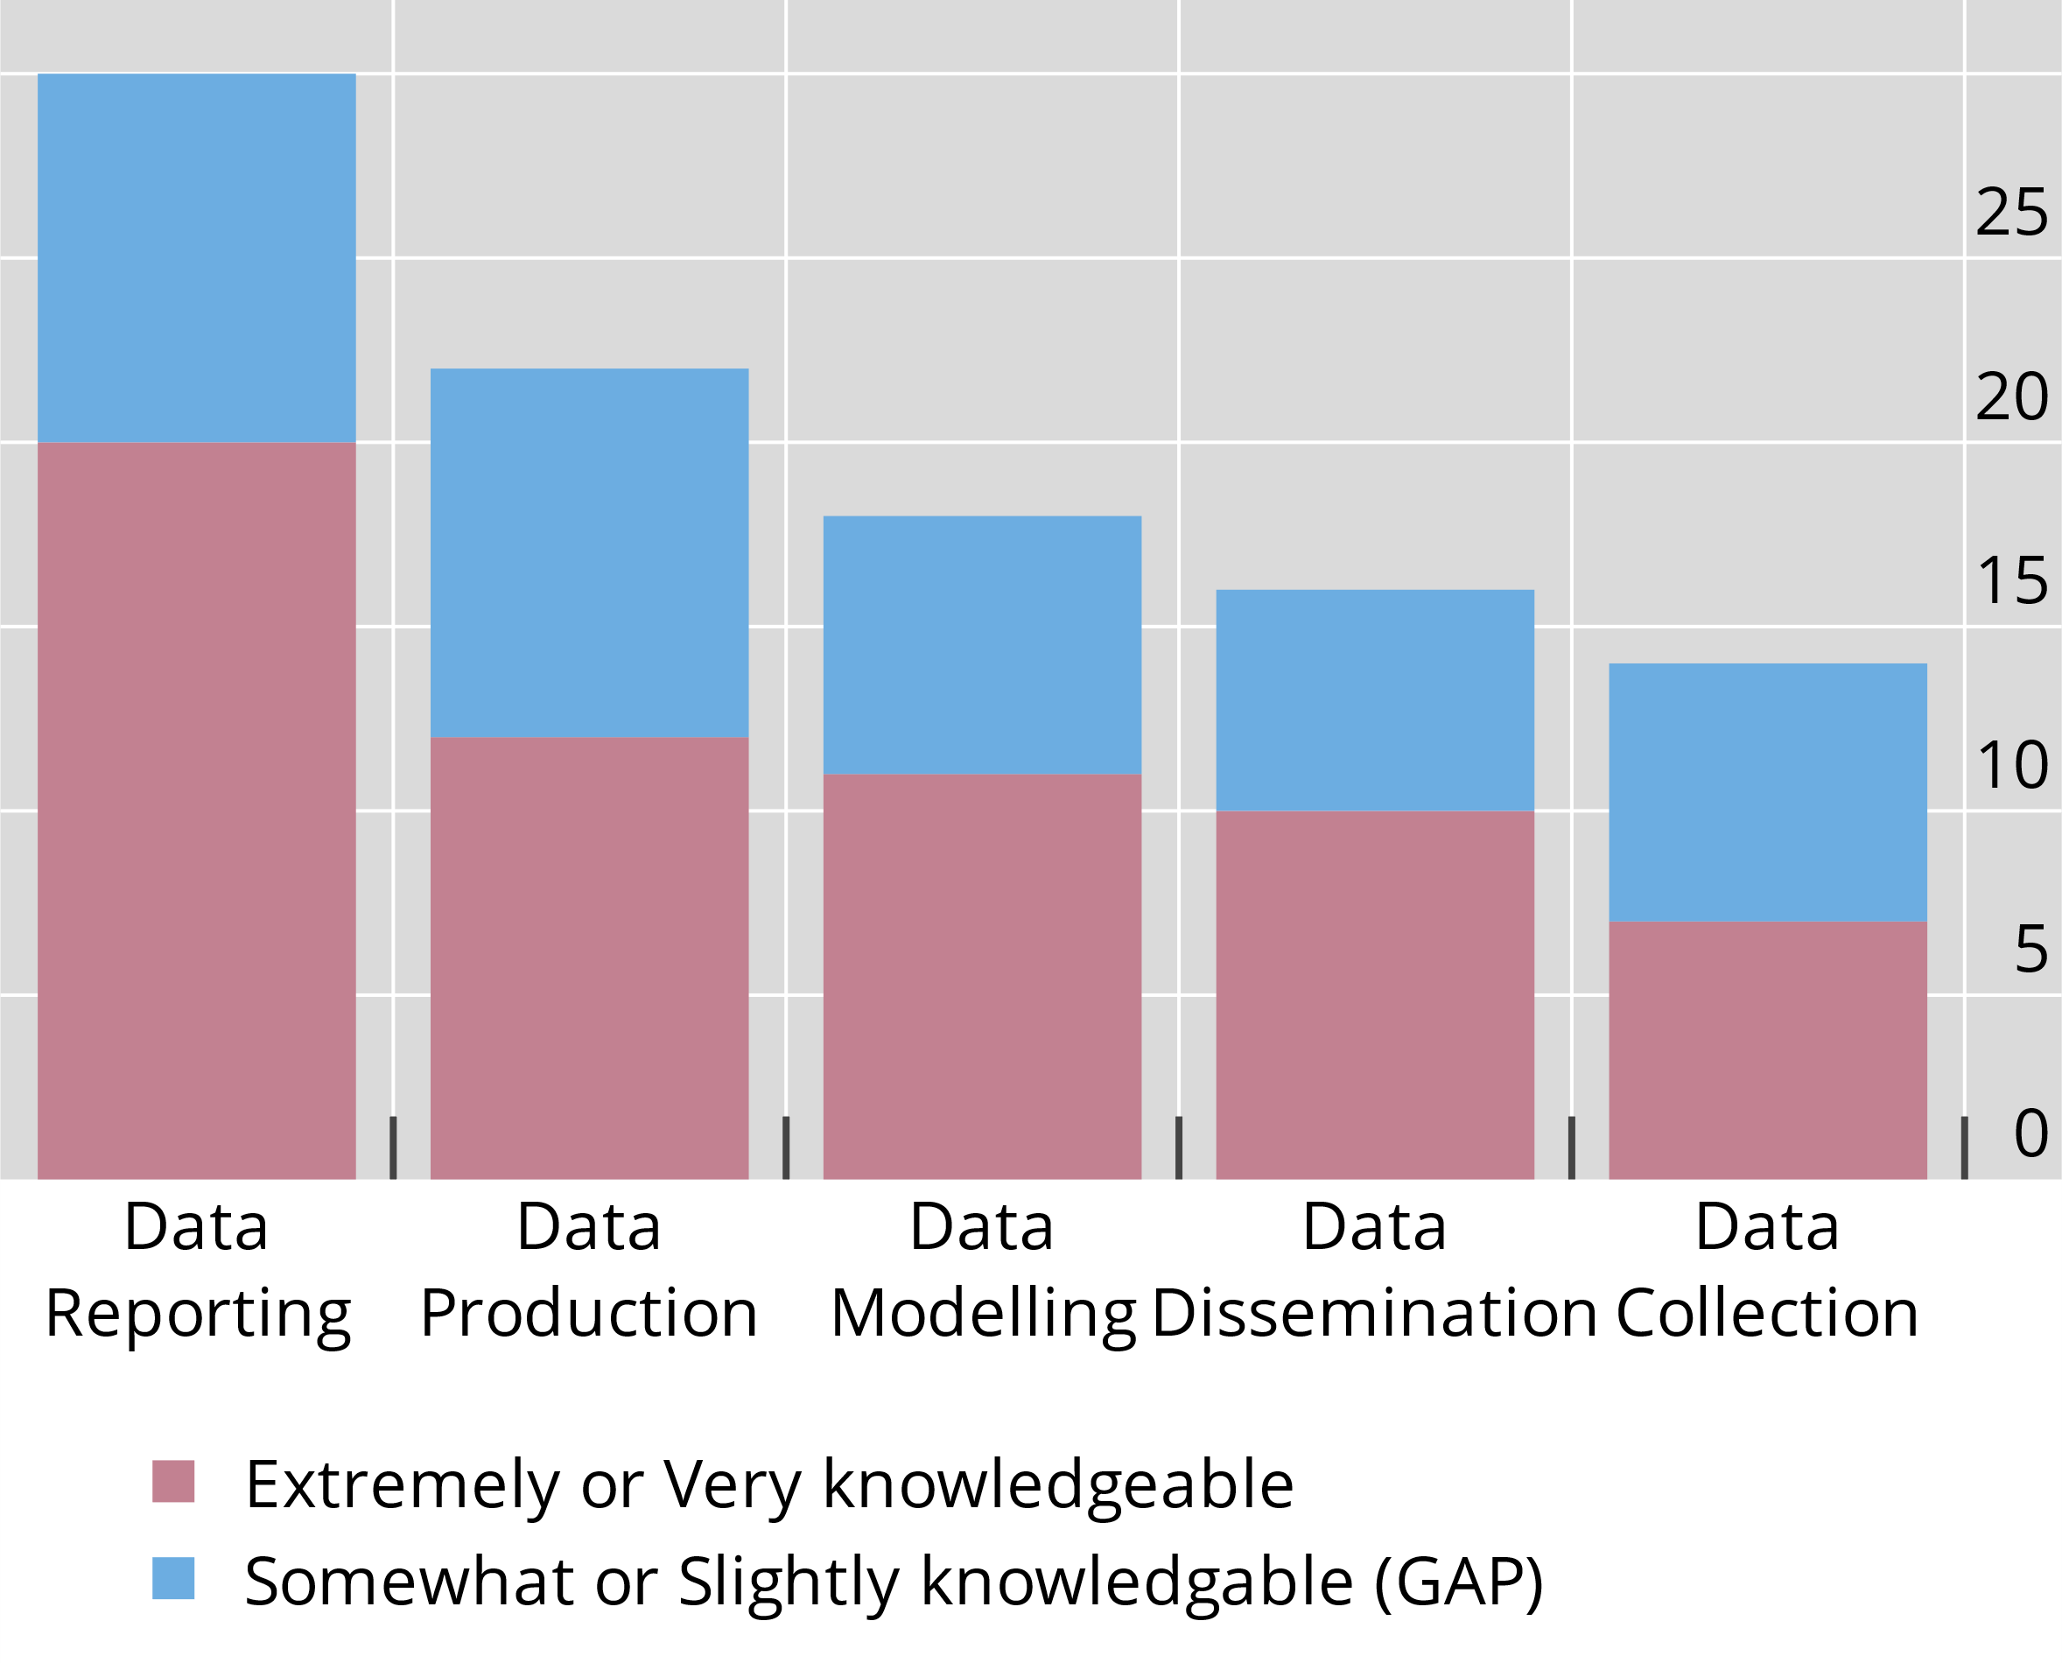
SDMX knowledge gap
Fig 4 – SDMX relevance/knowledge
Regardless of the relevance we see a knowledge gap consistently distributed across all steps of the data lifecycle
Institutions indicating SDMX as highly relevant are somewhat/slightly knowledgeable in the standard
  Figures based on respondents indicating a high relevance for SDMX
Notes:
Bianca
Here you can see how the SDMX knowledge is distributed, for those institutions that recognize the standard as relevant.
While many respondents also indicate a good understanding of SDMX, there are still areas where knowledge can be enhanced. Even among those who find SDMX highly relevant, some gaps in understanding remain.
Slightly/not at all

Slide 9
SDMX by statistical domain
Notes:
Bianca

Slide 10
Statistical domains
Focus on official statistics, many already collected and shared using SDMX
Key Questions
  Which statistical domains are leveraging SDMX? Which are not, and why?
  What tools are used?
  Are there any gaps in the tools offered?
Notes:
Bianca
As the survey was directed to central banks, the main focus was on the official statistics shared among institutions. The survey aimed to identify the statistical domains are leveraging SDMX, and the reasons for which some domains may be lagging behind.

Slide 11
SDMX adoption in all data lifecycle steps by statistical domain
Fig 6 – SDMX by domain
SDMX is mainly used for reporting:
  Demand-driven: mandate to report in SDMX in selected areas
  Often other formats are converted to SDMX
  SDMX advantages are not fully achieved by all reporters
  Initial “demand driven” adoption is extended beyond reporting
Notes:
Bianca
Breakdown by data domain and data lifecycle steps.
Once adopted, extending SDMX to the other steps is a smaller incremental cost that carries large benefits
Unit is = number of answers
Does not sum to 52 because the same institution may use SDMX in more than one step of the data lifecycle
Advantages: python libraries and other open source tools (as VTL or the dashboard generators) are continuously developed
The forum and the community support
The API to allow others to pull data in a common format
… global DSDs make data exchange easier

Slide 12
SDMX adoption in data lifecycle steps excluding reporting
Fig 7 – SDMX (no reporting)
Excluding the data reporting adoption:
SDMX adoption is ~30 to 45% across all data domains
Survey shows significant plans of further adoption across all domains
SDMX adoption plans highlight the statistical domains supported by existing global artefacts
Notes:
Bianca
We can see there is a correlation between a global DSD and SDMX adoption.
Scale is 0 to 1 (percentage of producers)
We removed the collection and reporting figures to see the true SDMX adoption: if an institution is using SDMX in Production, modelling, OR dissemination, then it is counted here
We want to see the adoption and how it is expected to grow

Slide 13
SDMX tools

Slide 14
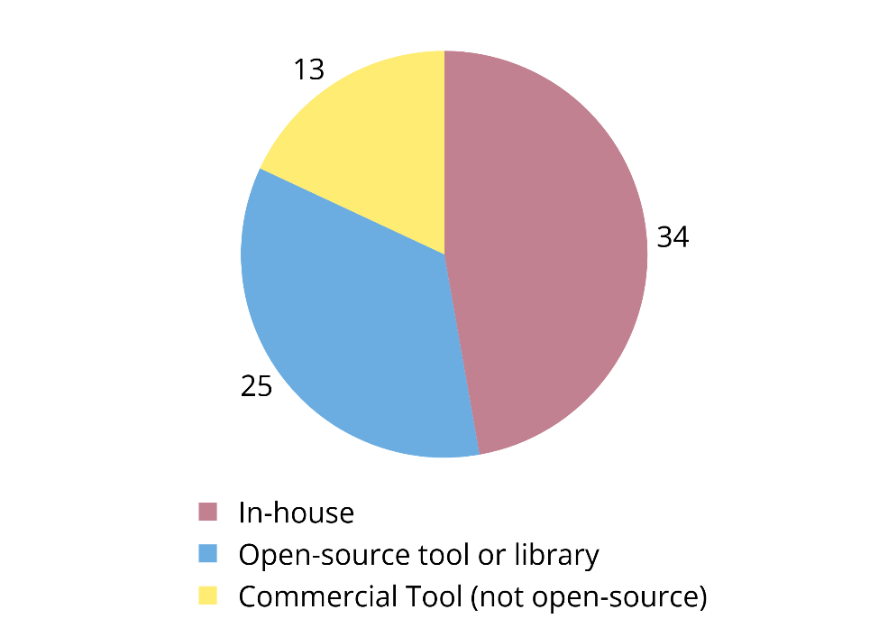
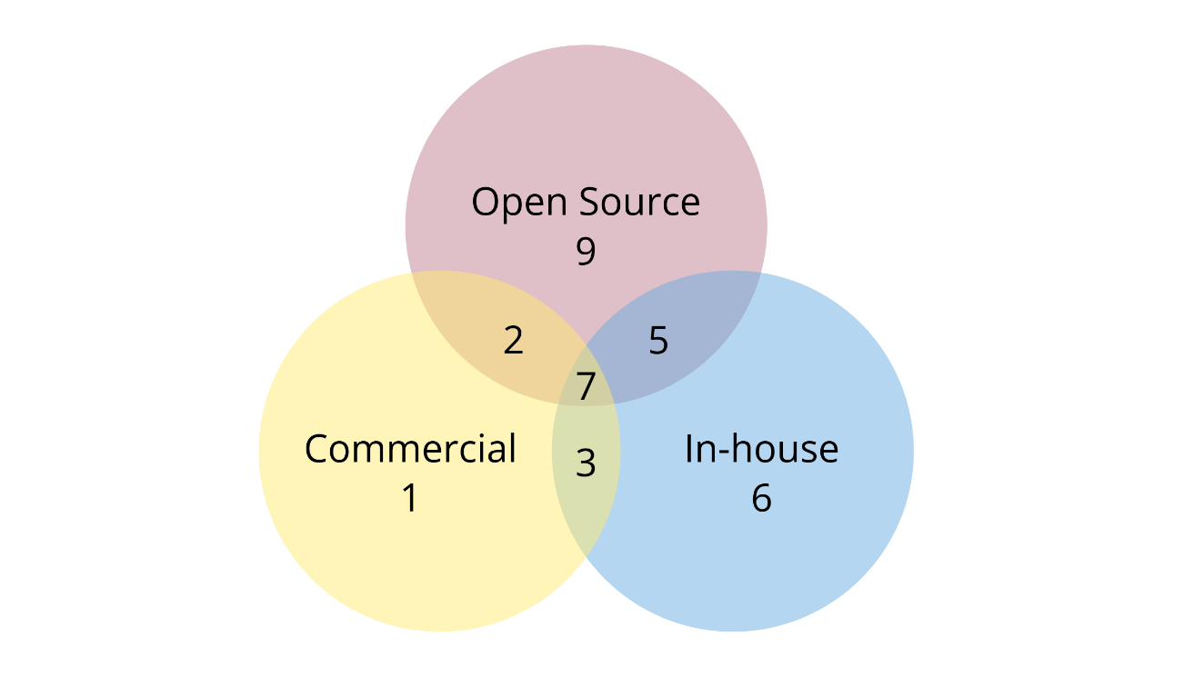
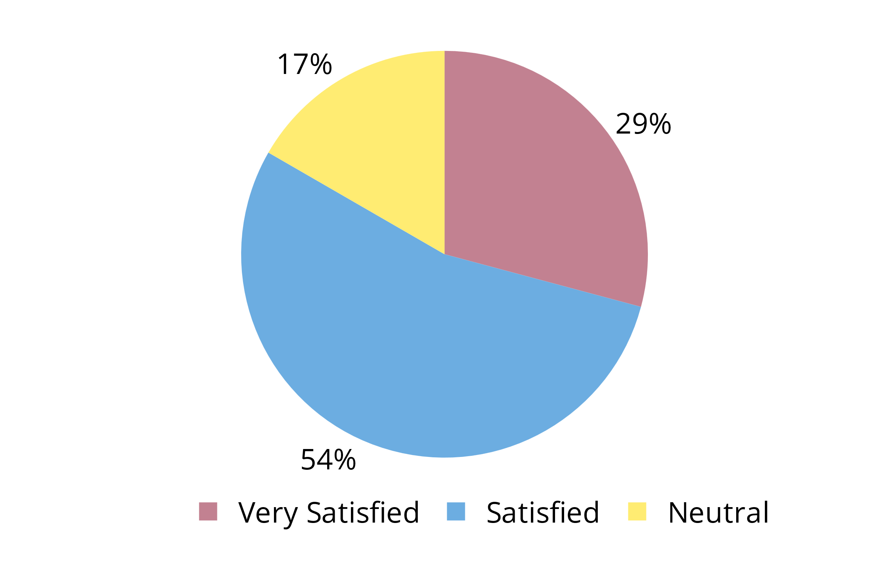
Categories of tools in use
  Interoperability
  is essential
There is a rich ecosystem of tools in use
Most central banks use a variety of tools and types of tools
Central banks are generally satisfied or very satisfied with open-source tools
# of unique SDMX tools in use
Central bank SDMX tool usage
Satisfaction with open-source tools
Notes:
Instead of a single, monolithic "end-to-end" IT solution, the SDMX standard advocates for a modular, flexible approach – which, in turn, necessitates targeted learning resources and a strong focus on interoperability.
The variety of tools used illustrates one of the strengths of SDMX: its modular, loosely coupled design, that encourages fit-for-purpose tools which can be combined to respond to specific needs of central banks.
Moreover, a significant 83% of central banks reported being very satisfied or satisfied with the SDMX open-source tools, which are now being utilized in all stages of the data lifecycle. Satisfaction with in-house or commercial tools was not assessed.

Slide 15
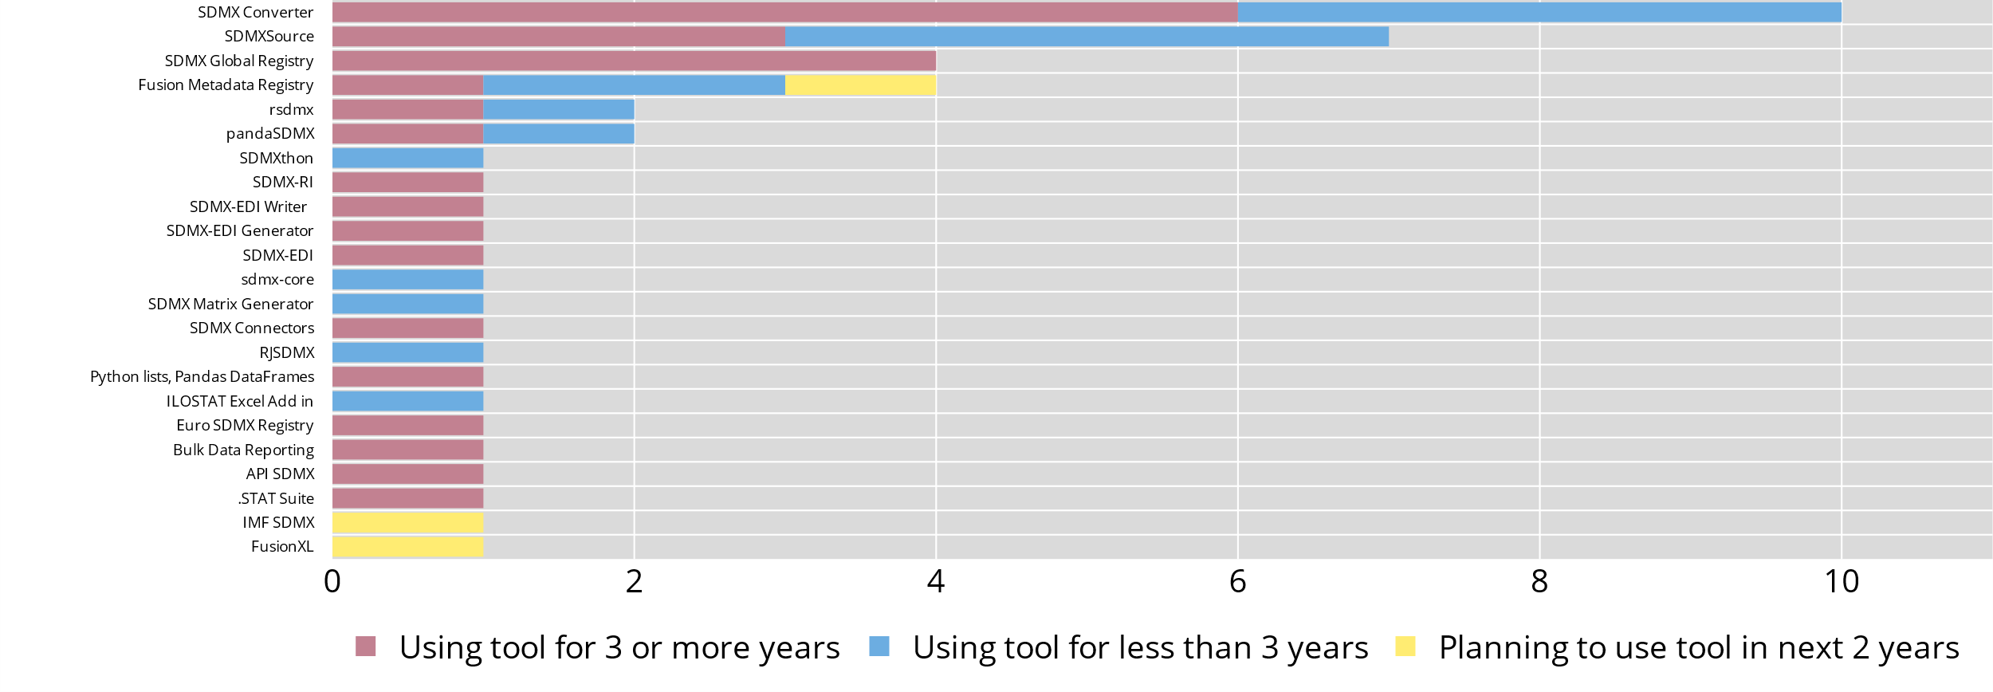
Usage of SDMX open-source tools
Many tools in use – a few are widely adopted
Notes:
Currently, there are 25 SDMX open-source tools in active use by at least one central bank. Notably, a large proportion of these tools are used by only one or two central banks.
Two of the main barriers to SDMX adoption (as well as migrating to SDMX 3.0) are the cost of adapting internal software tools and the lack of support for SDMX in (traditional) open-source tools. These barriers, combined with the findings that many existing SDMX tools are used by a few institutions only, could indicate an inefficient and fragmented marketplace in need of consolidation.

Slide 16
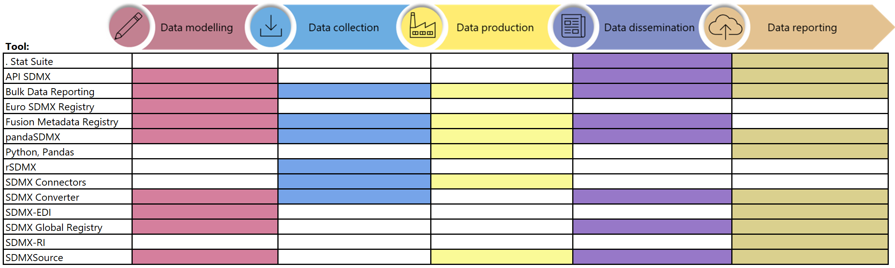
Tools and the data lifecycle
Rich ecosystem of tools that covers the full data lifecycle
Many tools are specific for one task
Some tools are used throughout the whole data lifecycle
Notes:
The survey confirmed that there is a rich ecosystem of open-source IT tools (such as those pertaining to the sdmx.io ecosystem) to support the SDMX adoption and implementation throughout the data lifecycle. These SDMX tools, often complemented with in-house or commercial tools, provide all architectural components necessary to support the GSBPM phases

Slide 17
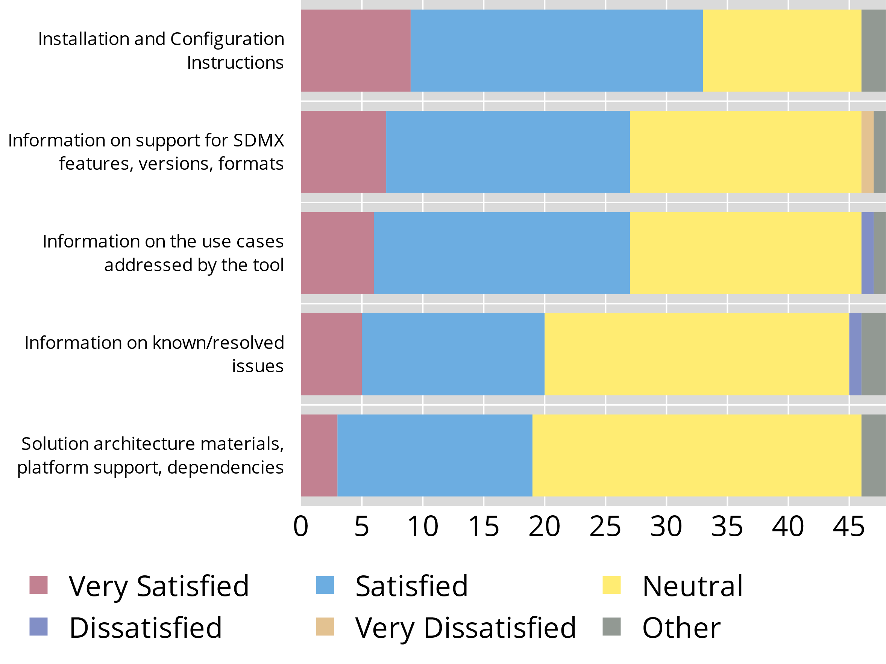
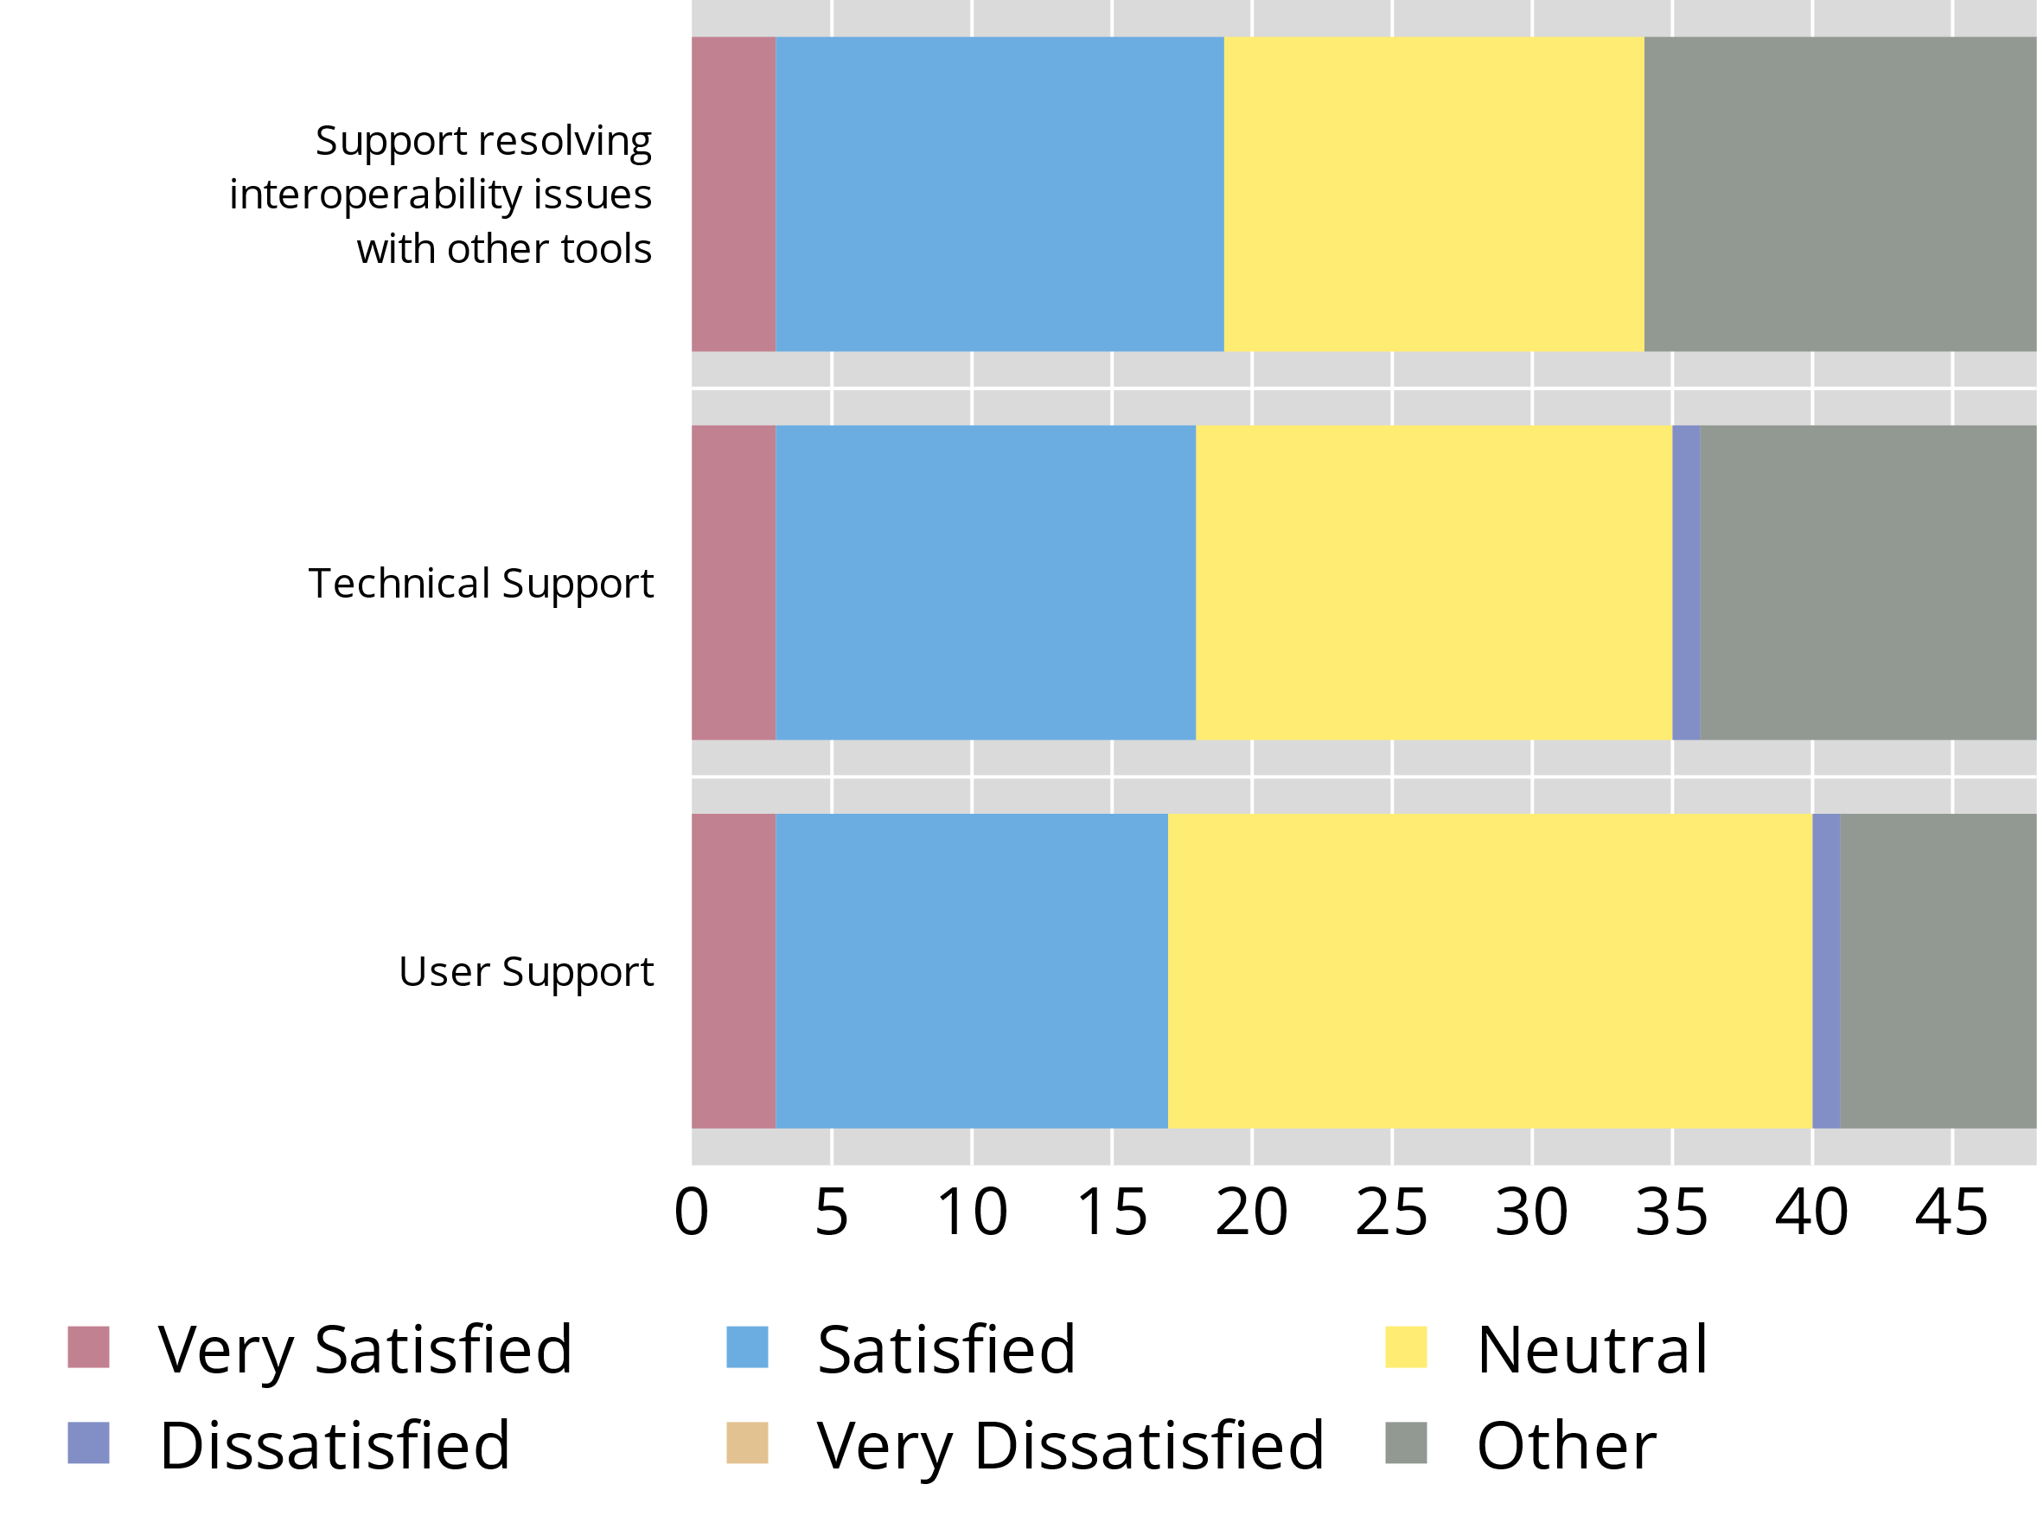
Satisfaction with resources and support
tbd
Satisfaction with pre-implementation resources
Satisfaction with post-implementation support
# of unique SDMX tools in use
Notes:
The successful adoption of an SDMX tool also depends on the related, necessary knowledge and skills of an organisation, which is largely driven by the availability of related learning resources and support services from the tool providers. Thus, the survey measured the central banks’ satisfaction with such learning resources and support services in addition to the overall satisfaction with open-source tools, to identify improvement and innovation opportunities.
The overall satisfaction with SDMX open-source tools is positive, for both pre-implementation and post-implementation support materials, with essentially no Dissatisfied or Very Dissatisfied responses. Initiatives by the open-source software producer community to better understand user needs and coordinate efforts are underway, with increased tool adoption and satisfaction measures of success.
Learners progress along a learning curve; to support learners in this journey, the survey also requested central banks to prioritise their learning needs, by tool. The findings varied greatly on a tool-by-tool basis. However, the demand for more learning videos and recorded workshops emerged across most tools.

Slide 18
Key takeaways
Q&A

Slide 19
Key takeaways
There is a notable and significant increase in SDMX adoption among central banks
Most central banks reported using multiple open-source SDMX tools and expressed satisfaction with the tools and the support resources.
the main obstacles to both initial adoption and to transitioning to new versions of the standard:
  Lack of necessary resources
  Lack of adequate IT tools (either the need to adapt internal tools or feature gaps in open-source tools). Tools need to seamlessly integrate and communicate to each other.
35% to 50% of responding central banks reported lacking the requisite expertise to implement SDMX in relevant data lifecycle stages.
Correlation between SDMX adoption and global DSD. Due to engaging domain experts?

Slide 20
Thank you!

