Slide 1

Manage Artefacts with FMR Workbench
José Vereecken

Slide 2


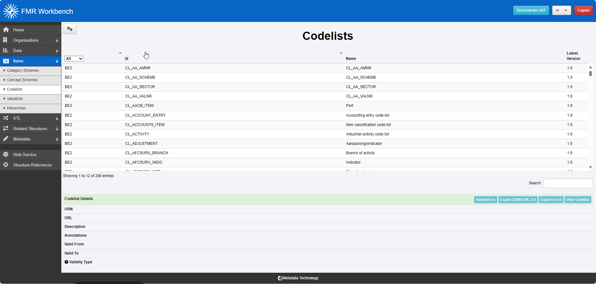
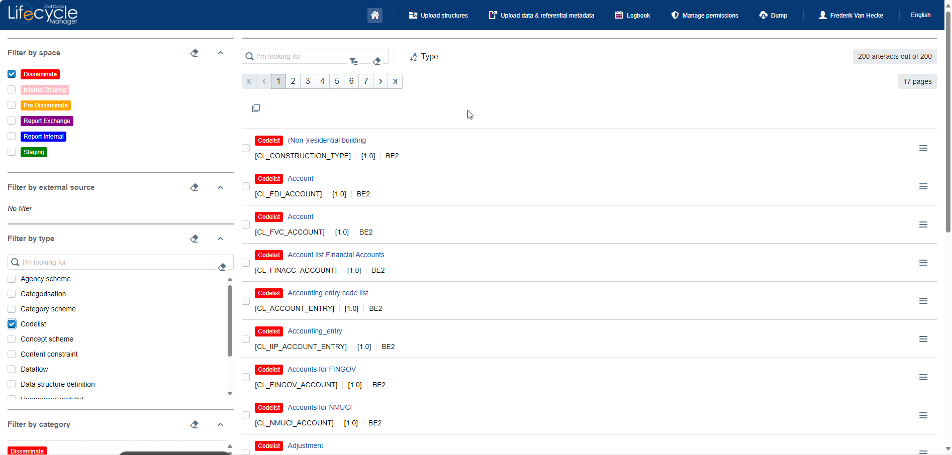


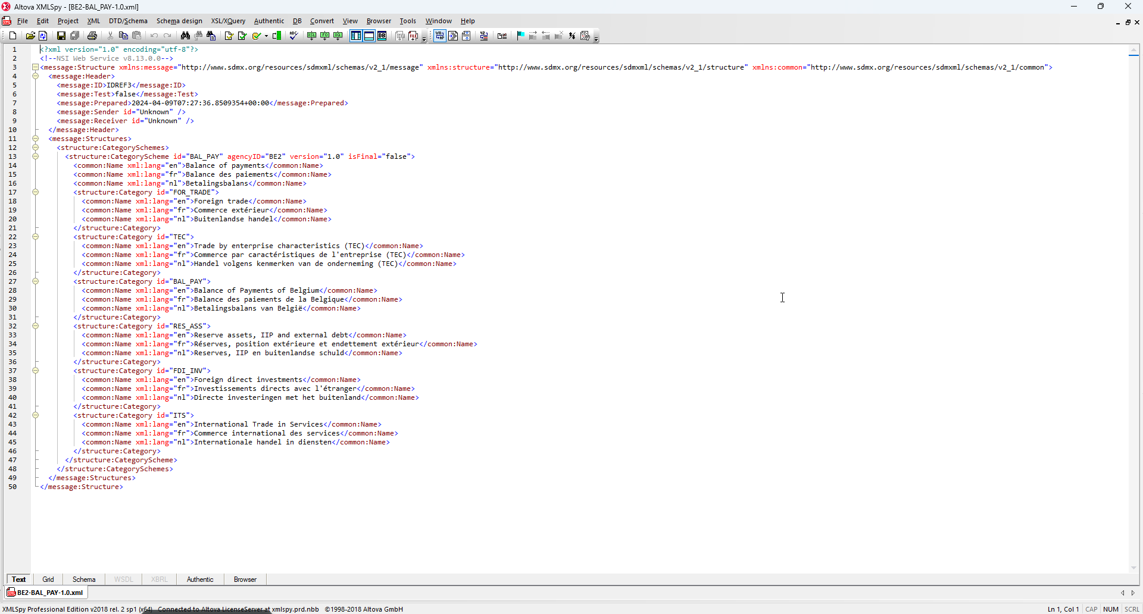
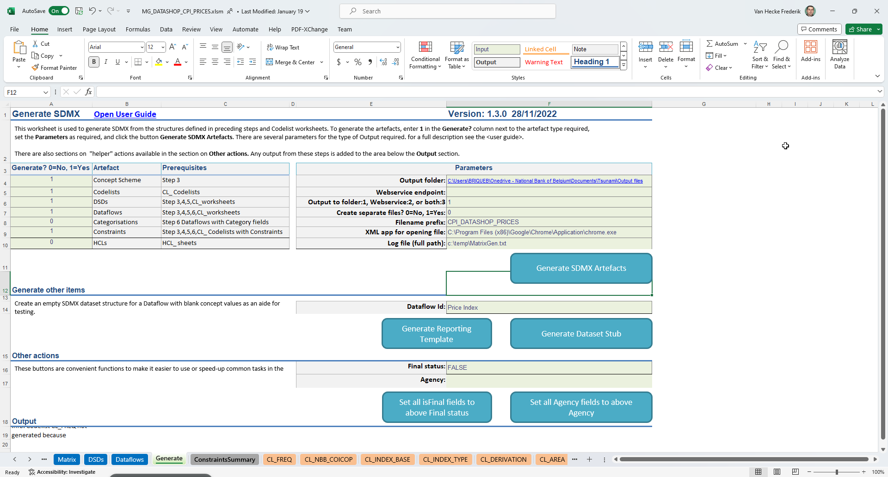
Introduction
.STAT

Slide 3

Demo FMR-Workbench
        Starting from Excell Matrix Generator
        Modify codelist using Codelist Wizard
        Modify a view using Dataflow Wizard
        Modify constraints using Constraints Wizard
        Modify annotations using Annotations Wizard

Slide 4
Conclusion on FMR Workbench
        No SDMX experience required
        User-friendly
        Use of self explaining wizards
        Less risks of making mistakes
        Separated from other administration actions (security)
        Used for:
            Creation/maintenance of codelists, labels, etc...
            Visualisation of data: easy to maintain dataflows, filters, constraints

Slide 5

Thank you
Jose.vereecken@nbb.be
Manage Artefacts with FMR Workbench
www.nbb.be

