Slide 1
sdmx.io update
SDMX Experts Workshop
October 2024

Slide 2

What is sdmx.io?
sdmx.io is not a single project but an ecosystem of open source tools, patterns, guidance, learning materials and other resources like pre-configured containerised environments that make the software quick and simple to deploy.
Share software tools and components based on SDMX
Complement existing tools in order to achieve statistical use-cases
Interface SDMX with other standards or tools
Promote reusability of SDMX software
An open-source SDMX software and resource portal
  Software releases (FMR, FusionXL, etc.)
  E-learning courses and webinars
  Knowledge and use-case articles
Governance in place, incl. Prioritisation and User Advisory Groups
Officially public, after the SDMX Sponsors approval

Slide 3
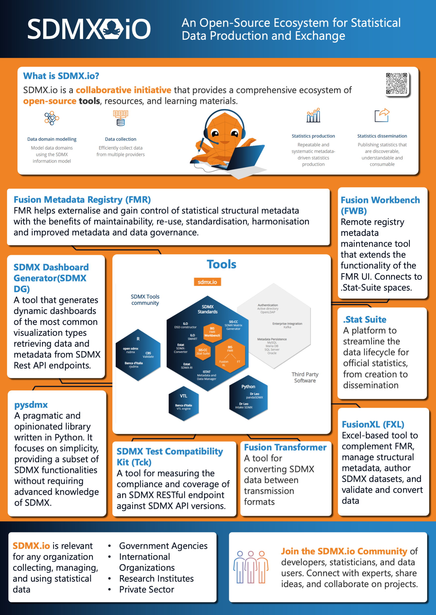
Achievements
Ecosystem expanded:
  .Stat Suite; Fusion Workbench; SDMX TCK; SDMX Dashboard Generator; pysdmx; gingado-ML library for economists
Upskilling:
  3 how-to webinars, high participation rate
  8 eLearning courses, modelling and how-to
Partnerships
  SDMX sponsors: OECD / SIS-CC, IMF, Eurostat
  Central Banks: NB Belgium, Bank of Italy, etc.
  NSOs: INSEE
  Private partners: Meaningful Data, HMS, Making Sense
Situational Assessment:
  SDMX tools survey & global report

Slide 4
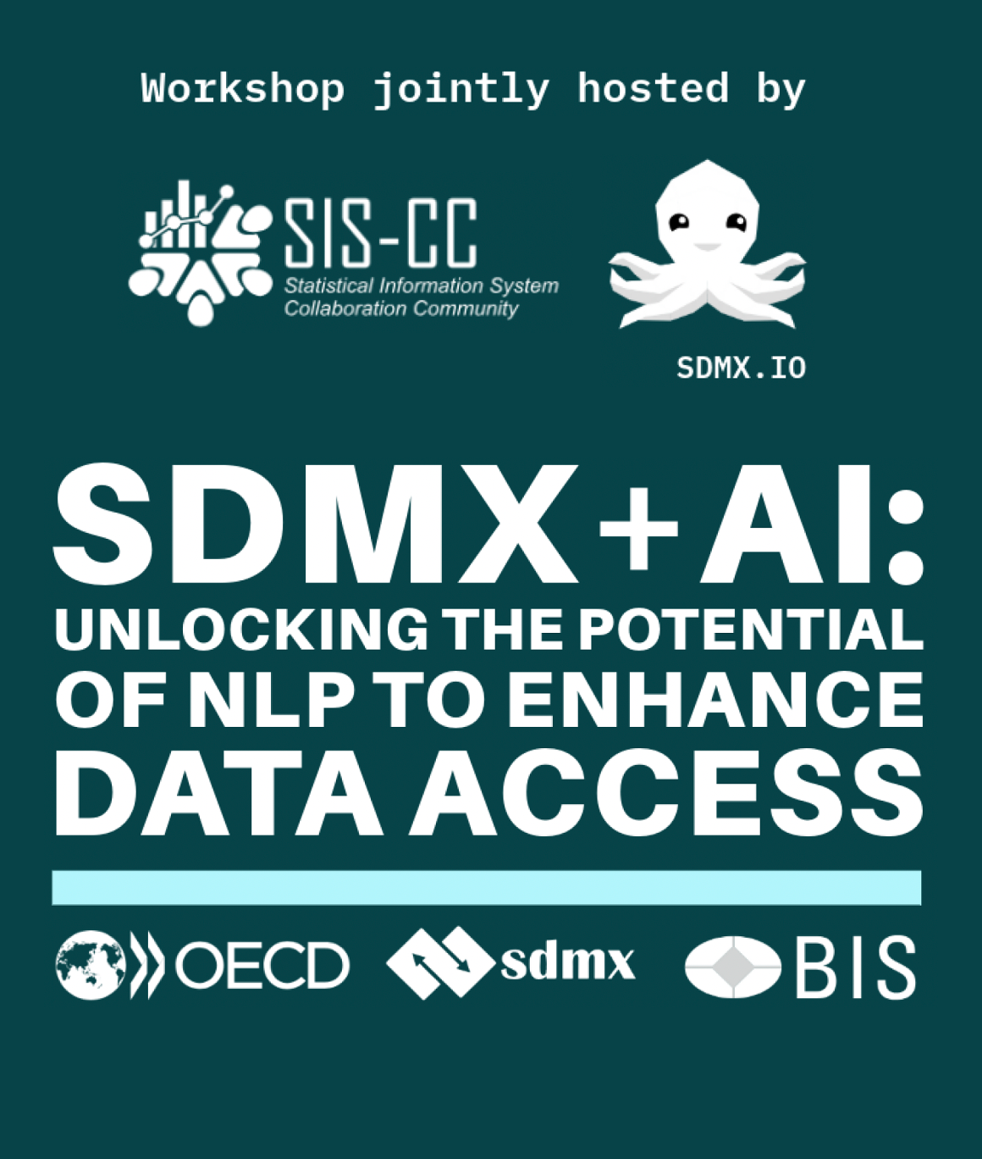
Underway
Innovation
  SDMX + AI initiative with partners
  SDMX Chatbot
Audience : SDMX for Data Scientists:
  Find SDMX data – catalogue of SDMX data (SGDS)
  Use SDMX data – collection of use cases
Ecosystem
  python toolkit - pysdmx / SDMXthon integration
  VTL / FMR integration
  SDMX Data Science tooling
Upskilling
  Courses on task automation using SDMX API
Partnerships
  Onboarding of more public and private sector partners

