Slide 1
Using SDMX annotations to drive the visualisation of microdata
12th SDMX Experts workshop
7-11 October 2024
Amsterdam, the Netherlands

Slide 2
Use case
Store microdata in .Stat Suite Core data-warehouse
Associate microdata with their aggregations
Allow drilldown from aggregated data to associated microdata
Present microdata in a user-friendly table to the user
Solution also works for disaggregated data (higher level that microdata)

Slide 3
Demo
Debt transparency - Gross amount of new financing (USD)
Creditor reporting system (CRS)

Slide 4
Mechanism: Structure
Need a DSD to store both aggregates and microdata
Additional dimensions required for mechanism:
An uncoded dimension that is a unique identifier for microdata. E.g. DD_ID
Use a string such as a GUID
A coded dimension that indicates if the data point is aggregation or microdata. E.g. DD_DIM
Aggregations are set to _T (total)
Microdata are set to DD (drilldown)
Need a codelist for DD_DIM with items for aggregation (_T) or microdata (DD)

Slide 5
Mechanism: Annotations
Dataflow annotations:
DRILLDOWN
A dimension id that designates if the data point is aggregated or disaggregated (e.g. microdata). E.g. DD_DIM
The Data Explorer will add a hyperlink to data points with DD_DIM=_T
DEFAULT
Set the default selection to show the aggregated data layer (e.g. DD_DIM=_T)
NOT_DISPLAYED
Used to hide the DRILLDOWN dimension, and the unique identifier dimension. E.g. DD_DIM,DD_ID
DRILLDOWN_CONCEPTS annotation
Controls the components to show in the microdata table
Used to link aggregates to microdata. Any components not in DRILLDOWN_CONCEPTS are for grouping. E.g. REF_AREA, MEASURE, TIME_PERIOD
They are all standard annotations https://sdmx.org/wp-content/uploads/Guidelines-on-the-use-of-SDMX-Annotations.pdf

Slide 6
Data
When data points are microdata:
Set DD_ID to <unique identifier>
Set DD_DIM to DD
Ensure grouping components (e.g. REF_AREA, MEASURE, TIME_PERIOD) are aligned with aggregate data points
When data points are aggregated:
Set DD_ID to _T
Set DD_DIM to _T
Set Microdata component values to _T or _Z

Slide 7
Data
Aggregated data
Aggregates to microdata grouping fields
Microdata

Slide 8
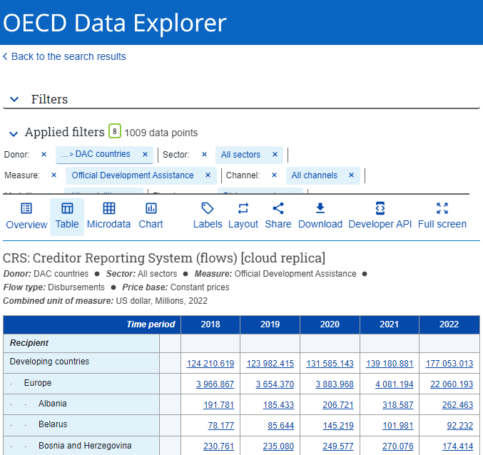
Thank you!
David Barraclough - OECD

