Slide 1
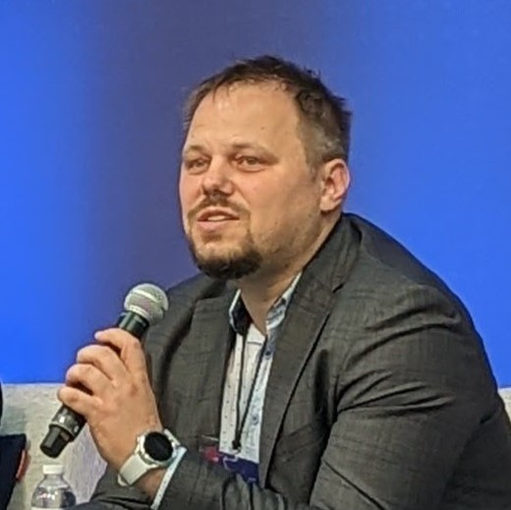
Microdata modelling challenges in SDMX
12th SDMX Experts workshop
7-11 October 2024
Amsterdam, the Netherlands
Daniel SURANYI
Lead Data Architect
ECB Data Office

Slide 2
What is microdata?
Can you generate a word cloud of topics related to the definition of microdata
The good news…
With SDMX 3 the
definition does not matter!
Just model your data!

Slide 3
So why are we here today?
The good news…
With SDMX 3 the
definition does not matter!
Just model your data!
The bad news…
History
Terminology
Experience
Guidelines
Examples

Slide 4
Some background…
Background…
History
Terminology
Experience
Guidelines
Examples
Some details…
“SDMX is for macrodata"
“SDMX is a verbose file format”
Identifier / Dimension
Characteristics / Attribute
Variable / Measure

Slide 5
Work Approach…
Use Cases
Challenges
Challenges
Collect
Analyse
Group &
Categorise
Challenges
Not yet…
SDMX 3 (native)
SDMX 3 (workarounds)
Solve
Best practises
Guidelines
Gaps → TWG
Cross-Working Group
Task Force on
Microdata and SDMX

Slide 6
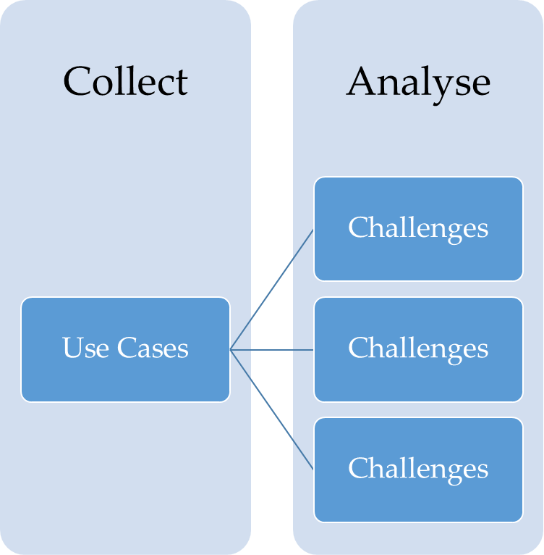
Overview
Some challenges
Multiple measures
Relations (concepts)
Relations (DSDs)
Arrays / multi-value
Other standards
Code list governance
Sentinel values

Slide 7
What should I do now?
The good news…
Just model your data!
Existing guidelines
https://sdmx.org/?page_id=4345
Contact us ☺
Daniel.Suranyi@ecb.europa.eu
Cross-Working Group
Task Force on
Microdata and SDMX

