Slide 1
SDMX & AI – a Chatbot initiative
Using LLMs and RAG to ask questions of the SDMX technical standards and statistical guidance

Slide 2
Context
BIS exploring application of AI in multiple areas
In SDMX, a common barrier is lack of knowledge. Can an SDMX chatbot help?
This presentation will provide an overview of a number of BIS AI initiatives with a deep dive into an SDMX chatbot proof of concept

Slide 3
SDMX Chatbot - Overview
All SDMX technical documentation ingested into GenAI model
Quality Assurance – requires SDMX expert:
  Identified primary stakeholders and interests (eg. Data Modeller vs Developer)
  Produced 100 questions aligned to stakeholder interests
  Manually review responses
Future:
  Sustainability – can AI replace 'manually review responses' activity?
  Appropriateness of response – align writing style to stakeholder profile?
  Relevance of response – simple scoring by stakeholder?
  Expand with additional content, content types?
  Running cost to go public?

Slide 4
GenAI at BIS

Slide 5
GenAI and SDMX at BIS
SDMX plays an integral part in several GenAI applications at BIS
Relevance for further applications is likely

Slide 6
Metadata Ai Editor
When working with SDMX inconsistencies in metadata cause a lot of problems
Fixing is a lot of work and error prone
Metadata Ai Editor is a live tool that solves this issue

Slide 7
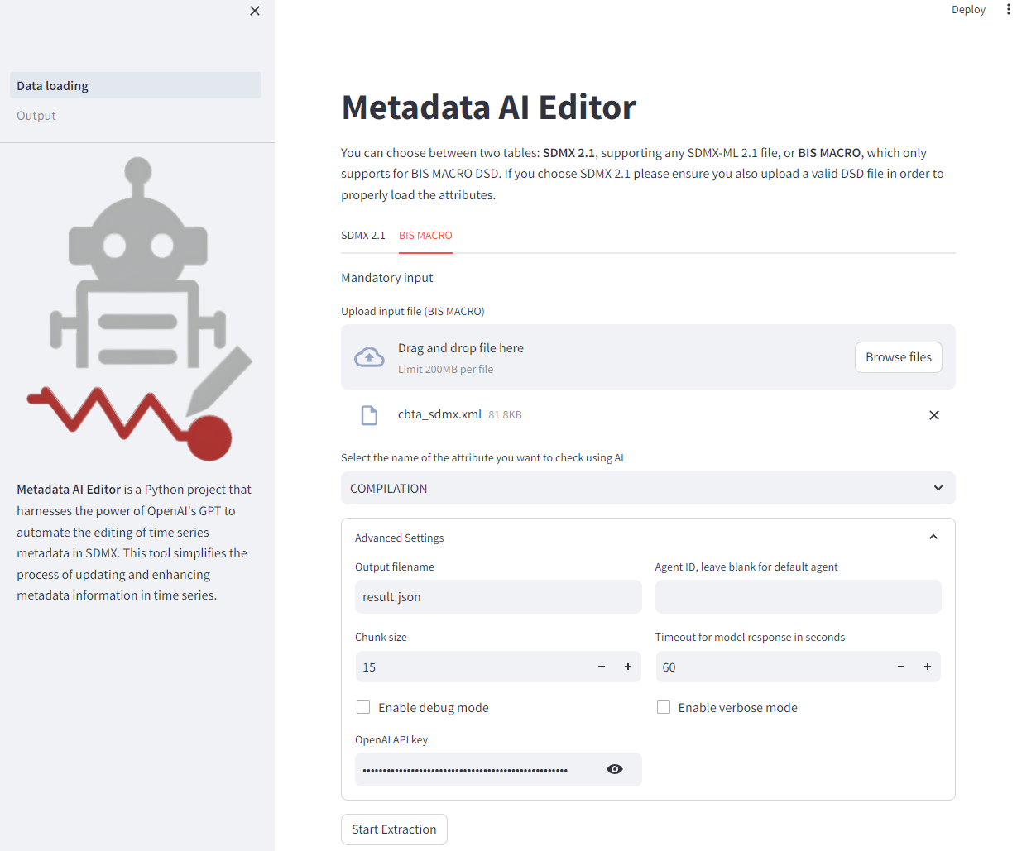
Metadata Ai Editor

Slide 8
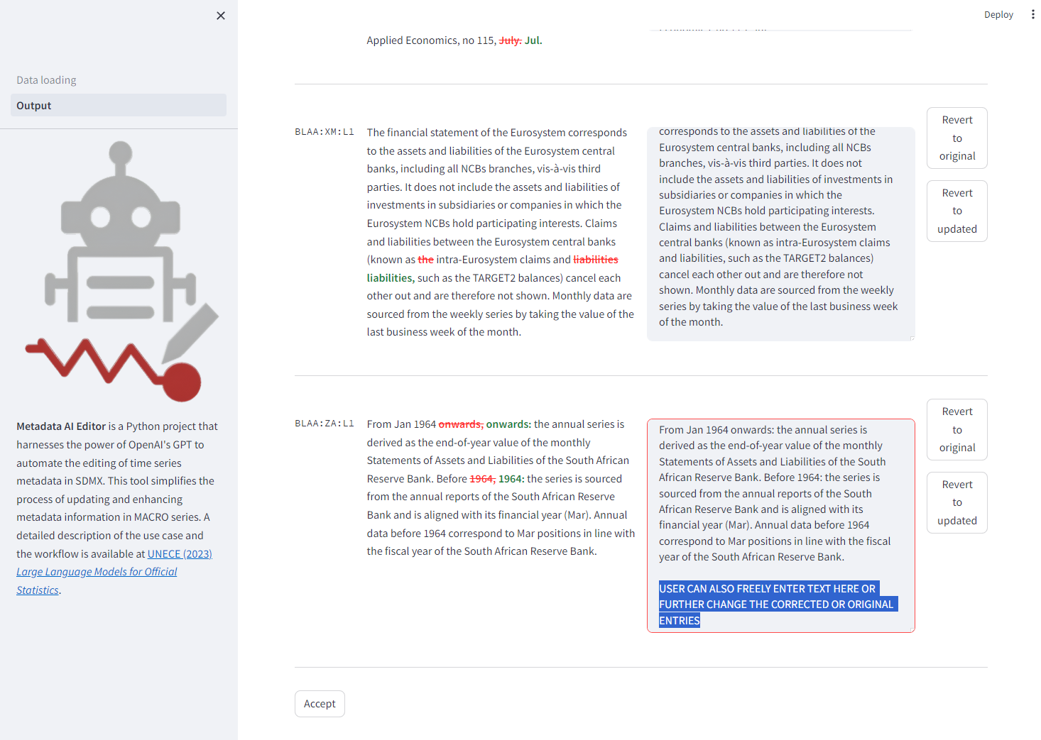
Metadata Ai Editor

Slide 9
SDMX RAG Chatbot
Several domain specific rag systems are offered within BIS
One is a specific rag system concerning SDMX documentation
Several prompts and outputs are generated to help users

Slide 10
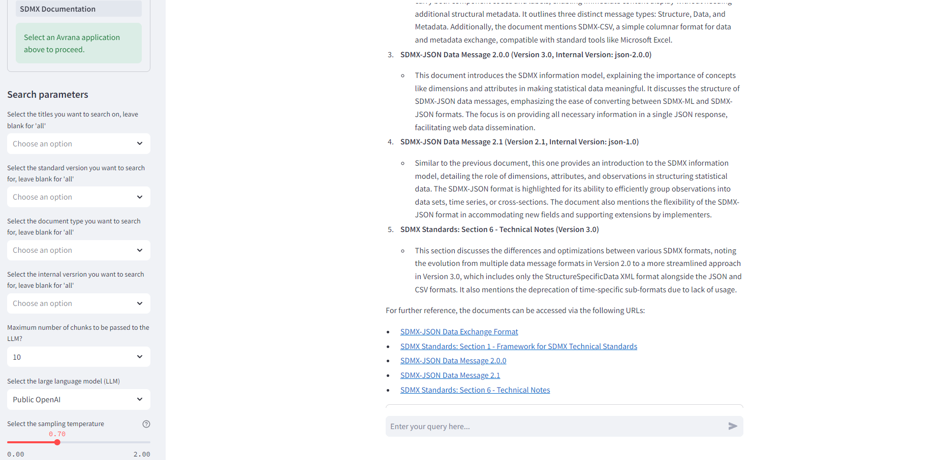
SDMX RAG Chatbot

Slide 11
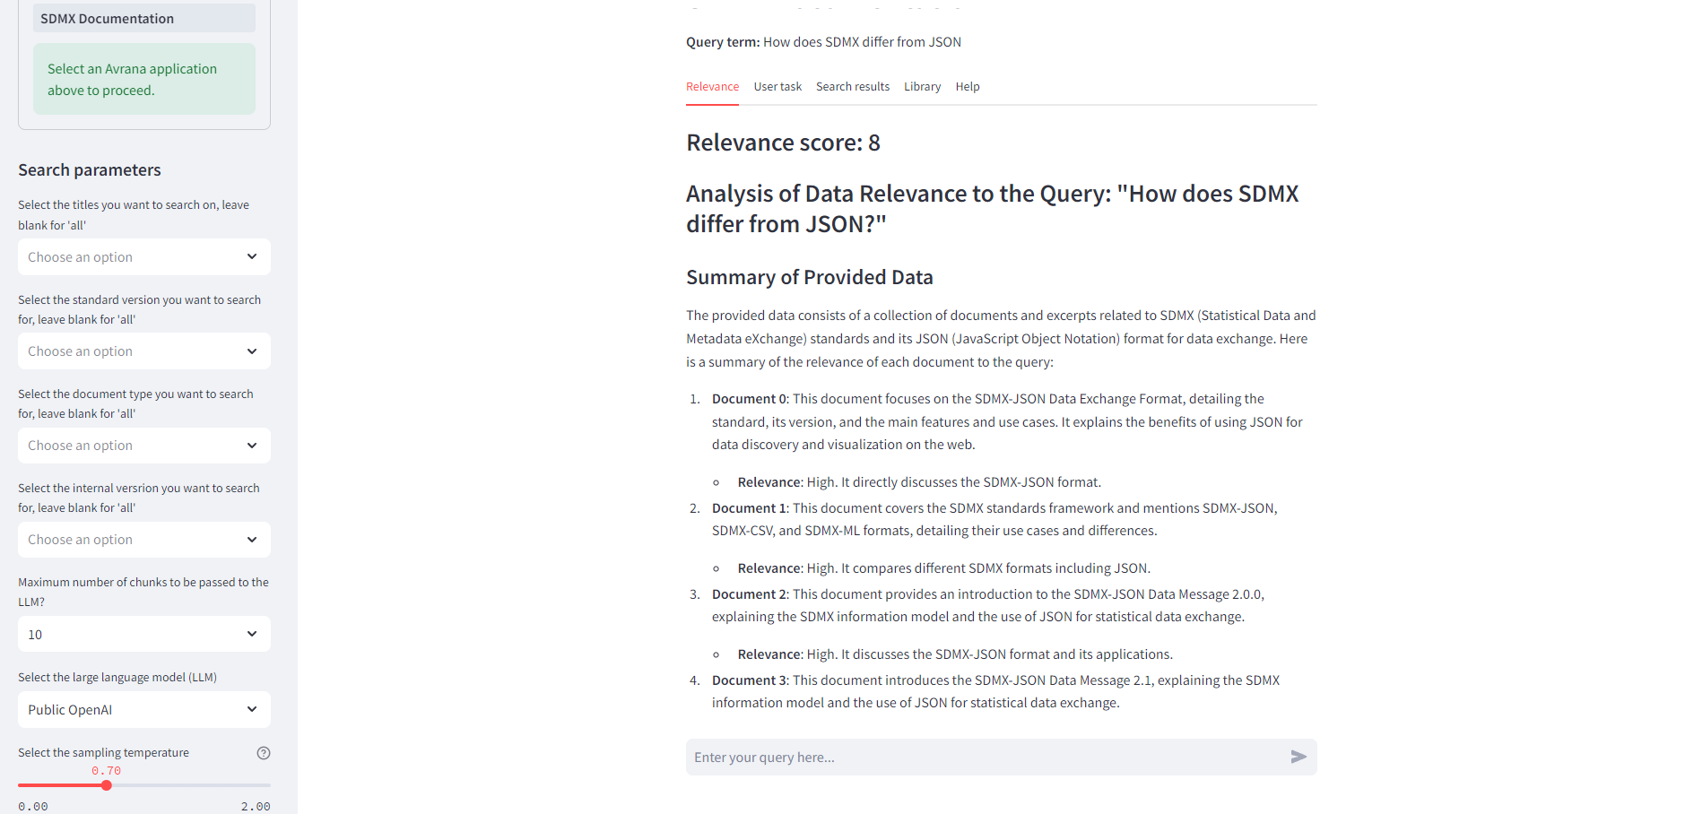
SDMX RAG Chatbot

Slide 12
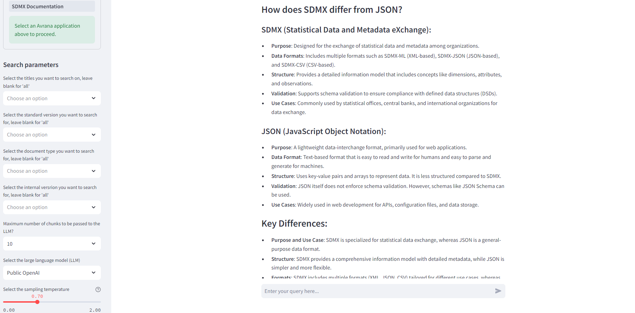
SDMX RAG Chatbot

Slide 13
New Rag System – Requirements and Architecture
The needs within BIS for RAG applications are varied
Different stakeholders, committees and researchers want individual applications with similar focus
State of the art is expanding at a rapid pace
Hence, focus is on a modular approach with high software engineering standards
Both access to self-hosted LLMS as well as GPT-4

Slide 14
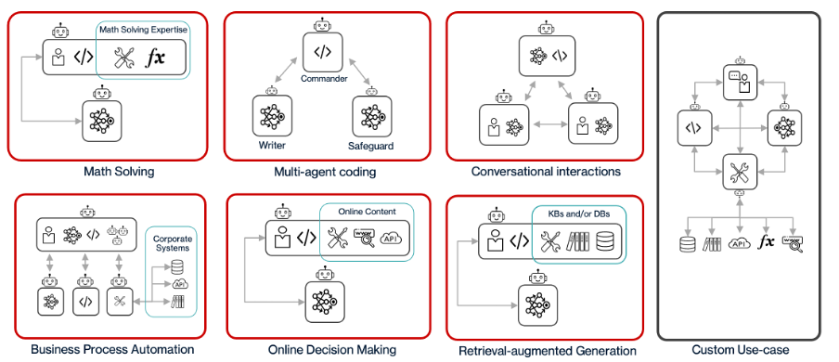
Multi-Agent Systems

Slide 15
Multi Component Systems - Key Capabilities and Benefits
Specialization: Individual Components can be optimized for specific tasks. This allows for greater efficiency and performance on niche tasks.
Customization: Users can mix and match different components depending on their needs. The compositions of agents can be adapted to different use cases.
Scalability: Individual components can be updated or swapped out. This makes upgrading existing use cases and adapting different version much simpler.
Cost Efficiency and Consistency: Individual Components can be reused and are always the same, saving on development.
Interpretability: With individual components, it may be easier to understand and analyze how different components contribute to the overall behavior of the system.

Slide 16
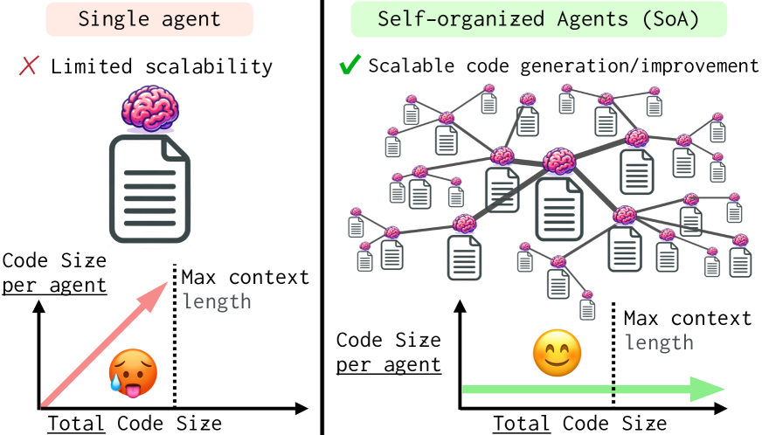
Re-Useable Graph Architecture

Slide 17
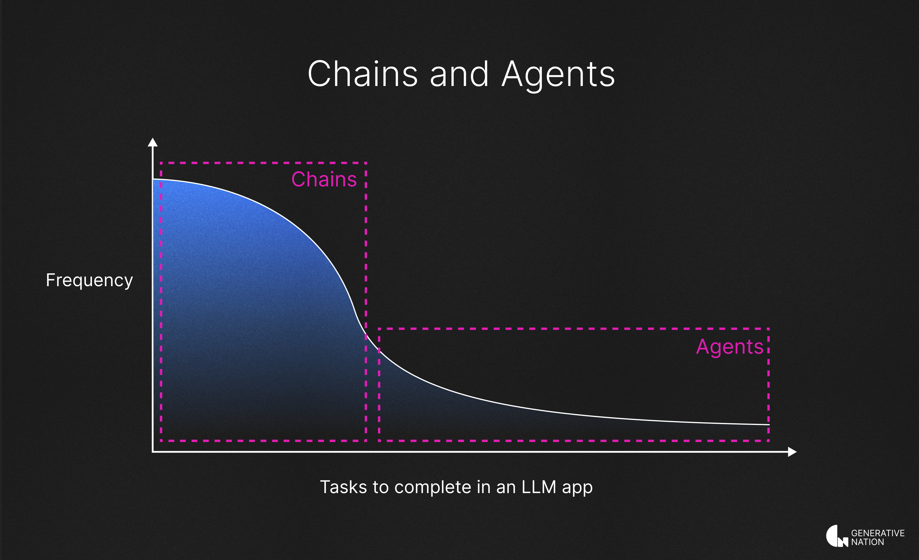
Re-Useable Graph Architecture

Slide 18
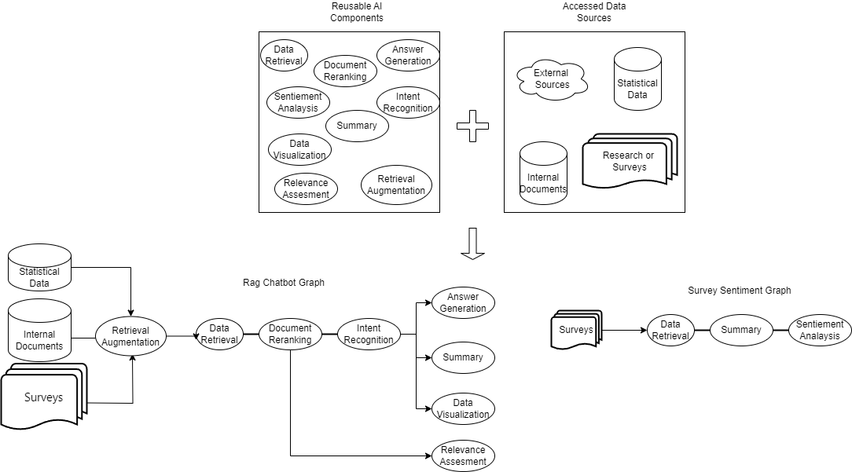
Re-Useable Graph Architecture

Slide 19
SDMX Chatbot

Slide 20
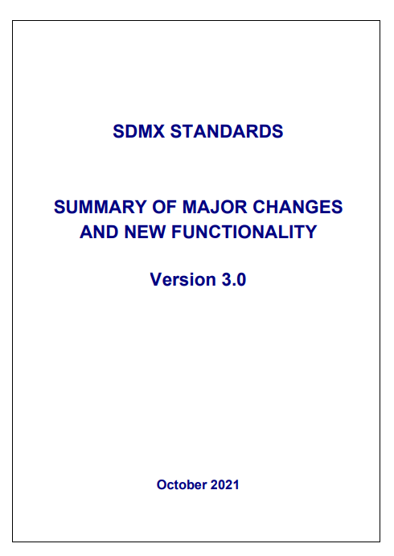
Master Thesis: SDMX Chatbot
Goal: research question answering for specific SDMX use case
Based on publicly available SDMX documentation
  Standard Major Changes 2.1/3.0
  Content-Oriented Guidelines
  SDMX Standard
  Roadmap

Slide 21
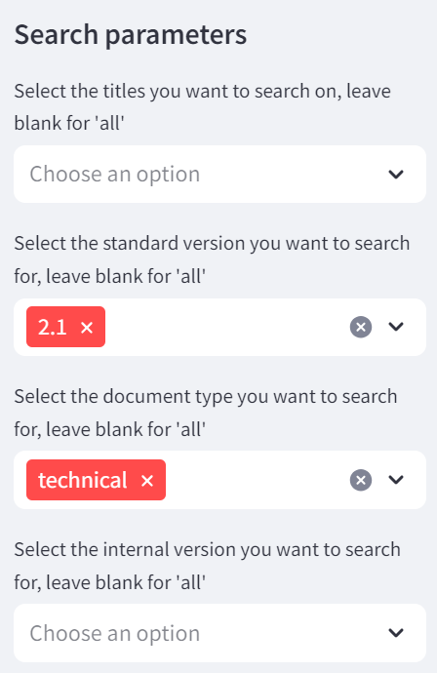
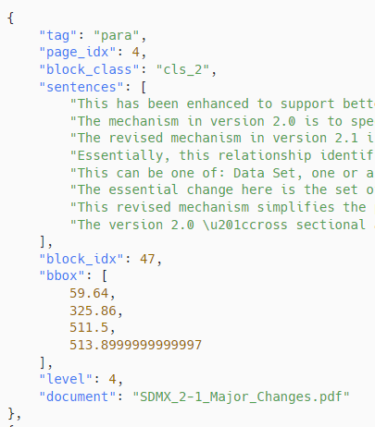
Data Preparation
High quality text extraction from PDFs
Clean data
  E.g. remove line numbers
Document structure (headings, lists)
Customize nlm-ingestor tool
  Layout-based heuristics
  Section headings as context for the LLM

Slide 22
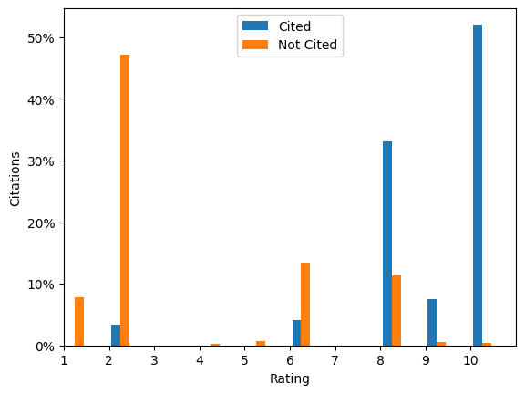
Citations
Important for transparency
Enhances usefulness of documentation
Debatable reliability
  60% accuracy [1]
Analysis of citation quality in answers to 100 SDMX-specific questions
Fix citation formatting and minor hallucinations with regex
[1]: Evaluating Verifiability in Generative Search Engines - Nelson F. Liu, Tianyi Zhang, Percy Liang

Slide 23
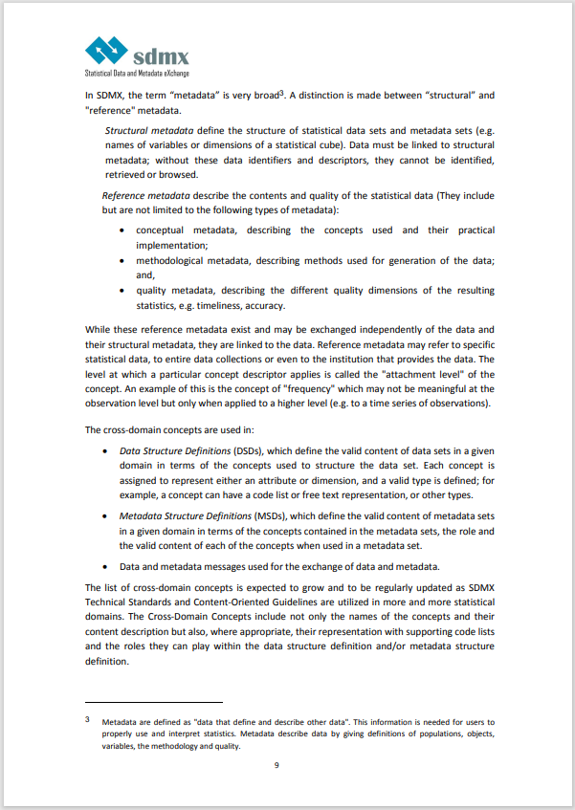
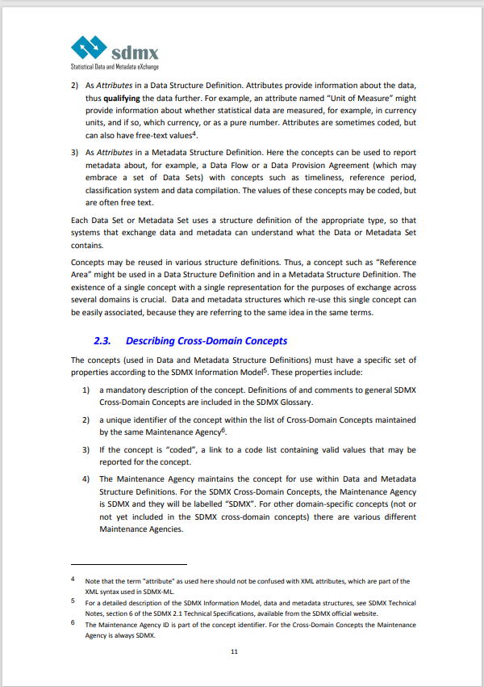
Outlook: Question Trees
In SDMX, metadata plays a critical role in data management, with a distinction between structural metadata, which define the structure of statistical data sets, and reference metadata, which describe the contents and quality of the data. Structural metadata include identifiers and descriptors necessary for identifying, retrieving, and browsing data. Reference metadata encompass conceptual, methodological, and quality aspects of the statistics, such as the concepts used, methods applied, and accuracy of the data. These reference metadata are closely linked to the data sets and may pertain to specific data, data collections, or data providers.
Additionally, the concept of attachment level determines the applicability of a concept descriptor at different levels of data representation. Cross-domain concepts are utilized in Data Structure Definitions (DSDs) and Metadata Structure Definitions (MSDs) to define the content and structure of data and metadata sets within specific domains. Ultimately, data and metadata messages are employed for the exchange of data and metadata across systems.
Summarize
Summarize
In SDMX, metadata is essential for data management and is categorized into structural and reference metadata. Structural metadata define the structure of statistical data sets, while reference metadata describe the contents and quality of the data, including conceptual, methodological, and quality aspects. Reference metadata are closely linked to specific data, collections, or providers. The attachment level concept determines where a descriptor applies in data representation. Cross-domain concepts are used in Data Structure Definitions and Metadata Structure Definitions to shape data and metadata sets within specific domains for exchange through data and metadata messages across systems. Attributes provide additional data information, coded or free-text, in both types of definitions, ensuring consistency by reusing concepts between different domains for effective data association and exchange.
Attributes play a crucial role in data management by providing additional information about the data, such as the "Unit of Measure" indicating the measurement standard used. Attributes can be coded or free-text and are utilized in Data Structure Definitions to qualify the data further. In Metadata Structure Definitions, attributes are used to describe data flows or agreements, with concepts like timeliness and classification system. These concepts may have coded or free-text values.
In both types of definitions, the reuse of concepts is common to ensure consistency across different domains. Reusing a single concept with a unified representation allows for easy association between data and metadata structures, facilitating effective data exchange and understanding of the information contained in the sets.
Summarize
Summarize
[2]: RAPTOR: Recursive Abstractive Processing for Tree-Organized Retrieval - Parth Sarthi, Salman Abdullah et al

Slide 24
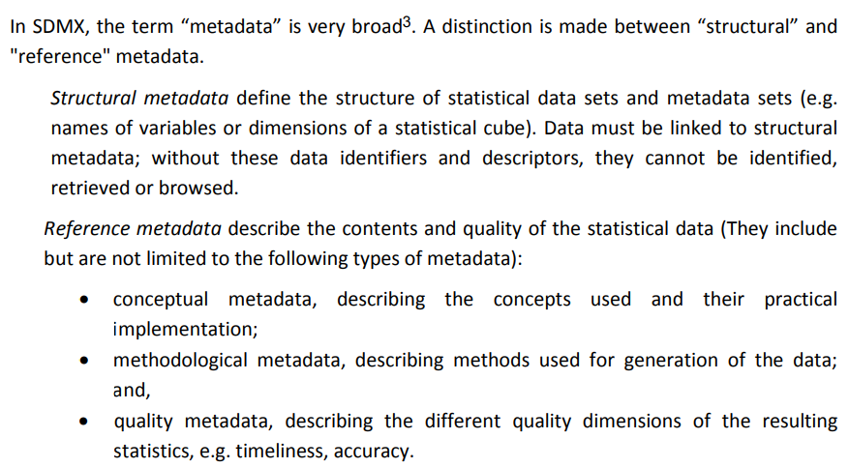
Outlook: Question Trees
What are some types of reference metadata mentioned?
How does data need to be linked to structural metadata?
Generate Synthetic Questions
What do reference metadata describe in SDMX?​
What is the distinction between "structural" and "reference" metadata in SDMX?​
What does structural metadata define in SDMX?​

Slide 25
Outlook: Question Trees
SDMX is a Standard for ...
Code Lists are …
Metadata is …
Reference Metadata is…
Structural Metadata is...
...
What are use cases of SDMX?
…?
…?
What is the difference between Structural and Reference Metadata?
…?
…?
How to use Reference Metadata?
…?
…?

Slide 26
Outlook: Question Trees
SDMX is a Standard for ...
Code Lists are …
Metadata is …
Reference Metadata is…
Structural Metadata is...
...
Citations expressed as subtrees
Improves search

Slide 27
Benefits: Question Trees
Useful for other tools/chatbots using SDMX
Publishable as FAQ
May help in improving the documentation

Slide 28
Collaboration
We are very willing to share our experiences

