Slide 1
Talk to Data with
Stat-GPT
Jeff Danforth (IMF)
Maksim Samusenka (EPAM)
12th SDMX Experts Workshop
OCTOBER 2024

Slide 2
Agenda
01
Business Case Intro (2 min)
02
Evaluation Progress (3 min)
03
Technical Deep Dive (10 min)​
04
Tools (10 min)
05
Next Steps (5 min)

Slide 3
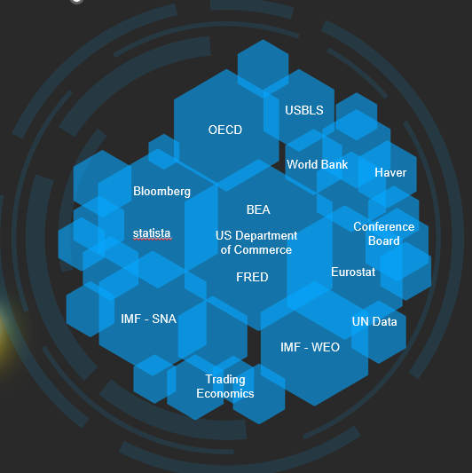
Users face several challenges when accessing official statistics
BUSINESS CASE INTRO
Official statistics are published across multiple platforms, in multiple formats, using multiple discovery tools.
Official statistics are published using statistical language (which is not necessarily ‘natural language’).
Official statistics are presented in thematic tables (prices, health, education, economy), when most questions cross themes.
Official statistics are redistributed and then redistributed some more raising issues about vintages and questions about ownership.

Slide 4
Project Status and Preliminary Evaluation
EVALUATION PROGRESS
We are here
Prototype
MVP
UAT
Evaluation among SDMX Sponsors
Project Timeline
June 2023
October 2023
March 2024
October 2024
SDMX Global Conference, Bahrain
Workshop SDMX+AI, Paris
12th SDMX Experts Workshop, Amsterdam
Number of unique users: 45
Number of unique requests: 430
Number of support requests: 7
Per-request tokens: 8.3k prompt tokens, 350 completion tokens
Per-request cost: $0.10

Slide 5
Initial Feedback and Feature Requests
Evaluation progress
DESCRIPTION | SUGGESTED IMPLEMENTATION
User should be able to query data from multiple datasets at the same time and compare the results. Use-case: compare GDP for Canada from IMF, WB and StatCan | Retrieve the series and then pack the series into a common set of dimensions (country, indicator, unit) – kind of move to the lowest common denominator. Then you can combine the series into the same sheet (with the additional column indicating the source of the data).
User should be able to receive response based solely on metadata (codelists, hieararchies, data structures), e.g. "what indicators from FRED do you have", "what is LIDC countries" | Implement ability to retrieve (and summarize?) specific structures, e.g. for the indicators from FRED question we should undesratnd what dimensions form the indicators in FRED dataset, and retrieve the corresponding codelists.
Smart processing of queries like "Get Misery Index", "Phillips curve". First we need to get understanding of what is Misery index or Phillips curve by refering to generic question agent, only then call Data Query. | Extend current router agent with planning component, implement chain-of-thought pattern.
Right now we are limiting the number of series that can be provided in the response due to the nature of the chat application. When thinking about StatGPT in portal context - such limitation does not make much sense. | Rethink logic of processing request like "All countries", "All counterpart areas", etc.
Select best indicator (most relevant) out of the ones that were found and provide one number if requested (e.g. what was the population of Lithuania in 2006?)
We were also asked to provide direct access to data behind StatGPT.

Slide 6
StatGPT in multi-organization set-up
Technical Deep Dive
We have successfully onboarded 8 datasets from 8 different organizations with different structures and NO modifications to original artifacts.
Data Modeling Problems
DATASET | NUMBER OF NON-TIME DIMENSIONS | NUMBER OF SERIES
IMF, World Economic Outlook | 3 | 8,169
WB, World Development Indicators | 3 | 237,820
OECD, Trade in Value Added (TiVa) 2023 edition | 6 | 8,738,610
BIS, Debt securities statistics | 11 | 35,279
ESTAT, GDP and main components (output, expenditure and income) | 4 | 29,635
StatCan, National Balance Sheet Accounts | 14 | 120
FRED, Financial Obligations Ratio | 3 | 2
ECB, Banking structural statistical indicators | 8 | 457
Different approaches to modeling
Packed / unpacked indicators
Data sets with multiple indicators or countries / dataset per indicator or country
Different approaches of handling metadata
Non-harmonized code lists, concepts, data structures, etc.
IT Problems
Different level of compliance with SDMX standard (ex: XML / JSON, 2.1 / 3.0, support for availability query)
Some agencies do not have SDMX endpoints

Slide 7
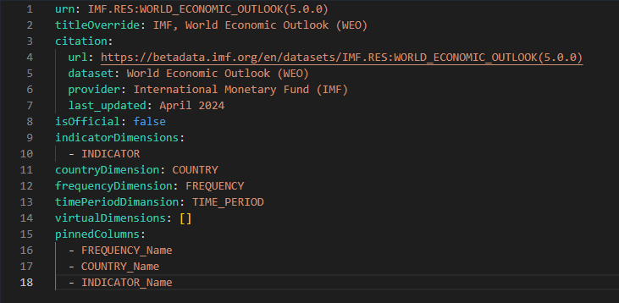
SDMX Data Set Onboarding
Technical Deep Dive
Dealing with modeling problems
SDMX must-have requirements
ARTIFACTS:
Codes in CodeLists should have comprehensive names
REGISTRY:
SDMX 2.1 or 3.0
JSON or XML
Structure Query (Dataflow, DSD, Concept Scheme, Code List, Hierarchical Code List)
Data Query
Data Availability Query
StatGPT Dataset Config:
Alias (name override)
Citation Info
Indicator / Country / Frequency / Time Period dimensions
Virtual dimensions
Pinned columns
Vision: these settings can be handled by standardized SDMX annotations.

Slide 8
Connecting to SDMX data
Technical Deep Dive
Dealing with IT problems
NOW
FUTURE
Current implementation: Data replica in a single SDMX Registry (IMF Data Backend)
Vision: Direct access to individual registries with dedicated SDMX Registry as a fallback for non-SDMX data or non-compliant SDMX data sources
Used to simplify the Proof of Concept
Stat-GPT
Stat-GPT
Master
SDMX Registry
SDMX Registry 1
SDMX Registry M
Master SDMX
Registry
Agency 1 Data
Agency 2 Data
Agency N Data
Agency 1 Data
Agency N Data
SDMX Replication
Non-SDMX Data Ingestion
Quick-facts
Used LLM: GPT4-Turbo
Supported CP: AWS, Azure, GCP
Supported Languages: English

Slide 9
Applications
TECHNICAL DEEP DIVE
TOOL | PURPOSE | DESCRIPTION | AVAILABILITY FOR TESTERS
Chat UI | End-user tool | Access statistical data via natural language in Chat-GPT like experience | YES
Excel add-in | End-user tool | Access statistical data via natural language from MS Excel | COMING
Chat Overlay | End-user tool | Embed StatGPT int your existing Web Portal | COMING
StatGPT Data Browser | Demo tool | View data available to StatGPT via classic faceted seatch interface | COMING
StatGPT Administrator Console | Administrator tool | Configure StatGPT data sources | NO
StatGPT Analytical Dashboard | Administrator tool | Observe metrics of LLM usage | NO
Evaluation Tool | SDLC tool | Evaluate performance metrics (precision, recall) of StatGPT | NO

Slide 10
Next Steps
NEXT STEPS
Want participate?
Request credentials:
SupportEPM-DIALStatGPT@epam.com
or
Scan a QR-code:
Adding Data Browser and Excel Add-in to the Evaluation (October 11)
Completion of evaluation (October 18)
Survey (October 18-October 25)
Report (November 1)

Slide 11
Annex

Slide 12
STAT-GPT architecture
User
COMMUNICATION CHANNELS
Standalone Chat Interface
Dissemination Portals
(Stat-GPT Assistant)
Excel Add-in
(Stat-GPT Assistant)
APPLICATION SERVICES
AI Models
API
Agents
Agent Orchestrator
Data
LLM Load Balancer
Applications
LangChain
SDMX Client
Metadata
SDMX
Interface
Prompts Log
Telemetry and Analytics
Embeddings
Prompts
Entitlements
AI DIAL
Stat-GPT
SDMX Warehouse
CLOUD SERVICES
LLM Models
Blob Storage
SSO
Logs
Vector Database
Monitoring
Deployment Orchestration
Secret Manager

Slide 13
Retrieve Data
STAT-GPT: How It Works
Please give me data for GDP per capita in dollars for Baltic countries for last 5 years
Hierarchy: IMF:COUNTRY_GROUPS(1.0.0), Group: Baltics
Code List: IMF:COUNTRY(1.0.0), Codes: 939 (EE), 941 (LV), 946 (LT)
Dataset: IMF:IFS(1.0.0)
COUNTRY:
INDICATOR:
FREQUENCY:
TIME_PERIOD:
Code List: IMF:COUNTRY(1.0.0), Code: 939, 941, 946
Code List: IMF:IFS_INDICATORS(1.0.0), Code: NGDPDPC
DSD: IMF:IFS_DSD (1.0.0)
Code List: IMF:FREQUENCY(1.0.0), Code: A [default]
2019-2023
I have modified existing data query in a following way:
Added indicators: Gross domestic product, current prices, U.S. dollars, per capita [NGDPDPC]
Added following countries: Estonia [939], Latvia [941], Lithuania [946]
Set interval 2019-2023
SDMX Query:
<host>/sdmx21/data/IFS/939+941+946.NGDPDPC.A?startPeriod=2019&endPeriod=2023

Slide 14
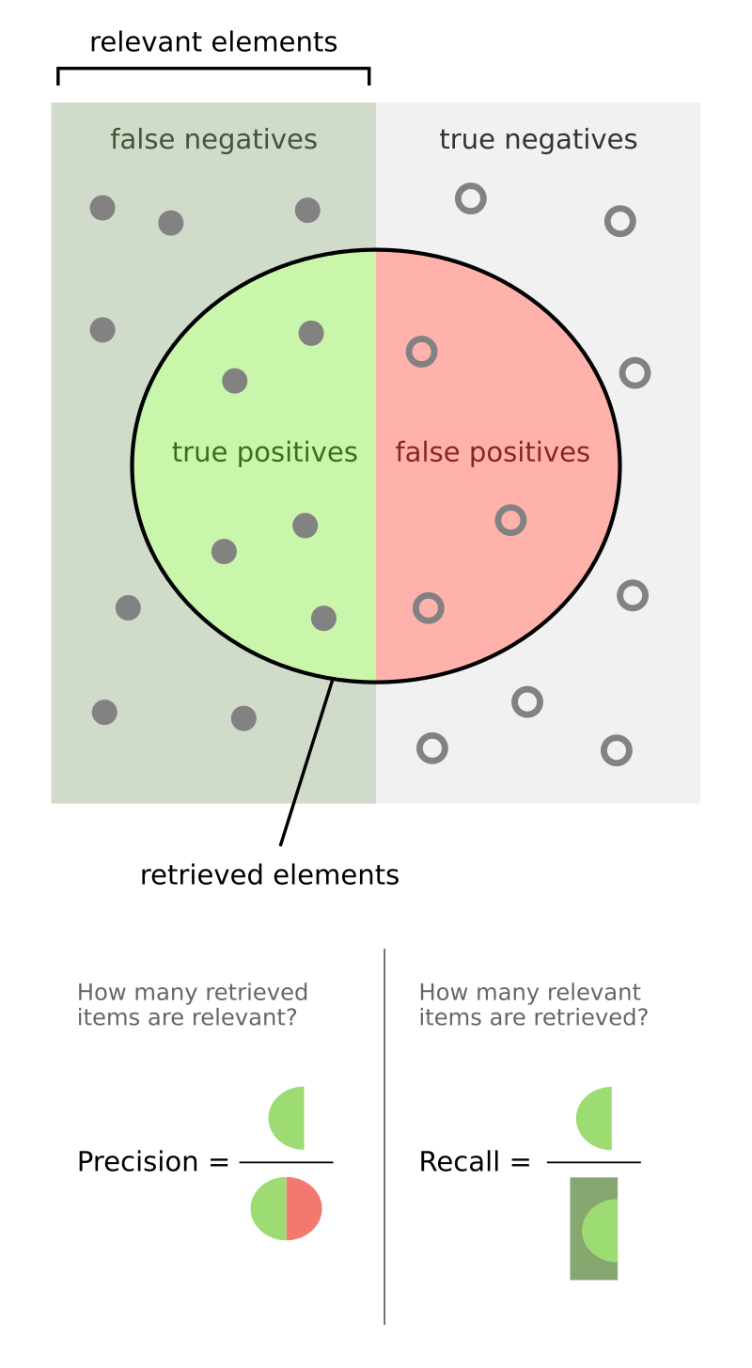
Evaluation
Theory (from Wikipedia)
Test Data Set
Test Conversations: 55
Test queries: 130
Single run costs: 13
StatGPT Metrics:
Precision: 0.72
Recall: 0.82
All evaluation metrics are calculated for the retrieval part. We want the user to be the judge that this is what they want. There cannot be any incorrect data or hallucinations at query time.

Slide 15
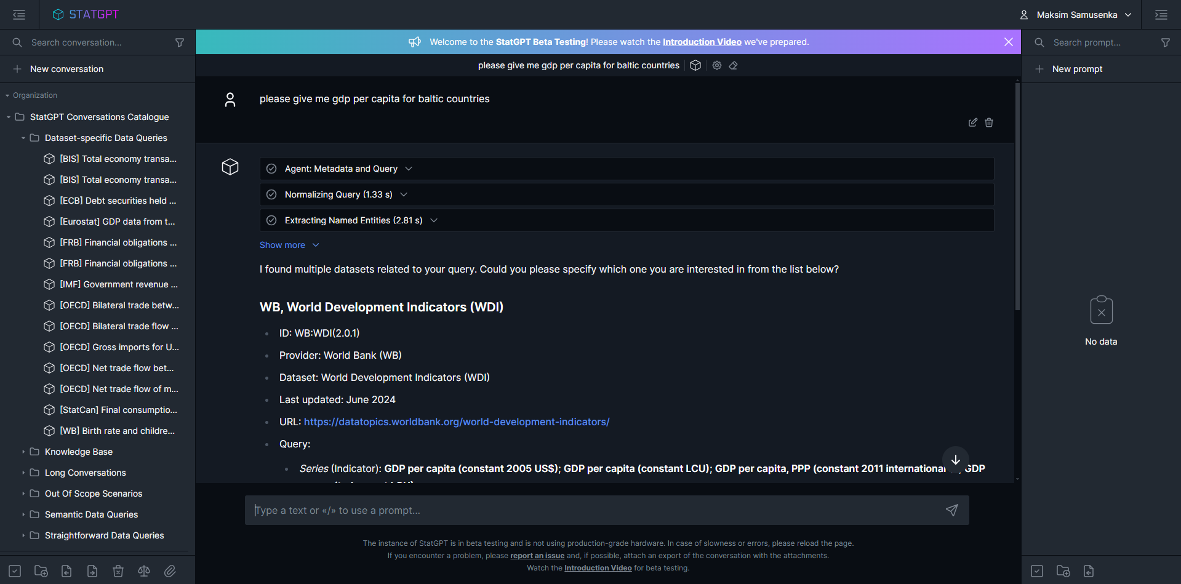
Chat UI
SCREENSHOTS

Slide 16
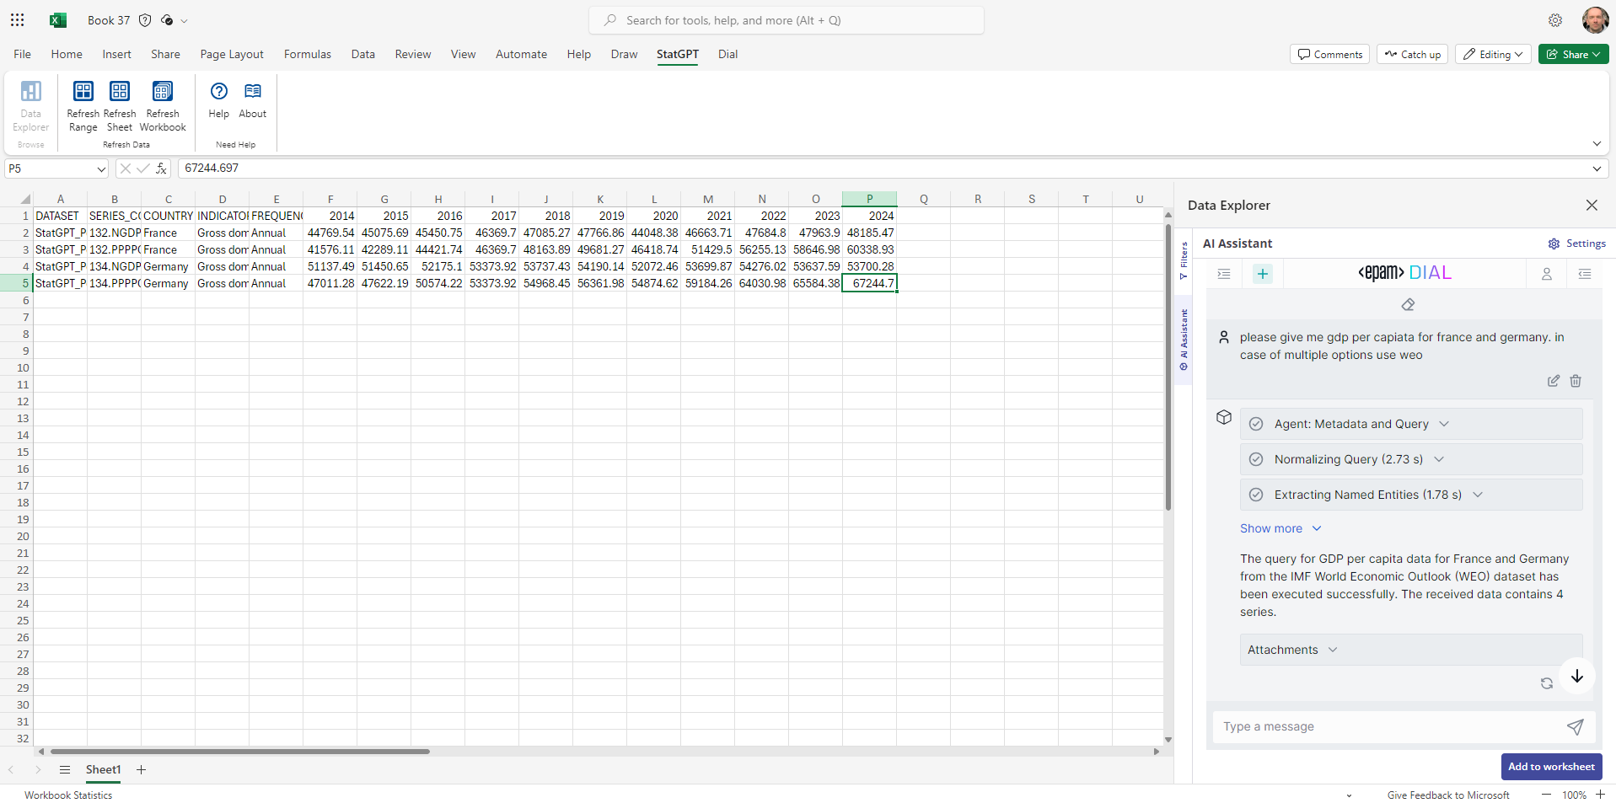
Excel Add-in
SCREENSHOTS

Slide 17
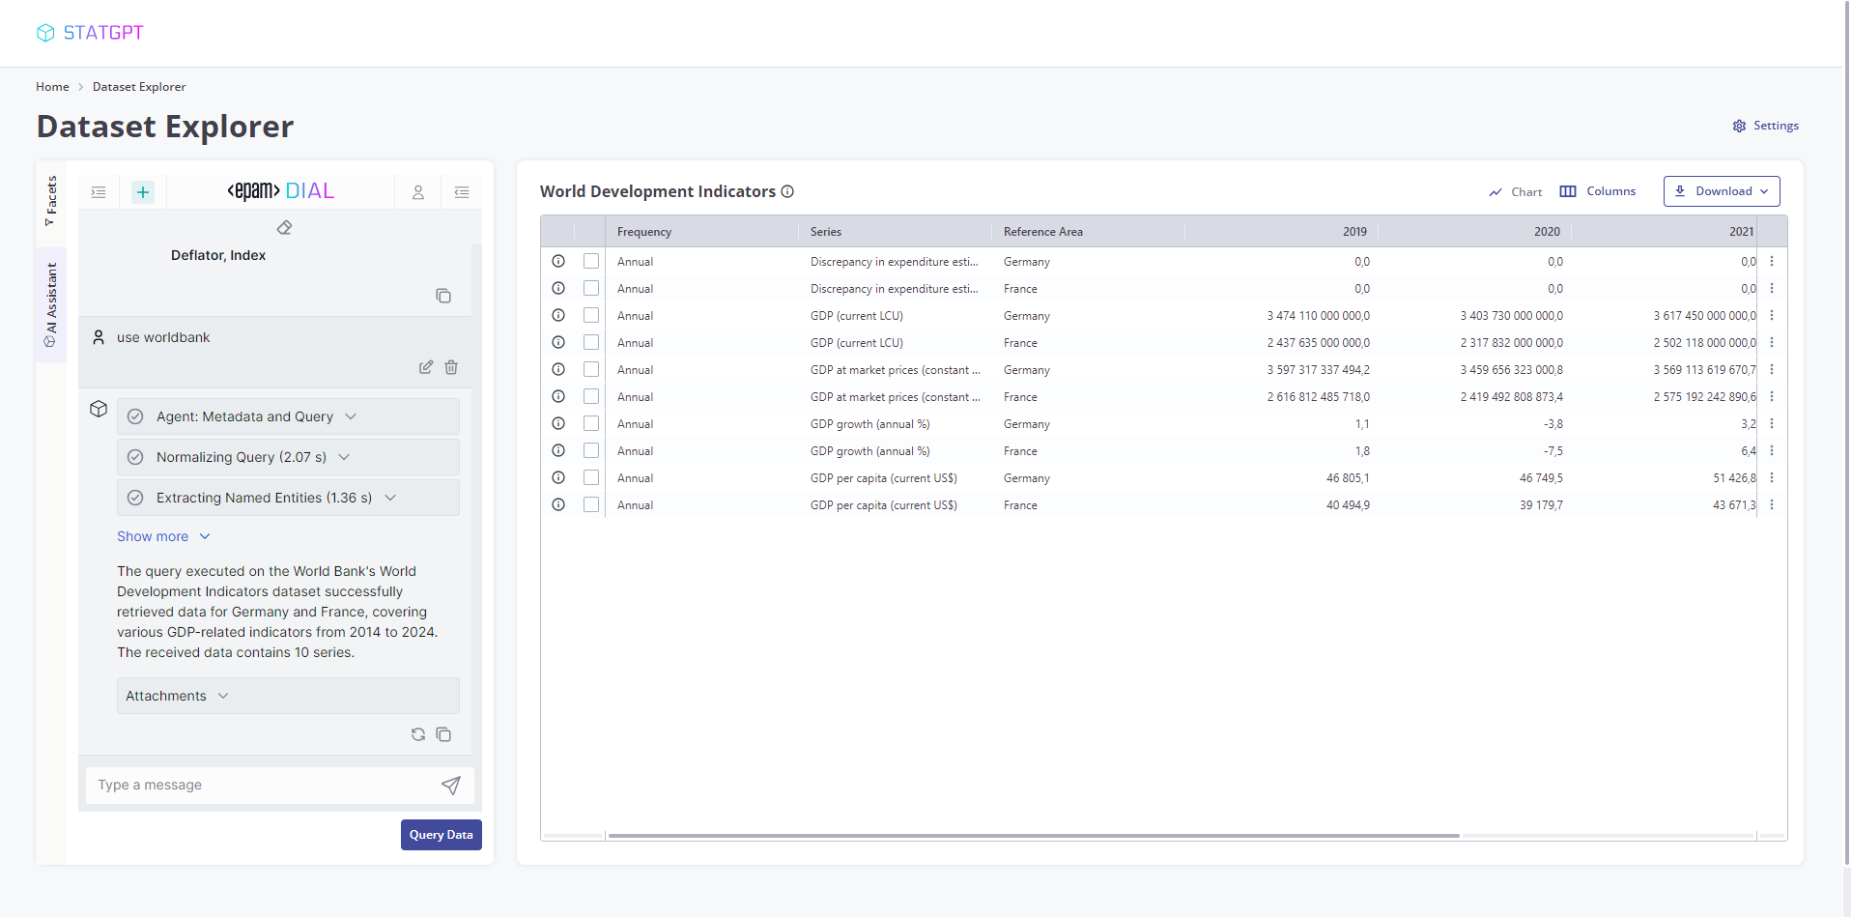
Data Browser + Chat Overlay
SCREENSHOTS

Slide 18
Data Browser + Chat Overlay
SCREENSHOTS

Slide 19
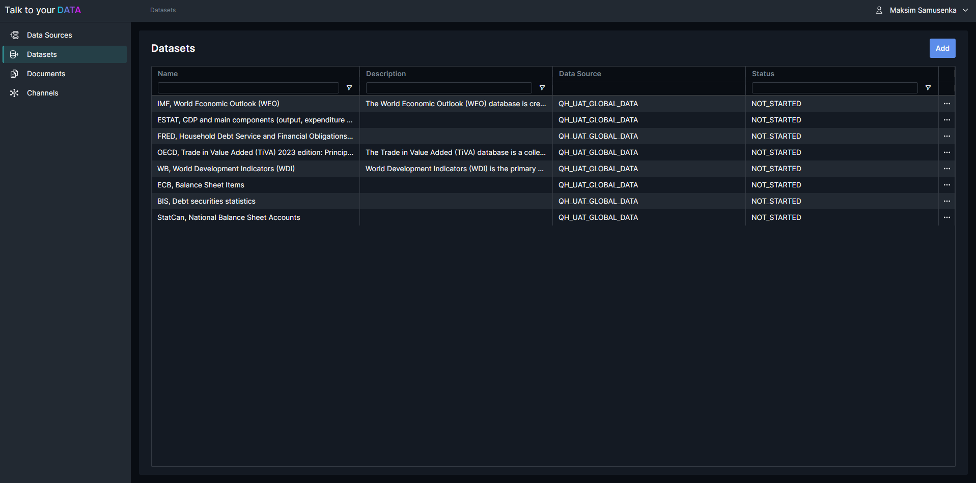
StatGPT Administrator
SCREENSHOTS

Slide 20
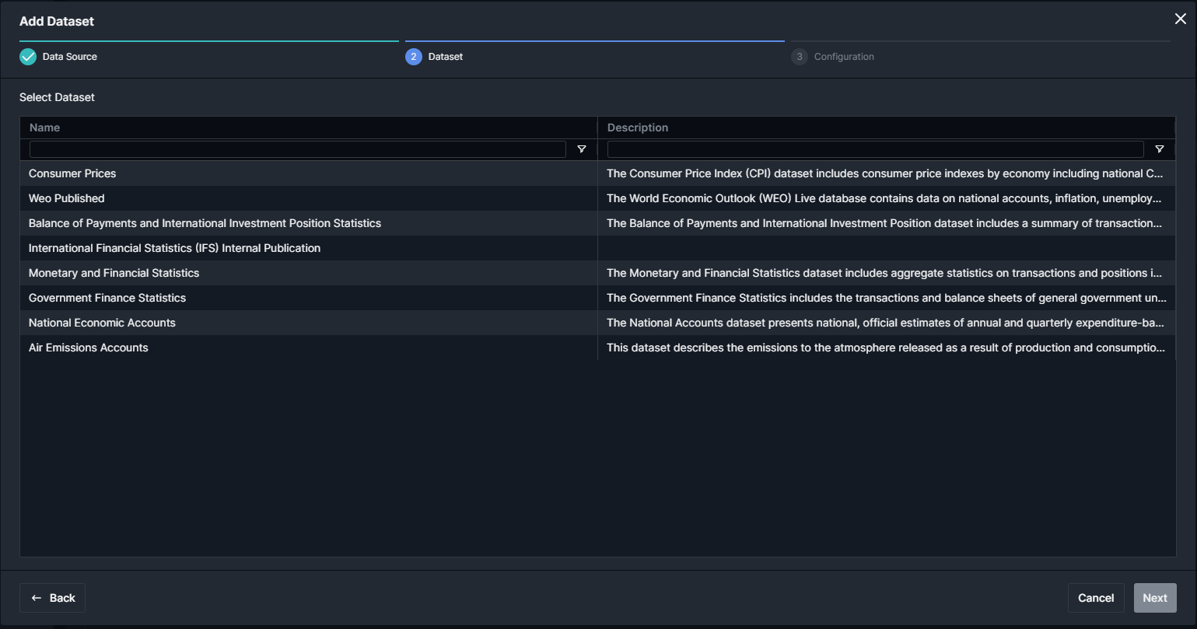
StatGPT Administrator
SCREENSHOTS

Slide 21
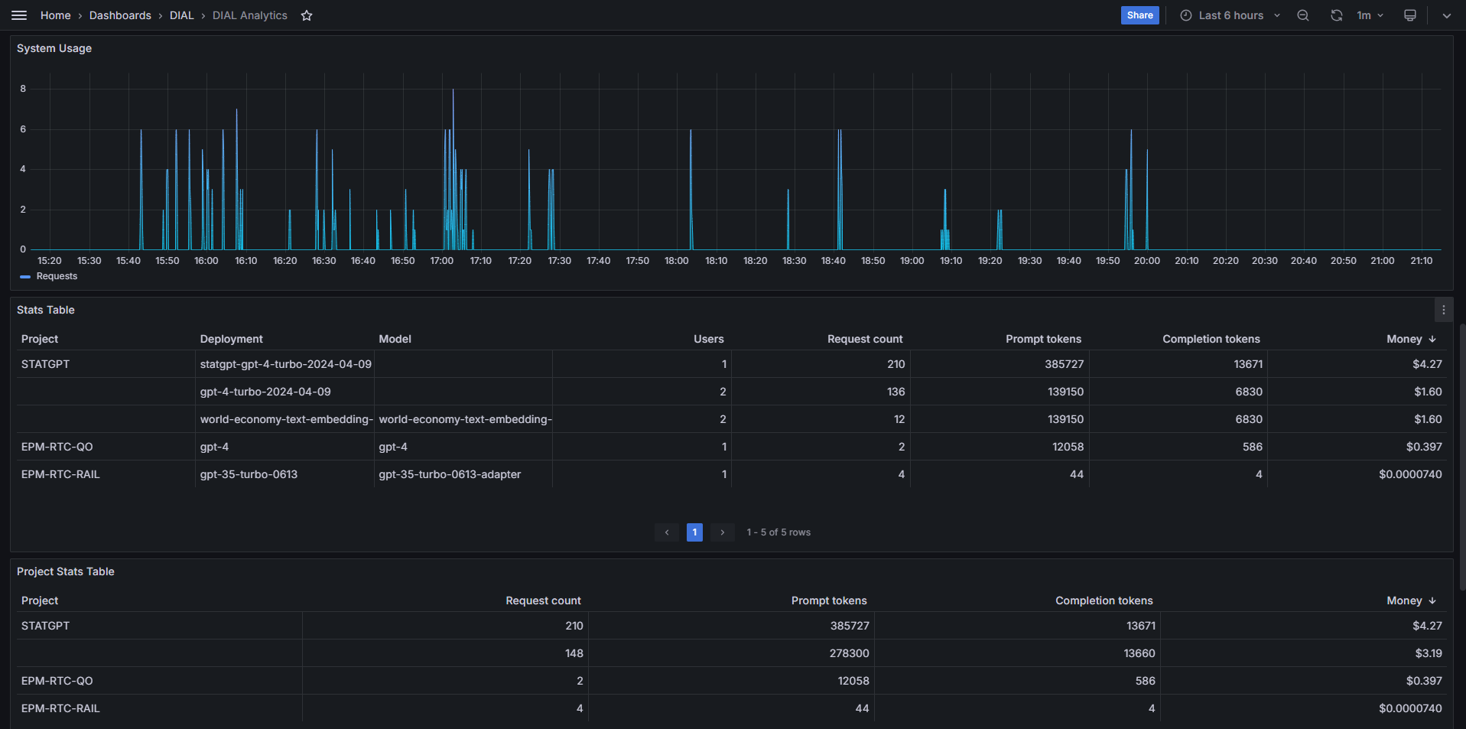
StatGPT Analytics
SCREENSHOTS

