Slide 1
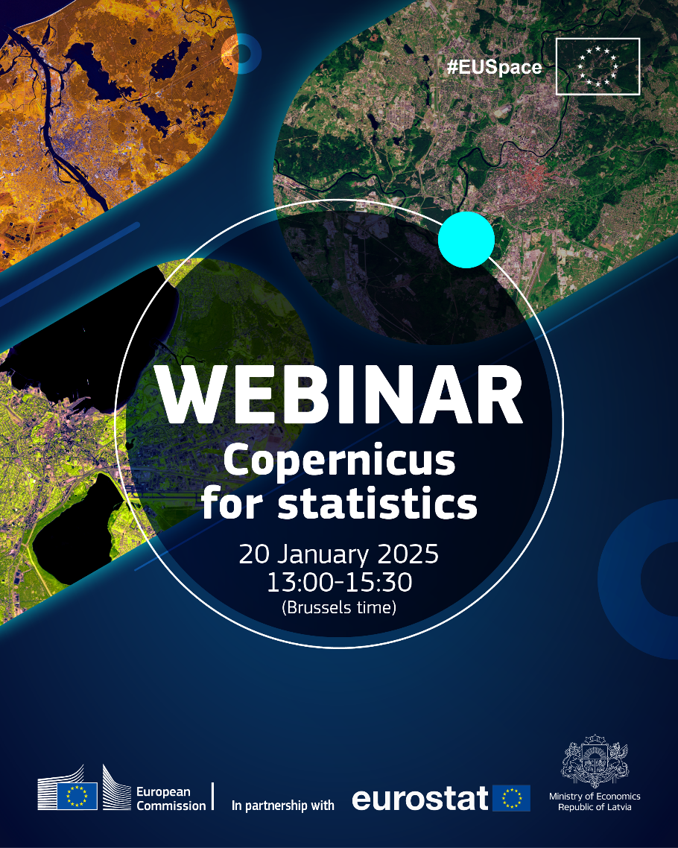
Earth Observation for Statistics
EO4S
COPERNICUS for statistics
EUROSTAT
Unit E4 – Regional Statistics and Geographical Information
Notes:
Good afternoon, my name is Carla Martins. And in the next 20 minutes I will present the EO4S activities in Eurostat.

Slide 2
Earth Observation for Statistics (EO4S)
EC
European Commission
DEFIS
DG Defence Industry and Space
ESA
European Space Agency
JRC
Joint Research Centre
POLICY DGs (AGRI, ENV, MOVE, CLIMA…)
ESS
European Statistical System
NSI National Statistical Institutes,
Mapping and Cadastral Agencies,
Space Agencies
DG
EUROSTAT
Statistical Domains
Unit E4 Regional Statistics and Geographic Information
GISCO
Geographic Information of the Commission
EO4S
Earth Observation for Statistics
Carla Martins
Hannes I. Reuter
Zach Kandylakis
Unit A5 Methodology and Innovation Statistics
Notes:
I start with placing the EO4S on the European Commission’s organogram.
So, the EO4S team includes myself as lead, my colleague Hannes Reuter (our lead GIS expert) and Zacharias Kandylakis (our EO/IT expert).
The EO4S activities are structured within the Geographical Information system of the Commission - the GISCO team. That belongs to unit E4 described earlier by our HoU Márta Nagy Rothengass. Our activities are also part of Eurostat’s innovation action plan managed by the Unit A5 the methodology and Innovation Unit.
Within its various domains, EUROSTAT harmonises, collects and disseminates statistics for EU policy needs. And this is done through the European statistical system (the ESS) , that includes the National Statistical Institutes and other relevant national organizations involved with statistical production. (like , for example, we deal with National Mapping and Cadastral Agencies and Space Agencies). The ESS then branches into the European Commission’s administrative structures that include in our case links to DG DEFIS, ESA, and JRC, DG AGRI, DG ENV, just to name a few.

Slide 3


Mandate
October 2021
Warsaw Memorandum
Methodology
IT Infrastructure
Governance
Skills
Applications
Directors General of the National Statistical Institutes
February 2022
Governance
framework
European Statistical System Committee
Notes:
I will now describe the Mandate for the EO4S.
In October 2021 the Director Generals of the European National Statistical Institutes held a conference in Poland on EO, in which the Warsaw Memorandum was adopted.
This document “Acknowledge(s) the urgent needs and the ongoing efforts to make extensive use of Earth Observation data in official statistics.”
4 months later, in February 2022, the Directors Generals of the National Statistical Institutes agreed on a governance framework for the implementation of the memorandum.
The framework is laid out in 5 main axes:
Methodology – guaranteeing a comprehensive and sound methodological basis
The Applications of EO data in statistics – concrete projects for showcasing and prototyping
IT Infrastructure – making available a sustainable IT infrastructure allowing the management of data
Skills- enhancing the offer of training and learning opportunities in the field of EO
Governance – assuring that the right people are engaged and onboard so that the activities have a real impact on the ESS statistical production
The rest of this presentation is structured around these 5 axes.

Slide 4

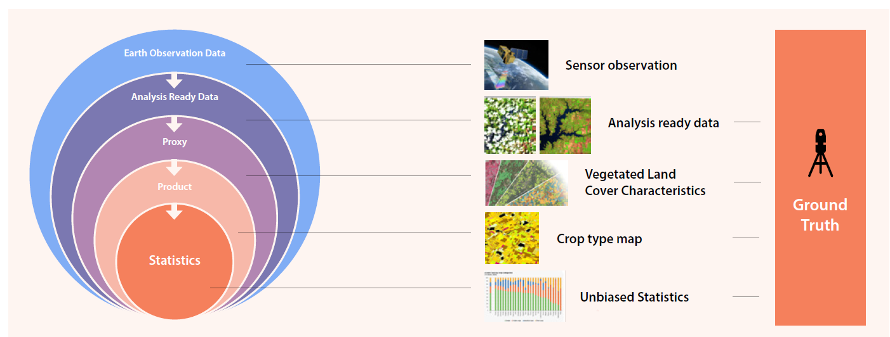
Methodology
How to go from EO to Statistics?
How in incorporate EO data in the Statistical Production process?
Notes:
Starting with Methodology, we ask the questions:
How to go from EO to Statistics?
How in incorporate EO data in the Statistical Production process?
Not going into detail, the figure here representes in a simplified way, the different phases from EO data to Statistics.
1. That outer circle represents the EO data directly from the sensor of the satellite
2. Then the second circle is the Analysis Ready Data, which is the result of removing the clouds, orthorectification and and calibration of the satellite data coming from the first circle.
3. In the third circle the data is transformed into a proxy (that can be done using auxiliary data, or simply by interpreting the original data). Some examples are: Vegetated Land Cover , Dominant Leaf Type, or Imperviousness.
4. From the proxy another type of data is generated. The proxy will be “translated” to data closer to the statistical demands – resulting in crop type maps, or a land cover maps. This 4th circle is referred to as “derived product”, but is still not the final stage.
5. The final stage is the statistical table. The statistical table is obtained not only by counting the pixels in the previous data set. But to be considered unbiased statistics, its accuracy needs to be measured. Meaning that the values obtained from the previous phases need to be compared with the reality on the field, in terms of its geographical measurement and its classification.
In other words: the process is not limited to counting pixels, but the output is rather a spatial statistical product, entailing a defined statistical methodology that includes probability and confusion matrices from the several steps of the processing. This will guarantee evidence-based results, that can qualify the data as official statistics. That is why the Ground truth data represented on the right side of the slide is needed all through the process. The ground truth data is essential in classifying the data and in validating it. And the intermediate data and procedures (of corrections and classifications of the satellite information) also needs to be known and measured.
So, the 2 main take aways from this slide are:
1- the importance of unbiased statistics – meaning the importance of knowing the statistical error, and
2 - the scope of EO4S that concentrates on the orange circles and not on the processing of the whole data chain.
This means the EO experts will manage the EO data and Statisticians will build the statistical data and report the accuracy. The dialogue and collaboration between statisticians and EO experts is key to the success of the process. Statisticians need to know the accuracy of the EO data. NSI’s should focus on the last two inner circles (from derived data products to unbiased statistics)– deriving a product, measuring the statistical quality and accuracy, and explaining to the EO experts the specifications on requirements in terms of measurement of the error, in terms of business continuity and in term of comparability.

Slide 5

Applications
Applications of EO data in statistics – concrete projects for showcasing and prototyping
Agricultural Statistics Poland
Ecosystem Accounting
EO projects for statistics NSI
GEOS Grants – several EO in several domains Buildings, energy
Notes:
On the application of EO4S we have compiled a list of projects that use EO data for obtaining statistics.
This inventory included a questionnaire to the National Statistical Institutes, and also a look into the work in Eurostat. The inventory is a living document that we aim to continue populating. You can access it through this link.
We have chosen some examples of EO4S projects to share with you today:
Ecosystem Accounting
Agricultural statistics in Poland
And some other examples namely from the GEOS and ESSnet grants.

Slide 6

Applications – Ecosystem Accounting
Legislation:
COM/2022/329 final
Statistics Explained:
Measuring the contribution of nature to the economy and human wellbeing
Notes:
The first example is Ecosystem Accounting
The Ecosystem accounting which is also part of Eurostat’s Innovation action plan.
We chose this example because it is in a more advanced state of being integrated in the Official statistics. This project is now legislated and data on Ecosystems extent, condition and services, is to be transmitted to Eurostat at the end of 2026. Ecosystem accounting will be used as the main metrics for the Nature Restauration Law.
Technologies and methodologies for the production process involve not only Earth Observation data products, but also biophysical models, geospatial data, mapping techniques, and other statistics.
Since 2015, our colleagues from the Environmental statistics Unit in collaboration with a dedicated Task force, DG environment and the Joint Research centre, have set up processing tools and guidelines for MS to produce the Ecosystems Accounts.
Extra information
Project started in 2015.
Develop and move into production European ecosystem accounts, based on the UN System of environmental-economic accounting ecosystem accounts (SEEA EA). These statistics quantify the ecosystems extent, condition and services (benefits for society), going beyond their recording in GDP and other conventional statistics, and giving visibility to natural capital. Estimated time to deliver impact: 31/03/27. Publication of mandatory ESS data that will be transmitted by 31/12/2026 under Regulation (EU) 691/2011, after Eurostat validation.

Slide 7
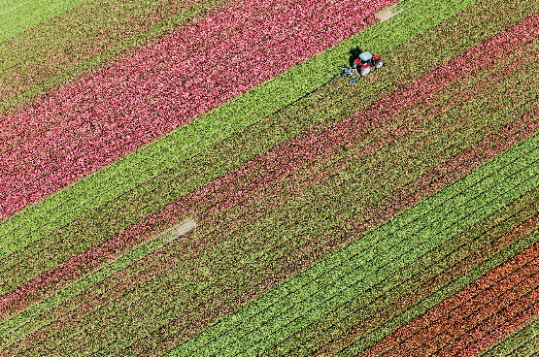
Applications – Agricultural Statistics Poland
EO Sentinel 1, 2 and 3
Area and crop yields are produced for
  Regional Economic Accounts for Agriculture,
  Integrated Farm Statistics,
  And Agricultural Crop Production.
Auxiliary data from IACS (administrative data from CAP).
Yearly sample of ground truth
Microdata -parcel / Publication LAU level
Accuracy
  error matrices,
  quality control on 20% of the sample,
  and estimates of regional experts.
In house IT infrastructure
In house EO experts
Notes:
The second example is
Agriculture statistics in Poland on yield estimations and annual crop production
Late last year, we had a meeting with Statistics Poland where we explored their agricultural statistics that is partially using EO data as input.
Here are the insights statistics Poland kindly shared with us:
EO data from Sentinel 1, 2 and 3 is used.
Some variables on Crop area and crop yields are produced for at least 3 EUROSTAT data products:
Regional Economic Accounts for Agriculture,
Integrated Farm Statistics,
And Annual Crop Production.
IACS data (which is the administrative data on farmers’ subsidies) is used
They use a yearly sample of ground truth data from photointerpretation that targets specific crops and is aligned with the tracking structure of the Copernicus Satellite data.
Data is produced at parcel level, but disseminated at amore aggregated level (because of data protection)
Accuracy is measured using
error matrices,
quality control on 20% of the sample, and
by using estimates of regional experts.
Currently Poland is using its own IT infrastructure – we need to keep in mind that 10 years ago when Statistics Poland started with EO, shared platforms like CDSE were not available.

Slide 8

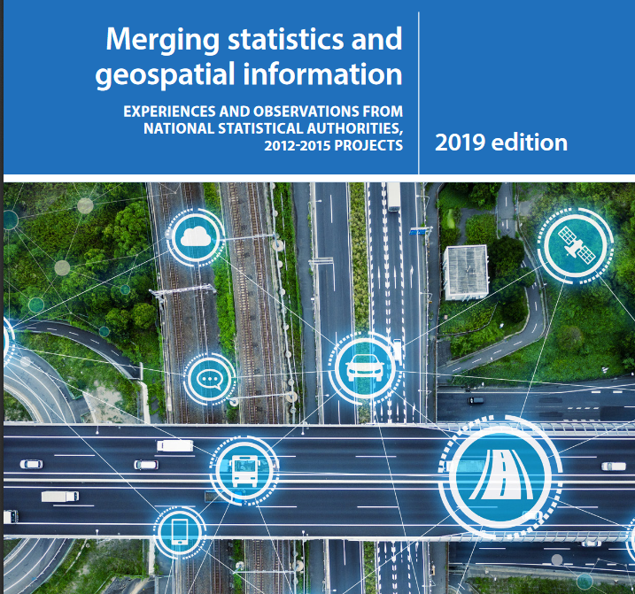
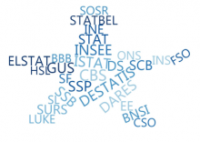
Applications – other projects
GEOS Grants (individual MS specific issues)
Main themes, (number of projects- total 88)
Example of Projects
Land use – Ecosystem Accounts, Soil sealing (39)
Urban sprawl across urban areas in Europe (NL/ESSnet)
Agriculture (24)
Crop recognition with very high-resolution data (BE/ESSnet)
Permanent grassland and soil moisture (SI/GEOS)
Climate/SDG (5)
Snow statistics in Finland (FI/ESA- GAUSS)
Transport (4)
Use of EO data for detection of containers (ESTAT)
Other (16)
The highest hill summits using LIDAR data (LV)
Solar Panel detection (NL/GEOS)
Satellite-based economic flash estimation (building activity) (DE)
2012-15
2016-20
ESSnet
Big data II
AI/ML4OS
Notes:
As mentioned previously, we have started an inventory of EO4S projects
The inventory includes projects financed by the GEOS grants (that aim at the integration of geospatial and statistical data). The slide include links to two publications of the GEOS grants where you can find summaries of the projects. The 2024 GEOS grant agreements have just been signed, 5 out of 10 of these projects are using EO data. The 2025 edition of the GEOS grant call will be launched in March this year.
The grants from the ESSnet are multi-beneficiary projects (involving several NSI’s). At least 2 of these projects include specific work packages on EO data. Here you have the links to the Big Data II project and to the current One stop shop for Artificial Intelligence/ Machine Learning for Official statistics.
On the right side of the slide there is list of:
the main themes of the projects we have collected until now in the inventory,
the number of projects for each theme
and some examples
Land use – Ecosystem Accounts, Soil sealing (39)
Urban sprawl across urban areas in Europe (NL/ESSnet)
Agriculture (24)
Crop recognition with very high-resolution data (BE/ESSnet)
Permanent grassland and soil moisture (SI/GEOS)
Climate/SDG (5)
Snow statistics in Finland (FI/ESA- GAUSS) GAUSS stand for Generating advanced usage of EO for Smart Statistics
And on transport Transport (4)
Use of EO data for detection of containers (ESTAT)
Other (16)
The highest hill summits (by Statistics LV using LIDAR data) this is not specifically statistical data but it is reference data for integrating other geographical datasets that will integrate Statistics
Solar Panels (NL/GEOS)
Satellite-based economic flash estimation (looking into construction activity) (DE) by Destatis

Slide 9


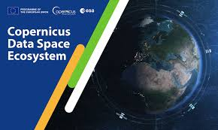
IT Open source
Common production
Copernicus Data Space Ecosystem
Free registration “Copernicus General User”
Upgrade to “Copernicus Services User”
for NSIs with privileged access/rights
ESTAT has Set up in-house projects in CDSE
IT strategy
Open-source code and software
Cloud-based platform (take the code to the data).
EU Ortho imagery
Notes:
Now passing on to the IT infrastructure and data management
Here we are collaborating with DG DEFIS and ESA, on exploring the capacities of the CDSE the Copernicus Data Space Ecosystem
As the llargest EO data platform in the world, CDSE offers not only the data but also
data processing tools and
a code repository that is shared by the ecosystem of users
We have an agreement we DG DEFIS that allows privileged access to NSI and Other National Authorities that are engaged in projects on EO4S.
If you are interested, you can follow the links in this presentation or contact us for further information.
We are also using CDSE for our in-house projects on EO. And we work closely with DG DEFIS to foster the uptake of the EO products for statistics. Our activities rely heavily on the collaboration with DEFIS and ESA and of course, on the use of the Copernicus data and the CDSE. In close collaboration with DEFIS we are currently looking into how we can better design into the production process our statistical requirements, so that the various processing phases of the EO data integrate the information for calculating accuracy of the final statistical output.
Furthermore, our strategy follows the indication of the Warsaw Memorandum’s implementation plan. We privilege open-source data and software, as well as shared cloud-based platforms for future common production of statistics. Taking the code to the data.
Regarding EO data management, EUROSTAT is also compiling a pan-european collection of Ortho Images that are another important source of EO data, often used to complement satellite data. Although Orthophoto maps have a much scarcer time coverage (with at best one image per year), they have, in general, a much higher resolution, which is needed when we aim to detect smaller sized phenomena (like solar panels or vehicles).

Slide 10

Skills
3 courses on EO
Next one will be in March 2025 on CDSE
2025 Big data Hackathon on EO for Statistics March 2025
Collaboration in Research and Methodology for Official Statistics
CROS
platform for data/knowledge sharing
Notes:
The next point describes the initiatives to promote Skills for the uptake of EO4S,
Here we have 3 main messages:
The first
Training and learning resources collected from several sources, are stored in ESTAT’s CROS platform the link is here in this slide.
Second highlight is the hakathon
ESTAT is preparing the 5 th edition of the Big Data Hackathon, and this year the theme is EO, many NSI’s are participating, as well as teams from several Universities that are part of the European Masters in Official statistics. It will be from 6 to the 10 of March in Brussels, just before the conference on New Techniques and Technologies in Statistics.
And finally the third message is on the ESS training programme
ESTAT has carried out 3 courses on EO within the European Statistical Training Programme. The next one will be about the CDSE the training is in presence, from 3 to 4 of March 2025, in Germany, in the city of Cologne.

Slide 11

Governance within ESS
Roles of NSI, Eurostat and other stakeholders
GEOS Grants - 4 NSI working on BUILDINGS
ESSNet AI/ML work package on EO CROPS and LAND USE
Task Force on Earth Observation for statistics NSI
17 countries (of which 12 are MS)
12 NSI and 5 Other National Authorities
4 Meetings a year
We are collaborating with
ESTAT’s statistical domains,
DGs
Notes:
And finally, about the governance framework of the EO4S
The most important element in our governance framework is the Task Force on Earth Observation for statistics. Within our TF we work on:
disseminating all the information, resources and activities,
collecting and sharing experience on EO projects.
Showcasing the different projects from the NSI
The task force is the essential connection to the NSIs, and to the procedures of the ESS.
The task force now has 17 countries (of which 12 are MS). It includes 12 NSI, and 5 Other National Authorities (like mapping agencies and environmental institutes)
We have 4 Meetings a year.
If you are interested in joining the TF, please let us know.
The second element of our governance is the close collaboration with ESTAT’s statistical domains and their respective policy DGs. This is essential for matching the statistical needs and the opportunities in the EO data.
The third element is the about innovation projects in the MS. We follow closely the GEOS grants (as I mentioned before, a new call is foreseen to be launched in March 2025. (It seems that March is the Month were everything happens!)
And we are following the WP on EO in the one stop shop for AI/ML, that involves several NSI’s. During the next years this project will transfer the experience of two selected EO4S projects (that use AI/ML) from their original NSIs to the statistical Institutes of the partner countries. The projects are on land use and crop statistics.

Slide 12

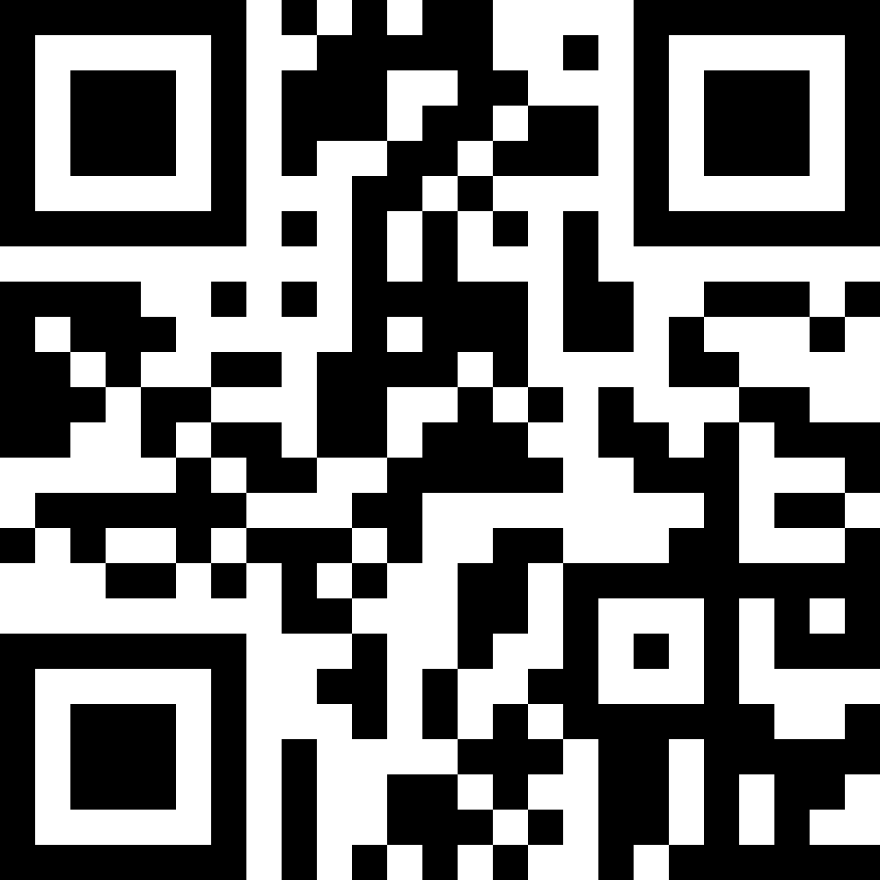
More Information EO4S:
https://cros.ec.europa.eu/book-page/earth-observation-statistics-eo4s
EMAIL:
ESTAT-GISCO-EO@ec.europa.eu
Notes:
Thank you for your attention and interest.
Here you have our contact details and links to more information on our activities. The presentation includes some complementary slides with extra information on methodology and on the application of EO4S. this presentation will be made available in EO4S page on the CROS portal.
A Big thank you to the Latvian Ministry of Economics, and DG DEFIS for this initiative and the organization.

Slide 13
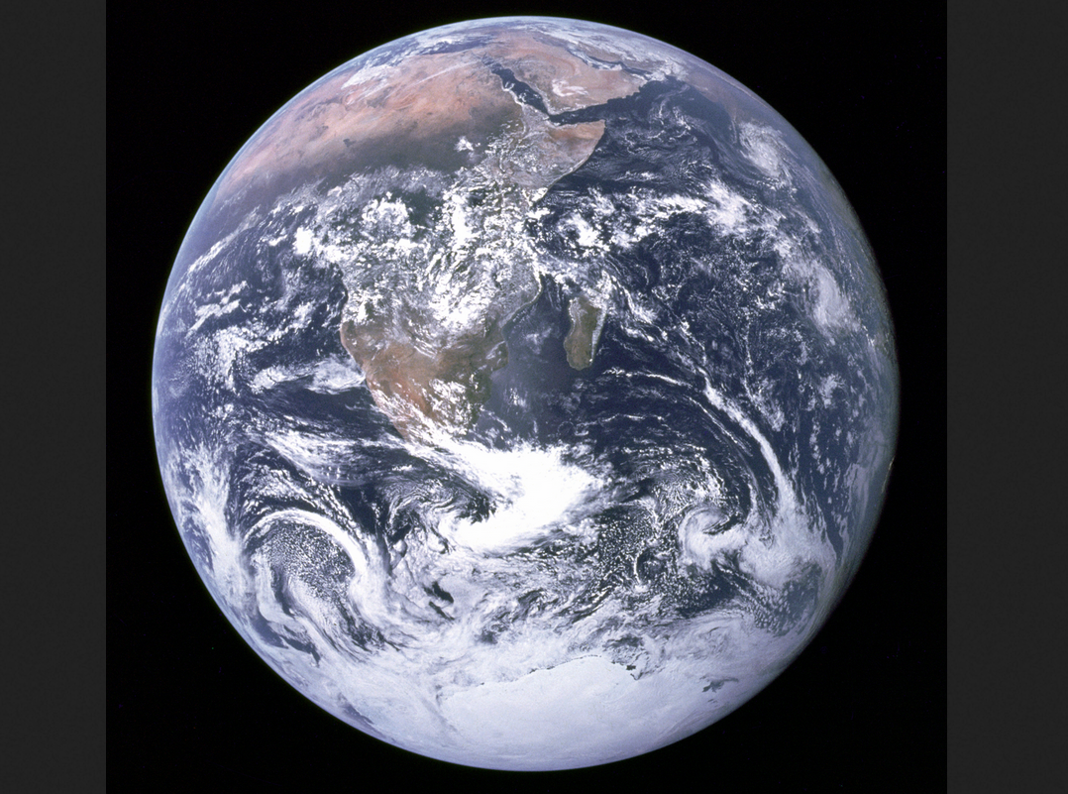

Thank you
ESTAT-GISCO-EO@ec.europa.eu
References/Images
Cover page - https://sentiwiki.copernicus.eu/web/sentinel-5p
https://www.researchgate.net/figure/Earth-remote-sensing-levels-from-left-to-right-ground-level-mobile-platforms-boats_fig1_337550795
Copernicus website: https://www.copernicus.eu/en
M365 Stock images
Wikipedia: "The Blue Marble" is a famous photograph of the Earth taken on December 7, 1972, by the crew of the Apollo 17 spacecraft en route to the Moon at a distance of about 29,400 kilometres (18,300 mi). It shows Africa, Antarctica, and the Arabian Peninsula.
Note: This presentation was based in the presentation prepared by Hannes I Reuter and Ruxandra Enesco for the Directors Group of Agricultural Statistics Seminar EO for Agricultural Statistics (6 June 2023 in Poland)
© European Union 2025
Unless otherwise noted the reuse of this presentation is authorised under the CC BY 4.0 license. For any use or reproduction of elements that are not owned by the EU, permission may need to be sought directly from the respective right holders.
Notes:
Thank you for your attention
For more information you can contact us with this email address.
We also have a folder on CIRCABC.
Questions?

Slide 14
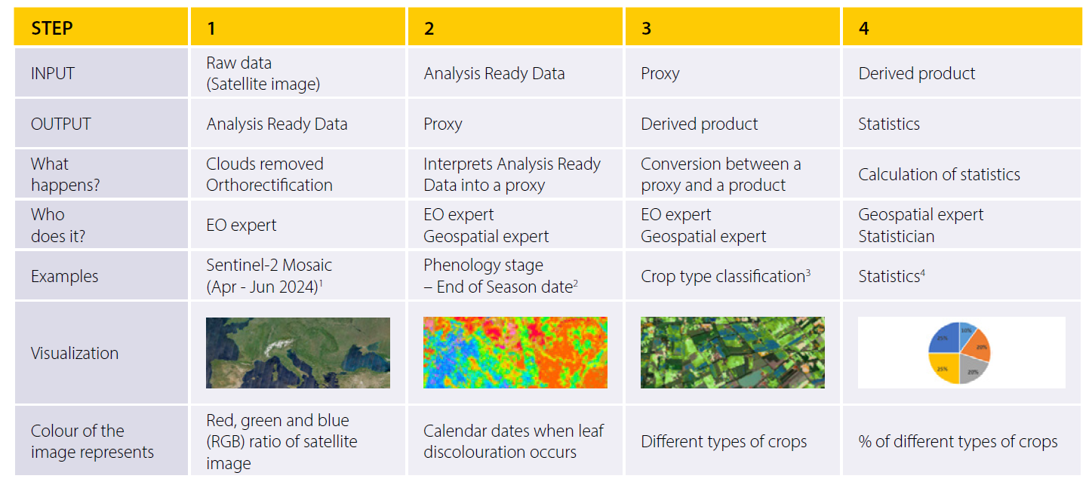
Methodology
Notes:
Follow up of slide 4:
Here the various steps are detailed, and some examples are given.

Slide 15



Methodologies
Methodologies How to go from EO to Statistics?
Poland Agricultural Statistics
Work on house /own infrastructure
Processing from scratch
Small scale
Flexibility
Easy to manage local ground truth data
Access to all the intermediate processing data
Calculation of statistical bias
ESTAT case studies
Work in CDSE /shared infrastructure
Using EO products
EU scale
Follow availability of products/processes
Difficult to manage/obtain ground truth data
No access to intermediate processing data
No calculation of statistical bias
Notes:
Methodologies
Poland - work in house, MS level, processing of data from scratch
Small scale, flexible, easy to manage ground truth (IACS) and local photointerpretation
In contracts with
ESTAT project on Crop Types - EU level, searching for processed EO products - at EU wide level (Copernicus Land Monitoring Service) - missing link from EO satellite data to Vegetation Land Cover Characteristics (VLCC) - +probability matrices and confusion matrices - to be able to calculate the unbiased statistics.
Fundamental the exchange between the EO experts and Official Statisticians

Slide 16
Applications – ESTAT Grassland Crop Type
EO Sentinel 1, 2 and 3
Area and crop yields are produced for
  Regional Economic Accounts for Agriculture,
  Integrated Farm Statistics,
  And Agricultural Crop Production.
Auxiliary data from IACS (administrative data from CAP).
Yearly sample of ground truth
Microdata -parcel / Publication LAU level
Accuracy
  error matrices,
  quality control on 20% of the sample,
  and estimates of regional experts.
In house IT infrastructure
In house EO experts
Notes:
A fouth example of the application of EO4S is our inhouse projects on Crop type, Grassland,
Last year we carried out a project to extract data from existing EO products. More concretely Grassland area from the EU Grassland watch - (produced by the European Environmental Agency -EEA)
and Crop type area from the 2022 EUCROPMAP (produced by the Joint Research Centre using Copernicus satellite data and LUCAS data for classifying and validating).
Main outcomes
Grassland watch only covered Natural 2000 areas and so would not cover the reference area we needed - which was the entire EU grassland as the one collected by the integrated farm statistics or the annual crop statistics. As alternative we analysed the grassland within the EUCROPMAP.
From the EUCROPMAP two datasets were produced:
The biased statistics - the pixel counting (converted to area) of the EUCROPMAP that included 19 crop type classes by NUTS 2. And had 80% accuracy measured for the EU as a whole).
The unbiased statistics - at first the idea was to reproduce JRC's whole production process of the EUCROPMAP, to be able to measure all the errors along the data processing phases. It turned out this was not feasible, due to missing intermediate data. As alternative we used a small area estimation method called eBLUP that stands for Empirical Best Linear Unbiased Prediction. The EBLUP data (based on the pixel counting) produced an estimation of the areas that (in general) had lower accuracy. This was due to missing ground truth data in some MS and for some crops. We need to keep in mind EUCROPMAP (was produce at for a EU scale, not a national scale).
LESSONS LEARNED
The importance of measuring the error in all the processing steps to be able to calculate the accuracy of the data. (probability and confusion matrices)
The importance of adequate ground truth data (proportional to the geographic scale of analysis).
When comparing the 2022 EUROCROPMAP with data from the integrated Farm Statistics or the Annual crop statistics, the pixel counting was closer than the EBLUP estimation. This was due to missing ground truth data in some MS and for some crops. We need to keep in mind EUCROPMAP (was designed for a EU scale, not a national or regional scales).
Estimates of storage space and processing units needed
The CDSE shared platform was tested for processing the data – that in our business model we envisage to produce at EU scale. We now have an idea of the needs in terms of Processing .
Metadata – needs to include the process description, and also the main characteristics of all the input data involved.
Next steps
– we are going back to drawing board. The idea is to design into the data processing a system to allow statisticians to measure the bias. For this we have had very good exchanges with DG DEFIS and the EEA that are producing the Vegetated Land Cover Characteristics products.

Slide 17
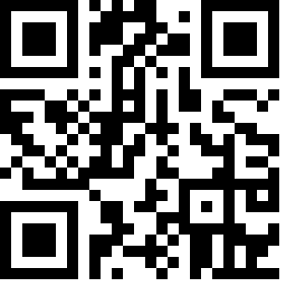
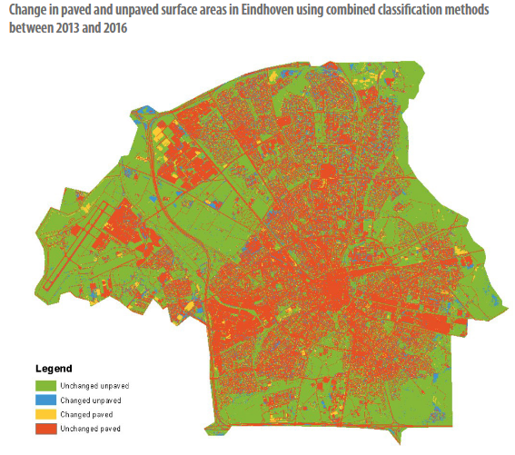
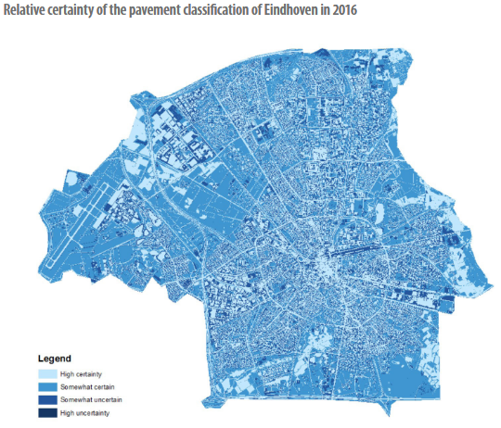
GEOS Grants Examples - Netherlands
Objective: provide estimates for paved and unpaved surface areas in support to the SDGs (e. g. urban heat, ecosystems account)
As a share of the total area (paved and unpaved),
the paved area decreased 9.4 % while the unpaved area increased by 9.5 %.
2016 - https://europa.eu/!qWrjQJ

Slide 18
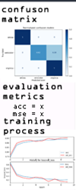
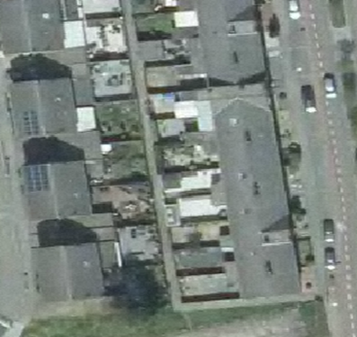

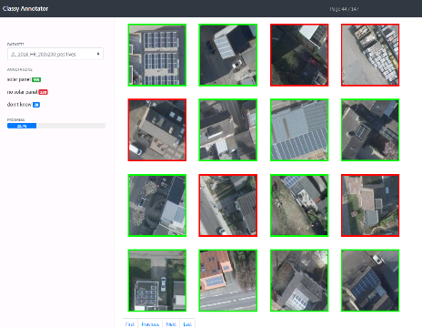
GEOS Grants Examples - Netherlands
Objective: provide estimates for solar cell estimates on buildings based on Ortho-Imagery in support to Transition to Energy Transition and sustainability
Model evaluation / validation
Data pre-processing
Model tuning
Data labelling
https://zenodo.org/record/7547703#.Y8pKly
2017+2021 - https://europa.eu/!qWrjQJ

Slide 19
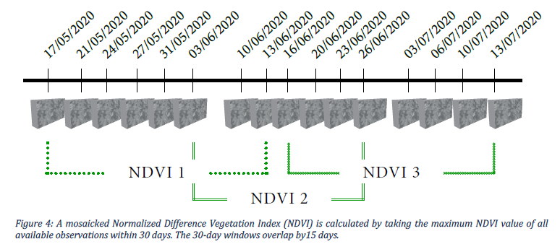
GEOS Grants Examples - Finland
Objective: provide estimates for agriculture production
Testing various input parameters/ML models
2018 - https://europa.eu/!qWrjQJ

Slide 20
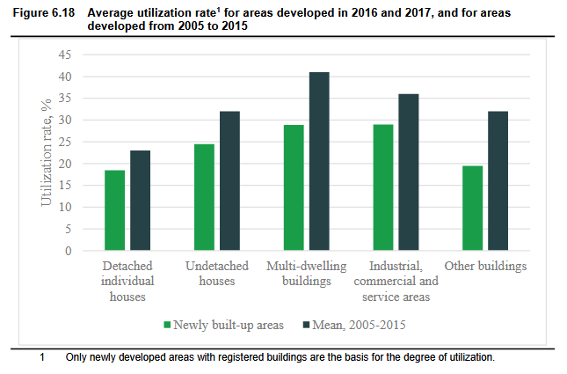
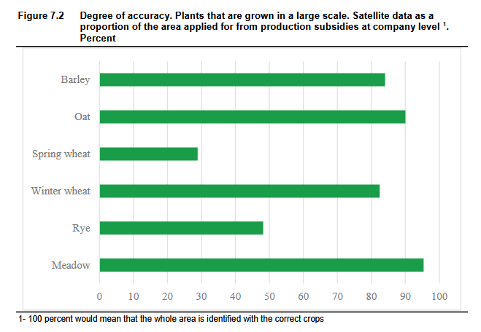
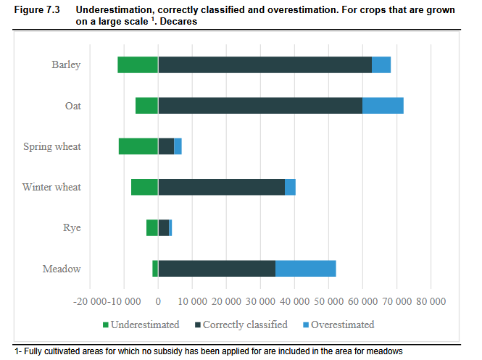
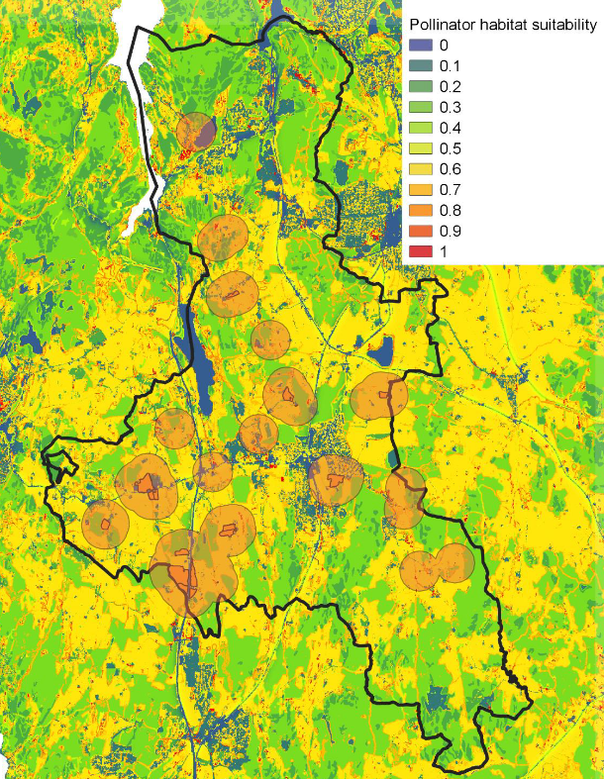
GEOS Grants Examples - Norway
Objective: test land cover, green share, crop identification and pollination services
Accuracy from 30-95% depending on the crop
Proximity to
Bee pollinator habitat
2018 - https://europa.eu/!qWrjQJ

Slide 21
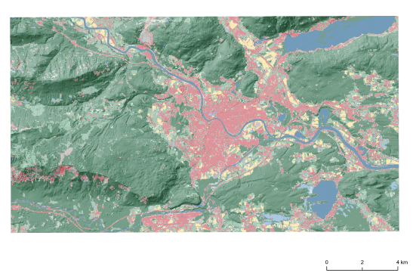


GEOS Grants Examples - Austria
Objective: provide estimates for agriculture, forestry and environmental statistics
2020 - https://europa.eu/!qWrjQJ

Slide 22
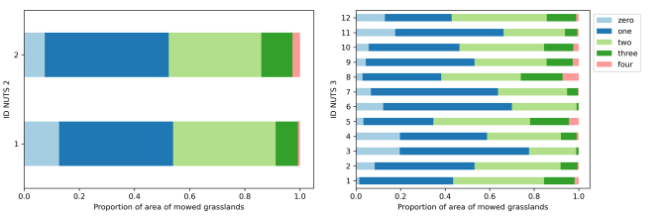
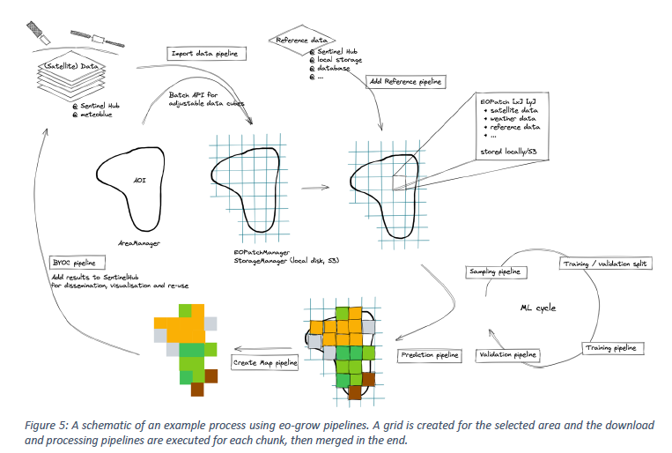
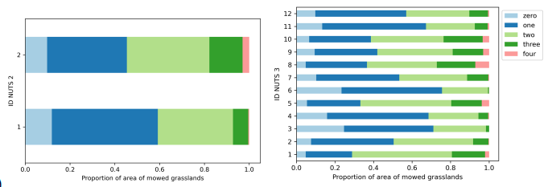
GEOS Grants Examples - Slovenia
2017
Objective:quantify key parameters of grassland use (frequency of mowing, use of fertilizer, grassland renewal,… )
……
2021
2020 - https://europa.eu/!qWrjQJ

Slide 23
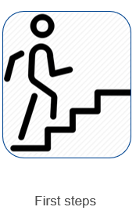
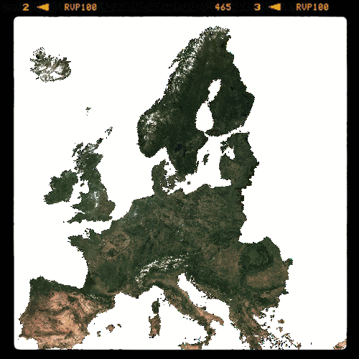
Ortho-Imagery service in GISCO
Notes:
We present to you another task of the first steps of our EO4NS.
is about the Ortho images that are also EO data.
The GISCO team is currently putting together an EU wide ortho-imagery service that is collecting the available ortho images throughout Europe and making them accessible through a map service to the European Institutions. This is an example of the north of Germany where you can see the different scales available. And another important feature is that is also includes different time coverages.

