Slide 1
Economic and Finance statistics
Statistics Quality Frameworks (ESS&ESCB)
Claudia Junker, Eurostat
Spring semester 2021

Slide 2
Jointly organised by
European Statistical System (ESS)
European System of Central Bank (ESCB)
EMOS labelled programmes
The opinions expressed in this course are not necessarily those of the European Statistics System (ESS)or the European System of Central Banks (ESCB)

Slide 3
Quality Framework for the European Statistical System
Legal framework
Article 338 of TFEU – with 7 Principles
Regulation (EC) No 223/2009, as amended by Regulation(EU) 2015/759 – with 6 Principles, mention of the CoP, quality reporting and the output quality criteria
Sectoral, domain-specific legislation – with quality provisions included
ESS quality framework – Is not legally binding, is a self-commitment and is self-regulatory
European Statistics Code of Practice (ES CoP) - https://ec.europa.eu/eurostat/web/products-catalogues/-/KS-02-18-142
Quality Assurance Framework of the ESS (ESS QAF) https://ec.europa.eu/eurostat/documents/64157/4392716/ESS-QAF-V2.0-final.pdf
General quality management principles (continuous interaction with users, commitment of leadership, partnership, staff satisfaction, continuous improvement, integration and harmonization)
Sectoral legislation

Slide 4
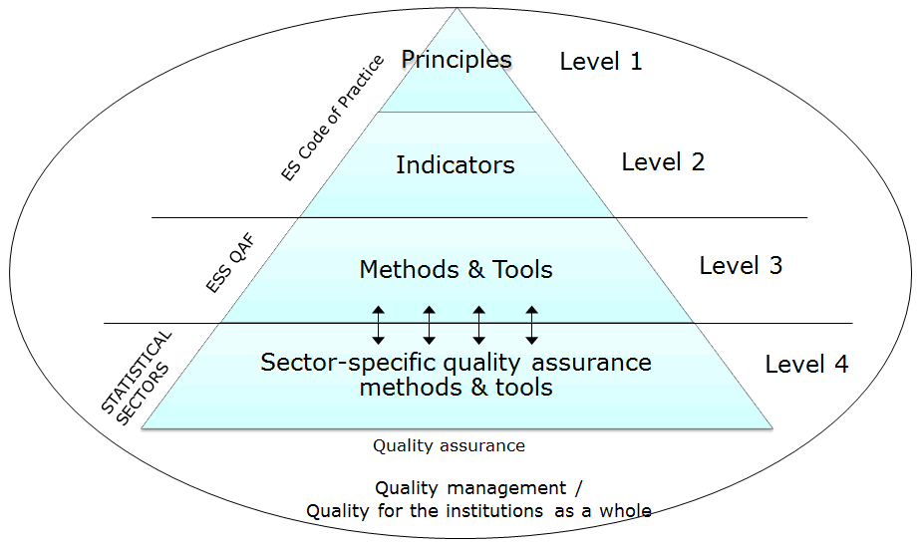

Slide 5
Level 1 and 2 – Code Principles & Indicators
16 Principles:
Institutional environment
Professional independence
Coordination and cooperation (NEW since Nov 2017)
Mandate for data collection
Adequacy of resources
Commitment to quality
Statistical confidentiality
Impartiality and objectivity
+ 84 Indicators
Statistical processes
Sound methodology
Appropriate statistical procedures
Non-excessive burden on respondents
Cost effectiveness
Statistical output
Relevance
Accuracy and reliability
Timeliness and punctuality
Coherence and comparability
Accessibility and clarity

Slide 6
Professional independence
Is specified in law
Heads of statistical authorities have sufficiently high hierarchical standing
Heads of statistical authorities have responsibility for ensuring development, production and dissemination in an independent manner
Heads of statistical authorities have sole responsibility for deciding on statistical methods, standards, procedures
Statistical work programmes and reports are published
Statistical releases are clearly distinguished
Statistical authorities comment publicly on statistical issues
Procedures for recruitment and appointment of heads of statistical authorities are transparent and based on professional criteria only

Slide 7
Other elements of professional independence
Heads of statistical authorities decide on the content and timing of statistical releases (Ind 1.4)
Statistical release dates and times are pre-announced (Ind 6.5)
Statistical authorities independently decide on the time and content of statistical releases (Ind 6.7)
All users have equal access to statistical releases at the same time (Ind 6.7)
Any privileged pre-release access to outside users is limited, justified, controlled and publicised (Ind 6.7)

Slide 8
ESS QAF
Principle 1: Professional independence
Professional independence of statistical authorities from other policy, regulatory or administrative departments and bodies, as well as from private sector operators, ensures the credibility of European Statistics.
Indicator 1.6
Statistical releases are clearly distinguished and issued separately from political/policy statements
ESS Quality Assurance Framework: Methods of implementation
1. Description of statistical outputs. Internal guidelines for describing statistical outputs to users, including formulations on how to be non-political in statements, are developed and available to staff.
2.Training on how to communicate about statistics. Statistical authorities ensure that suitable statistical training courses are provided to staff of the National Statistical System to facilitate objectivity in communicating its statistics.
3. Identification of statistical releases. Guidelines are in place to clearly identify statistical releases (e.g., press releases, press conferences, reports) as products of the statistical authority.
4. Definition of brand. A brand of the National Statistical Institute/National Statistical System as appropriate and Eurostat is defined. It includes a logo that can be widely recognised by its design, format, colours and layout.

Slide 9
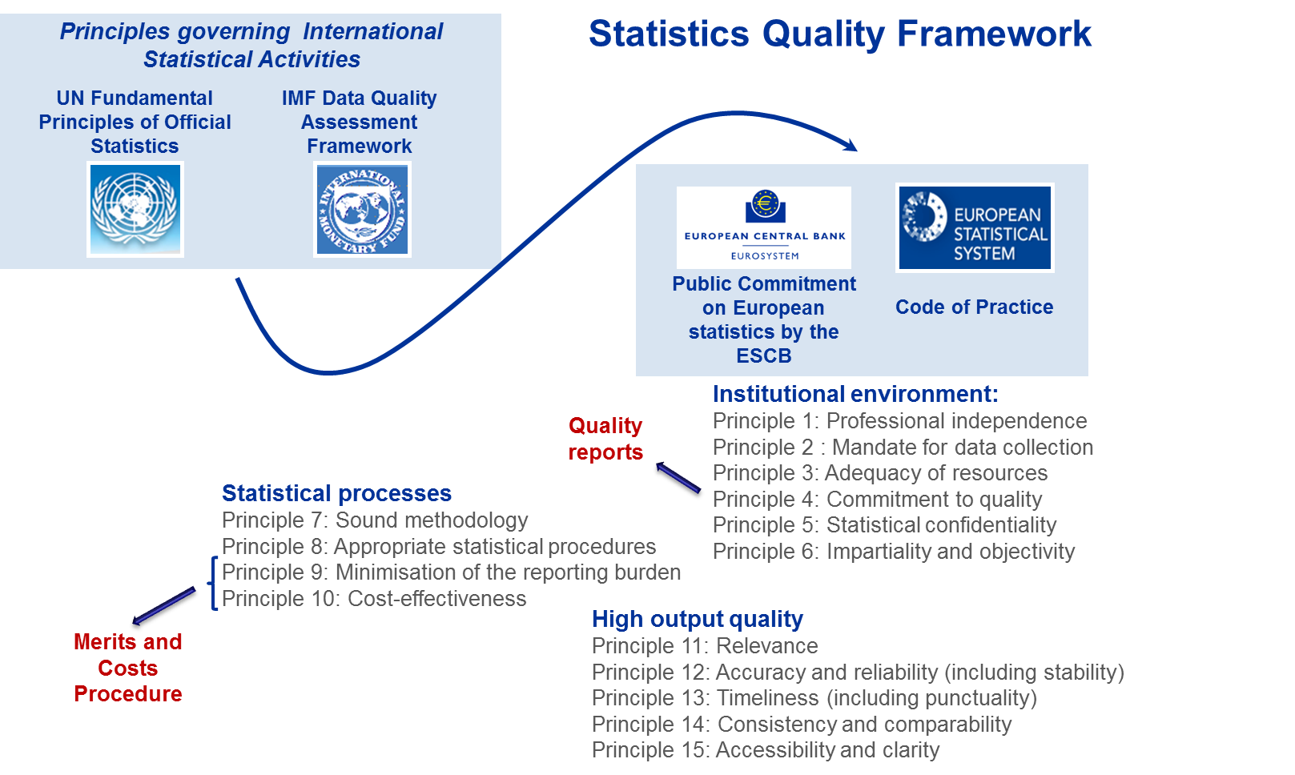
Quality framework for ESCB statistics

Slide 10
Public commitment on European Statistics by the ESCB
public statement (link)
legal mandate
compliance with European and internationally agreed standards, guidelines and good practices
independence of the ESCB statistical function
collaboration with the ESS – principles are mutually consistent with the ESS Code of Practice
efficient use of resources
minimisation of reporting burden
confidentiality protection

Slide 11
Public commitment on European Statistics by the ESCB
Quality principles and associated indicators of good practice
Institutional environment
Statistical processes
High output quality
P1. Professional independence
P2. Mandate for data collection
P3. Adequacy of resources
P4. Commitment to quality
P5. Statistical confidentiality
P6. Impartiality & objectivity
P7. Sound methodology
P8. Appropriate statistical procedures
P9. Minimisation of reporting burden
P10. Cost-effectiveness
P11. Relevance
P12. Accuracy and reliability (incl. stability)
P13. Timeliness (incl. punctuality)
P14. Consistency and comparability
P15. Accessibility and clarity

Slide 12
Monitoring of the quality framework – peer reviews
To assess compliance with and implementation of the quality framework in the ESS
First round in 2006-2008, Second round in 2013-2015; Third round in 2021-2023
Methodology development, combination of audit-like/peer review approach, use of internal and external experts, self-assessments followed by visits
Result in reports+recommendations produced by experts and improvement actions developed by the NSIs per country and for Eurostat, followed by annual monitoring of their implementation;
http://ec.europa.eu/eurostat/web/quality/peer-reviews

Slide 13
Thank you
Notes:
Update/add/delete parts of the copy right notice where appropriate.
More information: https://myintracomm.ec.europa.eu/corp/intellectual-property/Documents/2019_Reuse-guidelines%28CC-BY%29.pdf

