Slide 1
Statistical monitoring of sustainable development at global, EU and national level (with a case study of Poland)
Part 1 – Global and EU monitoring
Nicola Massarelli – Eurostat
EMOS webinar, 28 February 2018
Eurostat

Slide 2
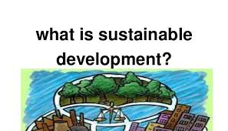

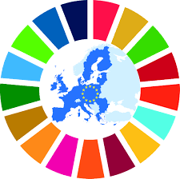
1
OUTLINE
Monitoring the 2030 Agenda
2
3
SDG monitoring in an EU context
Eurostat

Slide 3
Please describe SD
in max 3 key words or 1 sentence
Eurostat

Slide 4
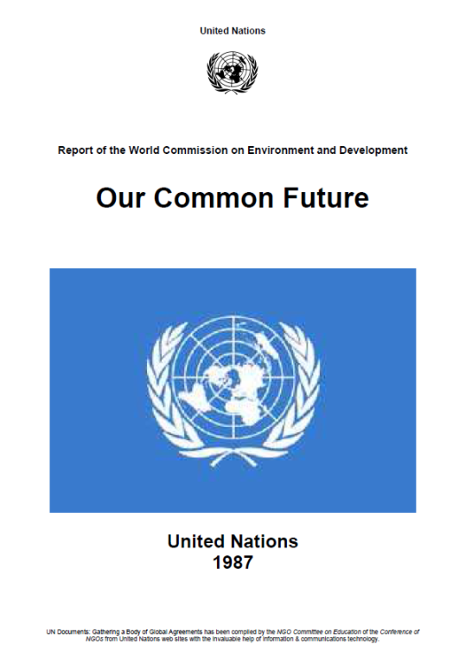
Sustainable development
Development that meets the needs of the present without
compromising the ability of future generations to meet their own needs
From the "Brundtland report" (1987)
Eurostat
Notes:
Report of the World Commission on Environment and Development "Our Common Future"
United Nations, 1987
Gro Harlem Brundtland, Prime Minister of Norway and chair of the Commission in 1987
The Brundtland report is important because for the first time it linked expectations on well-being and economic growth with the respect of the environment and the preservation of natural resources.

Slide 5
Dimensions of sustainable development (2)
Later
Elsewhere
Here & now
Eurostat
Notes:
From the Brundtland report and the CES recommendations on measuring sustainable development

Slide 6
Dimensions of sustainable development (1)
Social
solidarity
Economic efficiency
Environmental responsibility
Institutional
Dimension
Eurostat

Slide 7



Many ways to decline SD
2030 agenda
(17 goals)
No poverty
Zero hunger
Good health and well-being
Quality education
Gender equality
Clean water and sanitation
Affordable and clean energy
Decent work and economic growth
Industry, innovation and infrastructure
Reduced inequalities
Sustainable cities and communities
Responsible consumption and production
Climate action
Life below water
Life on land
Peace, justice and strong institutions
Partnerships for the goals
CES recommendations (20 themes)
Subjective well-being
Consumption and income
Nutrition
Health
Labour
Education
Housing
Leisure
Physical safety
Land and ecosystems
Water
Air quality
Climate
Energy resources
Mineral resources
Trust
Institutions
Physical capital
Knowledge capital
Financial capital
EU SD strategy
(10 themes)
Socio-economic development
Sustainable consumption and production
Social inclusion
Demographic changes
Public health
Climate change and energy
Sustainable transport
Natural resources
Global partnership
Good governance
Eurostat

Slide 8
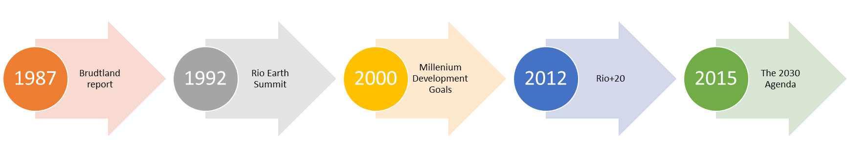
From the Brundtland report to the 2030 Agenda for sustainable development
Eurostat
Notes:
Brundtland report "Our Common Future" (1987): The report placed environmental concerns firmly on the political agenda. It recognised the interlocking nature of ecological, social and economic challenges and called for their discussion as one single issue. The report put forward eight interrelated objectives for sustainable development:
•• Reviving growth;
•• Changing the quality of growth;
•• Meeting essential needs for jobs, food, energy, water and sanitation;
•• Ensuring a sustainable level of population;
•• Conserving and enhancing the resource base;
•• Re-orienting technology and managing risk;
•• Merging environment and economics in decision making;
•• Re-orienting international economic relations
The United Nations Conference on Environment and Development, 1992 Rio de Janeiro. Rio Declaration contained 27 principles of sustainable development, including the often cited principle 7 on ‘common but differentiated responsibilities’ of states.
MDGs: 8 goals to meet the needs of the world’s poorest:
To eradicate extreme poverty and hunger
To achieve universal primary education
To promote gender equality and empower women
To reduce child mortality
To improve maternal health
To combat HIV/AIDS, malaria, and other diseases
To ensure environmental sustainability
To develop a global partnership for development
They've had mixed results.
The United Nations Conference on Sustainable Development - or Rio+20, or World Earth Summit, in Rio in 2012: Member States decided to launch a process to develop a set of Sustainable Development Goals (SDGs), which built upon the Millennium Development Goals and converged with the post 2015 development agenda.

Slide 9
Poll on the 2030 agenda
On the 2030 agenda for sustainable development:
  I know well what it is about
  I have heard about it
  I have no clue
2 – Monitoring the 2030 agenda
9
Eurostat

Slide 10


2030 Agenda for Sustainable Development: from MDGs to SDGs
MDGs
SDGs
2000 – 2015
2016 – 2030
Source: Swiss Federal Statistical Office
2 – Monitoring the 2030 agenda
10
Eurostat
Notes:
[Concept of the slide is taken from a video published by FSO, Neuchâtel (CH)]

Slide 11


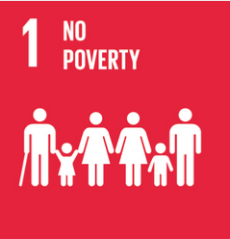








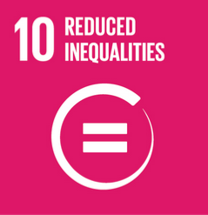







2030 Agenda for SD:
17 goals, 169 targets
LEAVE NO ONE BEHIND
2 – Monitoring the 2030 agenda
Eurostat
Notes:
The 2030 agenda for SD adopted on 25 September 2015 by at UN Summit on SD.
All countries of the world committed to implement all goals and targets by 2030.
The agenda foreseen regular follow up and review of progress towards its implementation

Slide 12
Overview of Goals and targets
2 – Monitoring the 2030 agenda
Eurostat
Notes:
107 substantive targets. e.g.: 1.4 By 2030, ensure that all men and women, in particular the poor and the vulnerable, have equal rights to economic resources, as well as access to basic services, ownership and control over land and other forms of property, inheritance, natural resources, appropriate new technology and financial services, including microfinance
62 means of implementation. E.g.: 1.a Ensure significant mobilization of resources from a variety of sources, including through enhanced development cooperation, in order to provide adequate and predictable means for developing countries, in particular least developed countries, to implement programmes and policies to end poverty in all its dimensions;
1.b Create sound policy frameworks at the national, regional and international levels, based on pro-poor and gender-sensitive development strategies, to support accelerated investment in poverty eradication actions
In general targes are multifaceted and cover several elements
There is no 1 to 1 correspondence between the goals and the related targets: the elements of the targets may not cover the whole goal or may go beyond the scope of the goal

Slide 13
SDGs & the dimensions of SD
Social
solidarity
Economic efficiency
Environmental responsibility
Institutional
Dimension
2 – Monitoring the 2030 agenda
Eurostat

Slide 14
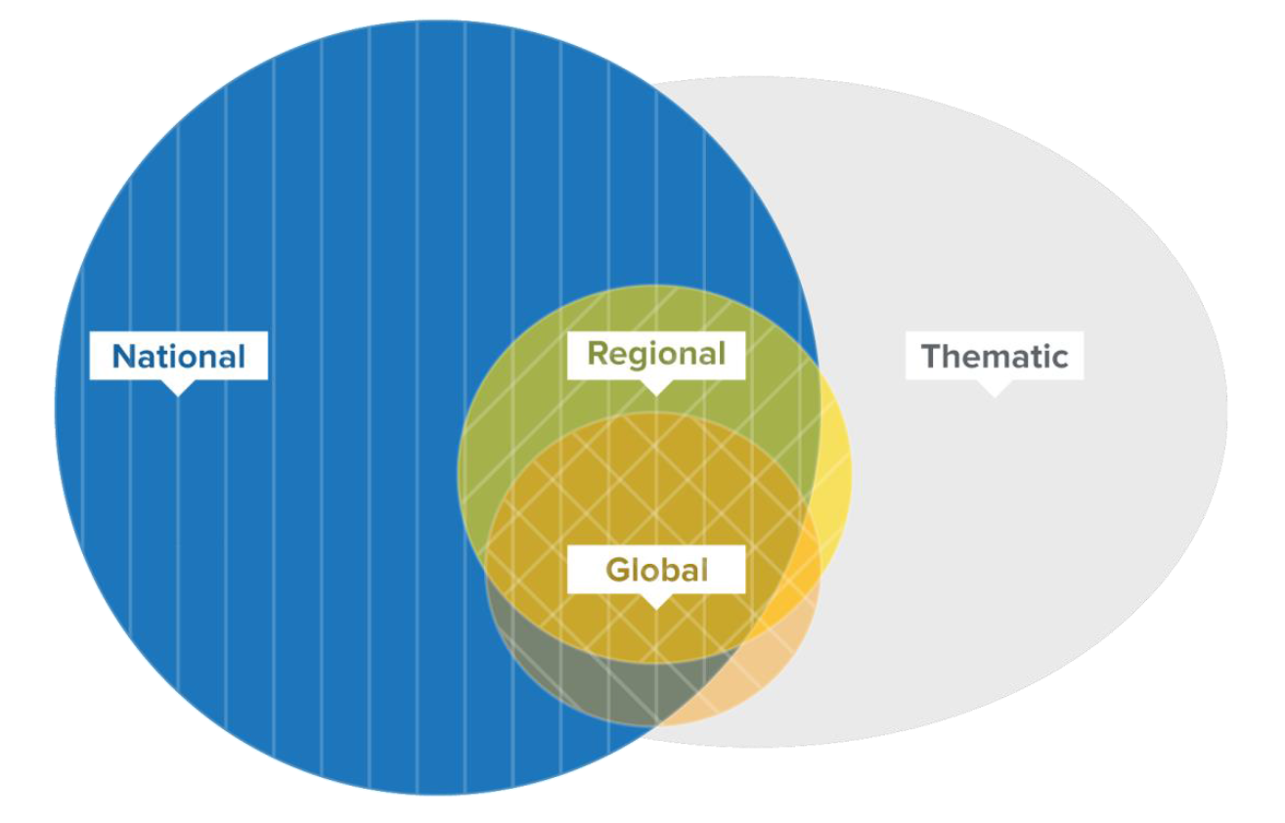
Different levels of SDG Monitoring
Source: SDSN Report «Indicators and a Monitoring Framework for the SDGs», 2015
2 – Monitoring the 2030 agenda
Eurostat
Notes:
Global (UN) - Agenda 2030's 17 goals and 169 targets - UNSC, IAEG-SDGs, "Custodian" agencies, ECOSOC & UN GA - Global list of 244 SDG indicators (232 different ones). Includes unavailable indicators
UN region (UNECE) - Developing guidance for member countries but no monitoring carried out
EU - SDGs in an EU context; focus on EU policies - Eurostat, other Commission services, National statistical offices - EU SDG indicator set. Based on existing indicators
National - National SD strategies, implementation of Agenda 2030 in national policies - NSOs and other national agencies - National SD indicator sets (exist in some countries, are being developed in others)
Thematic - Individual SDGs or specific topics - Thematic institutions (e.g. UN thematic agencies) - More detailed indicator sets
Other - Alternative monitoring - NGOs, think tanks, etc. (e.g. OEDC, Bertelsmann Stiftung, …) - Global or ad hoc indicators, ad hoc methodologies

Slide 15
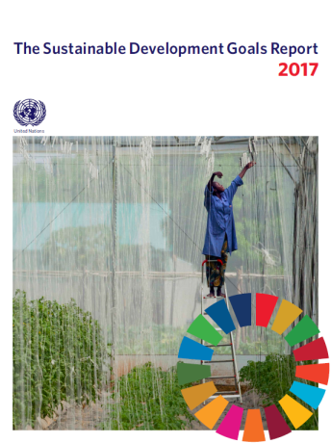
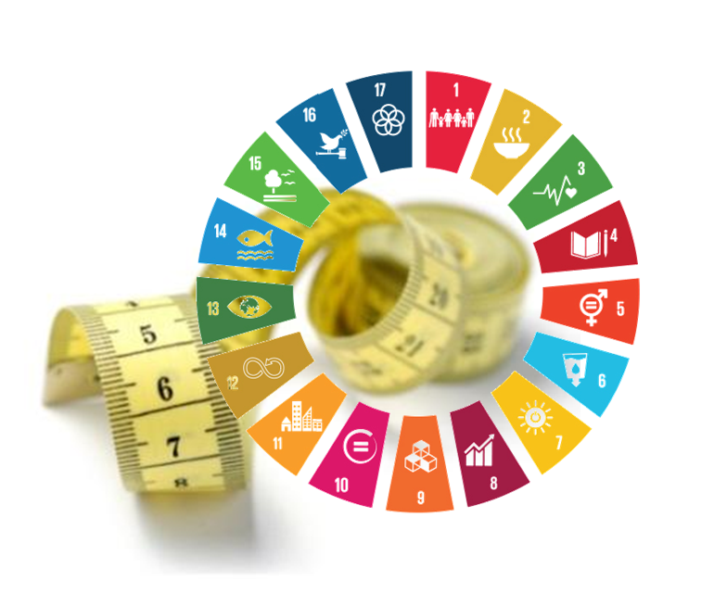
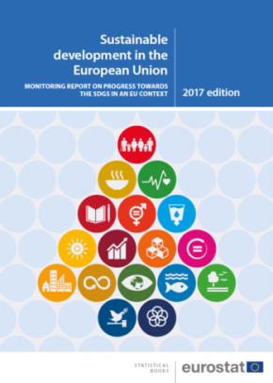
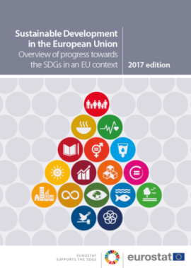
SDG reports now regularly produced
Global level:
2017 SDG report, produced by UN system, showing ≈ 100 out of 244 global SDG indicators
EU level:
1st EU SDG monitoring package, based on EU SDG indicator set
National level:
Reporting on national SD strategies based on national SD indicator sets
2 – Monitoring the 2030 agenda
Eurostat

Slide 16
Global monitoring – Main actors
UN Statistical Commission (UNSC)
Inter-agency and Expert Group on
SDG indicators (IAEG-SDGs)
"Custodian" agencies
(ILO, UNESCO, FAO, WHO, etc.)
ECOSOC and
UN General Assembly
2 – Monitoring the 2030 agenda
Eurostat
Notes:
[This slide provides an overview of the main actors in the global process. The organisations at the meeting probably know this, so there is no need to go into details on this slide.]
UN Statistical Commission (UNSC)
Mandates IAEG-SDGs
Reviews and approves IAEG-SDGs work and plans
IAEG-SDGs
Defines the Global indicator framework
Looks after its implementation, including the development of "missing" indicators, refinements and reviews, and establishment of data flows from countries to UN agencies
27 member countries (incl. 4 EU-MS: DE, FR, NL, SE)
International organisations are observers (incl. Eurostat)
"Custodian" agencies
These are mostly UN thematic agencies. For indicators in their field of competence, they collect data from countries, contribute to the UN global report, develop data collection and methodology for "missing" indicators
ECOSOC and UN General Assembly
For political approval (UNGA resolution approving the indicator list on 6 July 2017 – A/RES/71/313)

Slide 17
Set of 244 global SDG indicators
Tier classification (as of 15/12/2017)
Depends on for data availability and methodological development
Regularly updated by IAEG-SDGs
Tier 1: Data regularly produced (40%)
Tier 2: Methodology exists but no data (28%)
Tier 3: No international methodology exists (29%)
2% of indicators have multiple tiers
2 – Monitoring the 2030 agenda
Eurostat
Notes:
Tier 1: Indicator is conceptually clear, has an internationally established methodology and standards are available, and data are regularly produced by countries for at least 50 per cent of countries and of the population in every region where the indicator is relevant.
Tier 2: Indicator is conceptually clear, has an internationally established methodology and standards are available, but data are not regularly produced by countries.
Tier 3: No internationally established methodology or standards are yet available for the indicator, but methodology/standards are being (or will be) developed or tested.

Slide 18
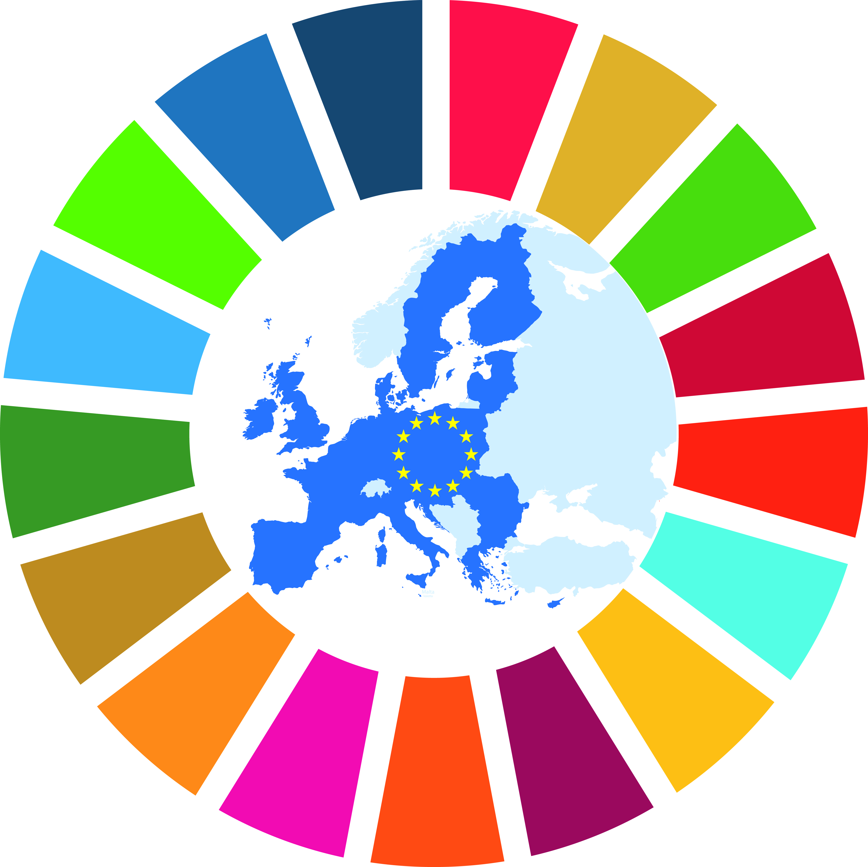
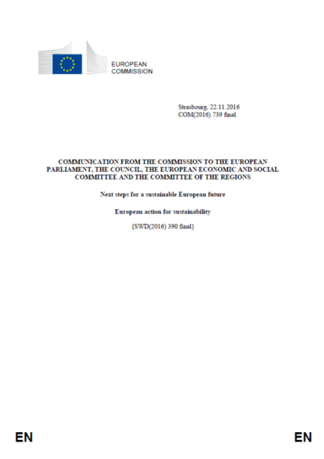
EU SDG monitoring: policy background
Commission Communication COM(2016) 739 on Next steps for a sustainable European future, released on 22 November 2016
«From 2017 onwards, the Commission will carry out more detailed regular monitoring of the Sustainable Development Goals in an EU context, developing a reference indicator framework for this purpose»
3 – SDG monitoring in an EU context
Eurostat
Notes:
The Communication outlines the EU answer to the 2030 Agenda. It shows how the EU policies contribute to achieve the SDGs.

Slide 19
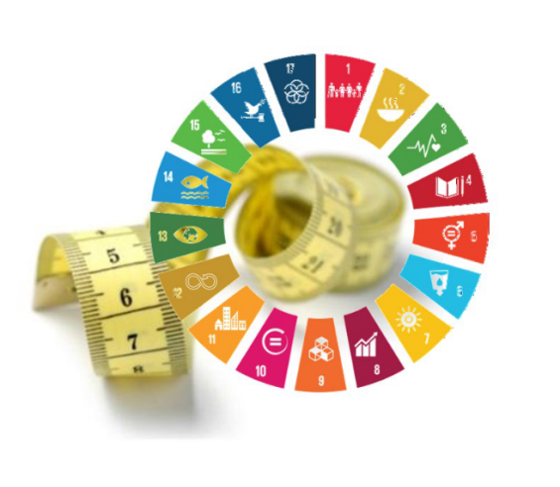
EU SDG indicator set
Indicators chosen for their policy relevance
and statistical quality [strong links with EU policies & in line with European Statistics Code of practice]
Only already existing indicators
Result of a broad consultative process
[including: Member States (via NSIs), EU Council Committees, users, academia and civil society, international organisations (FAO, UNEP, …)]
Favourable opinion of the European Statistical System (ESS) Committee on 18 May 2017
3 – SDG monitoring in an EU context
Eurostat

Slide 20

EU SDG indicator set: main features
100 different indicators, evenly distributed
across the 17 SDGs
41 multipurpose indicators
68% from ESS, 32% from non-ESS sources
56% aligned with UN SDG indicators
88% annually updated
Breakdowns by gender, age groups, NUTS 2 region, educational level, degree of urbanisation, income and disability
3 – SDG monitoring in an EU context
Eurostat

Slide 21


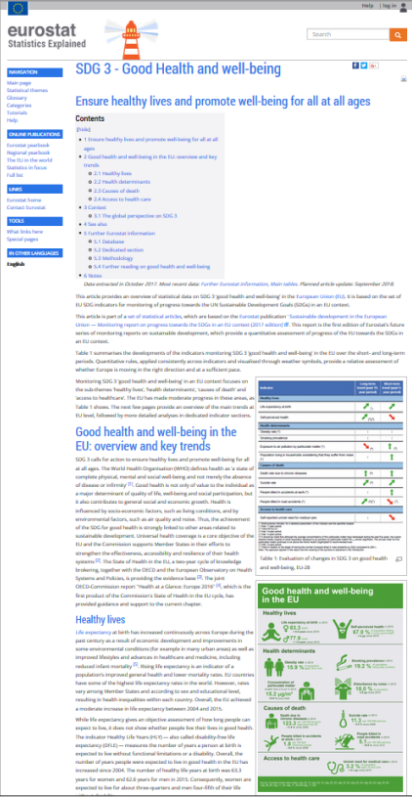
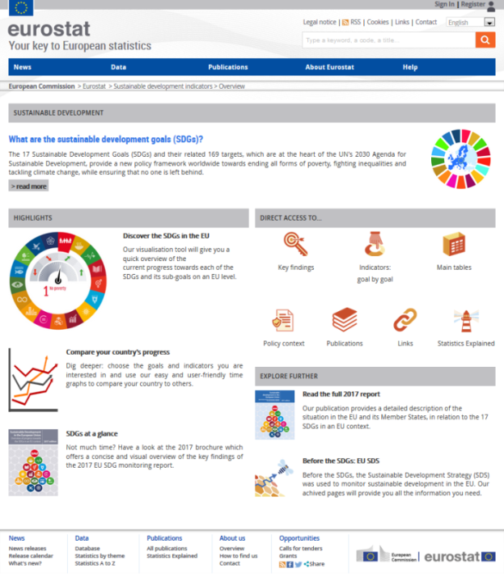
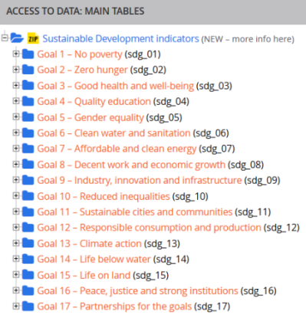
EU SDG monitoring: Eurostat's 2017 package
Monitoring report & Brochure
Statistics Explained
Dedicated website
Online database
3 – SDG monitoring in an EU context
Eurostat

Slide 22
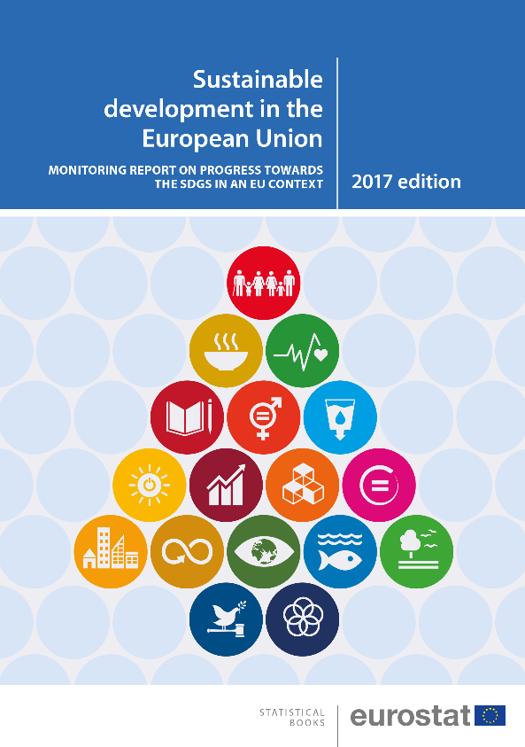
EU SDG monitoring report
Synopsis
Introduction
17 thematic chapters
[1 chapter per SDG]
Annexes
3 – SDG monitoring in an EU context
Eurostat

Slide 23

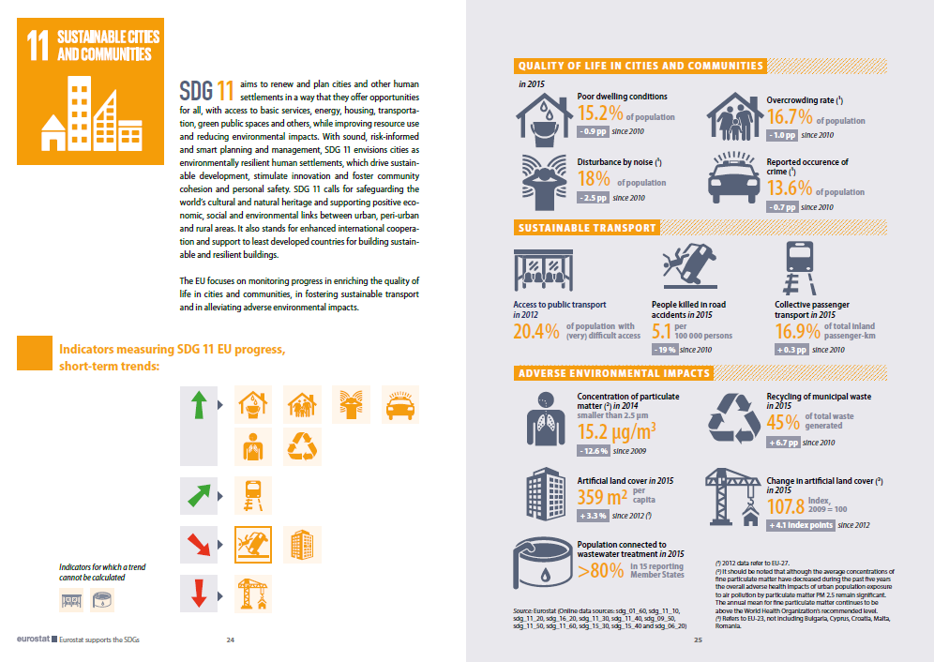
EU SDG brochure
40 pages
[intro + 2 pages per SDG]
Visual presentation of results
3 – SDG monitoring in an EU context
Eurostat

Slide 24

Next steps
EU SDG indicator set will be reviewed for 2018,
to make sure that it includes the most relevant
and highest quality indicators and that it aligns
with the UN global indicators as much as possible
[Ongoing refinement process until March 2018]
2018 EU SDG monitoring report foreseen in September
3 – SDG Monitoring in an EU context
Eurostat

Slide 25

Thank you for your attention
nicola.massarelli@ec.europa.eu
Eurostat's EU SDG dedicated website:
http://ec.europa.eu/eurostat/web/sdi/overview
Eurostat

