Slide 1
EMOS network meeting EMOS communication activities
6 March 2024

Slide 2
Agenda 1. Introduction 2. Existing EMOS communication channels 3. Ideas for new actions 4. Related news

Slide 3
Introduction

Slide 4
Introduction
EMOS network (33 university master’s programmes and partner organisations) in 17 European countries
Effective communication, engagement and cooperation key to the success of EMOS
EMOS brand visibility and reputation
Attractiveness and benefits of EMOS
Information on activities and events

Slide 5
2. Existing EMOS communication channels

Slide 6
Existing EMOS communication channels
EMOS webpages
Central, run by EMOS secretariat
Network partners – universities & statistics producers
Social media channels
EMOS network – mailing lists

Slide 7
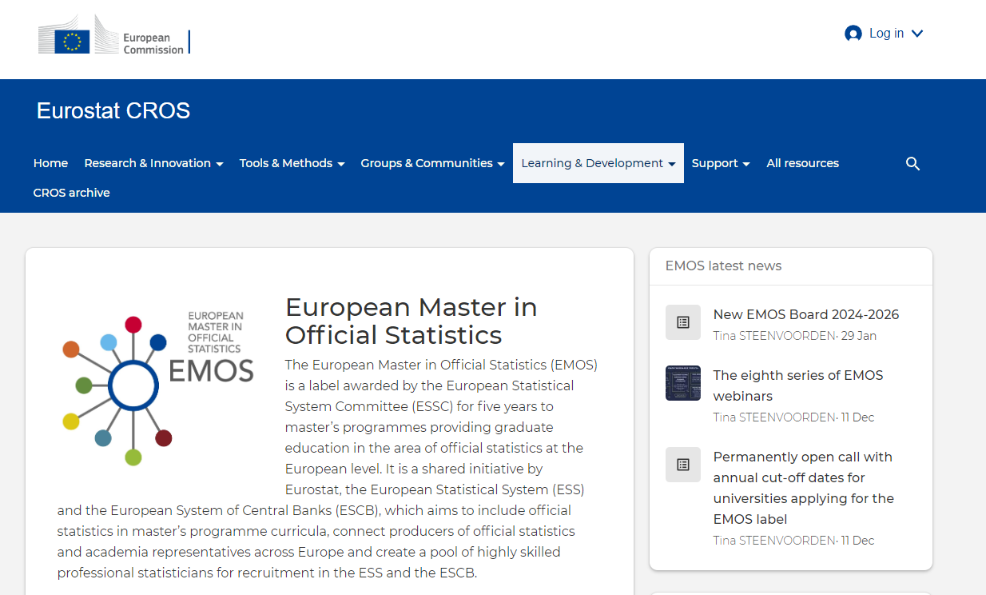
EMOS webpages
New EMOS webpages published in January 2024
New URL address: https://cros.ec.europa.eu/dashboard/emos-dashboard

Slide 8
EMOS webpages - call for action (1)
review and update links to EMOS webpages on own communication channels (new URL address!)
promote the new EMOS webpages
reuse and share information

Slide 9
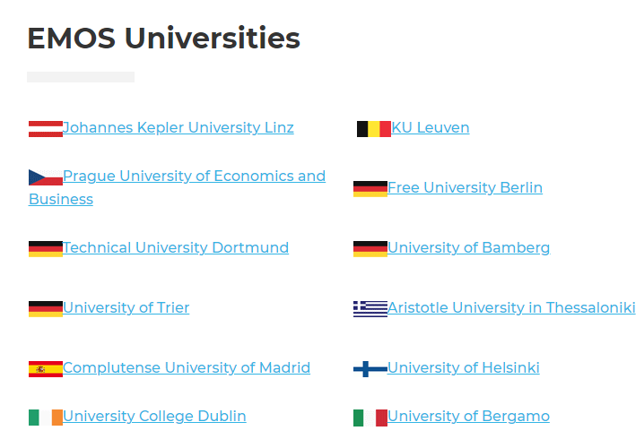
EMOS webpages - call for action (2)
Review and send an update for your EMOS-labelled programme description:
https://cros.ec.europa.eu/book-page/emos-programmes-across-europe-0

Slide 10
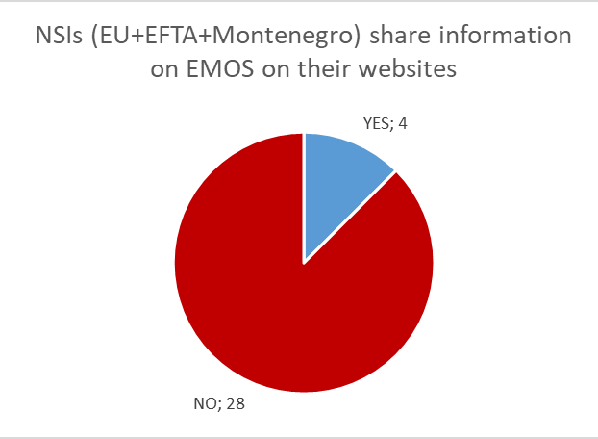
EMOS network partners webpages

Slide 11
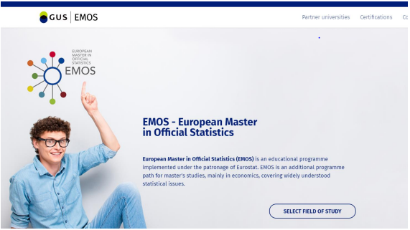
EMOS network partners webpages
EMOS on Statistics Poland website
https://emos.stat.gov.pl/en/

Slide 12
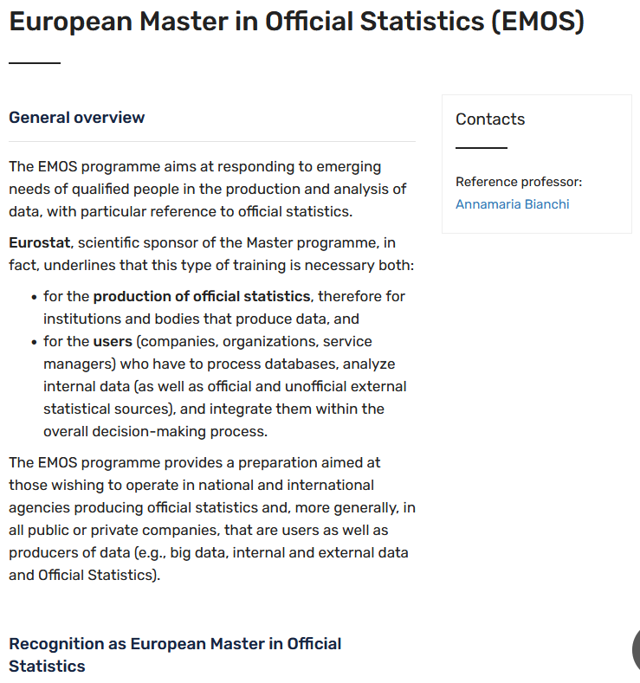
EMOS network partners webpages
EMOS on University of Bergamo website
https://ls-eda.unibg.it/en/opportunities/emos

Slide 13
Social media channels
EMOS is currently present on three social media platforms:
page on LinkedIn
channel on YouTube
account on X (Twitter)

Slide 14
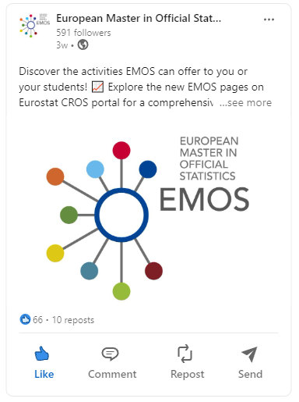
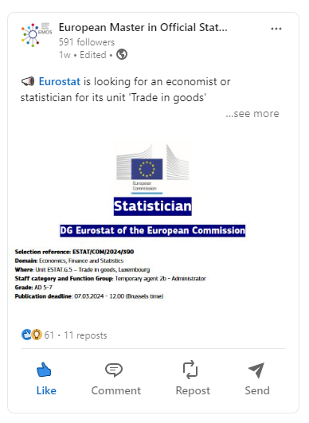
LinkedIn

Slide 15
YouTube

Slide 16
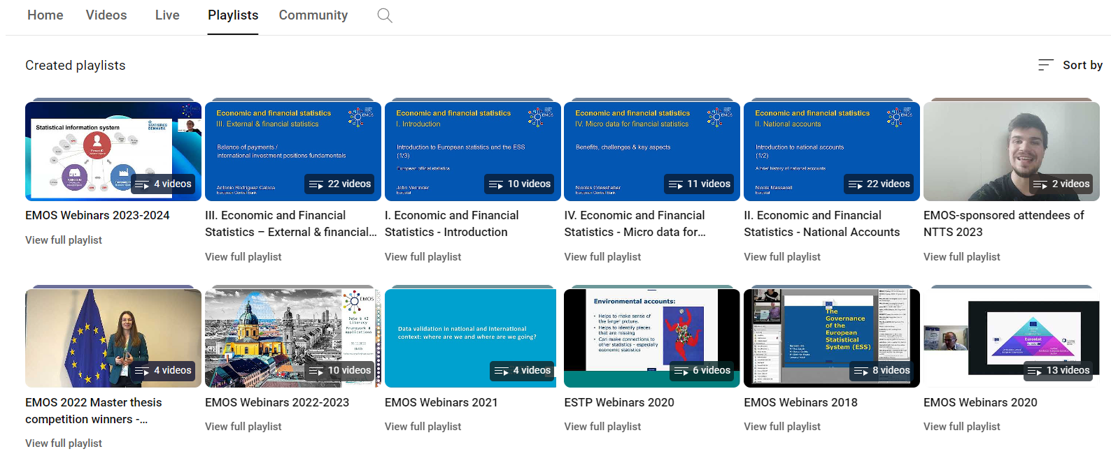
YouTube

Slide 17
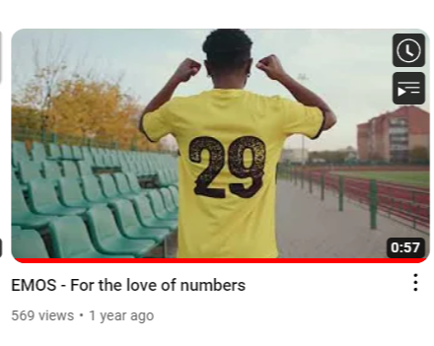
YouTube EMOS promotional video
European Master in Official Statistics - EMOS - YouTube

Slide 18
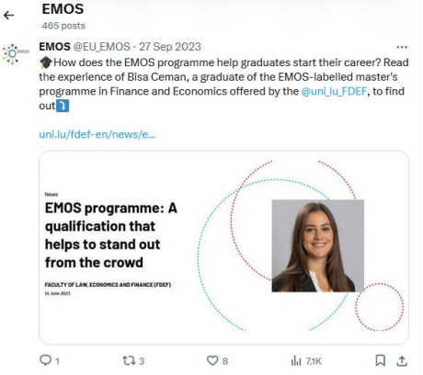
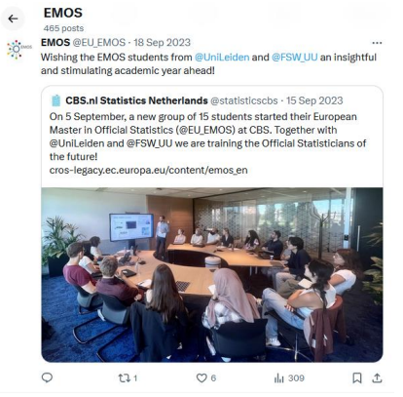
Social media channels

Slide 19
Social media channels - call for action
follow EMOS communication channels
promote EMOS communication channels
share updates and news to post

Slide 20
EMOS network – mailing lists
Mailing lists used to distribute information and updates:
contacts at EMOS-labelled master’s programmes
general EMOS contacts at National Statistical Institutes (NSIs)
contacts at NSIs for cross-border traineeships
EMOS graduates
EMOS Board members

Slide 21
EMOS network – mailing lists – call for action
inform the EMOS secretariat of any changes
share messages with relevant individuals within your organization

Slide 22
Discussion
Any examples of good practices you would like to share? What are your main communication channels?
How can the EMOS secretariat support your communication efforts?
Would you suggest some other means of communication and outreach coordinated centrally by the EMOS secretariat?

Slide 23
3. Ideas for new actions

Slide 24
Ideas for new actions
Proposal to launch:
section on EMOS students and EMOS network members on new EMOS webpages
section dedicated to featuring EMOS research projects on the EMOS webpages
creation of dedicated groups linked to the EMOS LinkedIn page
presentations for EMOS network members by the EMOS secretariat
continuation of EMOS network meetings

Slide 25
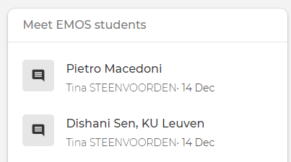
Section on EMOS students
‘Meet EMOS students’ section on the EMOS webpages
testimonials prepared at past events

Slide 26
Section on EMOS network members
Proposal: launch a section ‘Meet the EMOS network’ to feature representatives of organisations that are part of the EMOS network and the EMOS Board members
encourage and invite your students to participate in the ‘Meet EMOS students’
respond to the EMOS secretariat invitation to be featured in the ‘Meet the EMOS network’
Role of EMOS network members:

Slide 27
EMOS research projects section on the EMOS webpages
Proposal: to prepare a dedicated section to share the recent research work of EMOS network partners in the field of official statistics
Role of EMOS network members:
share your research work with the EMOS network
connect with members of the EMOS network with similar research interests

Slide 28
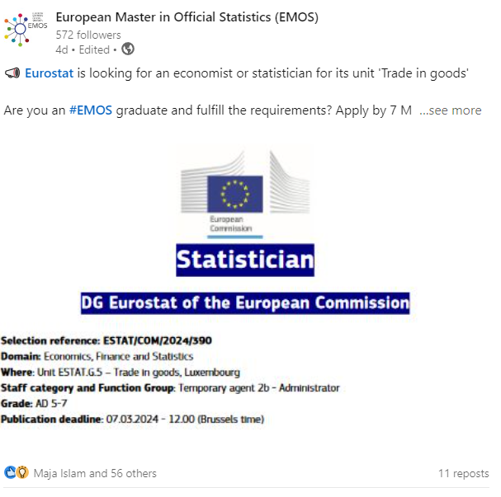
Creation of dedicated groups linked to the EMOS LinkedIn page
Proposal: further promote and engage via the EMOS LinkedIn page by creating dedicated LinkedIn pages:
‘EMOS Alumni’
‘Vacancies in official statistics’

Slide 29
Creation of dedicated groups linked to the EMOS LinkedIn page
Role of EMOS network members:
join and actively contribute to the EMOS LinkedIn page: share job opportunities and relevant events
invite students, graduates and network partners to follow the page

Slide 30
EMOS presentations for EMOS network members by the EMOS secretariat
Offer: presentation by EMOS secretariat for all EMOS-labelled master’s programmes and partner organisations who teach courses to EMOS students
Role of EMOS network members:
in case of interest, contact the EMOS secretariat
inform of any specific topics or areas that should be covered

Slide 31
Overview of proposals
Meet EMOS students
Meet the EMOS network
EMOS Research
EMOS LinkedIn ‘EMOS Alumni’, ‘Vacancies in official statistics’
presentation about EMOS by the EMOS secretariat

Slide 32
Discussion
Would you be willing to be featured in the section ‘Meet EMOS network members’?
What is your opinion about the collection of research articles on the website? Would you be willing to contribute?
Would the presentation from the EMOS Secretariat about EMOS be interesting for your students?

Slide 33
EMOS network meetings 2023/2024
To share and discuss best practices among EMOS network members:
Sharing coursework among EMOS partners (video)
EMOS students’ exchanges (video)
Redesigning EMOS-labelled master’s programmes (video)
Research and thesis project collaborations with organisations other than NSIs (video)

Slide 34
EMOS network meetings - upcoming
3 Apr 2024: NSIs supporting EMOS (register here)
24 April 2024: Information session on the Joint Research Centre (JRC) scientific traineeships programme
24 May 2024: DG EAC on Staff Exchange and Doctoral Networks

Slide 35
EMOS network meetings - discussion
Have you participated so far and do you plan on participating in the future?
Do you find EMOS network meetings useful?
What are possible topics?
How and when would you like to be informed about the meetings?

Slide 36
4. Related news

Slide 37
Information on ongoing/upcoming events
EMOS Coding lab 2024
Master Thesis competition (open call September 2024)
Next EMOS workshop: 14-15 November 2024 in Wiesbaden
Next New Techniques and Technologies for Statistics (NTTS conference) 11-13 March 2025

Slide 38
Any other questions?

Slide 39
Thank you!
Keep in touch:
ESTAT-EMOS@ec.europa.eu
@EU_EMOS @europeanmasterinofficialst492 www.linkedin.com/company/theemos

